Slide 1
Community Engagement for Monitor Assessments
Community Police Commission

Slide 2
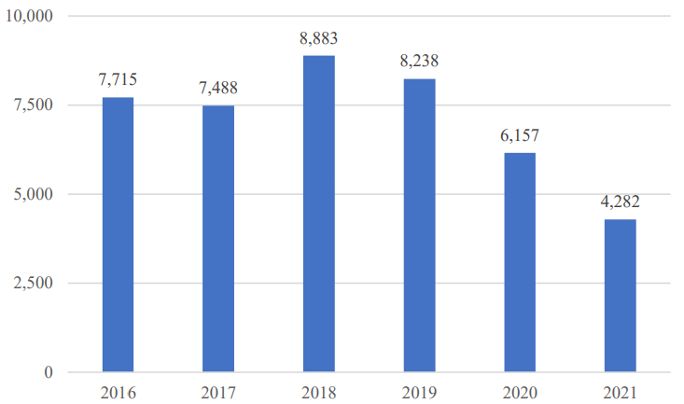
Stops and Detentions: Key Data Feedback
Quality of Stops & Frisks
Report needs more details on methodology
More details needed on decrease of adherence to frisk policy
STOPS AND DETENTIONS ASSSEMENT, Figure 1: Stops by Year, 2016-2021
Source: SPD Open Data
Notes:
For this report, I focused on the Quality of Stops & Frisks, and some other data points – but didn’t have a chance to look at full report, as it was divvied up among CPC members.

Slide 3
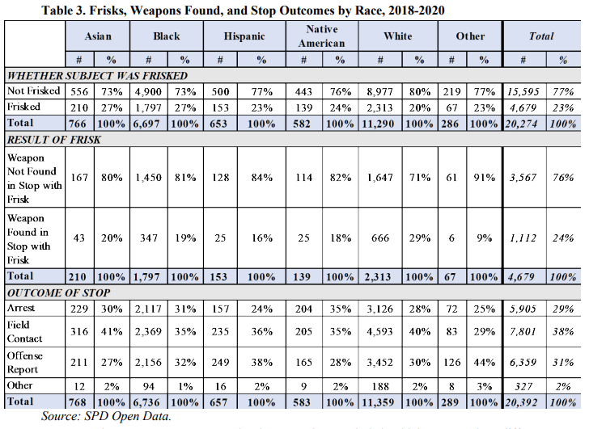
Stops and Detentions: Key Data Feedback (cont.)
Weapons section – needs data on legal ownership
Minorities still frisked more – needs more research
Lack of graphics for methodology

Slide 4
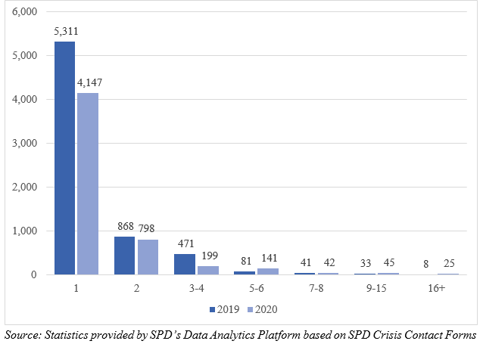
Crisis Intervention Assessment: Key Data Feedback
Sharp Increase in individuals having 5+ crisis contacts with SPD
Use of Force (UoF) Level statistics unavailable in dataset
Five Mental Health professionals in Crisis Response – data?
Included data from beginning of consent decree/where possible for comparison
CRISIS INTERVENTION ASSESMENT, Figure 1: Number of SPD Crisis Contacts by Individual, 2019 – 2020
Notes:
For this assessment draft, I was able to dive deeper into the data points as a whole.

Slide 5


Crisis Intervention Assessment: Use of Force Feedback Timeline
Use of Force Data cited in assessment, but not available in crisis intervention dataset.
CPC Provided Feedback on 2/4/2022
Further highlighted by community members on 2/8/2022
Met with Relevant Partners in SPD Data Analytics Platform (DAP)
CRISIS INTERVENTION ASSESMENT, Table 2: Use of Force Involving Individuals Experiencing Behavioral Health Crisis, by Use of Force Level, 2019–2020
Source: Statistics provided by SPD’s Data Analytics Platform based on SPD Crisis Contact Forms and Use of Force Reports. See explanation below regarding data quality issues regarding uses of force involving crises.
Notes:
Levels of use of force not highlighted inside dataset, nor multiple instances of it.

Slide 6
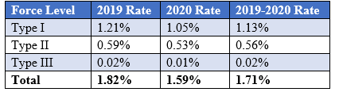
Crisis Intervention Assessment: Use of Force Feedback Timeline (continued)
SPD DAP explained Use of Force level Data not in public dataset for two reasons:
  Privacy
  Complexity
CPC releases statement on 3/22/22, highlighting omission of this data, calling for SPD/Monitor to release public dataset w/ information
SPD Responds on 4/05/22, with formal explanation of omission of data and other points
CRISIS INTERVENTION ASSESMENT, Table 3: Percentage of Crisis Contacts Involving Use of Force, by Force Type, 2019–2020
Source: Statistics Provided by SPD’s Data Analytics Platform based on SPD Crisis Contact Forms and Use of Force Reports. See explanation above regarding data quality issues regarding uses of force involving crises.
Notes:
Explain gap – talking to commissioners, policy team members, discussions, etc.

Slide 7
Questions?
Reach out directly to CPC Staff:
  Email: Evan.Lih@seattle.gov or OCPC@seattle.gov

