Slide 1
Emergency Preparedness
Presented by the Seattle Office of Emergency Management

Slide 2
Seattle’s top hazards…
10. Tsunamis/Seiches
11. Infrastructure and Structural Failures
12. Fires
13. Transportation Incidents
14. Water Shortages
15. Social Unrest
16. Attacks
17. Hazmat Incidents
18Volcanic Hazards
Earthquakes
Snow and Ice
Windstorms
Power Outages
Cyber Attacks
Landslides
Disease Outbreaks
Flooding
Excessive Heat

Slide 3
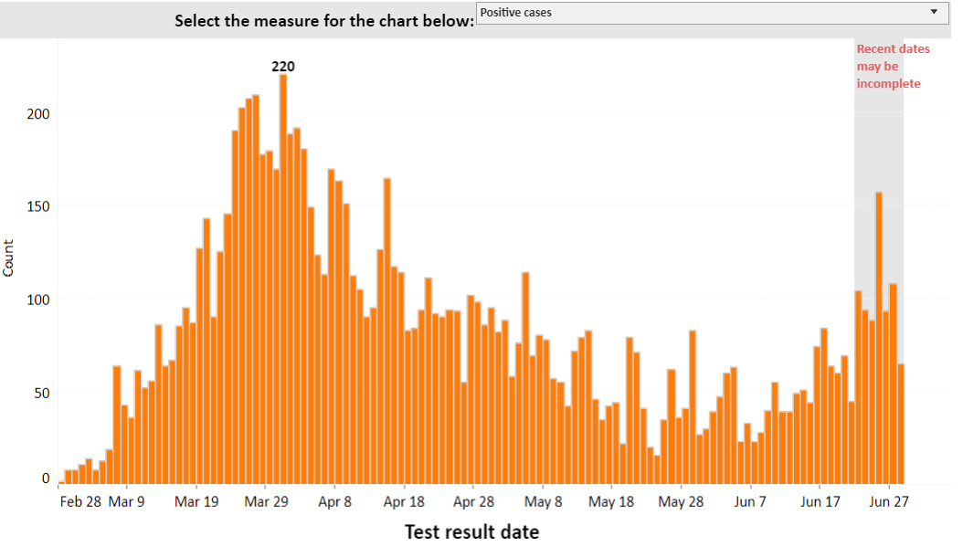
COVID-19: Current Situation
Phase 2:
Strongly encouraged, but not required to stay home unless engaging in Phase 2 permissible activities
Recreation activity involving 5 or fewer people outside of your household
Gather with no more than 5 people outside your household per week
Statewide MASK REQUIREMENT began June 26th
Daily Positive Test Results
https://www.kingcounty.gov/depts/health/covid-19/data.aspx

Slide 4
Hazard Outlook Summer 2020
COVID-19
Outlook | Potential Impacts
Second wave of COVID infections possible in the fall (September per UW Institute for Health Metrics and Evaluation) However projected case increases could be significantly less | If case numbers begin to increase again, you could see a reversal of phases and reinstitution of stricter social distancing guidelines
https://covid19.healthdata.org/united-states-of-america/washington

Slide 5
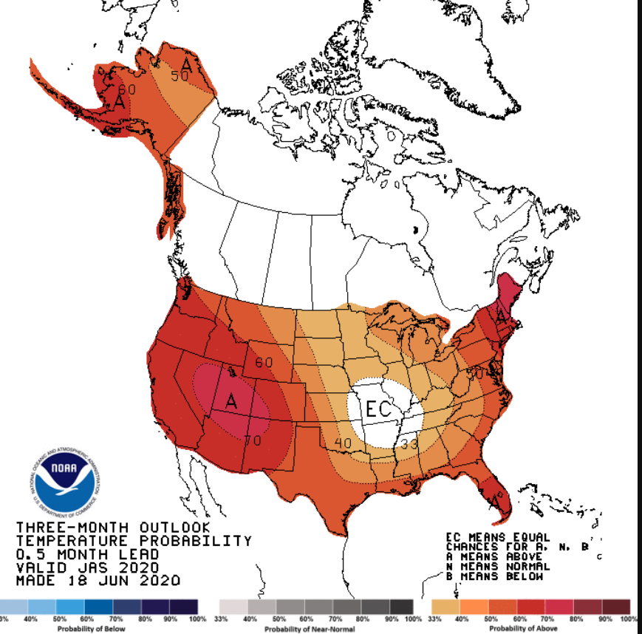
Hazard Outlook Summer 2020
Extreme Heat
Outlook | Potential Impacts
Above Normal temperatures expected through August | High temperatures for several days at a time increase health risks to people and pets with the potential for serious illness and death.

Slide 6
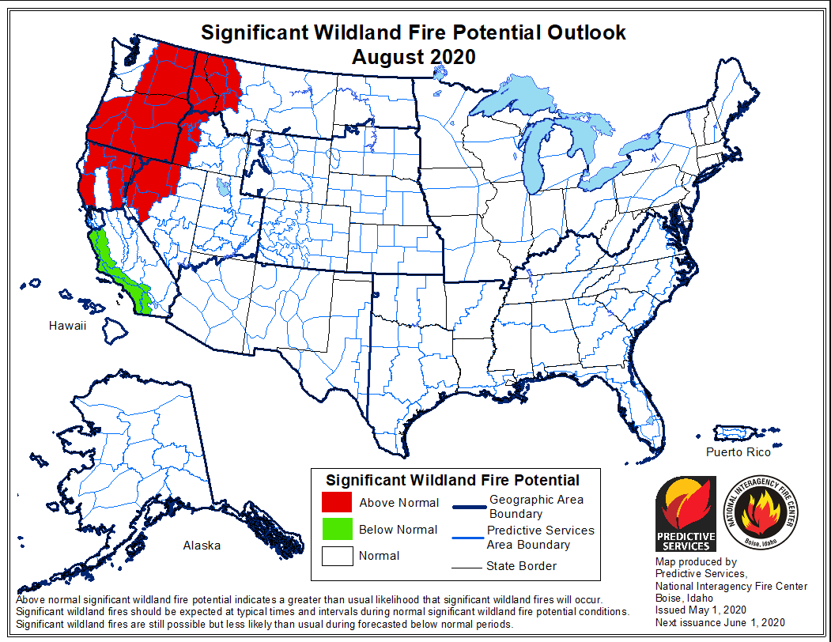
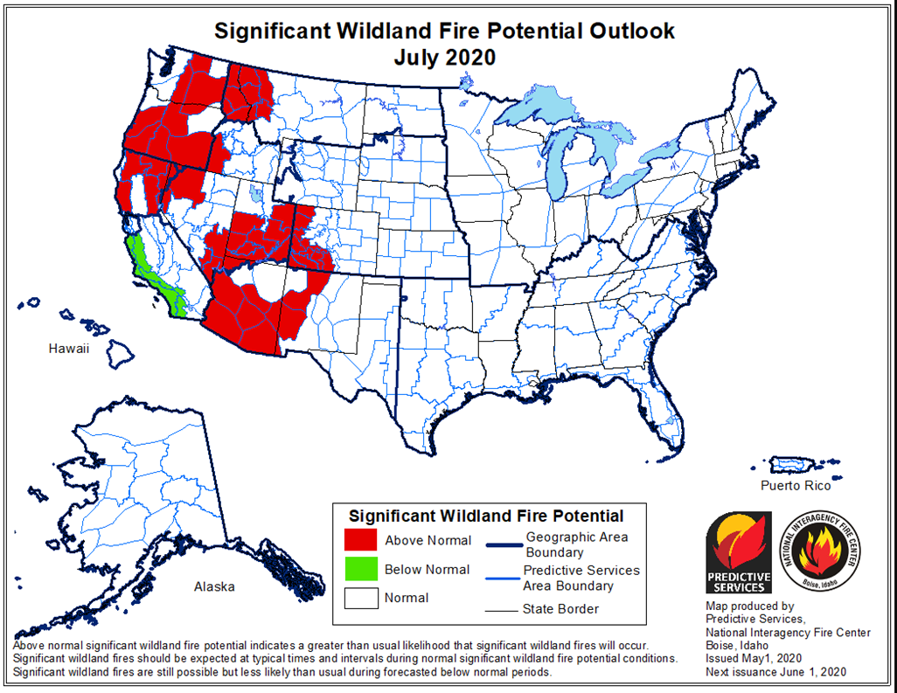
Hazard Outlook Summer 2020
Wildfire Smoke
Outlook | Potential Impacts
Wildfire potential is ABOVE NORMAL for July-August eastern Washington and most of Oregon Most of western Canada also has ABOVE NORMAL potential for wildfire during July-August | Smoke can cause wheezing, coughing, shortness of breath and headaches. Wildfire smoke may increase the severity of symptoms for people with COVID-19 Can worsen any existing lung, heart, or circulatory conditions

Slide 7
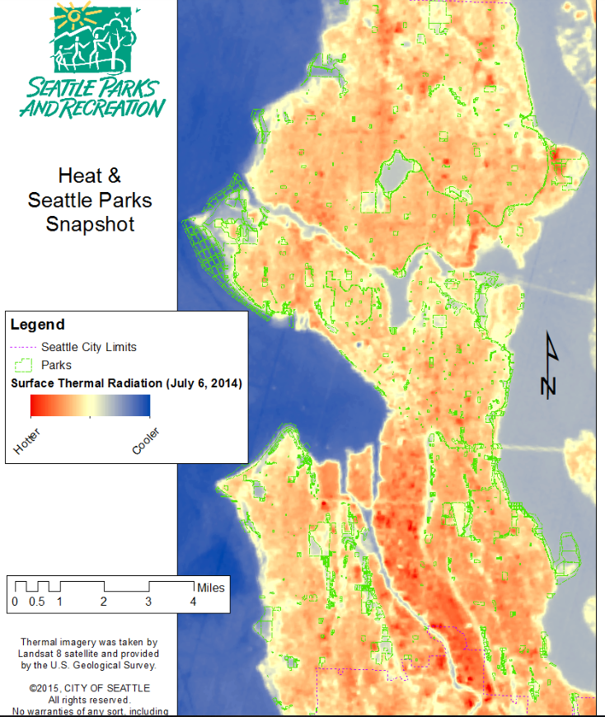
Overlapping Risk Factors
Certain populations are at heightened risk for heat, smoke, and COVID:
Elderly
Low income/limited access to healthcare
Cardiovascular conditions
Additionally, wildfire smoke is a respiratory irritant, which could make individuals more vulnerable to infection as well as increase the risk for serious case of respiratory illness.

Slide 8
Heat and Smoke During COVID-19
What is different this year?
Wildfire smoke may create additional risk for people with COVID-19 and worsen symptoms
Public spaces with cleaner and cooler air may not be open due to ongoing social distancing guidelines
People most at risk from COVID-19 are more likely to remain in their homes to avoid exposure. Isolation and the lack of access to spaces with clean, cool air could increase their vulnerability to extreme heat and wildfire smoke.
N95 respirators can be effective against wildfire smoke if fitted and worn properly, but these are in very short supply due to COVID-19. Cloth face coverings and surgical masks provide very little protection against wildfire smoke.

Slide 9
Baseline Hierarchy of Risks*
During “Safe Start” Reopening Phases 1 & 2:
COVID-19 safety
Heat
Wildfire smoke
During “Safe Start” Reopening Phase 3:
Heat
COVID-19 safety
Wildfire smoke
During “Safe Start” Reopening Phase 4:
Heat
Wildfire smoke (Unhealthy for all on AQI)
COVID-19 safety
*Subject to change based on severity of actual forecast(s)
https://www.kingcounty.gov/depts/health/covid-19/data.aspx

Slide 10
City Response to Extreme Heat
What are the triggers for City action:
Any advisory or statement from the National Weather Service which forecasts the potential for unusually warm conditions to impact the Seattle metro area.
Increased reports of heat-related illnesses or impacts (via call volumes/reports from EMS, Public Health, Human Services, 211, Media, Customer Service Bureau, etc.)
A number of “hot” days where the temperatures do not cool-off in the evenings for several consecutive days
Infrastructure impacts (fire, utilities, power/energy, transportation) that increase the risk of failures
Key Actions
Disseminate public messaging on how to stay cool, including providing a list of City facilities that are open and have air condition (i.e. libraries, community centers etc.)
Assess impacts to and address needs of vulnerable populations through the Human Services Department and other agencies
Review upcoming planned events in the city and assess impacts and need for cancellations
While COVID-19 is still a threat Public Health will provide guidance on whether opening congregate cooling centers is advisable

Slide 11
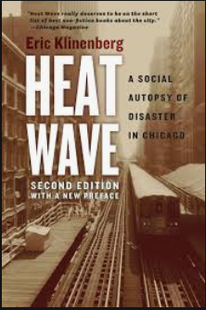
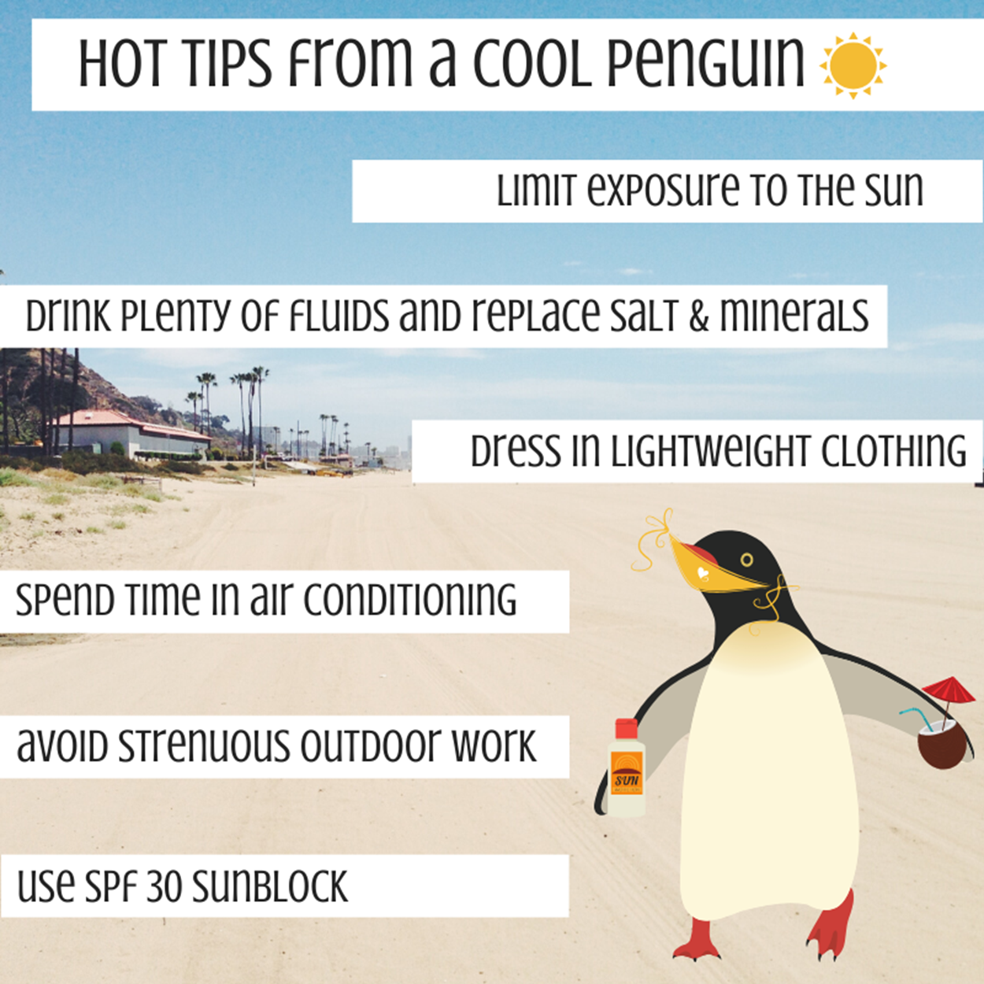
Preparing for Extreme Heat
Cover windows that receive morning or afternoon sun.
Take a cool shower or bath, or place cool washcloths on your skin.
Avoid drinks with caffeine, alcohol and large amounts of sugar because they can actually de-hydrate your body.
Do outdoor activities in the cooler morning and evening hours.
Check up on your elderly neighbors and relatives to take these precautions too.
People at higher risk: older adults, infants and young children, people who work or exercise outdoors, users of certain medications

Slide 12
City Response to Wildfire Smoke
What are the triggers for City action:
The AQI forecast increasing to Red/Unhealthy for All
Increased reports of air quality-related illnesses or impacts (via call volumes/reports from EMS, Public Health, Human Services, 211, Media, etc.)
A combination of poor air quality and extreme heat days
Shelter bed availability nearing capacity
Key Actions:
Disseminate public messaging on how to stay safe, including lists of locations where the public can get better air quality
Assess impacts to and address needs of vulnerable populations through the Human Services Department and other agencies
Review upcoming planned events in the city and assess impacts and need for cancellations
While COVID-19 is still a threat, Public Health will provide guidance on whether opening additional cleaner air facilities

Slide 13
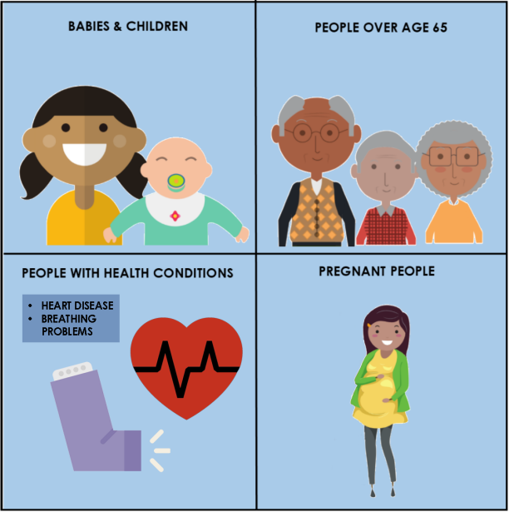
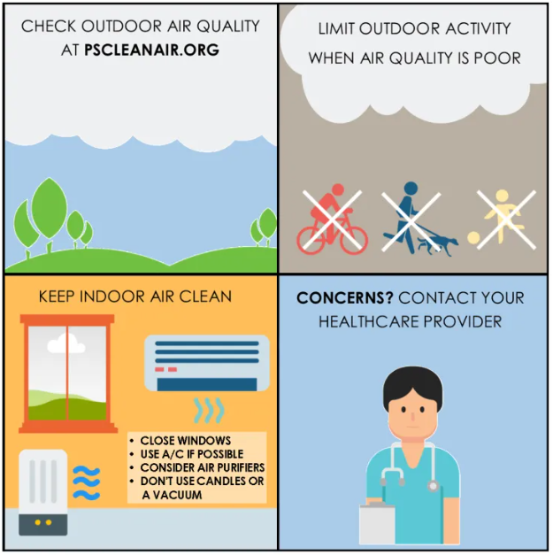
How to Be Prepared for Wildfire Smoke

Slide 14
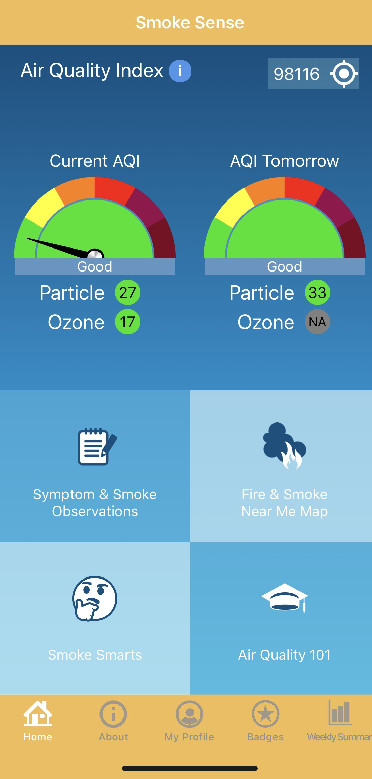
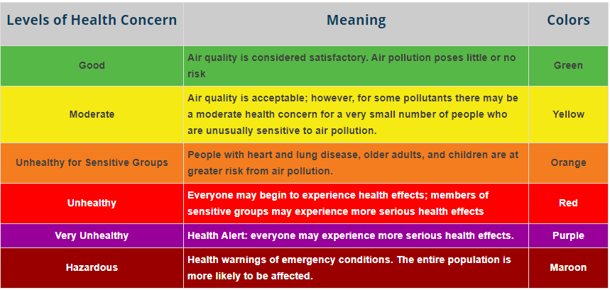
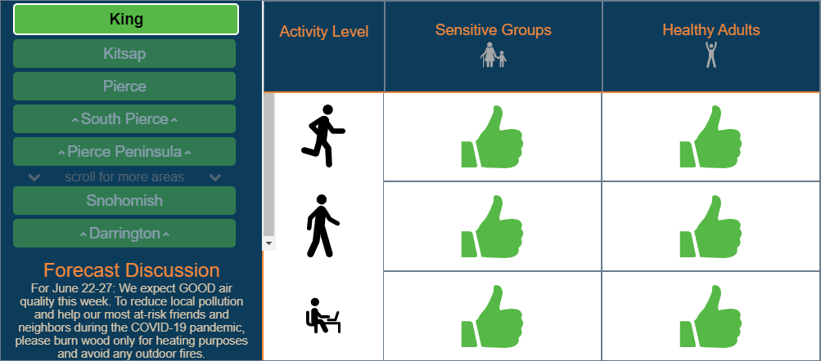
Preparing for Wildfire Smoke
Check Outdoor Air Quality
AiPSCLEANAIR.ORG (Puget Sound Clean r Agency)
EPA Smoke Sense App

Slide 15
Poor Air Quality Days, 2017-2018
July thru September | Moderate | Unhealthy for Sensitive Groups | Unhealthy for Everyone | Total number of poor air quality days
2017 | 16 days | 6 days | 2 days | 24
2018 | 15 days | 5 days | 4 days | 24
2019 | 6 days | 0 days | 0 days | 6

Slide 16
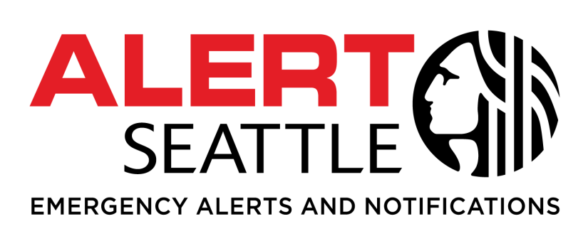
Sign up for emergency alerts
You can choose to receive Emergency Alerts or Community Notifications, such as:
Severe weather
Safety
Health
Special events
Utility disruptions
Major traffic disruptions
Emergency preparedness
Test messages
Sign up at Alert.Seattle.gov
Text “CovidSeattle” to 67283 to receive COVID-19 updates

Slide 17





Find out more information
Get AlertSeattle messages
  Sign up online at alert.seattle.gov
Tune into local emergency radio stations
  AM 710, AM 1000, FM 97.3, FM 97.7, and FM 94.4
Tune into local television
Follow city departments on social media
  @CityofSeattle, @oemseattle, @SeattlePD, @SeattleFire, @AlertSeattle, @SeattleDOT, @SeattleSPU, @SEAcitylight
Go to your nearest Community Emergency Hub

Slide 18
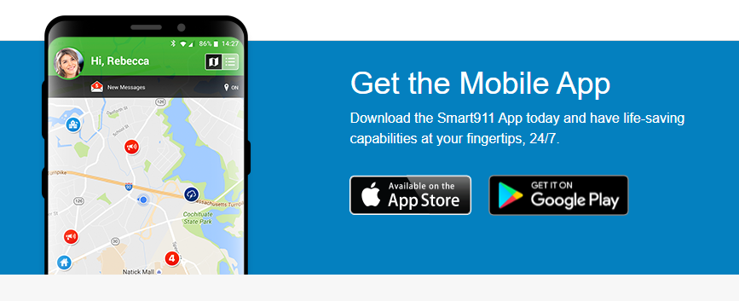
Other Regional Alerting Systems
SMART 911
Add key information about members of
your household that would help in the event of an emergency.
Give responders unique location info (door location, gate access etc.)
Add as much or as little information about your vehicles, pets, service animals etc.
Sign up for Alert Seattle through the Smart 911 app (must have Seattle address listed)
Alert King County
Pierce County Alert
Kitsap County Alert
SnoCo Alerts

Slide 19
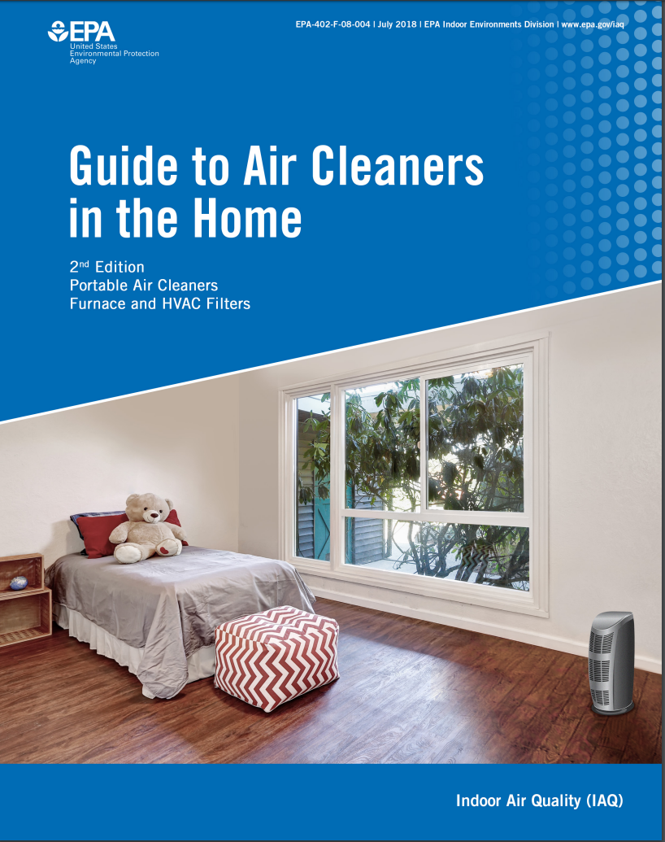
Preparing for Wildfire Smoke
Keep Indoor Air Clean
If you have an HVAC system, buy filters that have the highest designated filter rating (HEPA, High-Efficiency Particulate Air rating or MERV17-20) and run on “recirculate”
No Central Air?
  Designate a room in your home to be a “clean room.” This room should have as few windows or doors as possible, or they should be closed, to keep smoke out.
  Purchase a portable air cleaner
    Ensure appropriate clean air delivery rate (CDR) based on room size
    Make sure it is a California Certified device

Slide 20
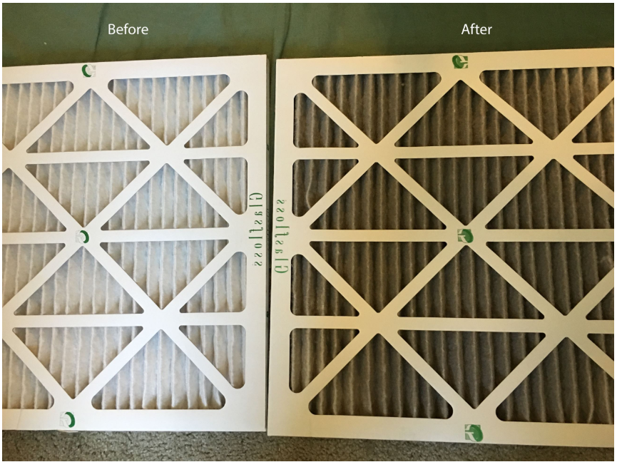
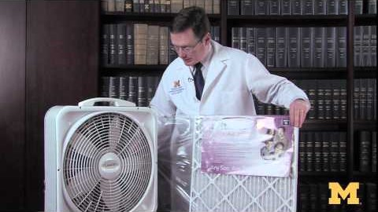
Preparing for Wildfire Smoke
Do-it-yourself air cleaner
20" x 20" box fan ($20.00)
20" x 20" x 1" MERV 13 or FPR 10 filter ($20.00)
Tape

Slide 21
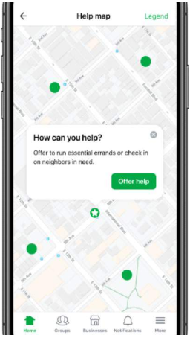
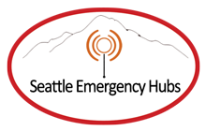
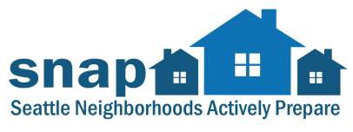
Connect with Neighbors Now
COVID-19 Specific Resources
Existing Tools and Resources
Community Emergency Hubs
seattleemergencyhubs.org
SNAP Groups
Seattle.gov/emergency/snap
NextDoor Help Map
AARP Community Connections
Many neighborhood based tools and sites

Slide 22
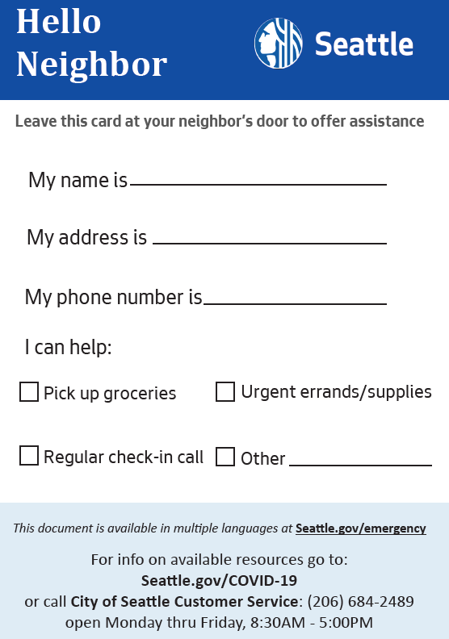
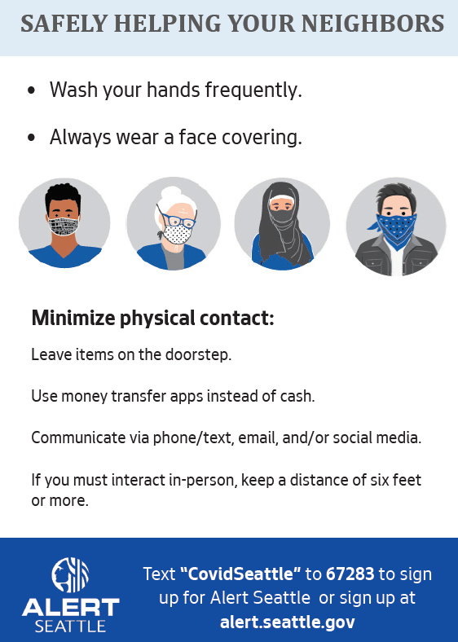
Safely Helping Neighbors

Slide 23
COVID-19 Information
Center’s for Disease Control: https://www.cdc.gov/coronavirus/2019-ncov/
WA State Dept. of Health https://www.doh.wa.gov/emergencies/coronavirus
Public Health Seattle & King County https://www.kingcounty.gov/depts/health/covid-19
City of Seattle http://www.seattle.gov/mayor/covid-19
Text “COVIDSEATTLE” to 67283 to receive updates via Alert Seattle
Sign up for Public Health COVID-19 email updates https://public.govdelivery.com/accounts/WAKING/subscriber/new?topic_id=WAKING_1386

Slide 24
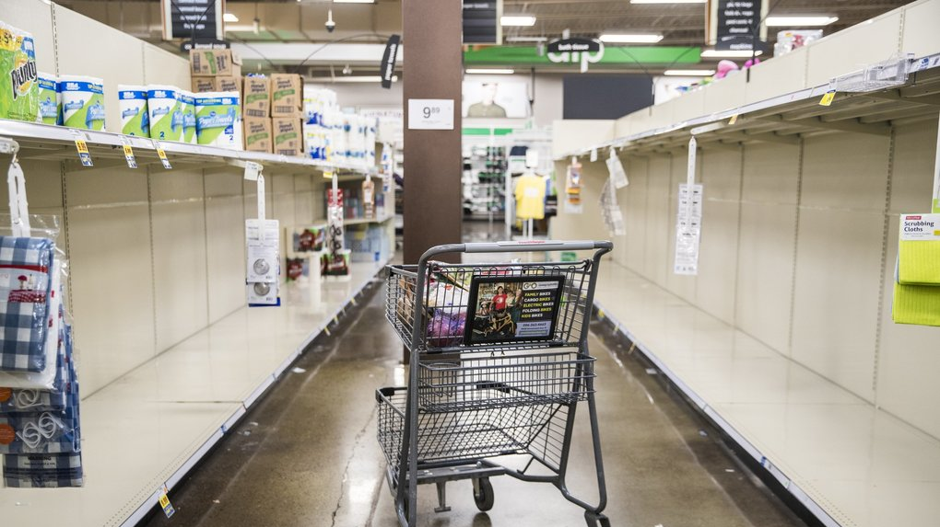
Build a Kit
Be prepared to be on your own for 14 days.
Think about what you use on a daily basis, and include those items in your kit
Have a kit in your car and at work

Slide 25
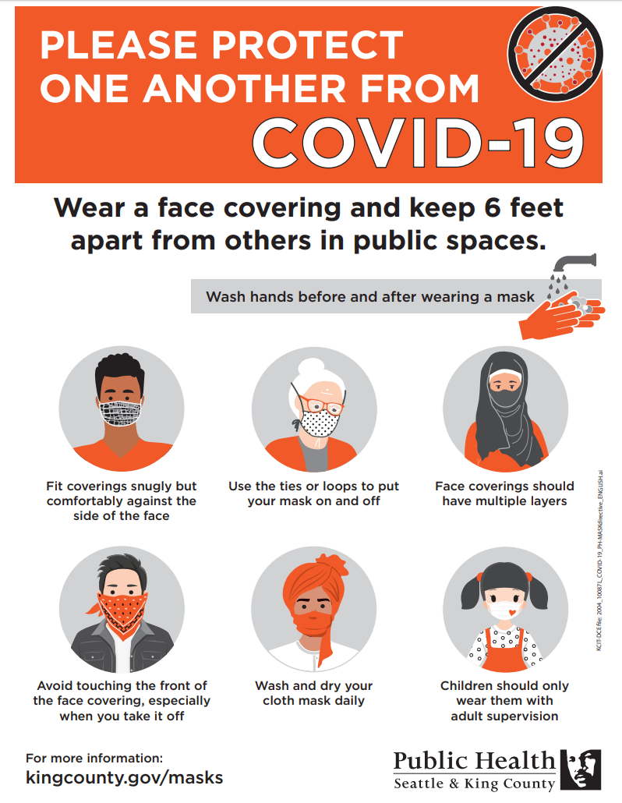
COVID-19 Preparedness Reminders
Wear a face covering
Wash hands frequently
Maintain social distancing of 6ft or more
If you are experiencing symptoms, get tested:
- Fever or chills
- Cough
- Shortness of breath, difficulty breathing
- Fatigue
- Muscle or body aches, headache
  - Loss of taste or smell
- Sore throat
- Congestion or runny nose
- Nausea or vomiting
- Diarrhea
FREE Testing sites in King County: http://www.seattle.gov/mayor/covid-19/covid-19-testing

Slide 26

Questions?
Thank you for attending- you’ll be happy you prepared ahead of time when the next disaster strikes!

