Slide 1

Older Adult Community Transportation RFP
Information Session
January 24, 2019
Jason Johnson, Interim Director | Jenny A. Durkan, Mayor
Notes:
Thank yous; Intros. What is ADS? Why countywide?
Format – walking through RFP documents.
How questions are answered – as thoroughly and accurately as possible with OFFICIAL answers provided in writing on Q&A document, which is posted on the RFP webpage. https://www.seattle.gov/humanservices/funding-and-reports/funding-opportunities/2019-older-adult-community-transportation-rfp (right-hand column)

Slide 2
Session Agenda
Introduction
Timeline
HSD’s Theory of Change
Background & Requirements
Submission Instructions
Review and Rating Process
Tips
Appeal Process
Q & A

Slide 3
Introduction
This Older Adult Community Transportation RFP is an open and competitive funding process.
Approximately $711,500 is available through the Older Americans Act Title III-B and Washington State Senior Citizens Services Act.
Funding awards will be made for the period of July, 2019 – June, 2020.
Notes:
Continued investment after the initial contract period will be contingent on successful performance and funding availability

Slide 4
Timeline
Funding Announcement January 14, 2019
Info Session January 24, 2019
Last day to submit questions
Wednesday, February 6, 2019
Application Deadline Wednesday, February 20, 2019 at 4:00 p.m.
Review and Rating
February 21 – May 14
Agency Notification Wednesday, May 15, 2019
Contract Starts Monday, July 1, 2019
Help Session Monday, February 4, 2019
Appeal Process May 16 – May 28

Slide 5
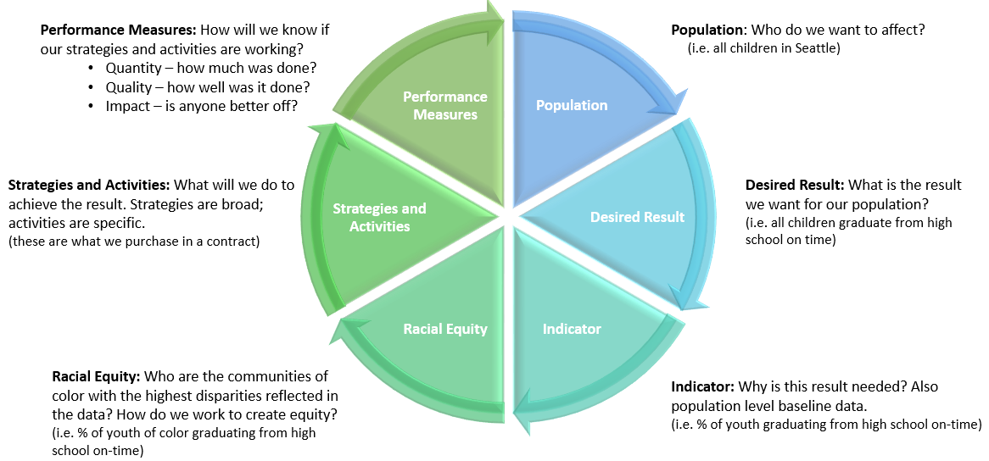
HSD Theory of Change (pg. 4)
Uses Results-Based Accountability and leads with race
Notes:
HSD uses a results-based accountability framework for planning our investments
Based on Trying Hard is Not Good Enough by Mark Friedman
Is a framework to drive towards results
Provides common language
Starts with the result in mind
Identifies accountability between entire population vs. programs
Measures impact instead of counting “things”
Components
Population – who do we want to affect
Desired Result – What do we want to change for the population
Indicators – why is the result need and how will we measure over time
Strategies/activities – what will we do to achieve the result
Performance Measures – how will we know if strategies are working

Slide 6
HSD Theory of Change cont.

Slide 7
Background & Requirements (pg. 6)
Overview of Investment Area
Service/Program Model
Criteria for Eligible Clients
Priority Populations and Focus Populations
Required Service Components
Expected Performance Commitments
Key Staff and Staffing Level
Specific Eligibility, Data, and Contracting Requirements
Notes:
Transition slide of what you’ll be talking about next.

Slide 8
Background/Overview of Investment Area (pg. 7)
What is community transportation?
Why does HSD invest in community transportation?
Outcome of this investment: All older adults experience stable health and are able to age in place.
Notes:
Community transportation, i.e. “special needs transportation,” consists of transportation services designed to improve the mobility of people who, because of physical or mental disability, income status, age, or other limiting factors, are challenged to transport themselves or purchase transportation (state definition). In the context of this RFP, community transportation consists of services that supplement King County’s fixed-route public transit network, and include the types of service listed in the RFP.
We invest in community transportation to improve the mobility of older people in King County. This enables those who would otherwise be socially isolated to maintain access to activities and services.

Slide 9
Service/Program Model (pg. 7)
Two program areas: Health Services Transportation and Food Access Transportation
Applicants may propose one or more transportation programs/solutions under one or both program areas.
Innovation is encouraged.
Notes:
Health Services Transportation is trips to medical, dental, and other essential appointments AND a new category of health-related trips, which include trips to a pharmacy, visiting a relative in a medical or long-term care facility, and trips to access health-promotion services/activities.
Food Access Transportation is trips to HSD-funded congregate meal programs AND other trips to access healthy food (food banks, farmer’s markets, grocery stores).
For reference, we currently support a volunteer transportation program and a nutrition transportation program that utilizes shuttle vans and subsidized transit tickets purchased through the King County Human Services Bus Ticket Program. Proposals are not required to include a particular mix of programs.

Slide 10
Criteria for Eligible Clients (pg. 8)
Eligible clients are King County residents, age 60+.

Slide 11
Priority and Focus Populations (pg. 8)
  Priority Population
  Older adults who are immigrants, non-English speakers, people with disabilities, LGBTQ, isolated, low-income, and/or living in rural areas of the County
  Focus Population
  Black/African American
  Hispanic/Latino
  Native Hawaiian/Pacific Islander
Notes:
Priority populations are identified as a group (or groups) comprising a specific demographic (seniors, youth, families, etc.) or having a specific issue in common (homelessness, mental health, violence involved, etc.).
Focus populations are identified as specific racial or ethnic groups within the priority population and with data showing the highest disparities in the investment area.
Defined by HSD’s Theory of Change, which aligns with the City’s Race and Social Justice Initiative. In the HSD’s approach, leading with race means identifying specific groups (vis-à-vis “people of color”) and aligning our work to address disparities.
Our funders define priority populations as “those with the greatest social and emotional need,” including the groups listed here.
We have decided as a department to use BRFSS, since it addresses health outcomes and it is likely to be updated. Data from BRFSS show that the groups facing the highest disparities in health status and food access are the three listed here.

Slide 12
Required Service Components (pg. 9)
Vehicle Accessibility and Maintenance
Minimum Service Standards
Reservations/Dispatching/Call Center Operation
Staff/Driver Training
Service Coordination
Service Start Date
Language Accessibility
Client Survey
Free service
Notes:
See RFP Guidelines for details of each service component

Slide 13
Expected Performance Commitments (pg. 10)
Quantity
    Unduplicated number of clients served by race/ethnicity
    Number of one-way trips provided by race/ethnicity of rider
Quality
    % of clients indicating satisfaction with the service
Impact
    - % of clients with improved access to health services and/or healthy food as a result of the service
Notes:
Performance measurement necessitates participant-level data reports and client evaluation surveys.

Slide 14
Key Staff and Staffing Level (pg. 11)
Program Manager
Staff level must be sufficient to effectively perform the service.
Written job descriptions
Volunteer recruitment
Qualifications for drivers

Slide 15
Other Requirements (pg. 11)
Three years of experience
Electronic submission of data/reports
Community Living Connections GetCare system
Notes:
Experience does not need to be specific to transportation
GetCare system has been adopted by AAA’s across the state, but HAS NOT yet been implemented by ADS.

Slide 16
Submission Instructions (pg. 12)
Applications due on Wednesday, February 20, 2019 by 4:00 p.m.
Mail or hand deliver to:
Seattle Human Services Department
RFP Response – Older Adult Community Transportation
ATTN: Jon Morrison Winters
700 Fifth Ave, Suite 5800
P.O. Box 34215
Seattle, WA 98124-4215
Online at: http://web6.seattle.gov/hsd/rfi/index.aspx.
No faxed or e-mailed submissions
Applications must be complete and on-time

Slide 17
HSD Online Submission System (pg. 12)
The system is NOT an online Application – no saving
You may upload files up to a maximum of 100 MB
Acceptable file types include: .pdf .doc .docx .rtf .xls .xlsx
There are required fields to be completed. Ensure you allow sufficient time to complete the steps in order to submit your application by the deadline.
The system automatically sends a confirmation to all e-mail addresses you enter
Notes:
The HSD Online Submission System is a web-based program that allows applicants to upload their application for HSD Funding Opportunities (e.g. RFP, RFQ)
Note that if combine docs into one PDF it may go above the 100 mb limit

Slide 18
Complete Applications (pg. 18)
Late applications will not be accepted. HSD is not responsible for ensuring that applications are received by the deadline.
Applications must include:
    Application Cover Sheet with a physical signature
    Narrative Response (14-page limit)
    Proposed Program Budget and Proposed Personnel Detail Budget form
    Proof of status as: IRS nonprofit, legal entity incorporation, or tribe
    Current Board of Directors roster
    Minutes from last 3 Board of Directors meetings
    Federally approved Indirect rate, if applicable
    Start-up timeline, if applicable
    Partner letter(s) of intent, if applicable
Notes:
Eligible applications are sent to the rating committee
Committee make funding recommendations to HSD director

Slide 19
Fiscal Documents (pg. 18)
    Agencies for which we have current financial and insurance documents will not be required to resubmit
    Agencies for which we have incomplete or no financial and/or insurance documents will be notified by the Coordinator and required to submit ALL requested documents within 4 business days from the date of written request
    Financial and Insurance documentation that may be requested are listed in Section IV. of the Application

Slide 20
Rating Criteria (pg. 13)
Proposed Solution | 30%
Commitment to Equity | 20%
Experience and Commitment to Safety | 20%
Budget and Leveraging | 20%
Partnerships and Coordination | 10%

Slide 21
Review and Rating Summary
Applications submitted
Rating committee reviews complete applications
Interviews, if necessary
Fiscal review
Final recommendations to HSD Director
Agency and public announcement
Notes:
Interviews will be used if necessary to address follow-up questions of the rating panel.

Slide 22
Tips
Follow the required format defined in the Guidelines
Be specific, detailed, and concise
Answer all questions and in the context of your proposed program(s)
Submit an accurate budget; double check your numbers
Propose plans for addressing services that are not in place

Slide 23
Tips (continued)
Have someone else read your application before submitting
Meet the 14-page limit
Use the application submission checklist
Start early
Review the Online Submission Assistance Page for helpful information: http://web6.seattle.gov/hsd/rfi/help.aspx
E-mail questions by the Q&A deadline Wednesday, February 6, 2019 at 5:00 p.m. to Jon Morrison Winters at jon.winters@seattle.gov.
Notes:
Meet page limit – excludes documents requested by HSD (use specific example from your RFP)

Slide 24
Appeal Process
Applicants have the right to protest or appeal certain decisions in the award process
Grounds for Appeals:
Violation of policies outlined in the Funding Process Manual
Violation of policies or failure to adhere to guidelines or published criteria and/or procedures established in the funding opportunity
Appeals Deadlines:
Appeals must be received within four (4) business days from the date of written application status (award/denial)
A written decision by the HSD Director will be made within four (4) business days of the receipt of the appeal. The HSD Director’s decision is final.
No contracts resulting from the solicitation will be executed until the appeal process has closed. An appeal may not prevent HSD from issuing an interim contract for services to meet important client needs.
Notes:
Only an appeal alleging an issue concerning the following subjects shall be considered:

Slide 25
Questions?
Questions & Answers posted on RFP website
Only written answers are official
Contact Jon Morrison Winters with questions prior to 5:00 p.m. on Wednesday, February 6, 2019
Any issues and/or questions about the online submission system, contact Mari Sugiyama, Funding Process Advisor, at (206) 684-0130 or mari.sugiyama@seattle.gov
(v3.0 - 2017)

