Slide 1
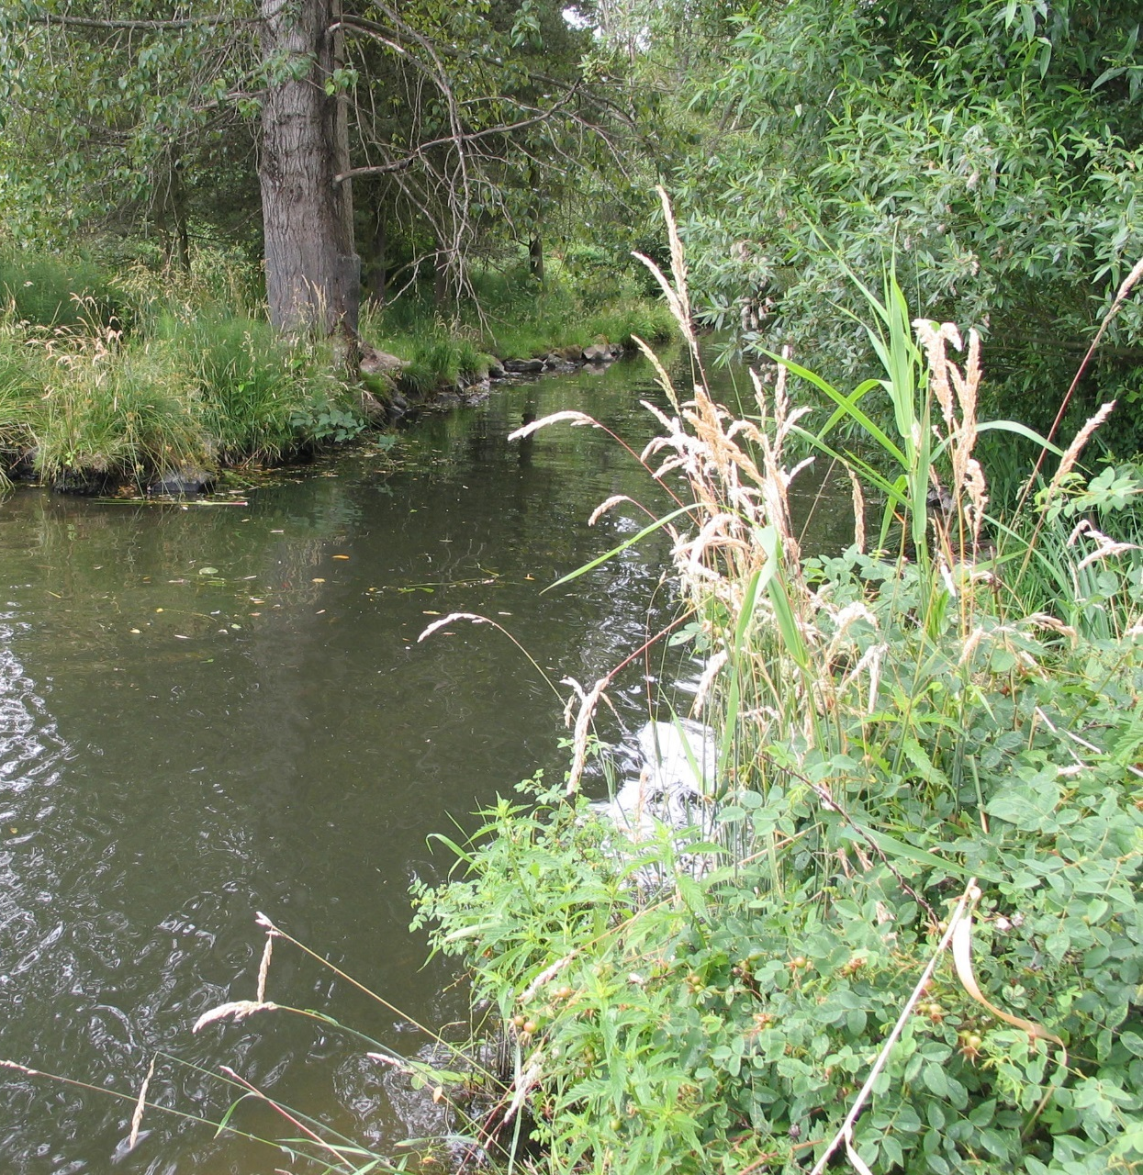

Environmentally Critical Areas Update
PLUZ Committee
November 29, 2016
Maggie Glowacki
City of Seattle
Department of Construction & Inspections

Slide 2
Presentation Overview
    What are Environmentally Critical Areas?
    Requirements for ECA update
    Best Available Science
    Summary of identified issues

Slide 3
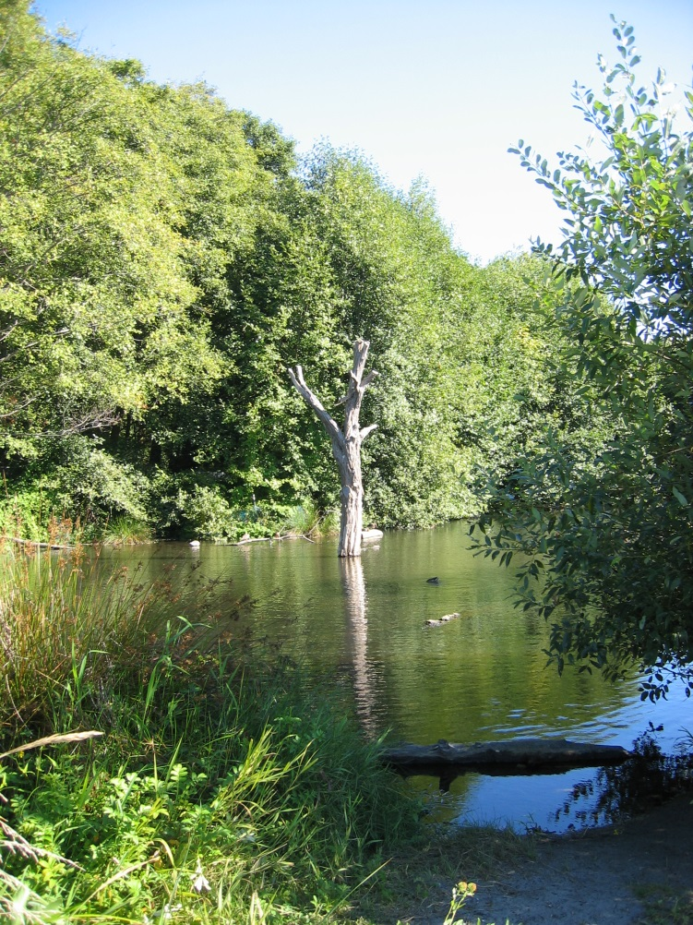
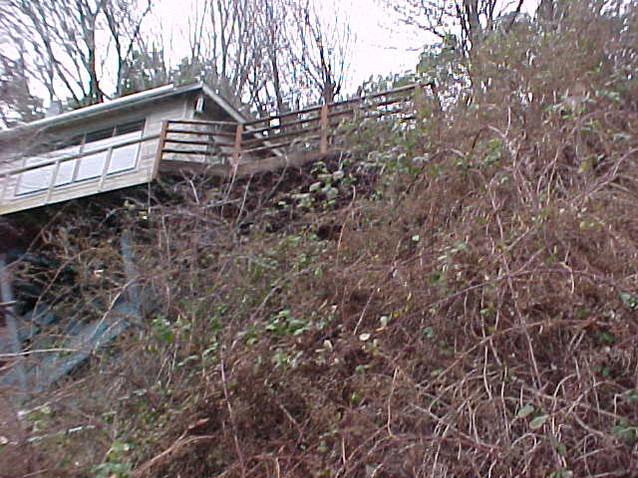
What are Environmentally Critical Areas?
Aquifers
Landslide-Prone and Steep Slope Areas
Peat bogs
Streams/Riparian Corridors
Small lakes
Wetlands

Slide 4
ECA Background
1990 – Washington State’s response to rapid growth was the 1990 Growth Management Act (GMA)
1992 – GMA-required protection of Environmentally Critical Areas
1995 – New requirement to use Best Available Science to protect ECAs with “special consideration” for protecting anadromous fish (e.g., salmon)
2016 – No new requirements; update ECA regulations for clarity and continued compliance with GMA

Slide 5
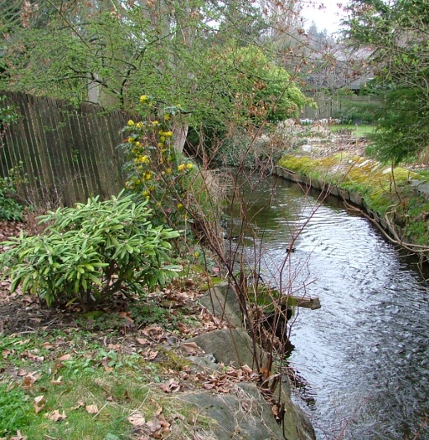
Requirements for the ECA Update
Review regulations for compliance with GMA
Best Available Science
Public participation plan
Develop policies and regulations

Slide 6
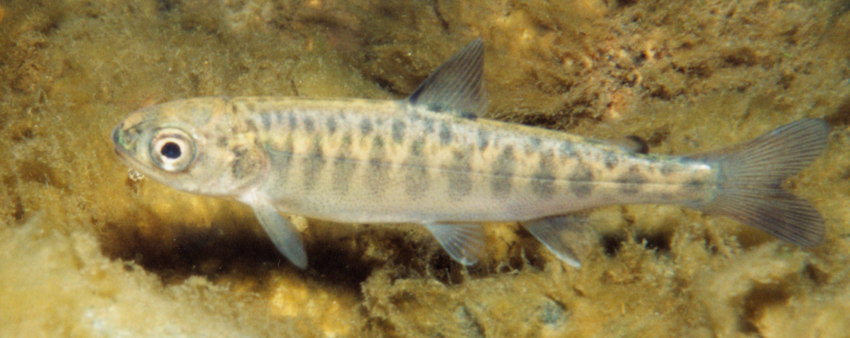
Best Available Science
RCW 36.70A.172(1) requires best available science to be used in developing policies and regulations to protect functions and values of critical areas.
This also requires measures to conserve and protect anadromous fisheries (salmon), including the protection of habitat for all life states of these fish.

Slide 7
Best Available Science
Best Available Science Documents - available on SDCI's ECA update website:
Best Available Science Review for Fish and Wildlife Habitat Conservation Areas (2013);
Best Available Science Review for Wetlands (2014);
Best Available Science Review for Geologic Hazard Areas (2014);
Best Available Science documents for the 2006 - 2012 ECA amendments;
Best Available Science for the City of Sammamish Critical Areas regulations;
Department of Community, Trade and Economic Development’s Critical Areas Assistance Handbook: Protecting Critical Areas within the Framework of the Washington Growth Management Act (2007);
Department of Ecology's Wetland Rating, Delineation, Buffer, Mitigation, and Protecting and Managing documents ( 2005 - 20016).

Slide 8
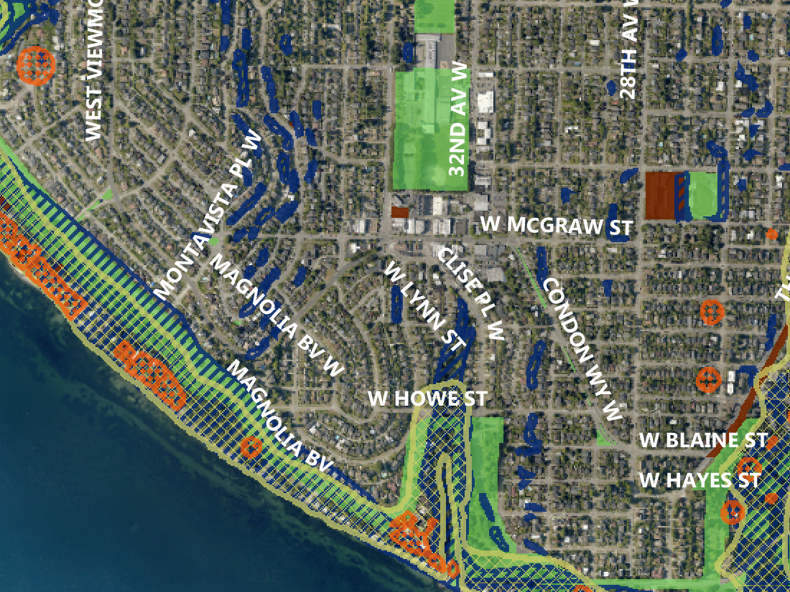
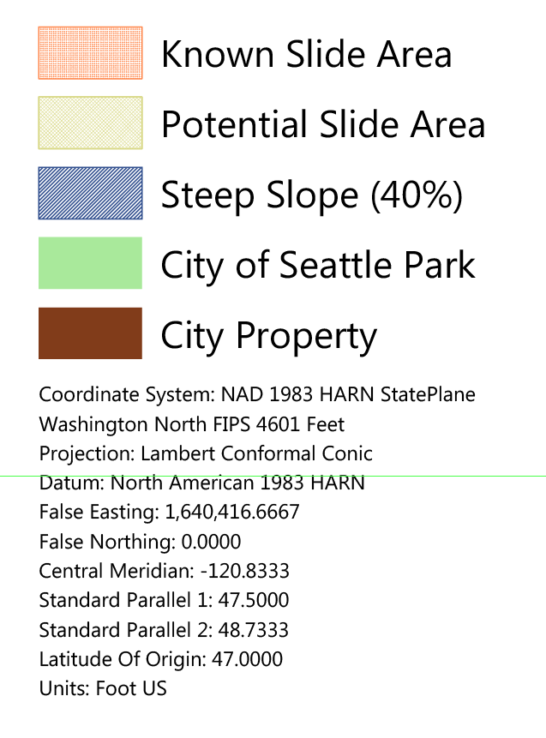
Mapping & Regulations

Slide 9
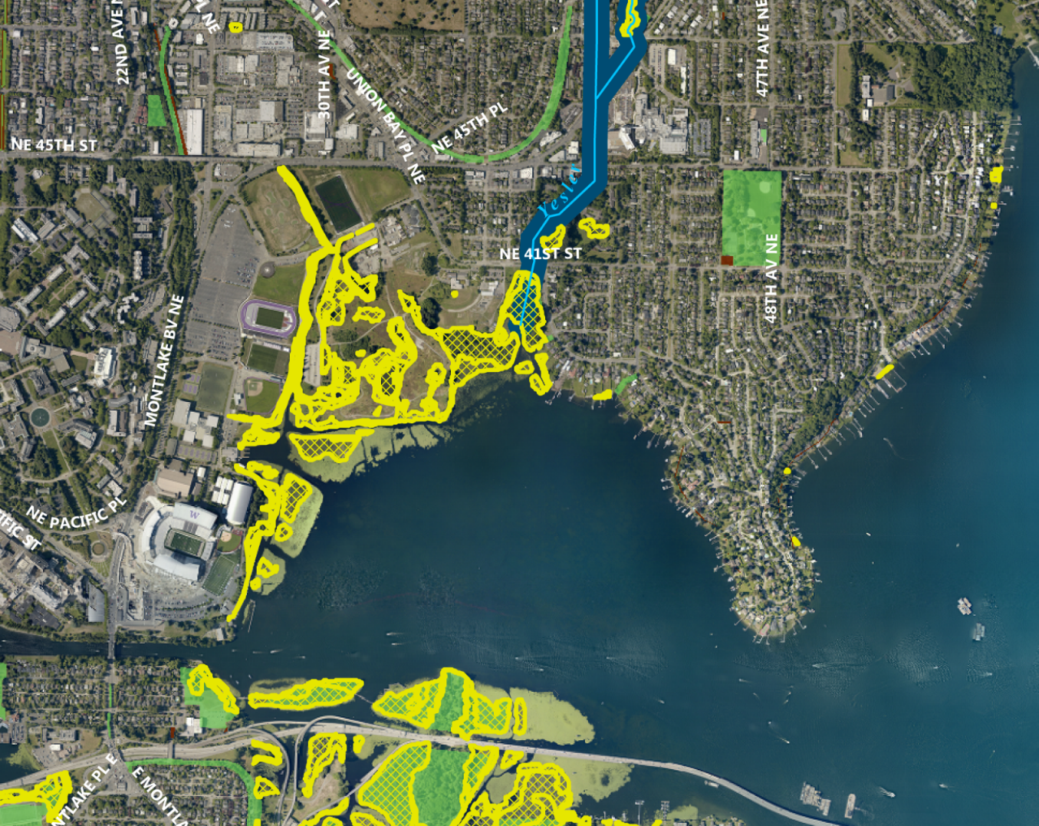
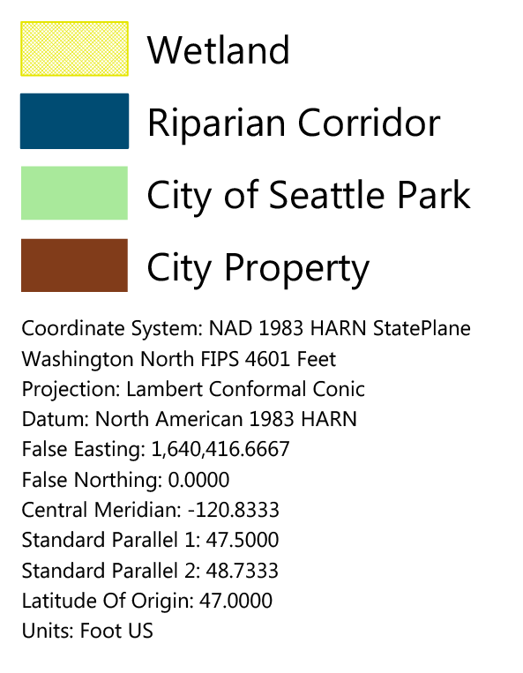
Mapping & Regulations

Slide 10
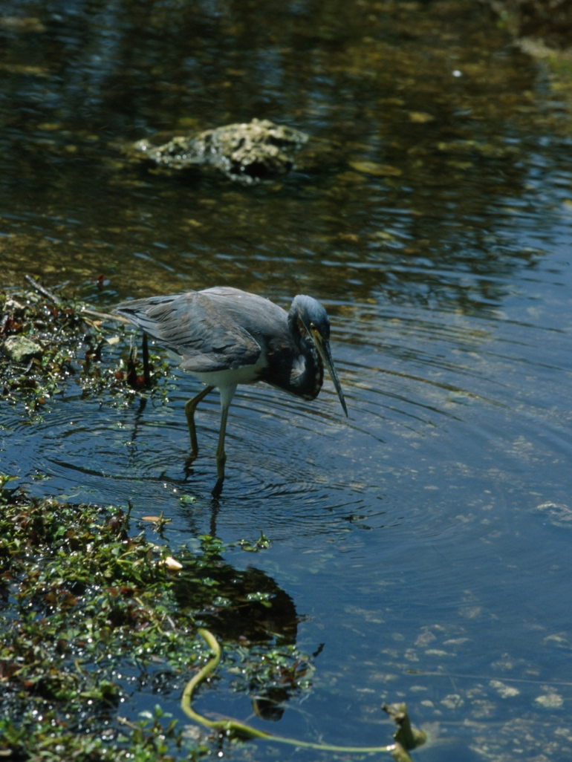
Priority Species Protection
    Priority species
    Bald Eagle
    Heron
    Options for compliance
    Standard Management Plan
    WA Department of Fish and
    Wildlife (WDFW) site-specific plan

Slide 11
Proposed Changes
Include greater protection for great blue heron based on WDFW’s 2012 Priority Habitat and Species guidance for great blue heron.
Increase wetland buffers from 85 to 110 feet for Class III wetlands that have moderate to high level habitat value.
Replace State Environmental Policy Act (SEPA) review with clear and predictable ECA regulations for certain projects that are exempt from SEPA under Section 25.09.800.
Amend the ECA/SEPA Director’s Rule to allow vegetation management as a SEPA exempt activity if it meets the SEPA exemption thresholds and ECA regulations.

Slide 12
Proposed Changes
Apply standards to achieve better fit in existing neighborhoods in subdivision processes. New houses would be required to meet the single-family lot coverage based on the non-ECA area and regulations include building separation standards.
Include a new section that establishes the steps in mitigation sequencing as set out in the 2007 Department of Community, Trade and Economic Development’s Critical Areas Assistance Handbook: Protecting Critical Areas within the Framework of the Washington Growth Management Act.

Slide 13

Thank you
Margaret.Glowacki@seattle.gov
(206) 386-4036

