Slide 1
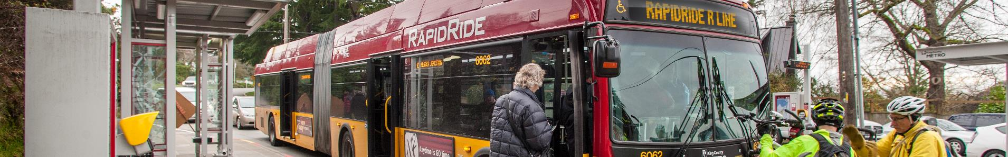
Seattle Pedestrian Advisory Board
RapidRide R Line Update
Jerry Roberson and Robyn Austin, Metro RapidRide
April 8, 2020

Slide 2
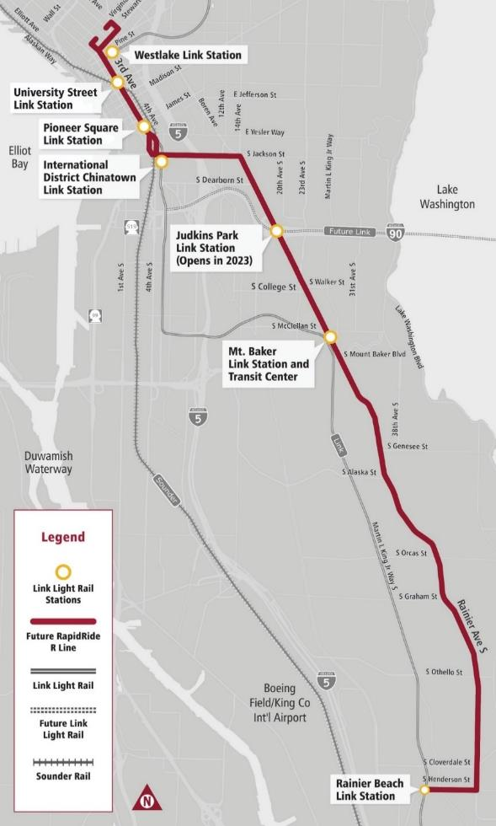

Upgrade of the current Route 7 in late 2024
Jurisdictional Partnership between SDOT and Metro
  Seattle Transit Master Plan (2012, updated 2016)
  Levy to Move Seattle (2015)
  METRO CONNECTS (2017)
Notes:
What is RapidRide R Line?

Slide 3
Why is RapidRide coming to the Rainier Valley?
11,200+ daily riders with significant projected growth
Part of a larger vision of connecting people and places throughout Rainier Valley
Improve service quality and reliability
Planning
Conceptual Design
2019-2020
Final Design
Construction
Start Service
Notes:
As more people move to the region, we need to make it easier to get around. We know the community highly values Route 7 and uses it to access essential services, but we see areas for improvement. Buses frequently bunch together and are not reliable for getting to and from work, school, grocery stores, medical appointments, and more. RapidRide R Line will bring riders improvements to service quality, safety, and access.
The graphic below shows Metro’s planned RapidRide R Line timeline from preliminary planning to service launch (the gold outline indicates our current stage).

Slide 4
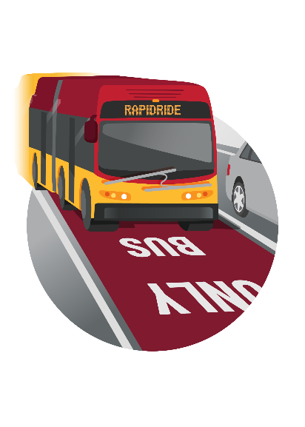
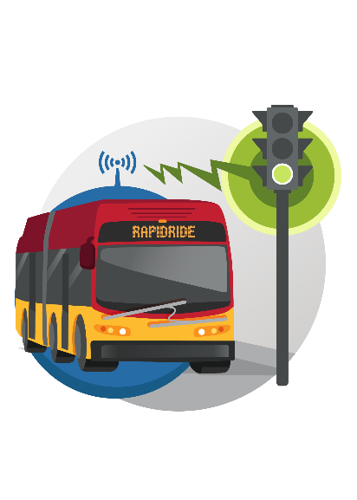
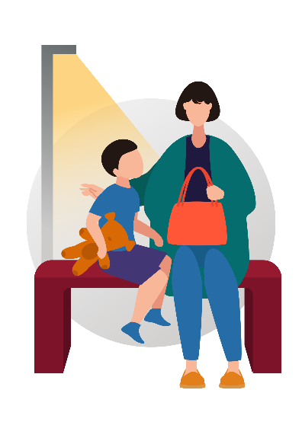
RapidRide R Line features
Speed & reliability
  Emphasis on reliability
  Minimize intersection delays
Passenger facilities
  Safety in design and siting
  Lighting enhancements

Slide 5
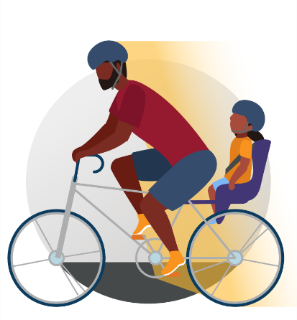
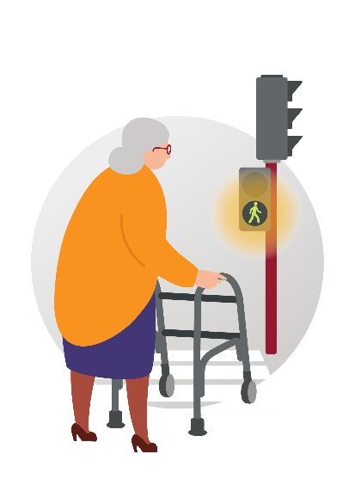
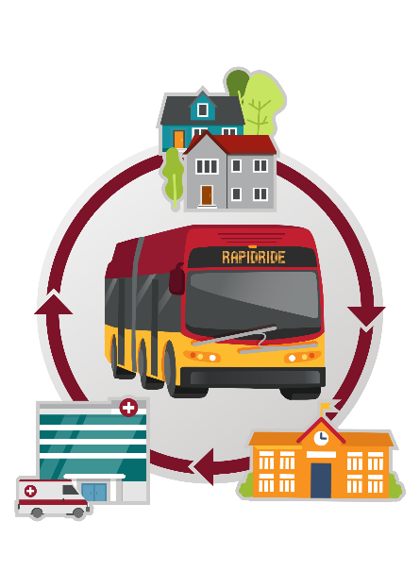
RapidRide R Line features
Access to transit
  Sidewalks and infrastructure
  Safe crossings
Service / operations
  Prentice Loop options
  Areas between Rainier Beach and Renton

Slide 6
Community Engagement Process
Initial Outreach
2017-2018
Needs
Assessment
Spring-Fall 2019
Preferred
Concept
Fall 2019-
Spring 2020
Final
Concept
Summer 2020
Notes:
This graphic includes an overview of previous and current engagement phases. Community engagement will continue through service launch.
Our most recent engagement will be used to inform the preferred alternative of capital investments for the corridor.

Slide 7
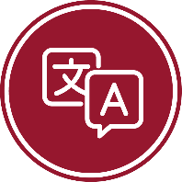


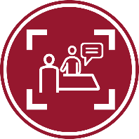
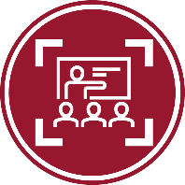



Practicing Inclusive Engagement
Translation and interpretation
Drop-in visits
Ethnic media ads/posts
Focused tabling
Focused
community briefings
CBO compensation
Accessible open house
Notes:
The communities around Route 7 and Rainier Avenue S are among the most diverse in Seattle, with higher rates of racial, cultural, and language diversity than the city-wide averages. Throughout this project, we seek to hear from people from groups who have been historically underrepresented or overlooked when it comes to transportation planning.
We continued to focus our engagement efforts on meeting people where they are at—through conducting drop-in visits, hosting events, attending regularly scheduled meetings, translating and transcreating materials, and providing interpreters. To meet the needs of the community, we developed an updated fact sheet in 12 languages: Amharic, Arabic, Braille, English, Oromo, Simplified Chinese, Somali, Spanish, Tagalog, Tigrinya, Traditional Chinese, and Vietnamese. We also created a mailer with text in all languages to promote upcoming engagement opportunities and share ways to learn more about RapidRide R Line. We hosted the online open house in the six most common languages in the area: English, Simplified Chinese, Somali, Spanish, Traditional Chinese, and Vietnamese. Based on community partner input, we brought interpreters to events and open houses when appropriate. We provided refreshments and activities for children at open houses and selected accessible venues to reduce the barriers for attendance.
While a public online platform is a common way to quickly get feedback from many people, respondents are typically English-speaking and wealthier. To widen our engagement reach beyond typical respondents, we emailed our online open house links to community partners we have engaged with to date and asked them to help us spread the word through their community. We also focused our in-person engagement efforts on opportunities to hear from communities who would be less likely to participate online.
Throughout the Needs Assessment phase, we often heard about the importance of compensating CBOs and community members for their time and effort in coordinating events and providing feedback. That feedback helped us formalize an agreement with Ethiopian Community in Seattle to compensate them for their support. We will continue to look for opportunities to partner with CBOs throughout the rest of our engagement.

Slide 8



Engagement reach
1,373
Online open house visitors
14
In-person engagement events
27
Drop-in visits
13
887
Community partner engagement activities
People engaged in-person
Notes:
Community partner engagement: We continued engaging with CBO partners and community groups to build and grow relationships. In addition to interviewing partner staff, we partnered with Asian Counseling and Referral Services (ACRS), Center Park, and Hillman City Neighborhood Association to host briefings. We also conducted neighborhood walking tours with Columbia City Business Association and The Lighthouse for the Blind.
Open houses: Metro held two open houses along the future RapidRide R Line route to share project information and gather feedback on the preferred concept. A Spanish interpreter participated in both events, and a Somali interpreter participated in the Rainier Beach event.
Tabling outreach: The project team hosted information tables at 12 gathering places, housing communities, and community events to build trust, raise awareness of the project, and gather feedback. When deciding on tabling event times and locations, our team considered nearby station locations and transit-dependency of community members.
Bus stop outreach: Metro’s team of transit educators engaged with Route 7 bus riders at various stops along the route to share RapidRide R Line upgrades and encourage participation in upcoming open houses.
Online engagement: Our online open house ran from February 19 through March 10. This online platform allowed community members to learn about the project and provide feedback on the preferred concept.
Route 7 operator engagement: We engaged with Route 7 operators directly and organized a guided tour of the current route for project planners to hear from veteran operators about areas for improvement and existing route features valued by the route riders.
Briefings with city and county councilmembers: Metro met with three local councilmembers and their staff: Councilmember Zahilay (King County), Councilmember Morales (Seattle), and Councilmember Lewis (Seattle). The team provided an overview of the RapidRide program, including RapidRide R Line-specific updates.

Slide 9
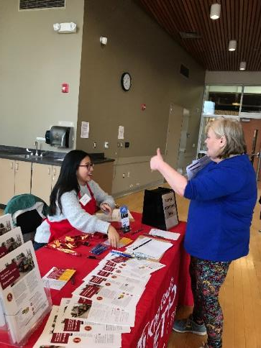
What we’ve heard
Station consolidation continues to be a key area of interest. Many people are concerned with access to transit especially for people who are older and those who have limited mobility.
Community members are looking forward to more reliable bus service and most understand the trade-offs needed to increase reliability.
Concerns remain around how Metro plans to serve riders who currently access the Route 7 south of S. Henderson Street.
Notes:
Image features our community engagement staff sharing about the project with a community member at the Rainier Beach Pancake Breakfast on February 8, 2020.

Slide 10
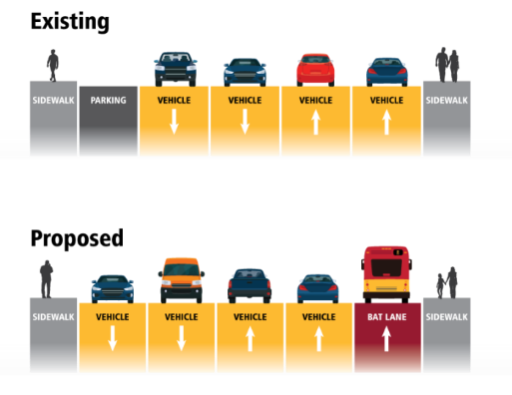
What we’ve heard
Most people support the proposal to remove on-street parking in favor of adding BAT lanes, but some expressed concerns for small businesses that may be impacted by this change.
People expressed strong support for sidewalk improvements and safer pedestrian crossings across all segments of the route.
Lacking bike infrastructure on and connecting to Rainier Avenue S. remains a significant area of concern.
Notes:
Image displayed is a sample of a street cross-section comparison from our engagement materials showing removal of parking in favor of adding a business access and transit (BAT) lane.

Slide 11
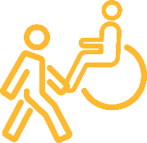
Planned pedestrian improvements
Coordinating with SDOT’s projects to make it easier and safer to get to bus stations.
Used Metro’s Access to Transit Evaluation Tool to prioritize
23 potential projects to improve access to transit.
  Rider-focused: Prioritizes improvements in areas with the most riders
  Safety-focused: Prioritizes improvements in areas with the greatest number of bicycle- and pedestrian-involved collisions
  Equity-focused: Prioritizes improvements in areas with
  the greatest amount of low-income, minority, disability
  and zero-car households.
Notes:
The evaluation tool utilizes three scenarios to evaluate benefit of access improvements.

Slide 12
Sidewalk access improvements
Missing sidewalk along a street intersecting Rainier Avenue S. within one or two blocks of a station location.
Sidewalks in very poor condition along Rainier Avenue S. within one or two blocks of a station location.
Sidewalks in very poor condition along Rainier Avenue S. in segments where Route 7 stops will be removed,
improving connections to station locations.
Notes:
The team used the following considerations to develop a methodology for generating potential access to transit improvement projects.

Slide 13
Crossing improvements
Intersections at stations without painted crosswalks on all legs.
Lighting and signal improvements for pedestrians
Improvements requested through public feedback including lighting, pedestrian signal recall time, ADA concerns
related to hearing and visual impairments, crossing
time, and conflicts with turning vehicles.
Notes:
The team used the following considerations to develop a methodology for generating potential access to transit improvement projects.

Slide 14
Bike access improvements
Close missing links in the bicycle network between stations and existing bicycle facilities by upgrading in-street minor facilities connecting to stations.
Implement Seattle Bike Master Plan (2014) planned bicycle facilities connecting to stations.
Notes:
The team used the following considerations to develop a methodology for generating potential access to transit improvement projects.

Slide 15
Next Steps
2020 Apr./May – Refinement of the Preferred Alternative
2020 Aug./Sep. – Completion of Corridor Planning & Upgrade Report & 10% Design
2020 Fall – Completion of alignment ordinance for January County Council vote
2021/2022 – Final Design Phase
2023/2024 – Construction Phase
2024 Fall – RapidRide R Line service launch

Slide 16
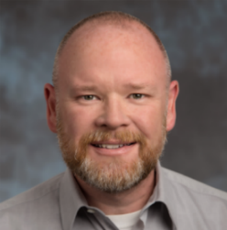
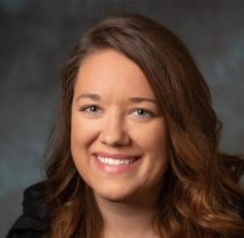
Any questions?
Contacts
Jerry Roberson
  RapidRide R Line Lead
    (206) 263-0776
    JRoberson@kingcounty.gov
Robyn Austin
  RapidRide Communications
  and Engagement Manager
    (206) 263-0939
    RAustin@kingcounty.gov

Slide 17
Route 7 -
Transit-Plus Multimodal Corridor (TPMC)
Seattle Bicycle Advisory Board

Slide 18
Project purpose
Metro Route 7 is one of the highest-ridership routes in Seattle, serving 11,000 daily riders and a wide variety of destinations including schools, community centers, grocery stores, homes, and parks.
While Route 7 buses are scheduled to come every 10 minutes or less throughout most of the day, street conditions cause delay.
SDOT is planning to improve pedestrian and bicycle connections and access, bus speed and reliability, and improve safety on Rainier Ave S by 2022, in preparation of Metro upgrading Route 7 to RapidRide in 2024.

Slide 19
Project key features
The key access, bus speed, and reliability improvements we’re currently studying include:
  Walking and Biking Improvements: Improvements to crossings and connections to neighborhood greenways to help people access transit safely
  Bus Improvements: Bus-only lanes to separate the bus from traffic (depending on the location, bus lanes may replace parking lanes or travel lanes)
  Signal upgrades: Signals that prioritize transit with queue jumps that give buses a head start and “smart signals” that activate or extend green lights for buses
  Safety improvements: Changes to address crashes and improve safety

Slide 20
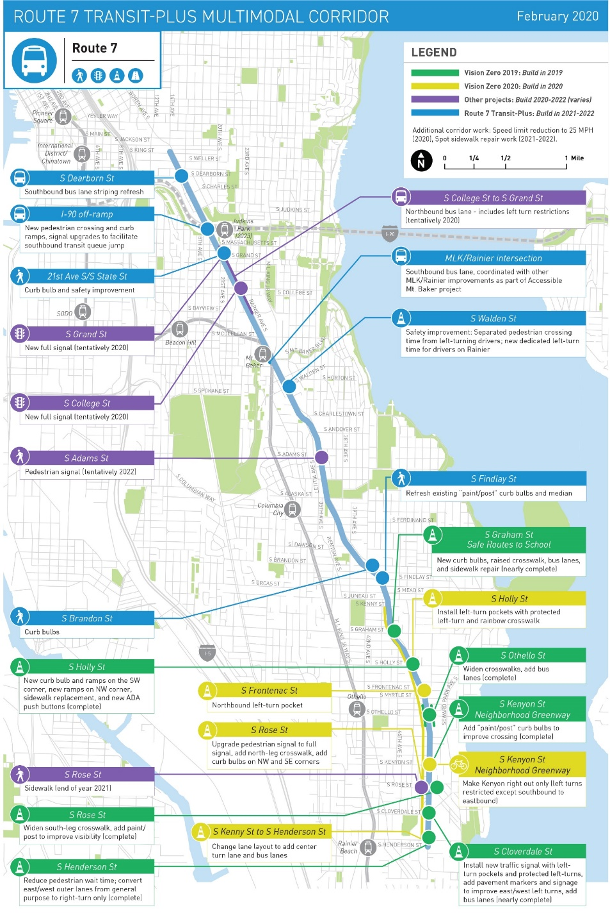
Project Overview
Project highlights:
3 new full signals
1 new pedestrian signal
21,278 square feet of sidewalk repair
20 new curb ramps

Slide 21
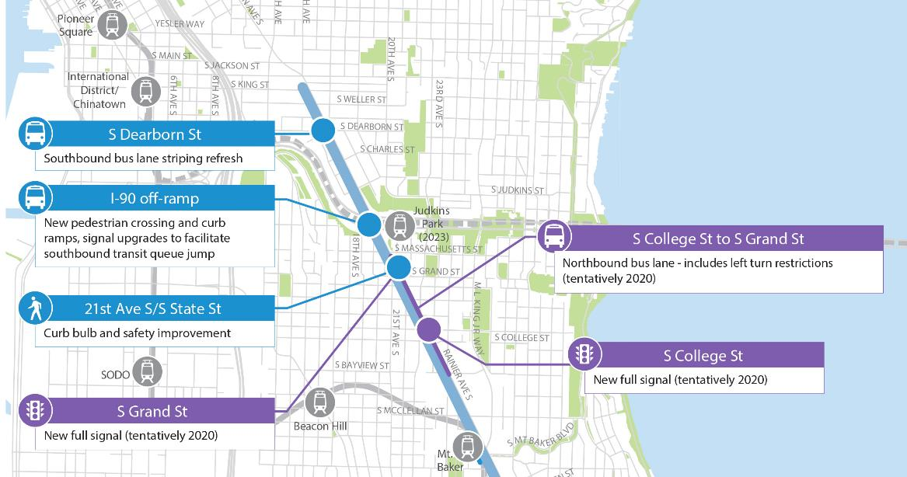
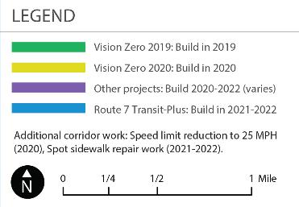
Zooming in:
Northern section
  New pedestrian crossing and curb ramps
  Curb bulbs and safety improvements
  New full signals at S Grand St and
  S College St
  Bus lane striping refresh
  Signal upgrades
  NB bus lane with left turn restrictions

Slide 22
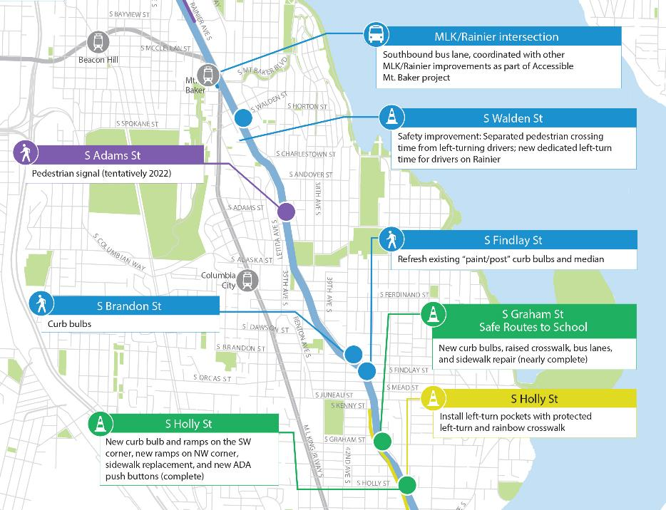
Zooming in:
Middle section
  New pedestrian crossing and curb ramps
  Curb bulbs, raised crosswalks and sidewalk repair
  Separated pedestrian crossing time
  New pedestrian signal at S Adams St
  Install left-turn pockets and rainbow crosswalk
  Refresh existing paint/post curb bulbs

Slide 23
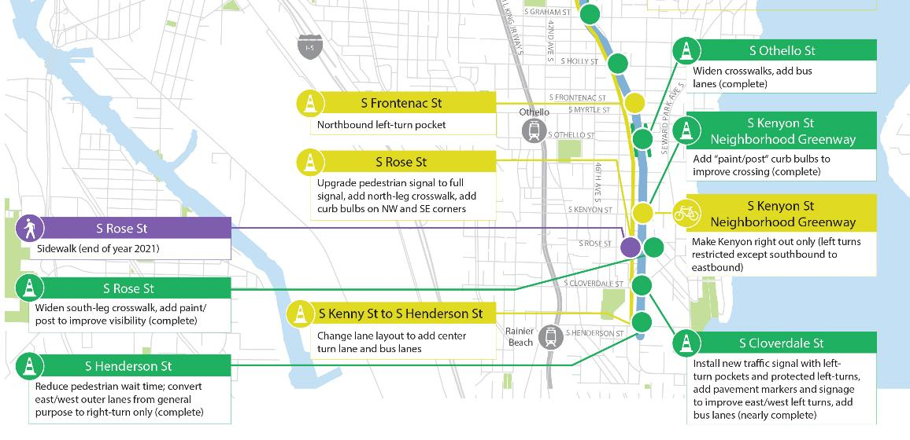
Zooming in:
Southern section
  Upgrade pedestrian signal to full signal with crosswalks and curb bulbs
  Left turn lane restrictions
  Add center turn lane and bus lanes
  Add left-turn pocket at S Frontenac St

Slide 24
Thank you!
Lisa Harrison
Communications and Outreach Lead
Lisa.M.Harrison@seattle.gov

Slide 25

Supplemental Slides

Slide 26
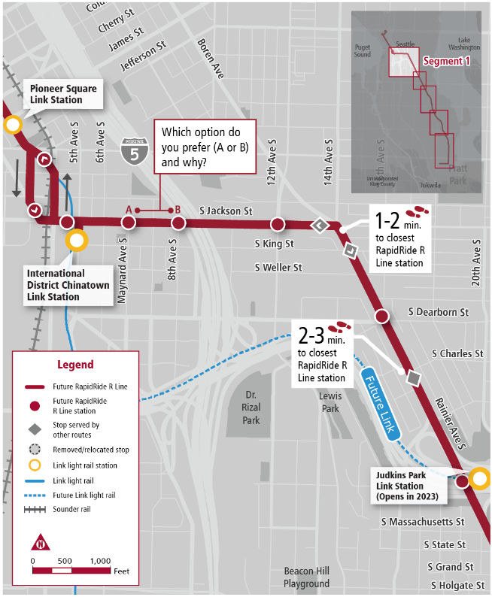
Station locations – Chinatown-ID to I-90

Slide 27
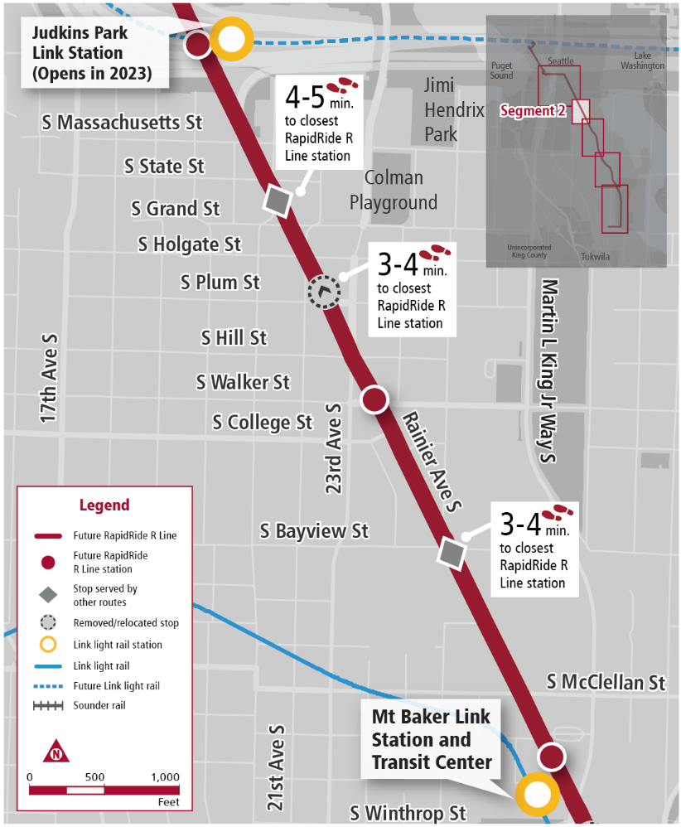
Station locations –
I-90 to Mount Baker

Slide 28
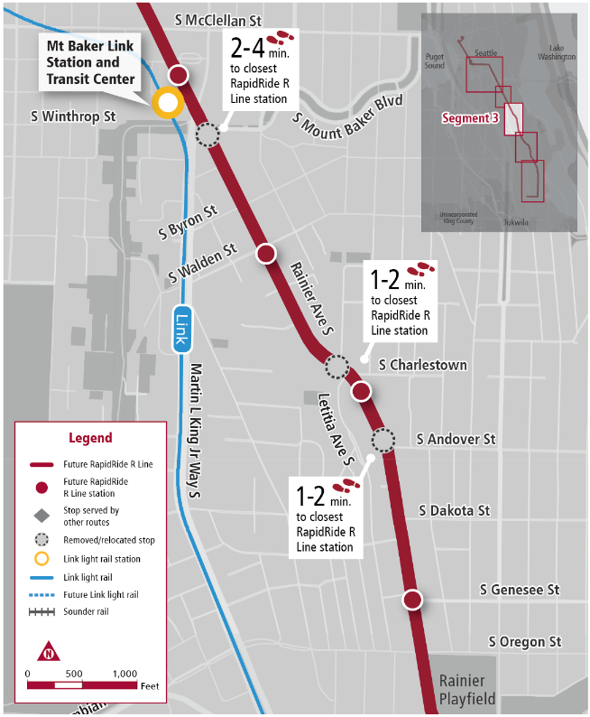
Station locations –
Mount Baker to
Columbia City

Slide 29
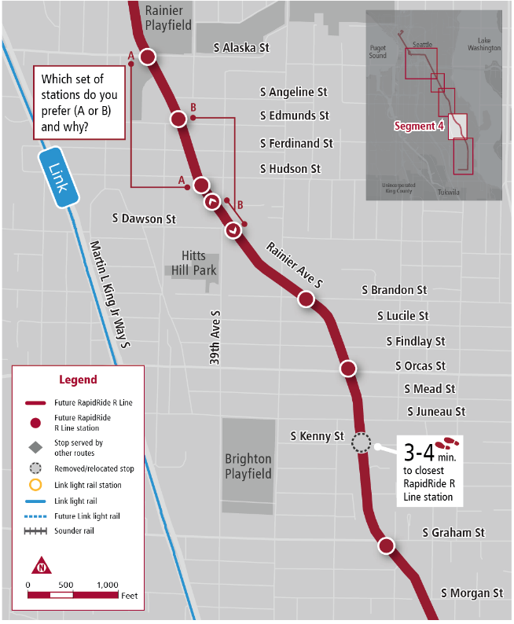
Station locations –
Columbia City to
Hillman City

Slide 30
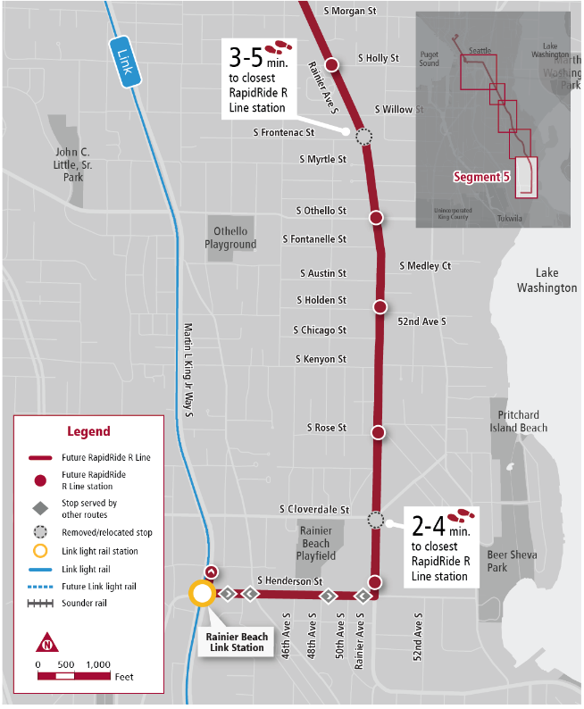
Station locations –
Hillman City to
Rainier Beach
Light Rail Station

Slide 31

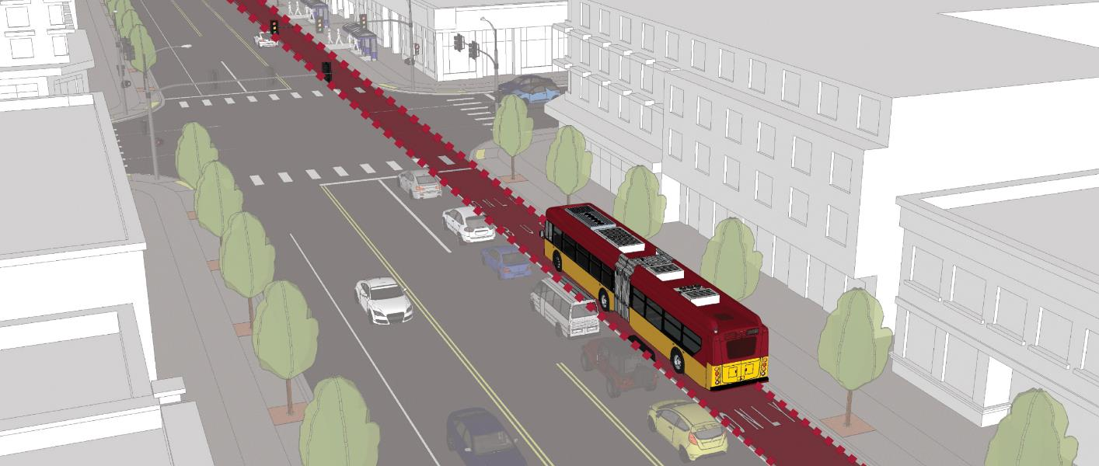
Speed and Reliability
Head start for buses and bus-only lanes
Bus-only lanes
Bus-only shoulder lanes
Shared right turn lanes
Notes:
RapidRide is Metro’s highest level of investment in service, amenities, speed and reliability, and innovation.
We’re building speed and reliability improvements to ensure the bus moves quickly and on-time.
Examples of speed and reliability improvements include:
A head start for buses and bus-only lanes so that buses move through traffic and intersections….

Slide 32
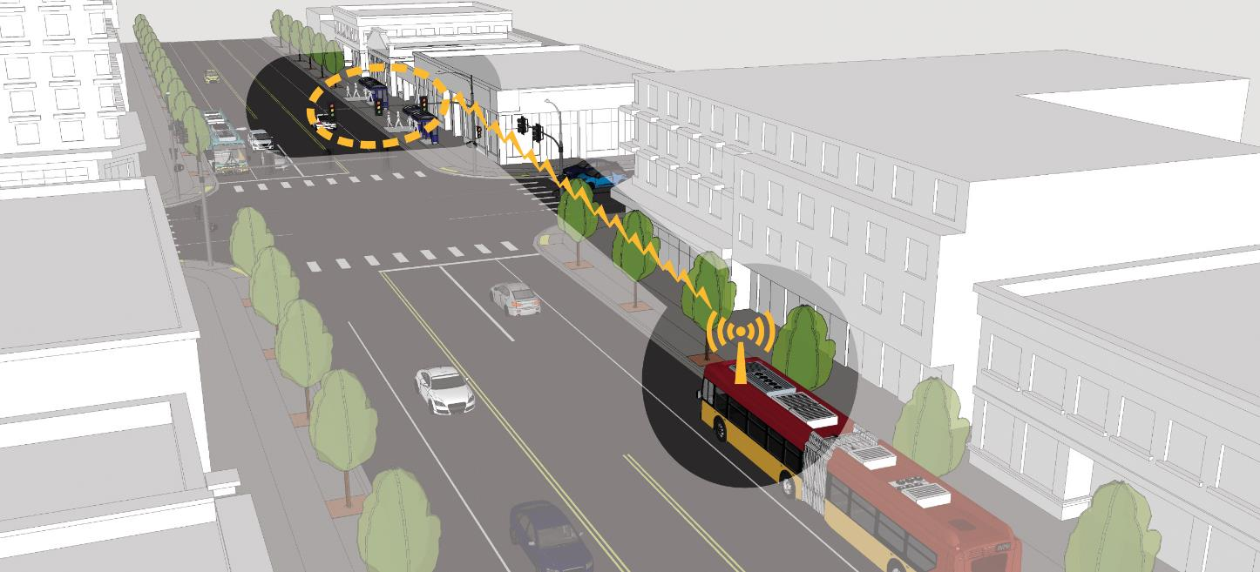
Speed and Reliability
Timed traffic lights
Notes:
Timed traffic lights to give buses the green light.

Slide 33
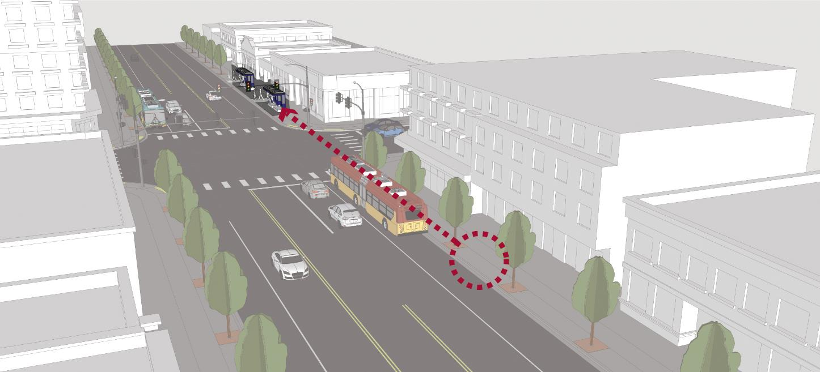
Speed and Reliability
Smart station locations
Notes:
Station placement after intersections with traffic signals to help reduce traffic.

