Slide 1
Training Instructions
Read through the entire training and edit the slides and slide notes to fit your store’s practices
See Food Donation Training Script and Food Donation Training Visuals, which are also found on SPU’s website
Additional posters, templates, and materials are found on SPU’s website
If you would like assistance tailoring this training for your store or would like SPU to host a free training at your store, please email: SPU_FoodRescue@seattle.gov

Slide 2
Food Donation Training
Business Name Presenter Names Date

Slide 3
Agenda Overview
Introductions & Background
Your Food Donation Program and Partners​
Standardizing Food Donation​ at Your Store
Your Questions & Suggestions
Notes:
Introductions + Background
Your Food Donation Program and Partners​
Where do the food donations go?
Why is quality food donation important?
Standardizing Food Donation​ at Your Store
Your store’s practices
Standardizing food donation in each department
What is and isn’t donatable
What goes where
Your Questions & Suggestions
Feedback about current practices
Where your store may need more assistance in the way of equipment, signage, training, etc.
Feedback about this training

Slide 4
Food Donation
Program and Partners
Food Donation at Your Store, Partner Highlights,
and Quality Food Donations

Slide 5
Food Donation at Your Store
Raise your hand if you know your store donates food​.
Notes:
Raise your hand if you know your store donates food​.

Slide 6
Food Donation at Your Store
Raise your hand if…
You have collected food from the shelves for donation
Notes:
Keep it raised if​
You’ve collected food from the shelves for donation​

Slide 7
Food Donation at Your Store (Continued)
Raise your hand if…
Raise your hand if…
You have collected food from the shelves for donation
You know which food banks or meal programs you donate to
Notes:
Keep it raised if​
You know which food banks or meal programs you donate to​

Slide 8
Food Donation at Your Store (Continued pt.2)
Raise your hand if…
Raise your hand if…
Raise your hand if…
You have collected food from the shelves for donation
You know which food banks or meal programs you donate to
You have interacted with a food bank employee or volunteer
Notes:
Keep it raised if​
You’ve interacted with a food bank employee or volunteer​
The chain of food donation is filled with people - from grocery store staff to food bank workers and volunteers to moms trying to feed their children. Here’s a glance at your food donation partners:

Slide 9
Food Bank Profile
[Complete this section with your food bank partner's info]
Hours
Type of service
Clientele and number served
Pounds saved/served or meals served

Slide 10
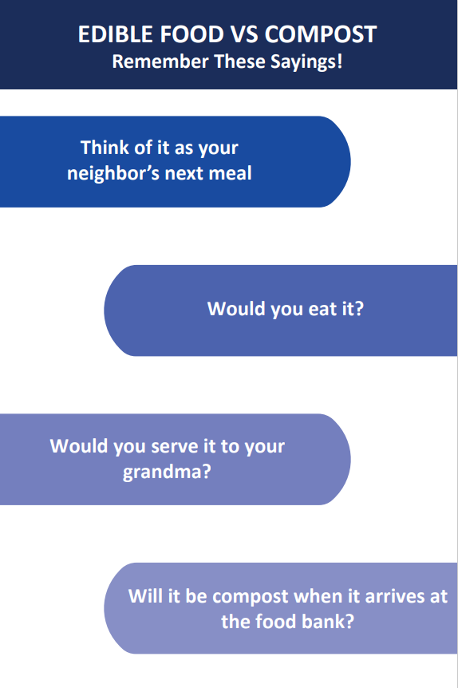
Quality Food Donations
Notes:
POTENTIAL ACTIVITY: Print the Food Rescue Mottos poster, Ask participants to draft yheir own mottos on sticky notes, vote on favorite mottos by adding a dot sticker next to them.
If you wouldn’t eat it, it’s compost.​ If your donations will be compost by the time they arrive at the food bank, your store is passing off compost and trash costs onto a non-profit run primarily by volunteers​ and funded largely by grants and donations.
Think of each donation as your neighbor’s next meal​
If you wouldn't serve it to your grandma, don't donate it

Slide 11
Standardizing
Food Donation at
Your Store
What Can and Can’t Be Donated

Slide 12
What Can’t Be Donated?
Things on the donation partner’s do not donate list.
If you wouldn’t eat it, don’t donate it.​
Think of it in two categories: Poor Quality and Type of Food
  Quality: moldy, wilting, very bruised, stale, opened packages, things not held at food safe temps​
  Type: Alcohol, kombucha, bottles that can be refunded, etc
Notes:
Things on the donation partner’s not donate list.
If you wouldn’t eat it, don’t donate it.​
Think of it in two categories: Poor Quality and Type of Food
Quality: moldy, wilting, very bruised, stale, opened packages, things not held at food safe temps​
Type: Alcohol, kombucha, bottles that can be refunded, cut fruit​

Slide 13
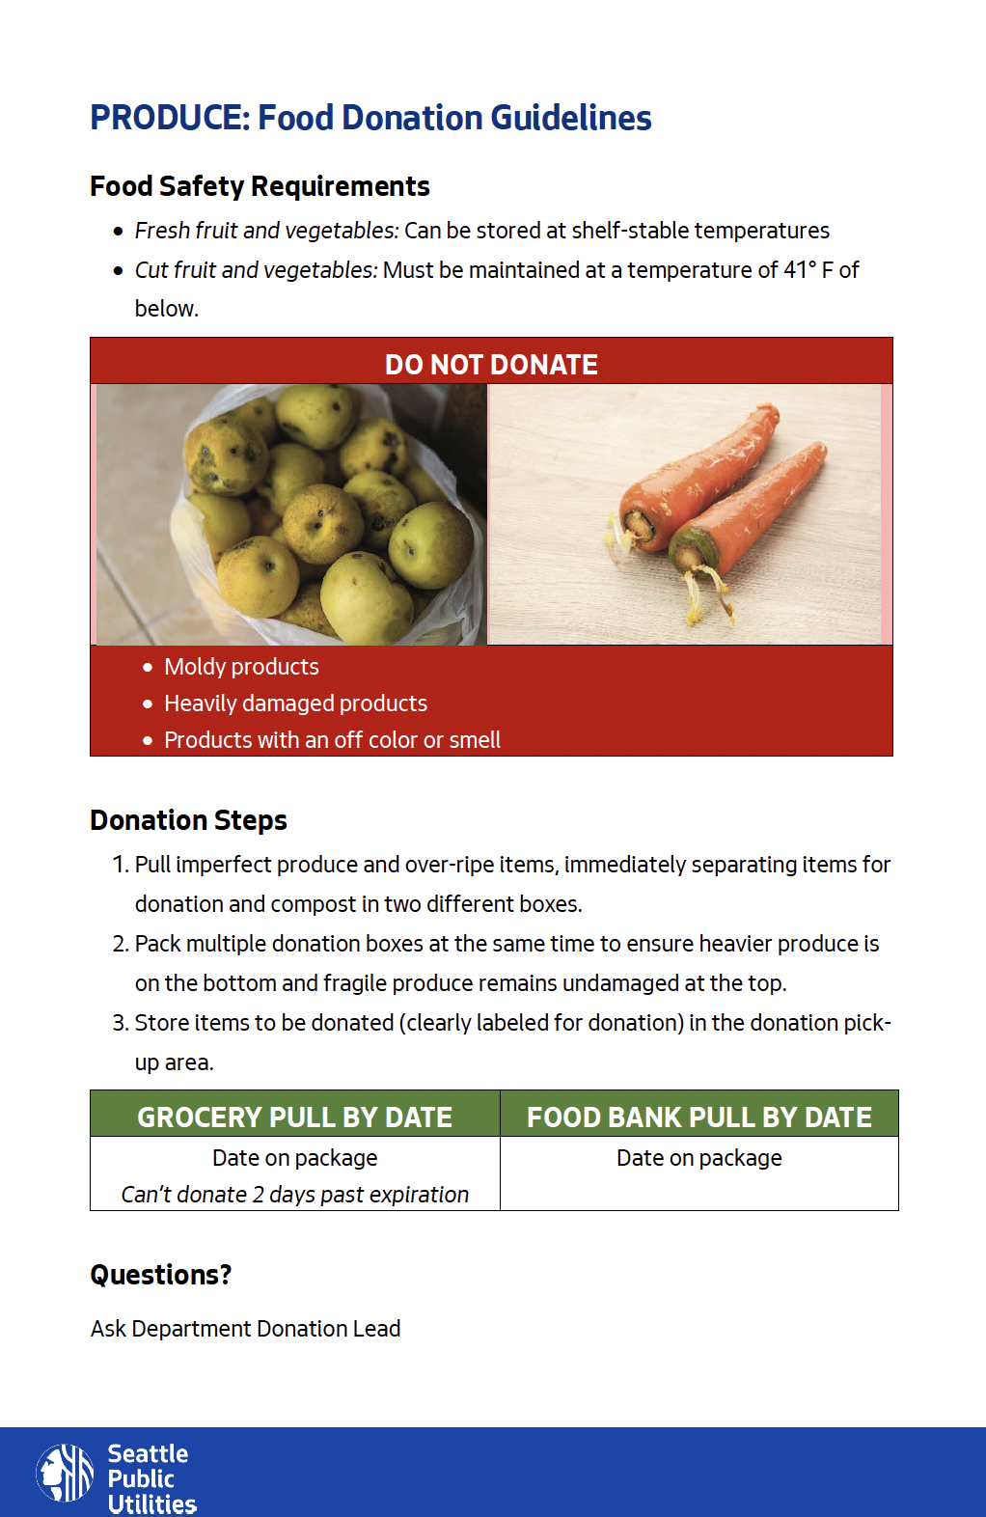
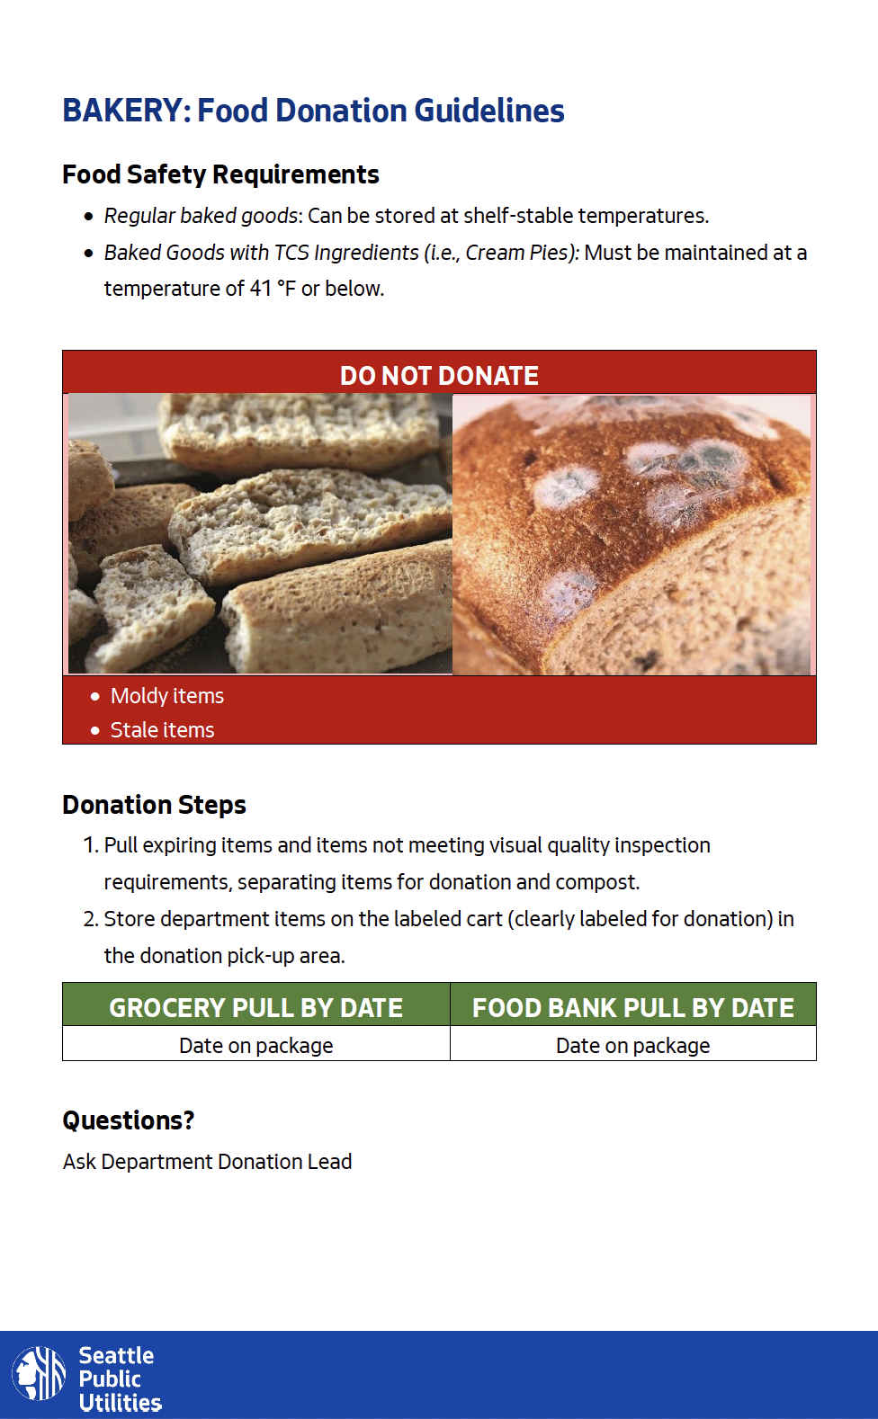
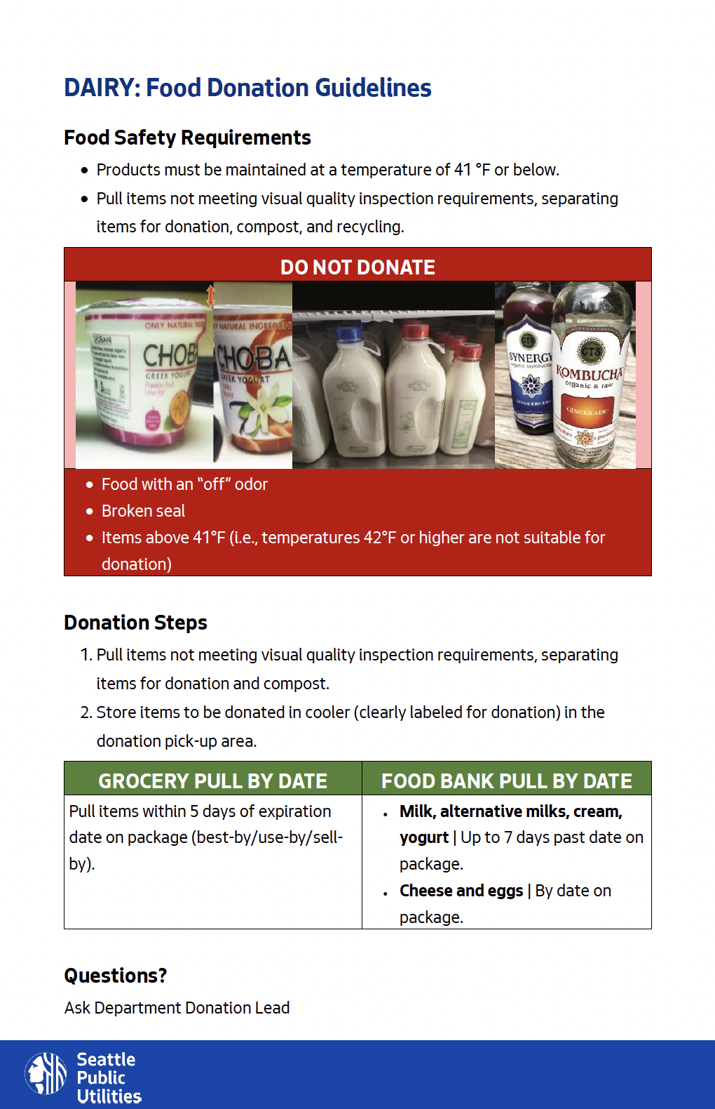
Food Donation Guideline Posters
Notes:
These posters can be customized for each department
The purpose is to reinforce what you know AND help newer staff or those who may have switched roles know what can and can’t be donated.​
Food donation and safety guidelines were researched and then finalized in partnership with KC PHD​
NOTE: Before the training print a copy of EACH department donation poster to be passed around and used for the next activity

Slide 14
ACTIVITY: Critique Department Donation Posters
Notes:
What is confusing?
What questions do you have?
Does anything look incorrect to you or different from how you've been doing it?

Slide 15
Donation Process at Your Store
Steps & Activities
Notes:
Standardizing the food donation process at your store makes it easier for everyone. Incoming staff and staff changing departments or roles can get up to speed quickly. Standardizing the process makes it easier to understand, creates efficiencies, and sets expectations for food bank employees and volunteers as well. For instance, creating a consistent, easily recognizable sign that can be hung on grocery carts that hold donations. This sign should clearly indicate to grocery staff and food bank staff what and why that cart of food is there. This reduces confusion and ensure food bank staff don’t inadvertently take food that is meant for sale vs. donation.
Standardizing food donation in your department and store happens by:
Communicating donation practices via on-the-floor training and shadowing including:
Culling/Separation on the floor or back of the house
Packing boxes intentionally - based on fragility, weight, and storage needs to prevent cross-contamination; no meat with produce, for example
Storing items at the proper temperature, including cold or frozen items
Staging items for donation back-of-house in a labeled area
(your store may scan out donations - where does that fall in this process?)

Slide 16
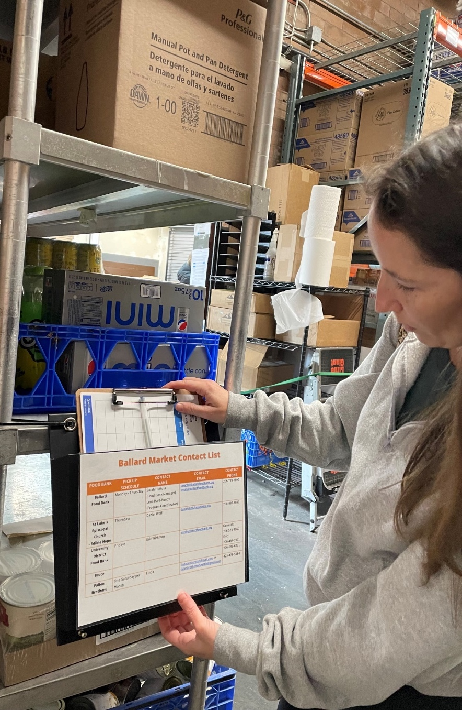
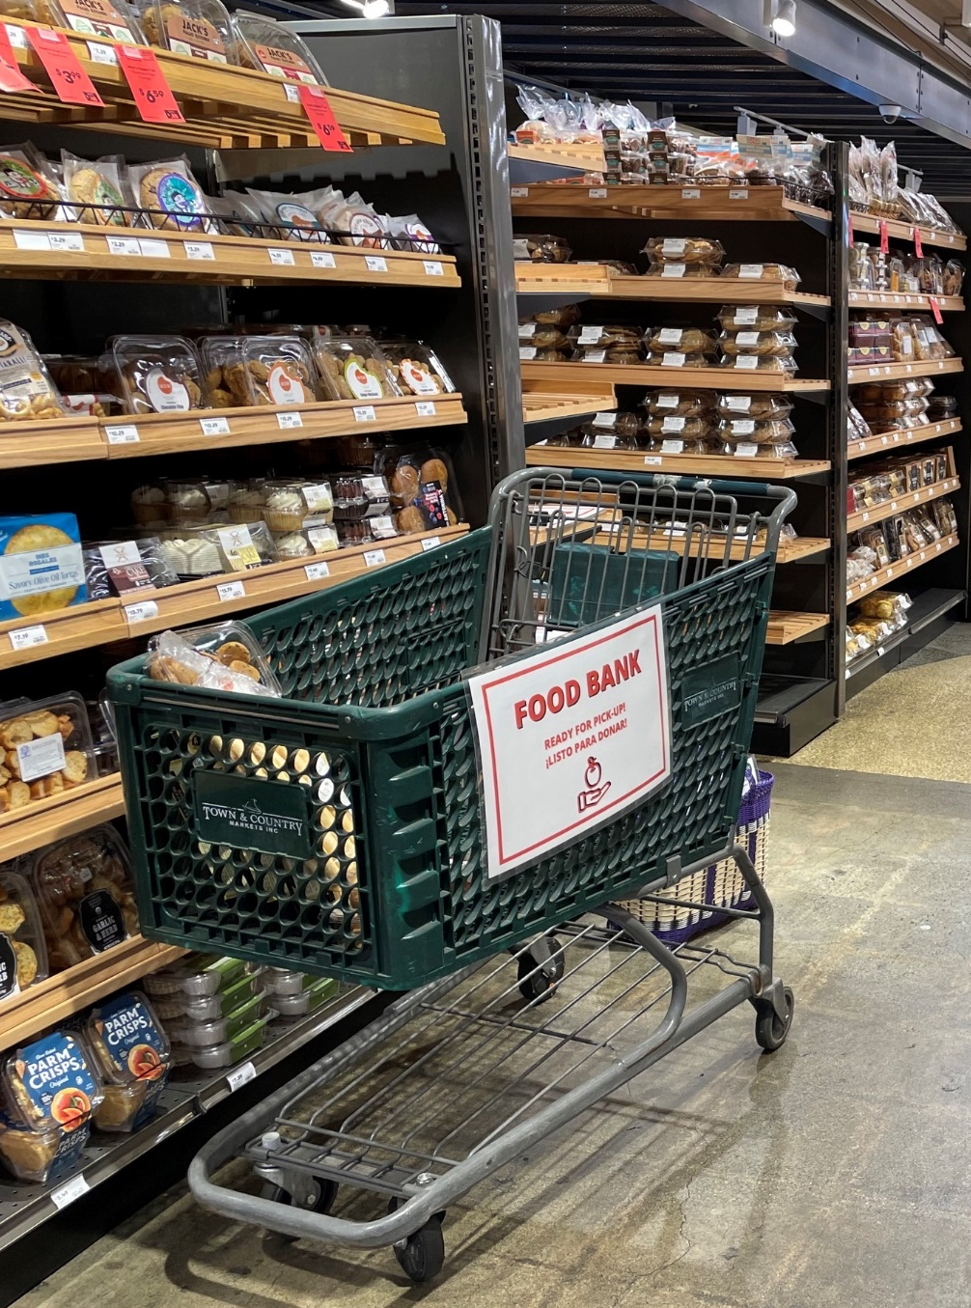
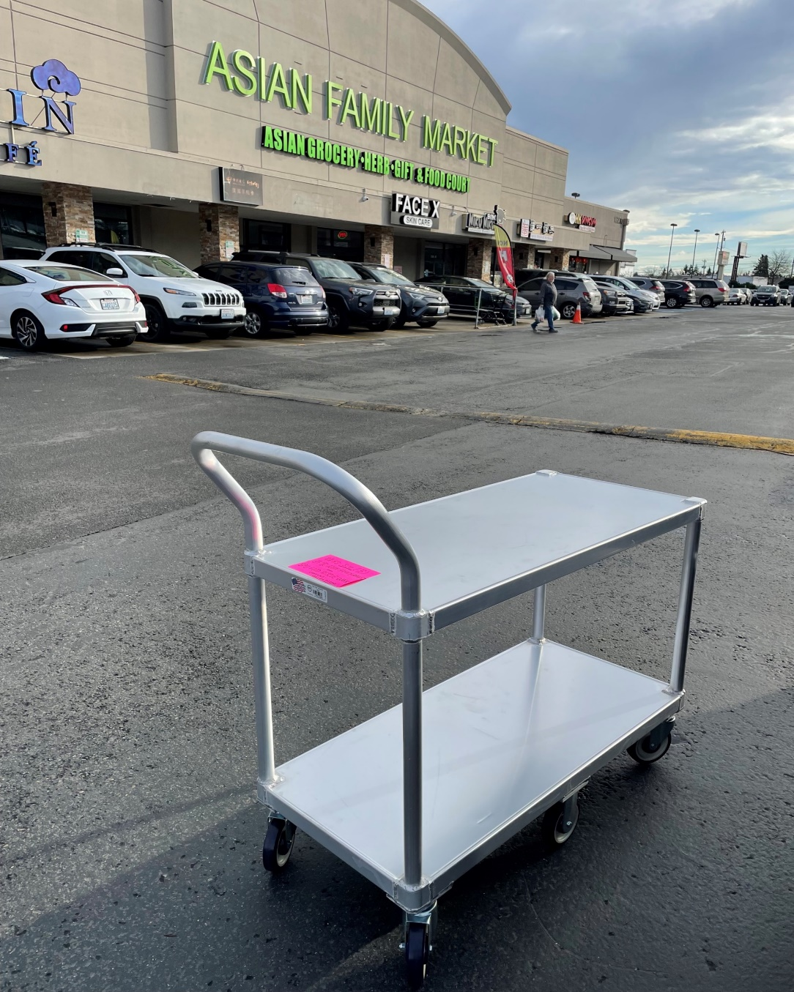
Helpful Equipment and Tools
Notes:
Hanging department donation guidelines
Hanging signage to mark donation staging areas
Using signage or other props to make it clear which push carts and shelves are for donation only
Using the contact sheet to help decrease miscommunication
Ensuring there is contact information for the person in charge of the donation program at your partnering organization
Empowering staff to reach out to donation partners with questions or important updates, such as changes to operations or a particularly large quantity of an item
Using the pick-up log to help track pickups and spot patterns
Requesting feedback from food bank partners to make sure your department’s donations are top-notch

Slide 17
ACTIVITY: Helpful Equipment & Challenges
Notes:
What other tools or equipment would help during this food donation process?
What difficulties do you have during these steps?​
Feel free to include forces that seem outside of your control like time, space in the cooler, etc.​

Slide 18
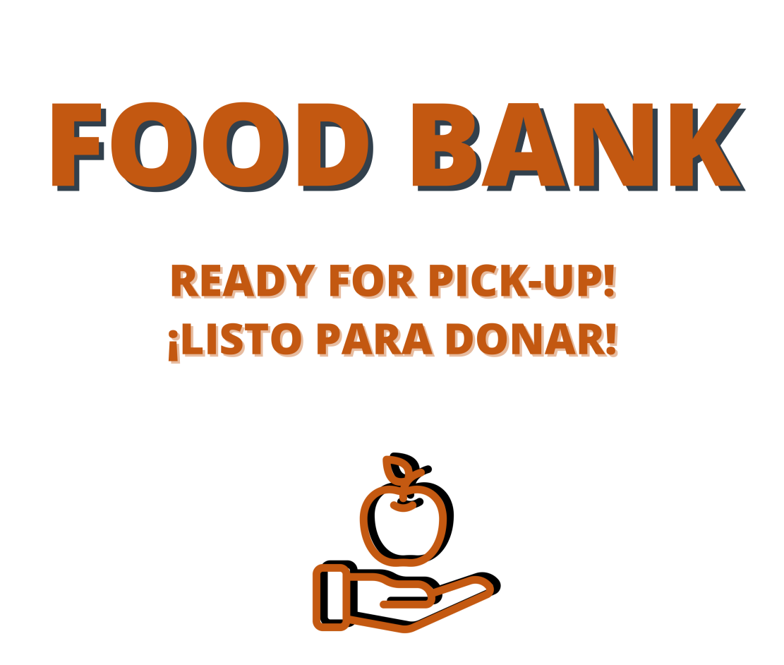
Food Donation Signage
Notes:
Signage is simple but provides a powerful visual cue for staff and volunteers.​ Signage is a form of communication, which is one of the frequently missed ingredients in food rescue operations.
Signage reconfirms your store’s commitment to food donation and quite literally makes space for it within the operations.​

Slide 19
ACTIVITY: Signage Critique
Notes:
Signage is simple but provides a powerful visual cue for staff and volunteers.​ Signage is a form of communication, which is one of the frequently missed ingredients in food rescue operations.
Signage reconfirms your store’s commitment to food donation and quite literally makes space for it within the operations.​
We want to create durable, useful signage for you. ​
Are there any other signs you may want or need? Any other languages? What are the flaws you're seeing with the signage? Pros/cons?

Slide 20
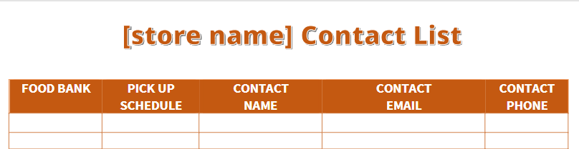
Contact Sheet
[Store name here]
Notes:
Currently, we have a contact sheet posted in X location, is there another place or additional locations where you’d like this information?

Slide 21
ACTIVITY: Contact Sheet Review
Notes:
Update to reflect the practices in your store: Currently, we have a contact sheet posted in X location, is there another place or additional locations where you’d like this information?
Developed based on feedback that donation partner contact information was not commonly known by people who may need it​.
Allows for quick and consistent communication​
Provides options in case typical pick-up partner is unavailable​
Decreases miscommunication or lack of communication​ with the HRO
Provides clarity on who is responsible for picking up donations each day ​
Empowers grocers to seek out a backup to pick up donations if the regular pick-up person is not able to come

Slide 22
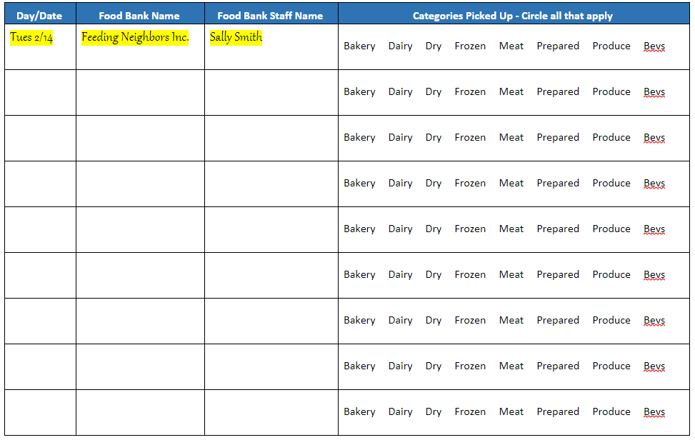
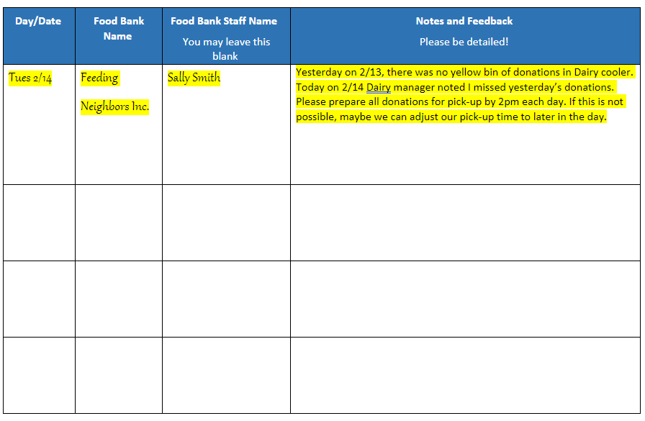
Pick Up Log
Notes:
Update to reflect practices in your store "currently we have the Pick Up log hanging in X location"
This provides a simple way to track and tally when pick-ups are happening that way at the end of a week or month, if there's a pattern, it can be spotted and talked about.​
This log notes the timeliness because freshness of food depends on timing​.
Packed on Tuesday and pick up is missed​
No pickup until Thursday ​
Wednesday morning see box of donations, confused – check log, no one came​
Need to recheck freshness/quality​ and potentially reach out to food bank to ask if their schedule changed or what happened?​

Slide 23
ACTIVITY: Pick-up Log Debrief
Notes:
This provides a simple way to track and tally when pick-ups are happening that way at the end of a week or month, if there's a pattern, it can be spotted and talked about.​
This log notes the timeliness because freshness of food depends on timing​.
Packed on Tuesday and pick up is missed​
No pickup until Thursday ​
Wednesday morning see box of donations, confused – check log, no one came​
Need to recheck freshness/quality​ and potentially reach out to food bank to ask if their schedule changed or what happened?​
This central document for receivers/department leads introduces an avenue for regular follow-up with donation partners in the event of miscommunication or missed pick-up​
It also provides a mechanism for HRO staff/volunteers to provide direct feedback to grocers, in writing if that is more comfortable.

Slide 24
Questions or Suggestions?
Thank you!
Notes:
Is there any additional feedback about current practices?
Any additional assistance in the way of equipment, signage, training, etc. that wasn’t brought up?
Feedback about this training?

