Slide 1
SEATTLE PLANNING COMMISSION
Thursday, April 24, 2014
7:30 – 9:00 AM
City Hall, Room L280
DRAFT AGENDA
Chair's Report and Minutes Approval 7:30 – 7:45 AM
Action: Approve Microhousing Letter 7:45 – 7:55 AM
Discussion: Pedestrian Zone letter 7:55 – 8:25 AM
Discussion: Comprehensive Plan Major Update 8:25 – 8:55 AM
Public Comment 8:55 – 9:00 AM
ADJOURN 9:00 AM

Slide 2
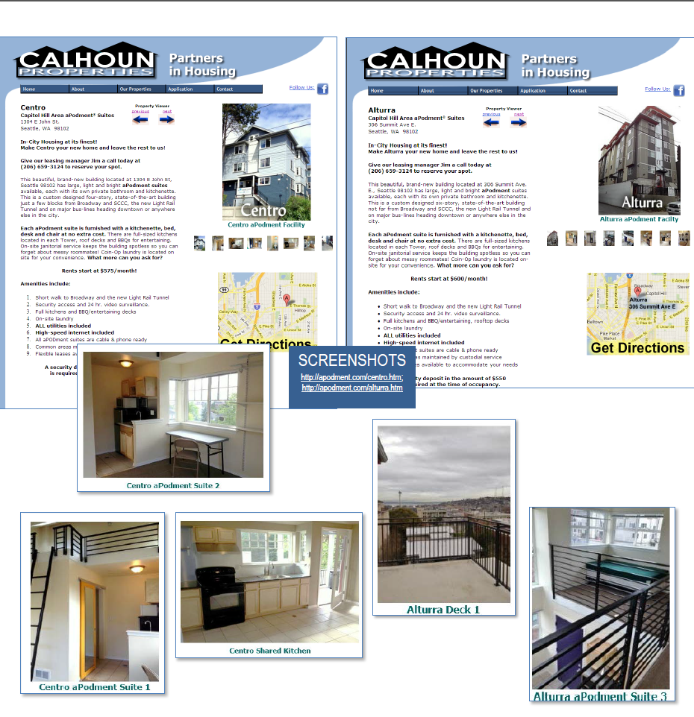
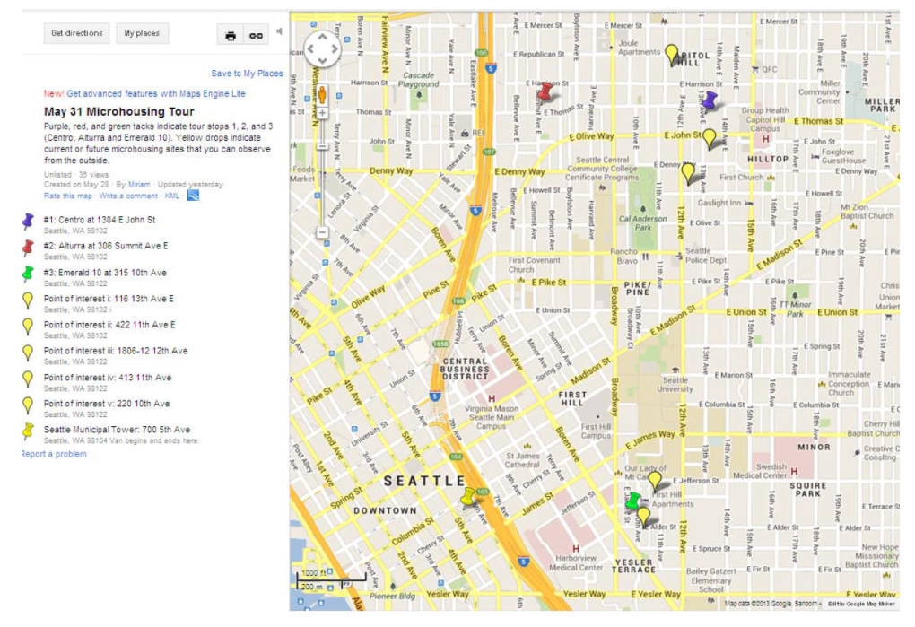
Action to Approve
Draft Letter to Council PLUS Committee
SPC Recommendations on Micro-housing Legislation
Background:
SPC has been involved in issue for over a year. In 2013:
Briefings from
  Office of Housing
  DPD (Planners, Principal Engineer, and Building Official)
Tour
Discussed at multiple meetings
Notes:
RE: Recommendations on micro-housing legislation
Dear Councilmember O’Brien,
The Planning Commission has been studying micro-housing development since the spring of 2013, when we were asked to provide our advice on potential code amendments.
In 2013, we received briefings from the Office of Housing and the Department of Planning & Development (DPD), including from DPD’s Principal Engineer and Building Official; viewed community forums; talked with micro-housing tenants and property developers during a local tour; and discussed this form of development over the course of several committee and full Commission meetings.
Our earlier input
The Commission provided initial input last summer in a letter to the City Council’s Planning, Land Use and Sustainability (PLUS) Committee and a memorandum to DPD Director Diane Sugimura offering our thoughts on DPD’s preliminary recommendations. The Commission observed that micro-housing helps fill a unique market niche by providing relatively affordable housing to individuals who want to live near work, school, and other important destinations or services, and who prefer a degree of privacy.
The Commission recommended that the City embrace micro-housing as a meaningful strategy to help ensure that a broad and diverse population can live in Seattle but also enact code refinements to make this form of development work better for tenants and neighborhoods. The recommendations we offered in the spring of 2013 included the following:
Provide a clear definition for micro-housing form to facilitate the specification of appropriate tailored development standards and enable fair and consistent application of design review thresholds.
Base design review requirements for micro-housing on building scale to provide for a more policy-neutral treatment of micro-housing relative to other forms of multifamily development types.
Create bicycle parking standards appropriate to this development type.
Revise eligibility standards for the participation in the Multifamily Tax Exemption program to require deeper levels of affordability for forms of housing, including micro-housing and small studios, which have substantially smaller living spaces than other forms of multifamily housing.
Provide standards for common spaces in micro-housing including requirements to ensure usability of shared spaces as areas of congregation.
Allow development of micro-housing in all zones where multifamily housing is currently allowed.
In hub urban villages, urban centers, and areas well served by transit, continue to allow micro-housing to be built without parking; and outside of those areas, continue to require parking consistent with the Land Use Code.
Comments and recommendations on the proposed legislation
We understand that the Council’s PLUS Committee has begun to review proposed legislation on micro-housing and congregate residences and we would like to offer additional comments and recommendations on the proposed legislation.
Elected officials had tasked DPD with designing and submitting to the Council code improvements that will both preserve the ability of these developments to offer affordable housing choices while ensuring that they also reflect the spirit of the City’s land use laws. The Planning Commission believes that the proposed legislation generally does a good job on both of these fronts. Below are our additional comments:
We generally support the definitions that the proposed legislation contains for micro-housing and congregate residences, but suggest removing the overly prescriptive specification that a micro contain no more than one sink. The proposed definitions provide needed clarity to facilitate consistent and predictable regulation of these forms of housing. The specification of formal definitions for both micro-housing and micros (the latter being the constituent sleeping rooms clustered within a micro-housing unit) will make it easier for the City to monitor growth and development trends
We agree that the definitions should enable micros to be distinguished from small housing units such as small studio apartments. However, the specification that a micro may not include two sinks unnecessarily limits the options that developers may offer in response to evolving market preferences and plumbing products, including compact and water-saving options. The specification that the sink be located within the bathroom itself may also preclude designs that would use space more efficiently.
We believe that maximum square footage combined with the other characteristics specified in the proposed definition are sufficient to clearly distinguish micros as a form of housing. One of the specified characteristics is that the micro does not contain a food preparation area or kitchen. The DPD Director’s Report notes that a key indicator of the presence of a food preparation area or kitchen is the presence of a stove or range, or the requisite wiring for a 220V electric service or gas supply line. The Commission believes that the lack of a sink outside the bathroom is not additionally necessary to indicate the lack of a kitchen.
The proposed structure and graduated thresholds for design review generally make sense, yet the threshold for Streamlined Design Review may need to be somewhat lower. The proposed legislation specifies design review thresholds for micro-housing based on building square footage, an approach that will better enable the City to apply design review requirements to micro-housing on a more level playing field with other forms of multifamily development.
The proposed GSF thresholds for Administrative Design Review and Full Design Review (at 12,000 GSF, and 20,000 GSF respectively) for micro-housing and congregate residences correlate closely with the scale at which more traditional types of multifamily housing developments are required to undergo design review based on the dwelling unit thresholds that apply to them.
We are, however, concerned that the proposed 6,000 GSF threshold for Streamlined Design Review (SDR) may be somewhat higher than the threshold needed to correlate with SDR thresholds for other forms of multifamily housing. One of the benchmarks that DPD used to arrive at the proposed SDR threshold was a three-unit townhouse. This is a reasonable benchmark for the SDR threshold given that SDR is currently required for developments containing three to eight units. However, we think the assumed average gross square footage (GSF) per townhouse of 2,000 may be an overestimate. We would recommend that the SDR threshold be reevaluated and potentially revised downward to a figure closer to the 5,000 GSF threshold that DPD had previously contemplated.
We support the development standards in the proposed legislation that add a minimum size requirement for shared kitchens and common areas, and that strengthen bicycle parking requirements. Providing for adequate space for tenants to enjoy a meal with friends or neighborhoods, and suitable space for tenants to park their bicycles are important improvements necessary to the livability of this form of housing.
We agree and would like to highlight that micro-housing should continue to be allowed in the same neighborhoods where it is allowed today. It is vital that micro-housing be allowed in suitable locations within the city. Micro-housing is an innovative housing product that broadens the options available, responds to contemporary lifestyle choices, and enables residents to save on housing costs. By providing attractive, relatively affordable in-city dwelling options for one-person households, micro-housing reduces the need for individuals to find roommate arrangements and may free up some existing multi-bedroom housing for families. Furthermore, micro-housing enables tenants to make good use of local and regional transit investments, and supports the City’s sustainability goals.
Proposed provisions for design review in micro-housing may help alleviate some of the broader design-related concerns with new development in Lowrise 3 Zones. On April 11, the Planning Commission sent DPD’s Director Diane Sugimura a memo conveying our thoughts on DPD’s preliminary staff recommendations for Lowrise Multifamily Code Corrections. In addition to providing input on potential Lowrise Multifamily Code Corrections, we noted that design review provisions for micro-housing may help alleviate some of the design issues that prompted concern in Lowrise zones. We suggested that DPD keep this in mind in drafting legislation to modify Lowrise zoning, and we would similarly suggest that this be a consideration in Council’s review of future legislation on that topic.
We support deepening the affordability levels that are required for micro-housing, congregate residences, and very small studio apartments to participate in incentive zoning. Due to their small size, it is appropriate that the affordability levels required for participation in incentive zoning be deeper for micro-housing, congregate residences, and very small studio apartments, than for forms of housing with larger living spaces. Ultimately, broader efforts are also needed to provide developers with effective incentives to include affordable units serving a broad spectrum of household sizes.

Slide 3
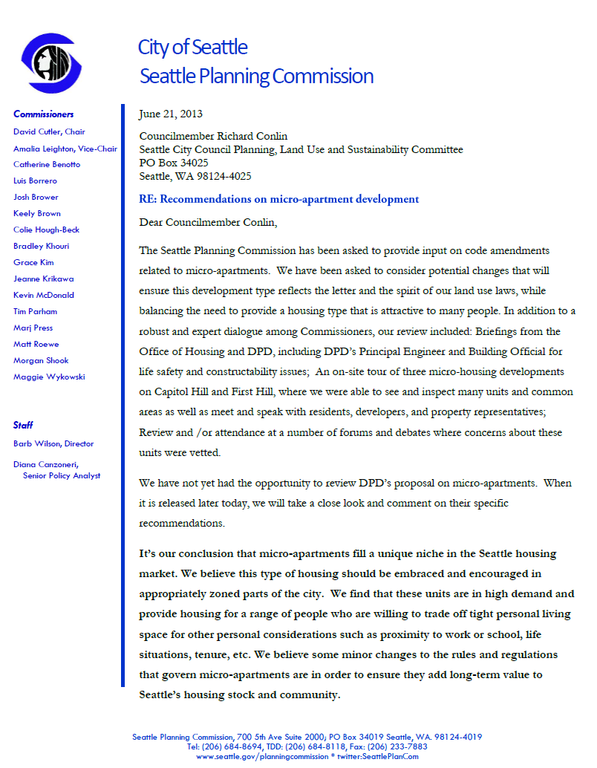
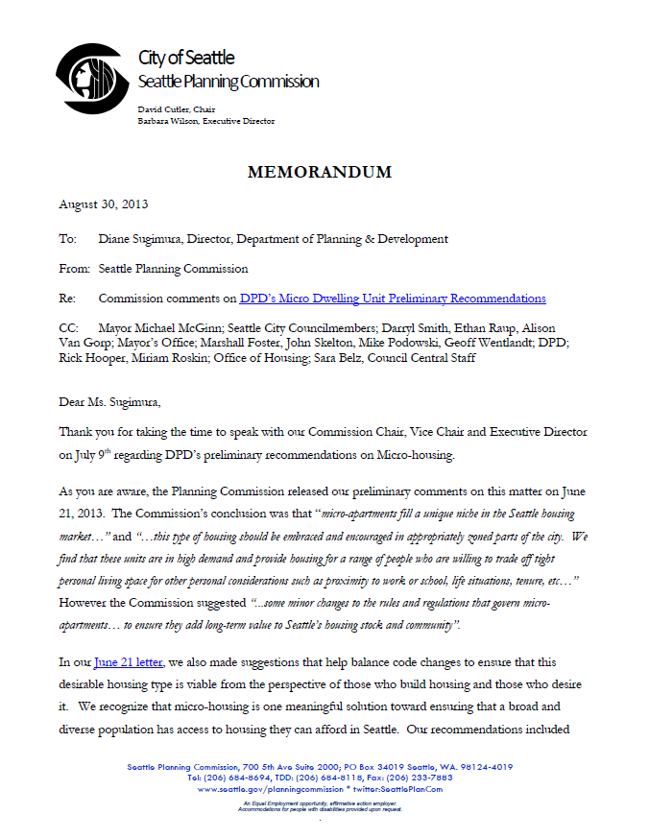
Micro-housing
Background (continued)
SPC provided initial input in 2013:
Letter to Council’s PLUS Cmte in June
Memo in August w/SPC’s feedback on DPD’s preliminary recommendations for code amendments.
Overall message:
Embrace micro-housing as a way to help people of modest means live in Seattle…
…also enact code refinements so micro-housing works better for tenants and for neighbors.

Slide 4
Micro-housing
Background (continued)
SPC’s H&N Committee worked on draft letter after got update from DPD in Feb. 2014.
Council PLUS Committee reviewing proposed legislation now.
Introductory briefing by DPD on April 18.
1st possible date for vote in PLUS mid-June.
Time ripe for SPC to send letter to Council PLUS.

Slide 5
Micro-housing draft letter
Recaps SPC’s initial recommendations:
Provide clear definition of micro-housing.
Base design review thresholds on building scale for more policy-neutral treatment relative to other multifamily housing.
Provide better bicycle parking standards.
Provide better standards for common spaces.
No additional restrictions on where micro-housing can be built.
No new parking requirements for micro-housing.

Slide 6
Micro-housing draft letter:
Recommending two changes to proposed legislation
Remove specifications that an individual micro:
  Contain no more than one sink
  that a sink can only be in the bathroom.
  Lack-of-full-kitchen in individual micro helps distinguish micro-housing as development type. Absence of a range or 220V electric service or gas supply sufficient to show lack-of-full-kitchen.
  Limiting sinks unnecessarily constrains developers’ ability to respond to evolving market preferences and products.

Slide 7
Micro-housing draft letter:
Recommending changes to legislation (cont.)
Consider reducing SDR threshold for micro-housing from 6,000 GSF (in proposed legislation) to 5,000 GSF.
  Thresholds should correlate with those for other types of multifamily housing.
  Proposed SDR threshold based on townhouse development with 3-units @ 2,000 GSF each.
  3-unit benchmark: reasonable
  Assumed average of 2,000 GSF per townhouse unit probably too high; should be re-evaluated

Slide 8
Micro-housing draft letter:
Additional recommendations/points
  Support proposed deepening of affordability levels for micros and very small studio apartments to participate in incentive zoning.
  New provisions for design review in micro-housing may help alleviate some of the broader design-related concerns in Lowrise 3 zones.

Slide 9
Pedestrian Zones
DPD is updating the pedestrian zone designation
Presented to Full Commission in February
General consensus that support would be beneficial to carrying this idea forward.
Thanks to Colie and Catherine!

Slide 10
Pedestrian Zone Letter
Support Pedestrian Zone Designation
Require Overhead Protection
Suggest Removable Railings for Outdoor Cafes
Right-of-Way Improvement Manual right place for streetscape and sidewalk design guidelines

Slide 11
Comprehensive Plan
Comp Plan Task Force met last week to discuss Commission's approach to Update
Evaluate outlines and elements in terms of vision, core values and overarching goals

Slide 12
Comprehensive Plan
Vision: Toward a Sustainable Seattle (unchanged)
Core values: Community (unchanged)
Social Equity (unchanged)
Environmental Stewardship (unchanged)
Economic Opportunity and Security (unchanged)
Overarching goal: To promote sustainable development -- that is, development that reflects, protects, and advances these core values, through a smart and well-integrated approach to where and how we grow. (unchanged)
To promote a sustainable Seattle through how we live and grow in a manner that reflects, protects, and advances these core values, through a smart and well-integrated approach to how we sustain our community and where and how we grow (revised)

Slide 13
Overarching Goals by Value:
Community
Our diverse communities will be healthy, safe and walkable.
Social Equity
All cultures, ethnicities, abilities, household types and economic backgrounds have access to the opportunities they need to advance their well-being and achieve their full potential so that there is a high level of opportunity and quality of life for all residents.
Environmental Stewardship
Our ecological systems are functioning and our natural resources are wisely protected for current residents and future generations.
Economic Opportunity and Security
Our dynamic and resilient low-carbon economy supports the needs of our socially and economically diverse population.

