Slide 1

City Neighborhood Council and the Neighborhood Planning & Land Use Committee
June 11, 2015
City Neighborhood Council

Slide 2
Charter of the City Neighborhood Council
The City Neighborhood Council (CNC) is a citizen-led advisory group, comprised of elected members from each of the City’s 13 Districts, organized under the authority of Seattle City Council Resolution 27709 (Establishment of Neighborhood Planning and Assistance Program) in October, 1987. Subsequent resolutions have refined or altered this initial resolution. They are Resolution 28115 (Amendment to Promote Diversity) December, 1989; Resolution 28948 (Neighborhood District Representation on the City Neighborhood Council) in July, 1994; and Resolution 29015 (City/Community Partnership) October, 1994.*
The CNC's purpose is to provide city-wide coordination for the Neighborhood Matching Fund, Neighborhood Budget Prioritization, and Neighborhood Planning programs.
The CNC also provides a forum for a discussion of common neighborhood issues and is available for advice on policies necessary for the effective and equitable implementation of the Neighborhood Planning and Assistance Program. Its monthly meetings are open to the public.

Slide 3
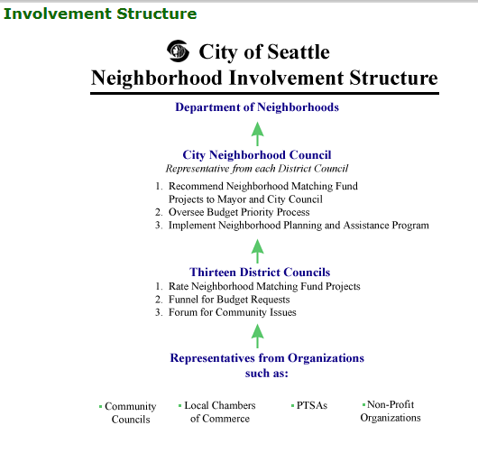
Neighborhood Districts and District Councils
The city is divided into 13 neighborhood districts.
Each District Council is comprised of representatives from community councils, nonprofit organizations and business districts.
The councils provide a forum for consideration of concerns and for the sharing of ideas for solutions to common problems.
To ensure that city programs and services are responsive and reflective of the needs and values of its neighborhoods, field staff known as Neighborhood District Coordinators serve as the community’s liaison and resource.

Slide 4
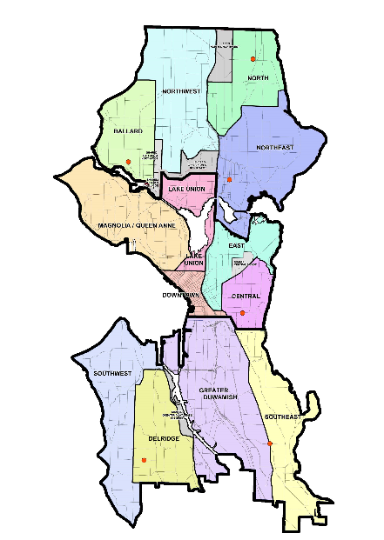
DON Staffing for Districts
North Region Team
Ballard & NW – Tom Whittemore
NE – Karen Ko
North – Chris Dumpys
Central Region Team
Central & Downtown – Yun Pitre & Laurie Ames
Queen Anne/Magnolia – Laurie Ames
Lake Union – Tim Durkan
East – Tim Durkan
South Region Team
SW – Kerry Wade
SE – Jenny Frankl
Delridge – Kerry Wade
Greater Duwamish – Jake Hellenkamp

Slide 5
CNC Member Organizations
Northwest DC
36th District Democrats
Aurora Avenue Merchants Association
Broadview Community Council
Friends of Green Lake
Green Lake Community Council
Greenwood Community Council
Haller Lake Community Club
Licton Springs Community Council
Phinney Neighborhood Association
Phinney Ridge Community Council
Ballard DC
36th District Democrats
36th District Green Party
36th District Republican Party
Ballard Landmark Residents Assn
Ballard Rotary
Ballard Place Condominiums
Ballard Chamber of Commerce
Ballard High School PTSA
Ballard Historical Society
Ballard Northwest Senior Center
Canal Station Condominium Association
Central Ballard Residents Association
Crown Hill Business Association,
Crown Hill Neighborhood Association
East Ballard Community Association
Friends of Burke Gilman Trail
Groundswell NW
Nordic Heritage Museum
North Seattle Industrial Association
Norwegian Commercial Club
Olympic Manor Community Club
Shilshole Liveaboard Association
Sunset Hill Community Association
Sunset West Condominium Association
Sustainable Ballard
Whittier Heights Community Council
North DC
Cedar Park Neighborhood Council
Cedar Park/Lake City North Emergency
Communication HUB
Douglas Park Cooperative
Lake City Community Council
Lake City Greenways
Lake City Townhouses
Maple Leaf Community Council
Meadowbrook Community Council
North Cedar Park Good Neighbor Association
Olympic Hills Community Council
Pinehurst Community Council
Thornton Creek Alliance
Victory Heights Community Council
North Seattle Chamber
South Cedar Park Good Neighbor Association
North East DC
Belvedere Terrace Community Council
Hawthorne Hills Community Council
Inverness Community Club
Laurelhurst Community Club
Matthews Beach Community Club
Portage Bay/Roanoke Park Community Council
Ravenna Bryant Community Association
Residents of Magnuson Park
Roosevelt Neighborhood Association
Roosevelt Neighbors’ Alliance
University District Community Council
University Park Community Club
View Ridge Community Council
Wedgwood Community Council
Windermere North Community Association
Queen Anne – Magnolia DC
36th District Democrats
36th District Republicans
Greater Queen Anne Chamber
Heron Habitat Helpers
Interbay Neighborhood Association
Interbay P-Patch
Magnolia Chamber of Commerce
Magnolia Community Center Advisory Cnl.
Magnolia Community Club
Magnolia Historical Society
Michaelson Manor Resident Council
Queen Anne Community Council
Queen Anne Helpline
Queen Anne Historical Society
Seattle Marine Business Coalition
Sustainable Magnolia
Sustainable Queen Anne
Uptown Alliance
Lake Union DC
Wallingford Community Council
Fremont Neighborhood Council
Fremont Chamber of Commerce
History House
Westlake Avenue North Association
East Lake Community Council
Cascade Neighborhood Council
Floating Homes Association
Wallingford Chamber of Commerce,
Lake Union Assn
East DC
Broadway BIA
Cal Anderson Park Alliance
Capitol Hill Community Council
Capitol Hill Housing Improvement Program
Capitol Hill Neighborhood Plan Stewardship Cnl.
Capitol Hill Chamber of Commerce
East Precinct Advisory Council
First Hill Community Council
First Hill Improvement Association
Freeway Park Neighborhood Group
Madison Park Community Council
Madison Park Business Association
Madison Valley Community Council
Madison Valley Merchants Association
Miller Park Advisory Council
Montlake Community Club
Miller Park Neighborhood Association
Pike-Pine Urban Neighborhood Coalition
POWHAT (Pike/OliveWay/Harvard Area Triangle)
Yesler Terrace Community Council
Southwest DC
Admiral Neighborhood Association
Alki Community Council
Fairmount Community Association
Fauntleroy Community Association
Genesee-Schmitz Neighborhood Council
Highland Park Action Committee
Junction Neighborhood Organization (JuNO)
Morgan Community Association (MoCA)
Senior Center of West Seattle
South Seattle Community College
Southwest Seattle Historical Society
/Log House Museum
West Seattle Junction Association
Delridge DC
Pigeon Point Neighborhood Council
North Delridge Neighborhood Council
Highland Park Improvement Club
Delridge Neighborhoods Development Assn
Nature Consortium
Camp Long Advisory Council
SWt Community Center Advisory Council
Southwest Youth and Family Services
Puget Ridge Neighborhood Council
Westwood Neighborhood Council
High Point Neighborhood Association
White Center Community Development Assn
Safefutures Youth Center
Longfellow Creek Watershed Council
West Seattle Crime Prevention Council
High Point Resources Coalition/Homeowners
Association/Open Space Association
Highland Park Action Committee
Campana Quetzal
Delridge Community Center Advisory Council
South Seattle Community College
Central Area DC
12th Avenue Neighborhood Plan Stewardship
Committee
African American Veterans Group of WA State
Black Dollar Days Task Force
CD Association
Central Area Chamber of Commerce
Central Area Cultural Arts Commission
Greater Duwamish DC
South Park Area Redevelopment Committee
Georgetown Community Council
Beacon Hill Merchants Association
Beacon Ridge Improvement Community
Duwamish River Clean Up Coalition
Beacon B.I.K.E.S.
Georgetown Merchants Association
South Park Neighborhood Association
Jefferson Park Alliance
North Beacon Hill Council
SODO Business Association
Manufacturing Industrial Council
South Park Information and Resource
Southeast DC
Eritrean Association in Greater Seattle
Mount Baker Community Club
Othello Station Community Action Team
Rainier Chamber
Lakewood/Seward Park Community Club
Rainier Beach Community Club
Rainier Valley Greenways
New Holly Neighborhood Clubs
Othello Neighborhood Association
Southeast Seattle Crime Prevention Council
Downtown
Under construction ☺

Slide 6
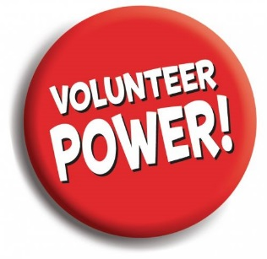
2015 Officers and Committee Chairs
Co-Chairs: Catherine Weatbrook, Laine Ross
Co-Vice Chairs: Karl deJong, Tony Provine
Secretary: Stephanie Tschida
  Committee Chairs:
  Neighborhood Matching Fund Committee Co-Chairs:
  Laine Ross, Catherine Weatbrook
  Neighborhood Planning and Land Use Committee Co-Chairs:
  Cindi Barker, Irene Wall
  Budget Committee Chair: Amanda Kay Helmick
  Transportation Committee Co-Chairs: Dennis Galvin, Kirk Robbins
  Youth and Schools Committee Chair: Eden Mack

Slide 7
Neighborhood Planning & Land Use Committee
Advocacy of neighborhood planning and citizen engagement
Analysis of citywide land use issues
Monthly meetings and email distribution list

Slide 8
NPLUC Analysis of Citywide issues – current work
Low Rise Code Corrections
Comp Plan 2035 & EIS
Comp Plan Annual Amendments
Omnibus Annual Amendments
Design Review Process Improvements
Neighborhood Conservation Districts
Incentive Zoning / Linkage Fee
Workforce Housing
ADU and DADU policy changes
TOD implementation
Living Building Initiative II
Pedestrian Retail Areas
Private Property Tree Rules Update
Development Impact Fees
Coordinated Street Furniture *
Family Size Housing
Building Code Major Update
*RFP Cancelled

Slide 9
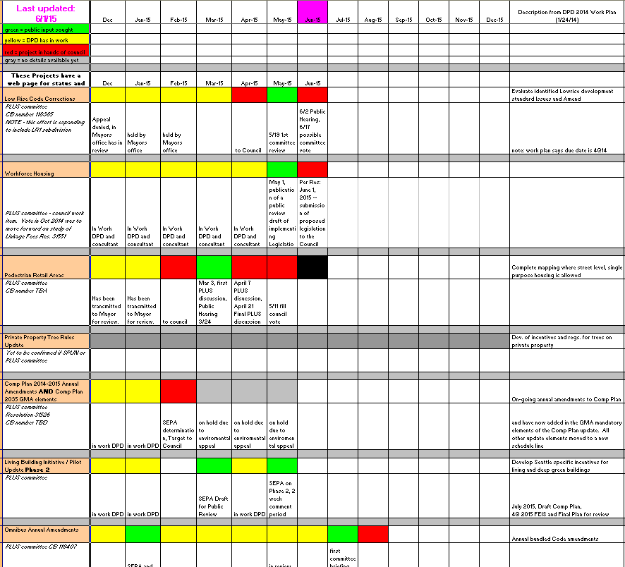
Land Use Engagement Tool

Slide 10
NPLUC Advocacy of Neighborhood Planning
June 27, 2015 event
Focused on the intersection of neighborhood plans and the Comprehensive Plan Update.
Re-established stewardship activity & connections
Incorporating new planning areas (Urban Design Framework, Action Plan, etc)
Engage UW Planning & Environment students

Slide 11
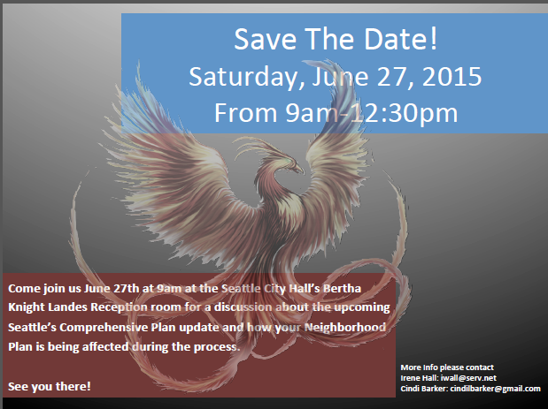
We would like to invite you to attend as well

Slide 12
PC and NPLUC - Similar Goals
Representing broad range of citizen concerns & opinion
Connecting citizens to government
Caring about physical and social fabric of Seattle
Challenged to keep up with rapid change
City Neighborhood Council

