Slide 1
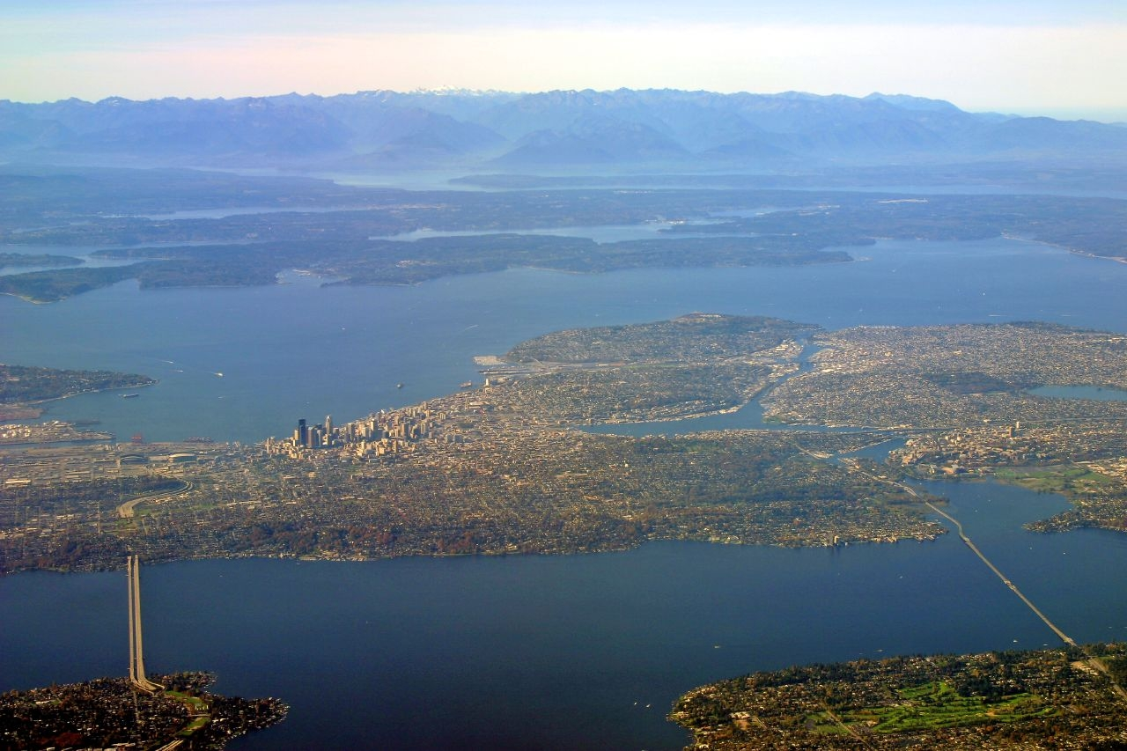

Seattle Planning Commission Briefing
December 11, 2014
Seattle’s Comprehensive Plan:
  What it is and why we have it
  How it’s working
  What’s new and what are we asking you

Slide 2
Agenda
Overview
Guidelines Used for Drafting (aka Style Guide)
SPC Review
Work Underway
Questions/ Updates

Slide 3
Two Legislative Actions
2015 – Annual Amendments
2016 – Seattle 2035
Revisions to Current Plan for GMA compliance
Planning horizon 2015-2035
Citywide Growth Estimates (70,000 HH & 115,000 jobs)
Inventories (housing, transportation, capital facilities)
Projections of Future Demand (housing, transportation, capital facilities)
Major Update
Revised introduction, goals, policies, etc.
This is what Draft #4 is all about

Slide 4
Schedule
Updated Public Engagement Plan 1Q 2015
Publish SEPA Annual Amendments Jan 2015
Public Hearing Annual Amendments March 2015
Draft EIS Alternative Analysis 2Q 2015
Council Adopts Annual Amendments June 2015
Draft Plan for Public Review 3Q 2015
Final EIS with Preferred Alt 4Q 2015
Mayor's Plan 4Q 2015
Council Adopts New Plan 2016

Slide 5
Goals for the Update
Make Plan accessible and usable
Explain how the Comprehensive Plan relates to other plans
Revise policies to increase clarity, remove redundancy and ensure relevance
Revise format to make it easier for readers to find relevant information and to understand policies
Work collaboratively with SPC to encourage broad public engagement
Reflect the community's values and aspirations
Provide opportunities for the public to contribute ideas and provide feedback
Improve the involvement of traditionally under- represented audiences
Make the review process accessible, engaging, racially and culturally inclusive
Emphasize Equity

Slide 6
Organization
Option 1 Elements
Growing Seattle (was Urban Village)
Option 2 Themes
Urban Form
Land Use
Transportation
Housing
Capital Facilities
Utilities
Economic Development
Arts and Culture
Environment
Container Port
Shoreline Management
Human Development
Parks & Open Space (NEW)
Mobility
Prosperity
Services
Capital Facilities
Utilities
Economic Development
Container Port
Environment
Transportation
Growing Seattle
Land Use
Housing
Arts and Culture
Parks & Open Space
Other
Neighborhood Planning

Slide 7
Who Developed the Draft?
DPD Team
Interdepartmental Team
RSJI Change Teams
Seattle Planning Commission
Equitable Development Initiative Team
RSJI Change Teams

Slide 8
Guidelines
More plain talk
Less redundancy
Clear hierarchy
Active statements
Intentional verbs
Consistency
Clarity
Goal 1.0
Policy 1.1
Policy 1.2
Goal 2.0
Policy 2.1
Policy 2.2

Slide 9
Is it a Goal or a Policy?
Goal - Future, long-term, broad city government or community outcome
  Policy - broad statements that set preferred direction to achieve the goal/outcome; doesn’t change with shifting funding or political priorities
NOT specific strategy or tactic (e.g. create a rain barrel fund, develop a sidewalk repair program, identify new funding sources for parks, etc.)

Slide 10
Work Underway
Plan Document
Supporting Documents & Tools
Integrating equity
Framework for prioritizing investments
Device to highlight connections
Glossary
Policy Crosswalk
Draft Plan Summary
Ultimate format of the final plan

Slide 11
Shifts in Direction
Monitoring growth
Eliminate duplicative Land Use Code policy (e.g. rezone criteria)
Homeownership as a goal
Siting policy for low income housing
Displacement
Priority uses for City surplus property
Urban Forestry goals
Notes:
Acknowledge SPC supports eliminating targets

Slide 12
New Concepts or Emphasis
Equity
Safety in transportation
Modal hierarchy
Cultural spaces and placemaking
Industry clusters
STEM job training
Climate: resilience, adaptation, preparedness
District systems (e.g. district energy)

Slide 13
NEW Parks & Open Space
Some policies formerly in Capital Facilities Element
Moved open space goals from Appendix
Focus is mostly on City Parks system
Draft could benefit from thoughts about broadening approach to open space

Slide 14
Feedback on the Draft
Most Useful
Problem policies
Shift in direction
Gaps
Strength
Duplication
Equity
Clarity
Least Useful
Line editing, copy editing
Major reorganization
Different policy hierarchy
“and especially…”

Slide 15
Questions for Discussion

