Slide 1
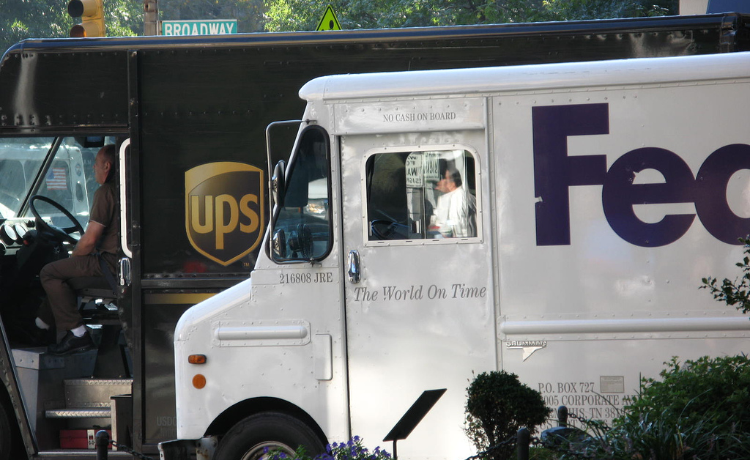

Freight Master Plan
Seattle Planning Commission
March 10, 2016

Slide 2

Work completed for FMP
2014
Gather information
Interviews
Select committee
2015
Policy framework
Existing conditions report
Analysis future conditions
Draft network
Bottleneck analysis
Develop freight projects
Strategies and actions
2016
Public review draft
Prioritization
Performance measures
Lots of public outreach!

Slide 3
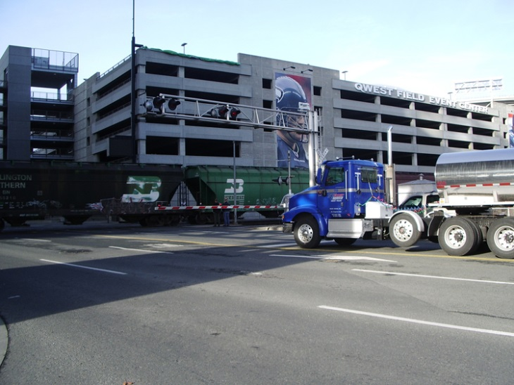
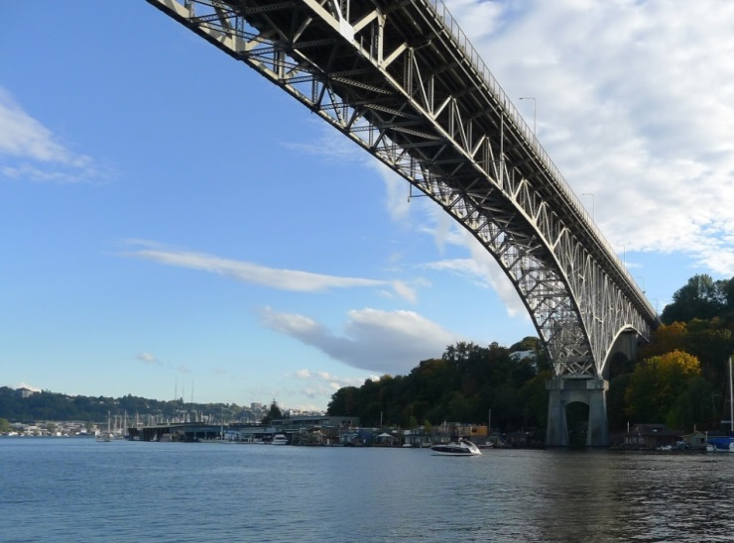
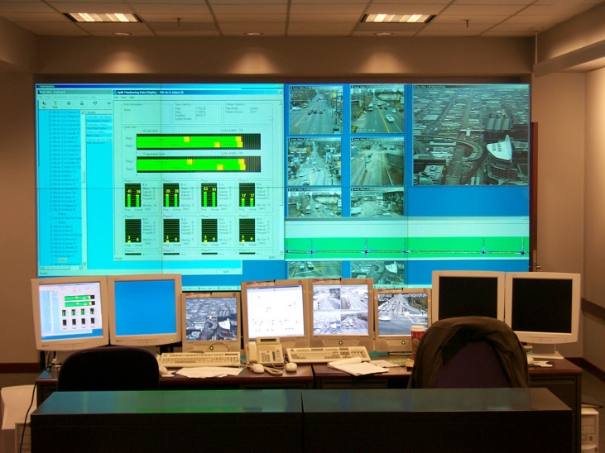
Draft freight
network designation
  Land use
  Trip purpose
  Roadway Classification
  Truck Volumes
  Physical Roadway Characteristics
  Connectivity
Tiered
system
criteria
Notes:
Freight goes everywhere
Need to recognize different levels of freight movement and needs
Need for context sensitivity

Slide 4
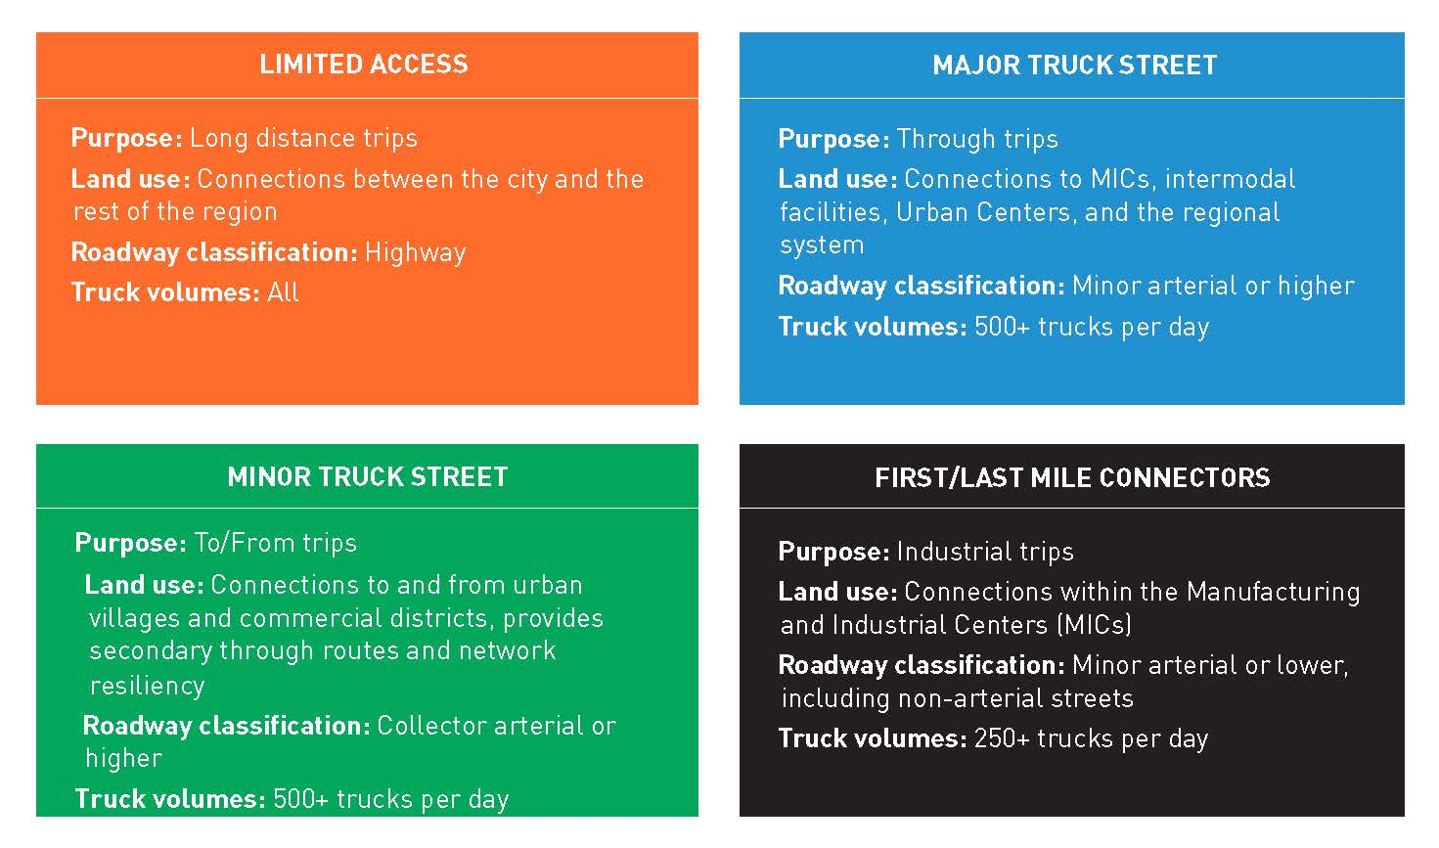
Draft freight network designation

Slide 5
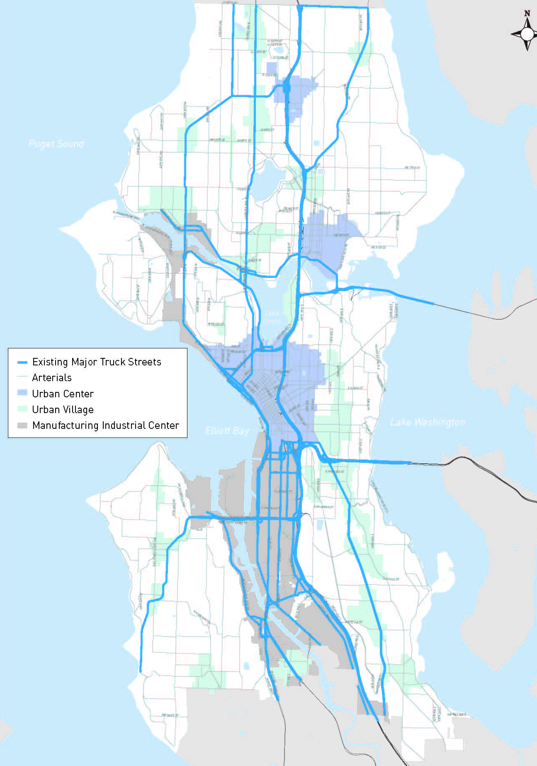
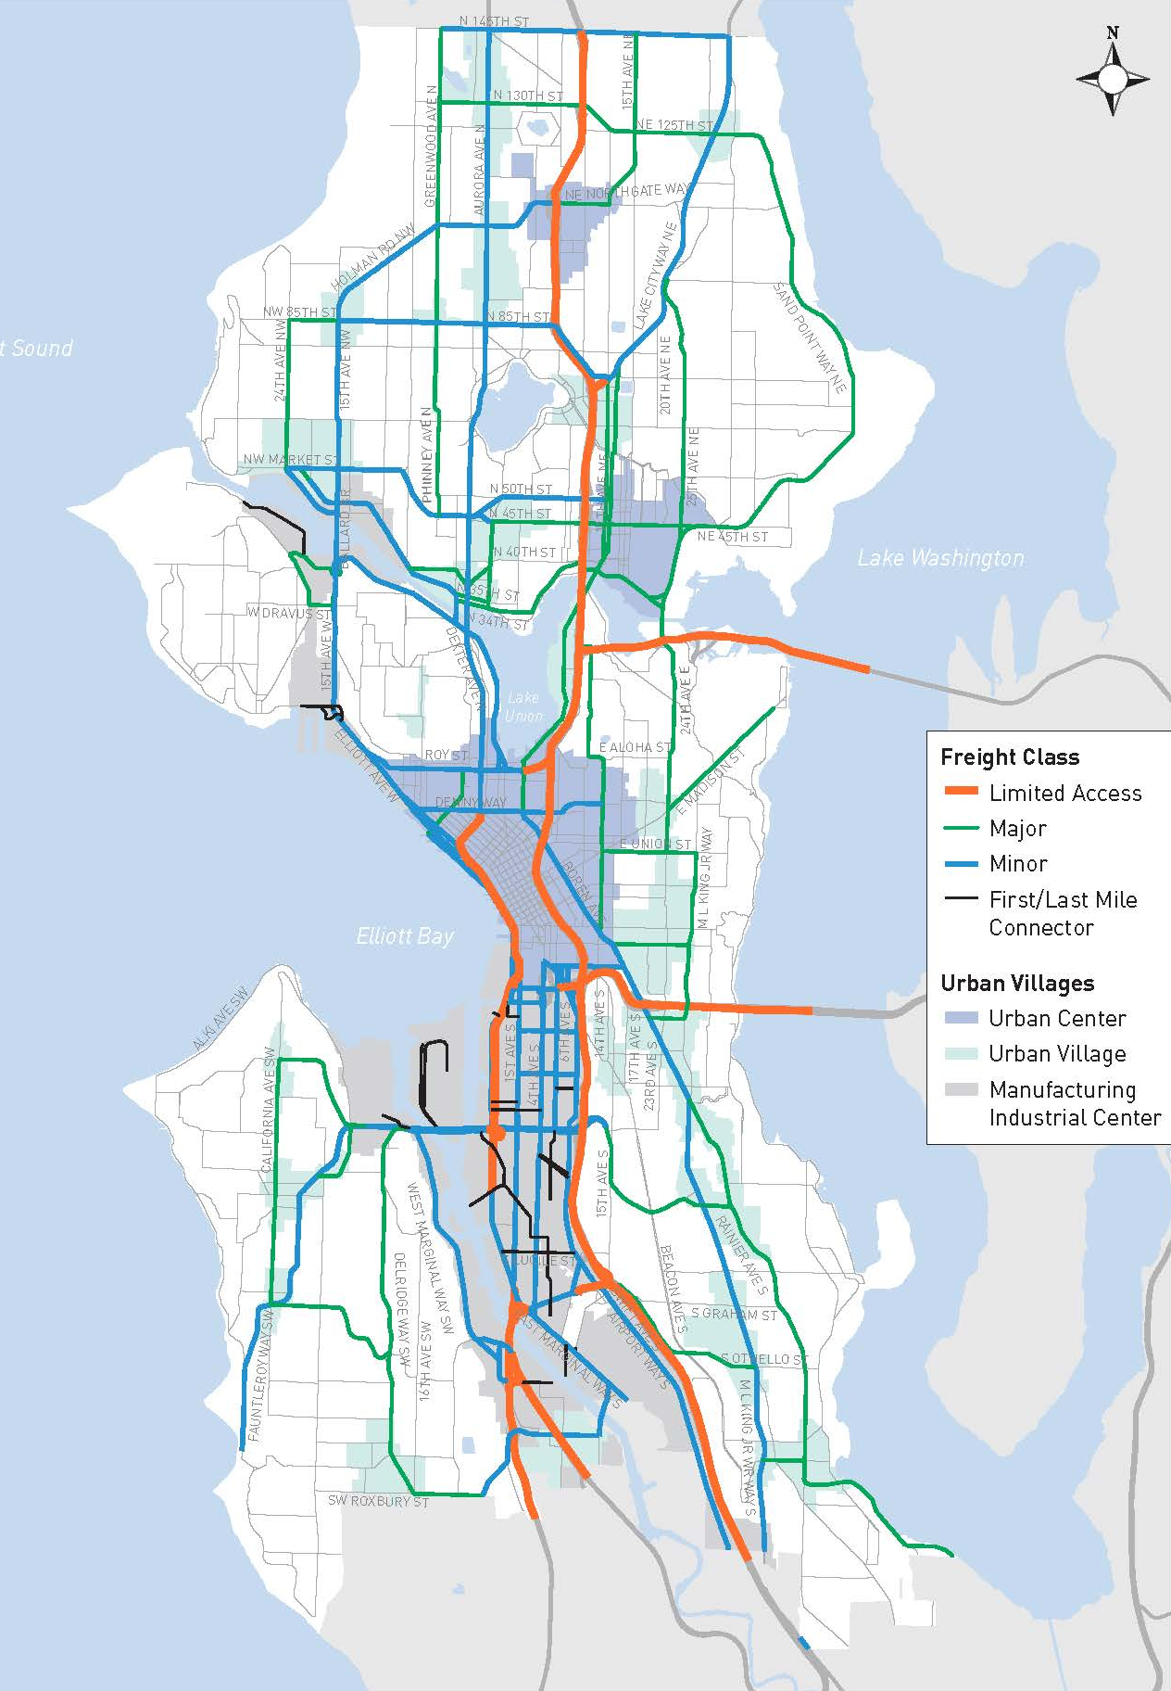
Existing network
Draft network

Slide 6
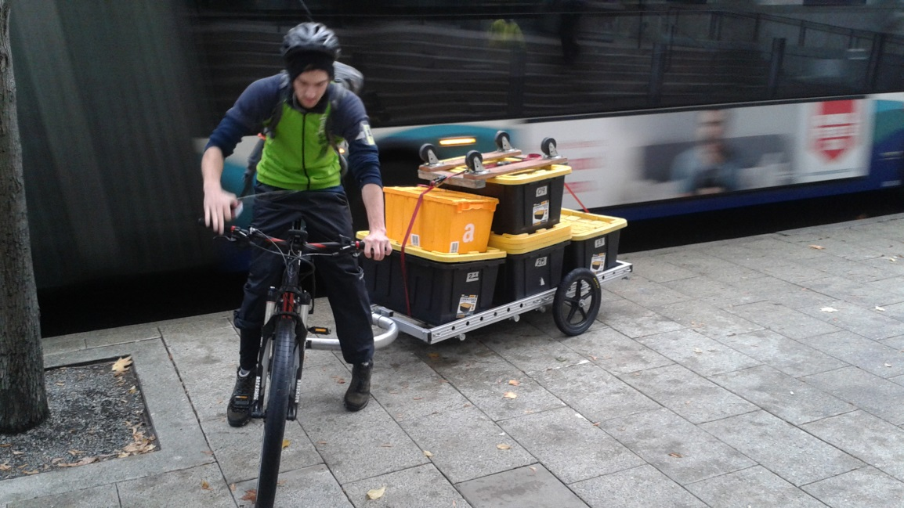
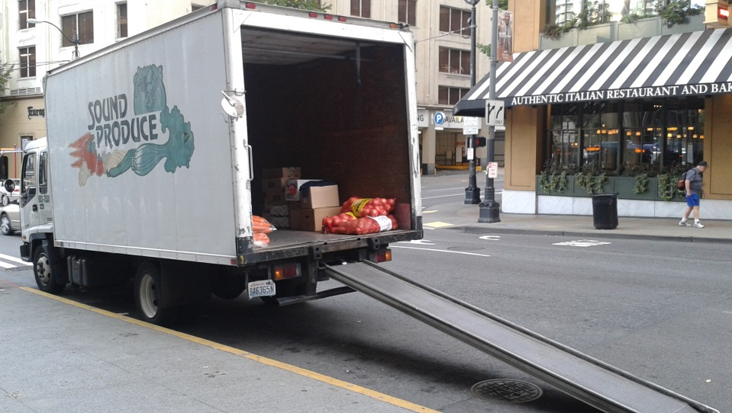
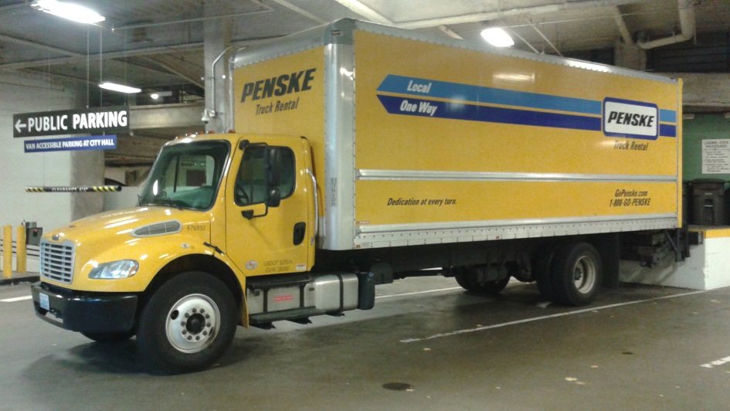
Purpose of truck design guidelines
Outlines basic design considerations for SDOT to accommodate freight
Improve safety and mobility for all users
Focused on truck street designations
Notes:
NOTE: Trucks will be on all streets for goods delivery and truck movements

Slide 7
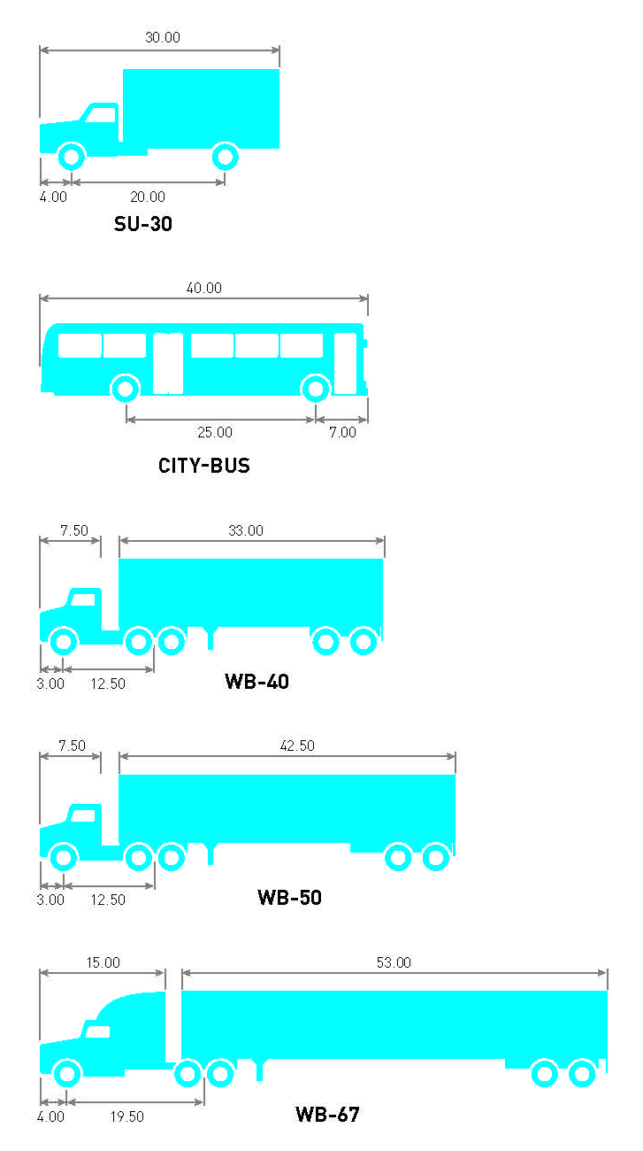
Considerations for truck design guidelines
Truck type, size, volumes
Design for vs. accommodate
Modal overlap
Additional information and detail in the Right-of-Way Improvements Manual (under development)

Slide 8
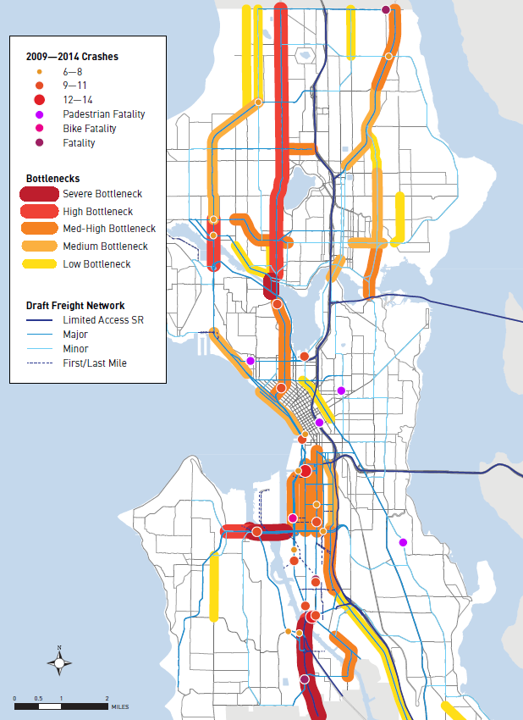
New freight project concepts
Perform bottleneck and truck collision analysis
Map freight projects from previous planning efforts (Move Seattle, Large Capital, FAP, etc.)
Identify locations without freight improvements
Recommended ideas/solutions to improve safety and mobility
FMP Draft includes 55 freight projects

Slide 9
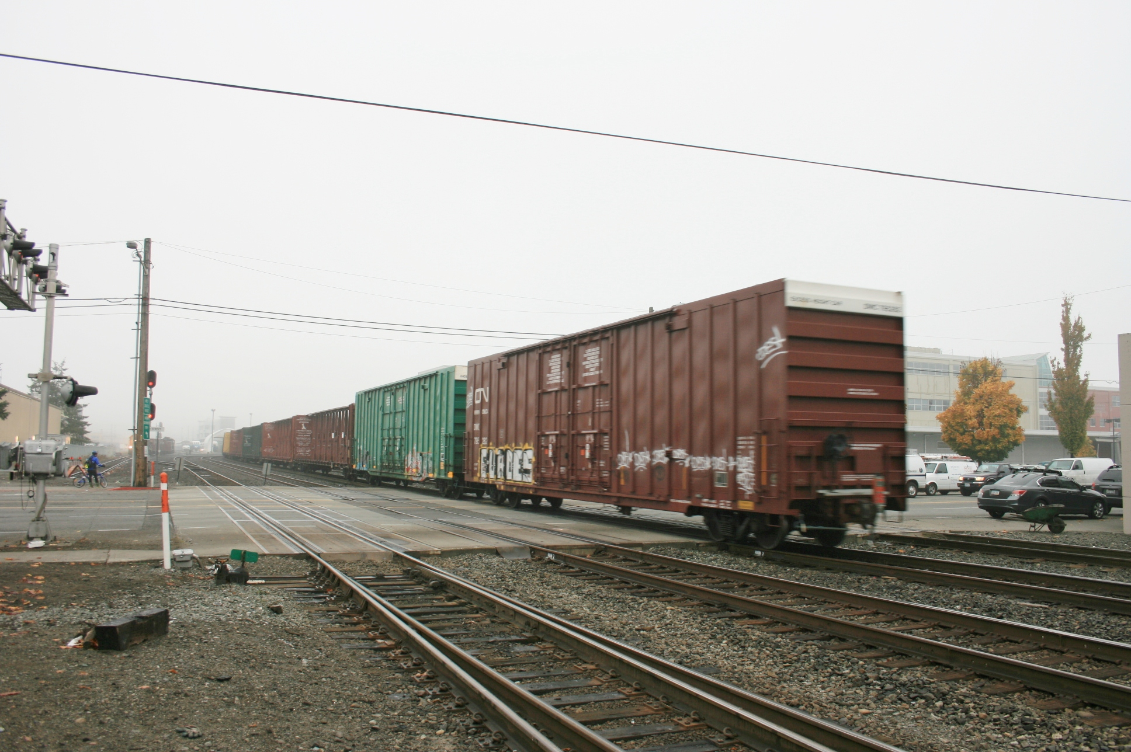
Project prioritization
Determine what projects to build and investments to make in the short, medium and long term
Rank projects based on quantitative and qualitative factors
  Quantitative factors based on the goals of the plan
Notes:
NOTE: Trucks will be on all streets for goods delivery and truck movements

Slide 10
Strategies and actions
Example Strategies
Economy
  Develop an Urban Goods Delivery Strategy
Safety
  Develop a comprehensive freight education program
  Explore programs to install truck side guards on city truck fleet
Mobility
  Expand the city's freight data collection program
  Provide tools to help the freight community navigate the city
State of Good Repair
  Address maintenance and rehabilitation needs on the freight network
Equity and Environment
  Work with communities impacted by goods movement
    Address freight impacts on incompatible land uses through integrated planning and implementation of small-scale projects
Based on plan goals
Will inform FMP implementation
Strategies guide us on how to achieve progress toward realizing the plan goals
Actions are specific tasks for implementation

Slide 11
Status and next steps
 | January | February | March |  | April | May | June
Develop draft plan
Release public review draft plan
Public review
Address comments
Anticipated Mayor’s recommended plan
Notes:
Insert a project timeline. Clarify the process and opportunities for engagement/feedback.

Slide 12





Questions?
Gabriela.Vega@seattle.gov | (206) 733-9029
Ian.Macek@seattle.gov | (206) 684-7576
http://www.seattle.gov/transportation/freight_fmp.htm
http://www.seattle.gov/transportation

