Slide 1
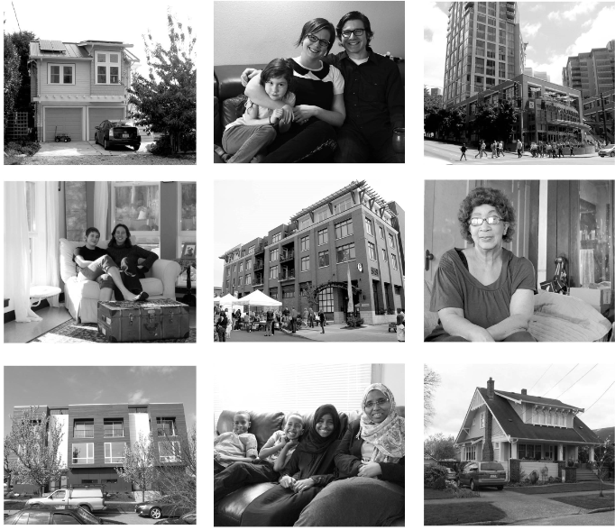
Affordable Housing Impact Mitigation Program
Robert Feldstein, Mayor’s Office of Policy and Innovation
September 10, 2015

Slide 2
Principles of the Grand Bargain Agreement
Two mandatory affordable housing programs for new development:
  Residential: Mandatory Inclusionary Housing (MIH)
  Commercial: Affordable Housing Impact Mitigation Program (also known as the Commercial Linkage Fee)
Commits to a shared production goal of 6,000 units for both programs
Increases development's contribution to affordable housing, while keeping current incentive zoning in place.
Ties new requirements to increases in development capacity
Allows for contribution to be modified if new development capacity cannot be utilized due to city requirements.
Sets up a framework to amend program once implemented
MIH Resolution – Fall 2015
Affordable Housing Impact Mitigation Framework Ordinance – Fall 2015
MIH Framework Ordinance – Early 2016
Zoning changes to activate both programs – 2016 - 2017

Slide 3
Mandatory Inclusionary Housing (MIH) & Affordable Housing Impact Mitigation Program
6,000 affordable housing units in 10 Years
Mandatory Inclusionary Housing
Outside Downtown / SLU
Affordable Housing Impact Mitigation Program
Downtown / SLU
$129M or
= 1,600 Units
$153M or
= 1,900 Units
$23M or
= 300 Units
$67M or
= 800 Units
Mandatory Inclusionary Housing
Downtown / SLU
Affordable Housing Impact Mitigation Program
Outside Downtown / SLU
1,500 Units Built
Mandatory Inclusionary Housing Performance.
On or Off Site Affordable Housing Units Built.
Note: Assumes leverage from other sources is used to translate fees collected to units built.

Slide 4
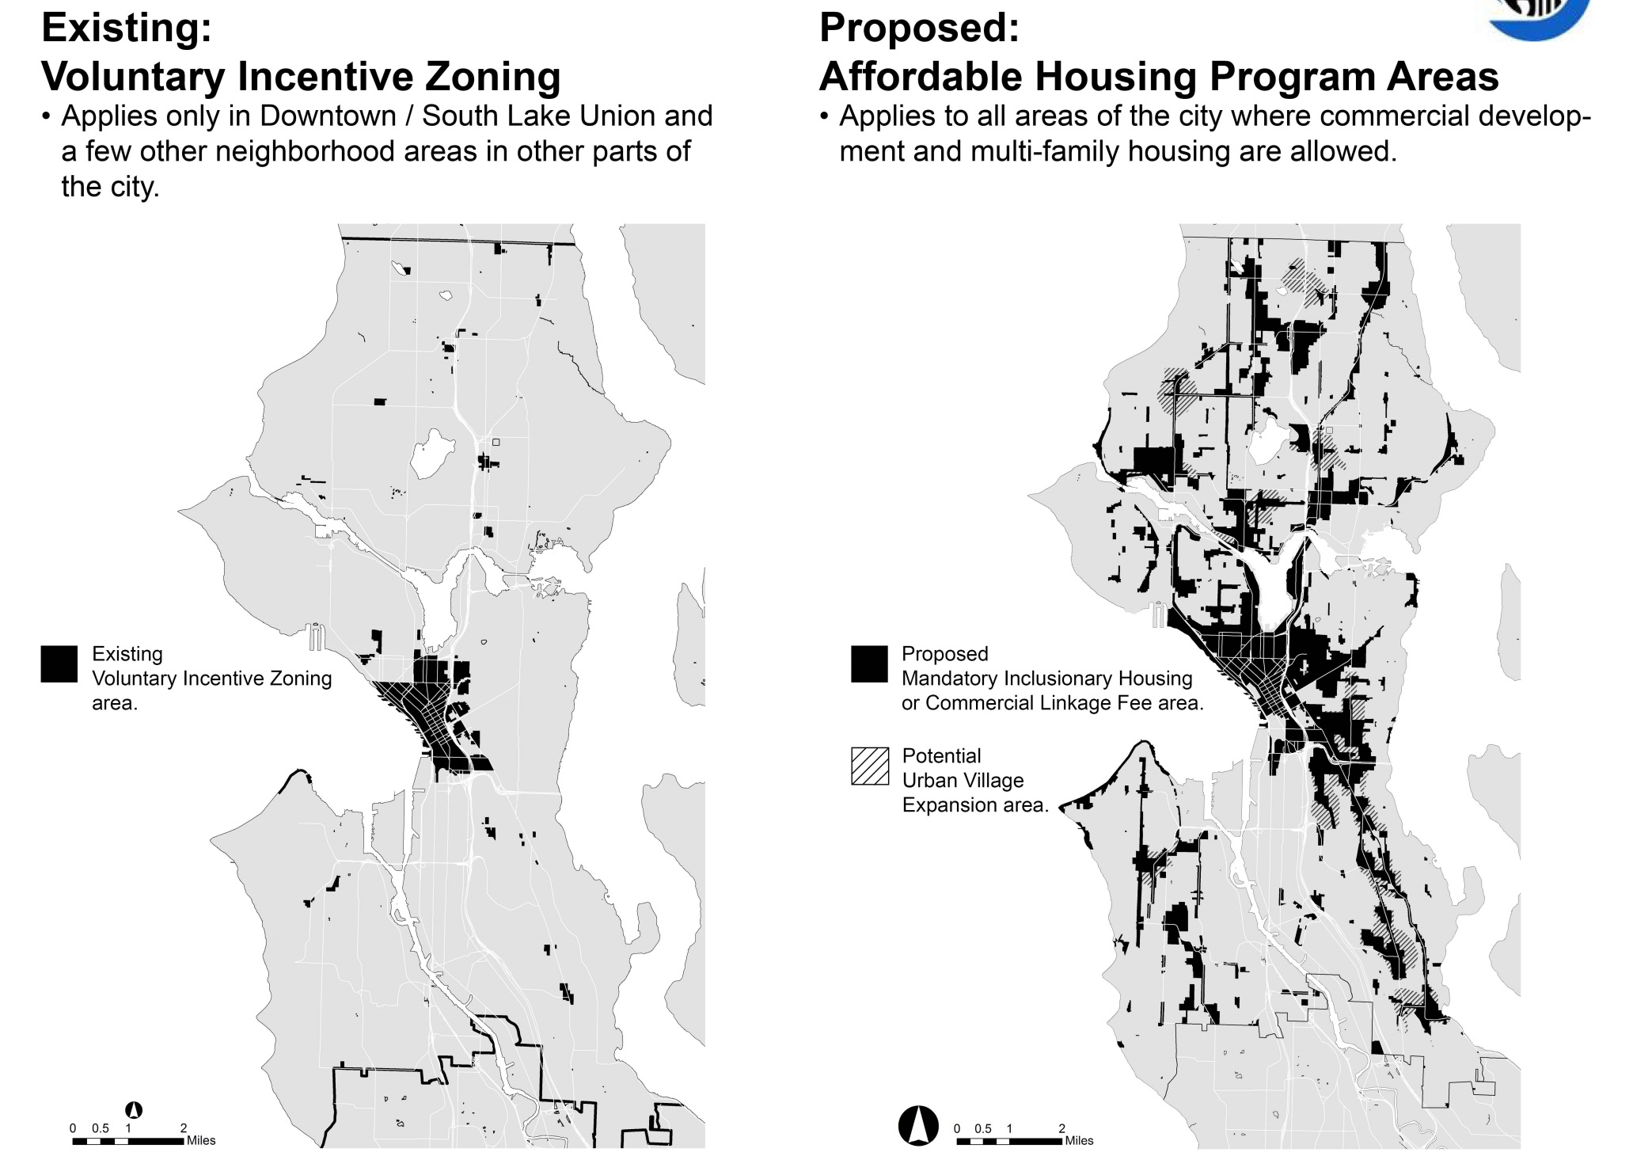

Slide 5
Affordable Housing Impact Mitigation Program

Slide 6
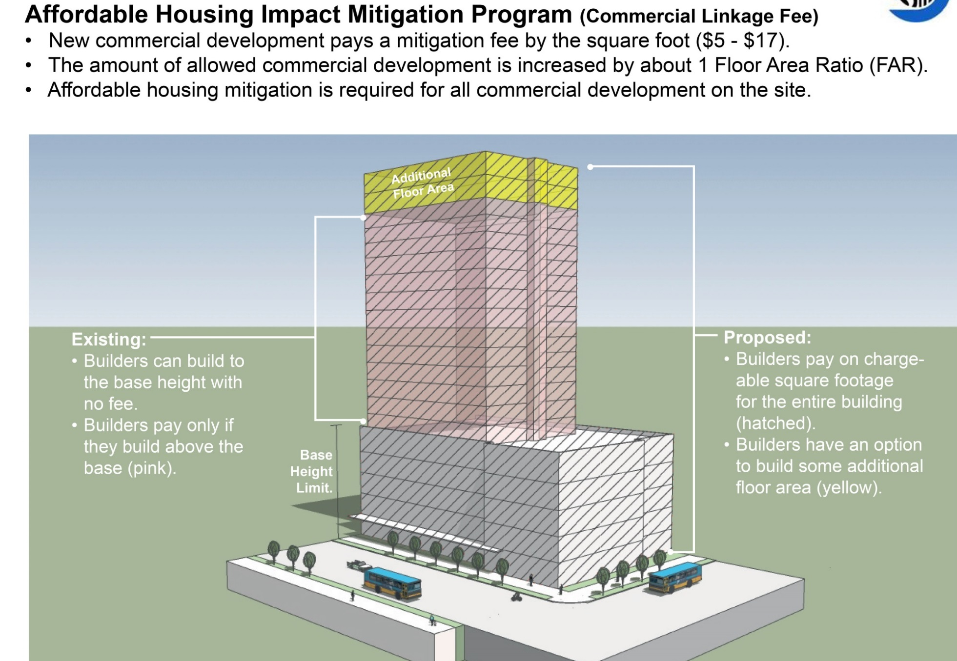
Affordable Housing Impact Mitigation Program (Commercial Linkage Fee)
New commercial development pays a mitigation fee by the square foot ($5 - $17)
The amount of allowed commercial development is increased by about 1 Floor Area Ratio (FAR) in Downtown/SLU and about one story in other locations.
Affordable housing mitigation is required for all commercial development on the site.
(gray).
Limited participation by commercial development outside Downtown/SLU.
floor area or height (yellow).

Slide 7
Affordable Housing Impact Mitigation Program (AHIMP)
Applies to developments with > 4,000 square feet of new chargeable floor area devoted to commercial uses
Does not apply to institutional uses, but Incentive Zoning will still apply in eligible locations
Exemptions for first 4,000 sf of street-level retail and all required street-level retail on pedestrian designated streets in primarily residential buildings
Requires cash contribution to the Office of Housing for capital investment in preserving or producing affordable housing (rental ≤ 60% AMI, ownership ≤ 80% AMI), or provision of onsite or offsite rental housing affordable to households ≤ 60% AMI
Developments are subject to the greater of Affordable Housing Impact Mitigation Program or Incentive Zoning requirements

Slide 8
Affordable Housing Impact Mitigation Program
Setting of Mitigation Amount – Downtown / SLU
Consistent methodology across Downtown/SLU based on Grand Bargain agreement
  Maintains amount of Incentive Zoning payment
  Adds higher payment amount for new capacity added
  Spreads payment across the square footage of the entire building
  Minimum of $8 / gsf
Results in an overall increase in a development’s contribution to affordable housing
Different mitigation amount by zone because existing IZ program differs in bonus FAR by zone
Fee is $0 in zones where no additional development capacity will be granted.

Slide 9
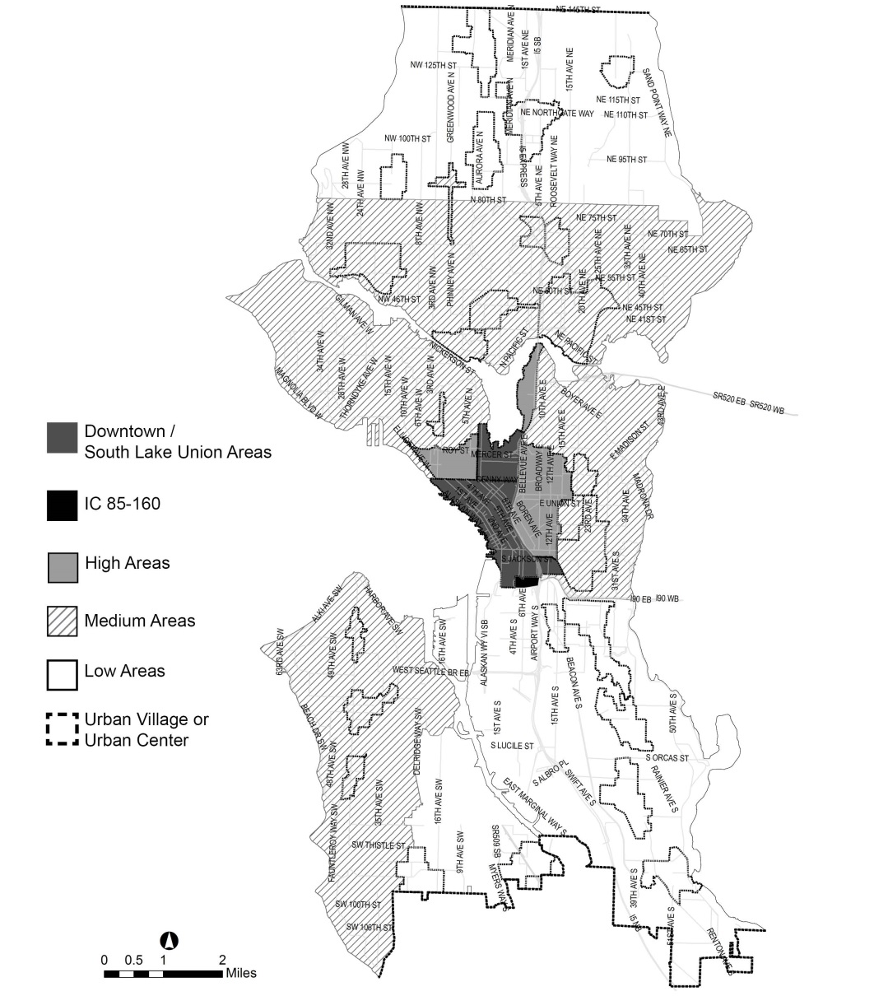
Affordable Housing Impact Mitigation Program
Setting of Mitigation Amount – Outside Downtown / SLU
Varies by geographic area to recognize the feasibility of development in different markets in the city
  $5/ gsf in low cost markets
  $7/ gsf in medium cost markets
  $8/ gsf in higher cost markets

Slide 10
Affordable Housing Impact Mitigation Program
Activating the Program
Program is linked to providing additional development capacity through zoning changes and is activated when the program (Chapter 23.58B) is specifically referred to within the provisions of a zone
Reference to 23.58B will be added when
  Land Use Code or Land Use Map amendments are made to increase commercial development capacity
  Zoning changes are sought through contract rezones
Does not apply to residential zones (LR, MR, HR, RSL, SF), industrial zones (IB, IG) or the Master Planned Community – Yesler Terrace (MPC-YT) zone.
Minor deviations from Development Standards allowed within defined limits to take advantage of new additional capacity (e.g. lot coverage, setbacks, etc.)
  Applicant may apply for fee reduction if it demonstrates additional capacity is still not useable even with development standard modifications.

Slide 11
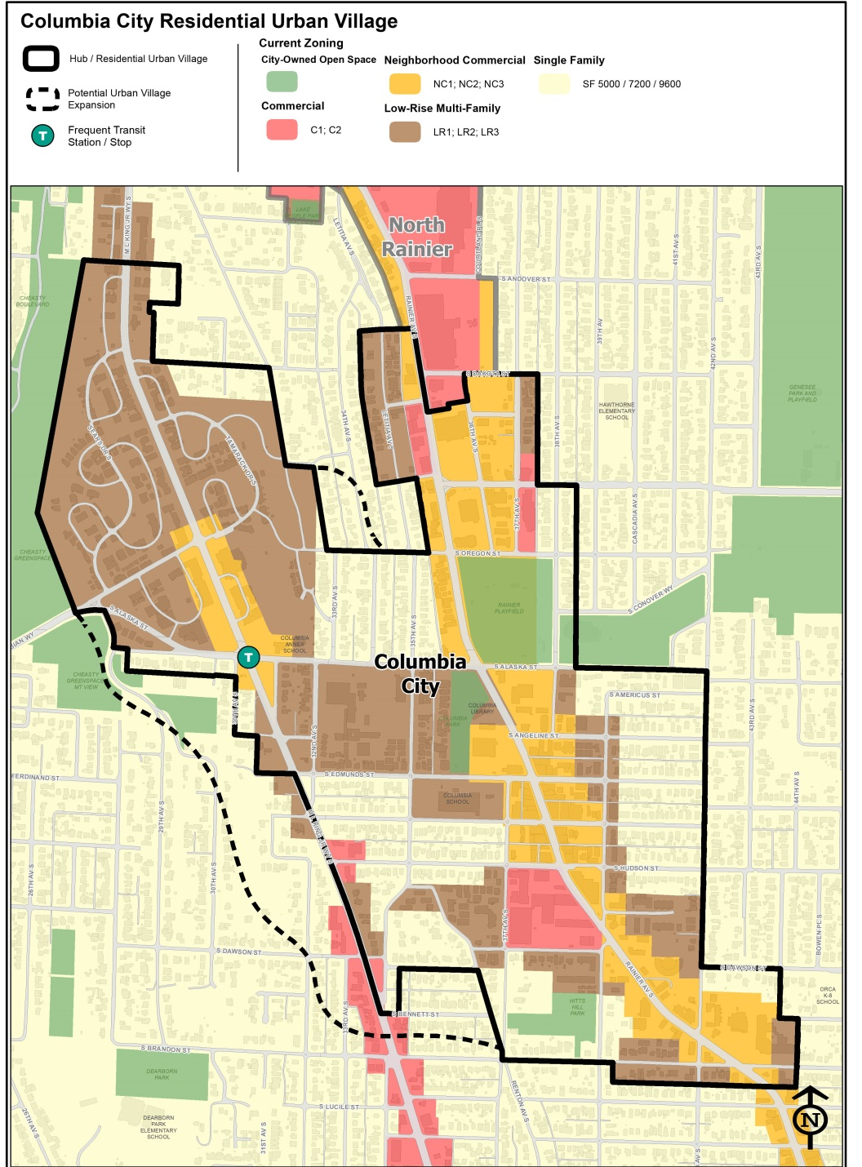
Example of Potential Zoning Changes
in an Urban Village to activate Mandatory Affordable Housing Programs
Existing Lowrise Multifamily Zoning
Increase amount of FAR, allowable density, or 1 extra story of height.
Existing Lowrise Neighborhood Commercial Zoning
Increase amount of FAR and 1 extra story of height.
.
SF Zoning Already Within Urban Village
Change to Lowrise, Residential Small Lot (RSL) zoning, or Midrise (MR) depending on neighborhood context.
SF Zoning Within Transit Walkshed
Evaluate change to Residential Small Lot (RSL) or Lowrise.
SF Zoning Other Areas
No change.

Slide 12
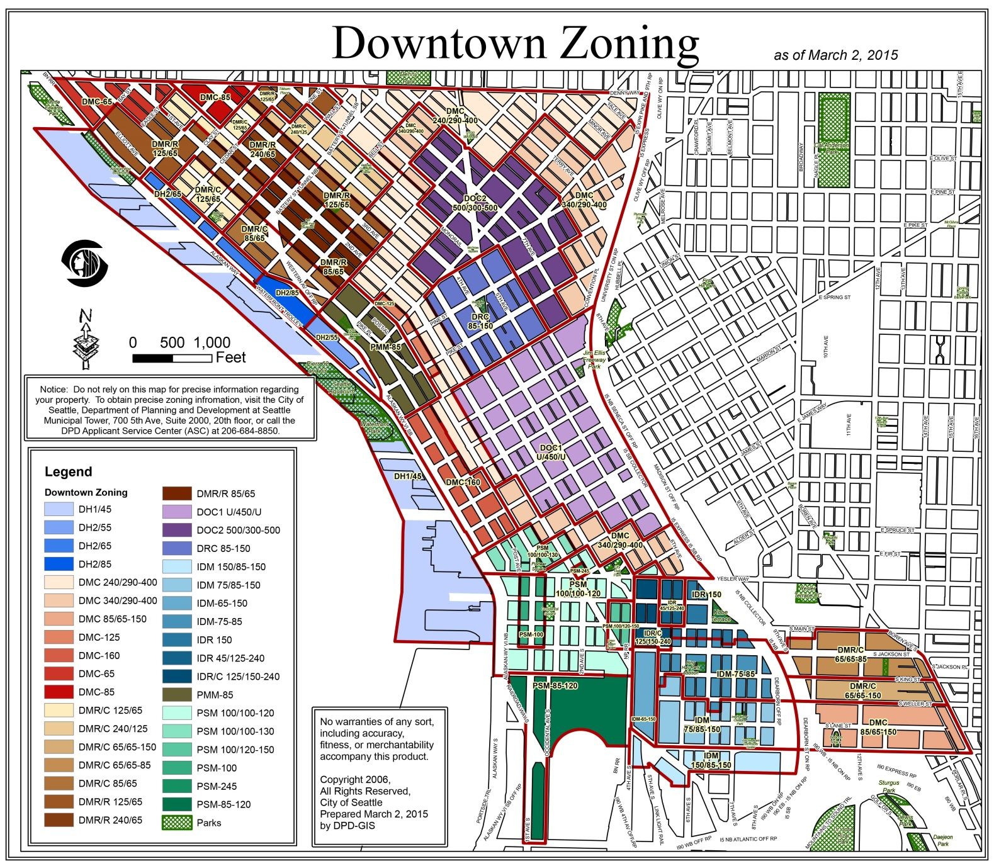
Example of Potential Zoning Changes
in Downtown / SLU to Activate Mandatory Affordable Housing Programs
Most Downtown Zones
Increase allowed FAR by ~1.0, or allowed residential floor plate size by 1,000 sq. ft.
Some Constrained Zones
No increase in commercial capacity. Examples: Harborfront zones, Pike Market Mixed, SLU Lakefront blocks
.

Slide 13
Affordable Housing Impact Mitigation Program
A steady and predictable program is a key component of the ‘Grand Bargain’ agreement
Initial Implementation Phase (through 2017)
  May change fees in table as increases in development capacity are further refined through 2017.
Ongoing Review (2018)
  May adjust fees should modeling of MIH and Impact Mitigation Programs drop below shared goal of 6,000 units
Post Implementation Review
  Amendments subject to a Technical Review Committee process and considered if:
    After 5 years, there is a failure to meet expectations of program performance
    There are significant positive or negative changes in the real estate market
    Neither of above, but 10 years has passed since implementation of program

Slide 14
Legislation Schedule for activating Mandatory Affordable Housing Programs
Legislation Schedule
Fall 2015 | Affordable Housing Impact Mitigation Framework Ordinance
Q1 2016 | Mandatory Inclusionary Housing Framework Ordinance
Q1 2016 | Zoning changes in Downtown, South Lake Union and 23rd Avenue
Q2 2016 | University District Zoning Changes
Q3 2016 | Seattle 2035 and consideration of Urban Village boundary changes
Q3 2016 | Zoning changes in coordination with Uptown and Rainier Beach area planning
Q2 2017 | Zone-wide changes to Commercial and Neighborhood Commercial, Multifamily zones, and single family areas in urban villages.
Ongoing Community Outreach and Engagement

