Slide 1
Seattle Planning Commission
October 12, 2016

Slide 2
Growth with affordability
What is Mandatory Housing Affordability?
  One of the 60+ recommendations of the HALA Advisory Committee
  Requires multifamily and commercial development to contribute to affordable housing
  Zoning changes required to put MHA into effect
Two-step implementation
  Framework legislation for MHA-Commercial (November 2015) and MHA-Residential (August 2016)
  Zoning changes everywhere MHA will apply
    Existing multifamily and commercial zones
    Single-family zones in urban villages
    Urban village expansion areas

Slide 3
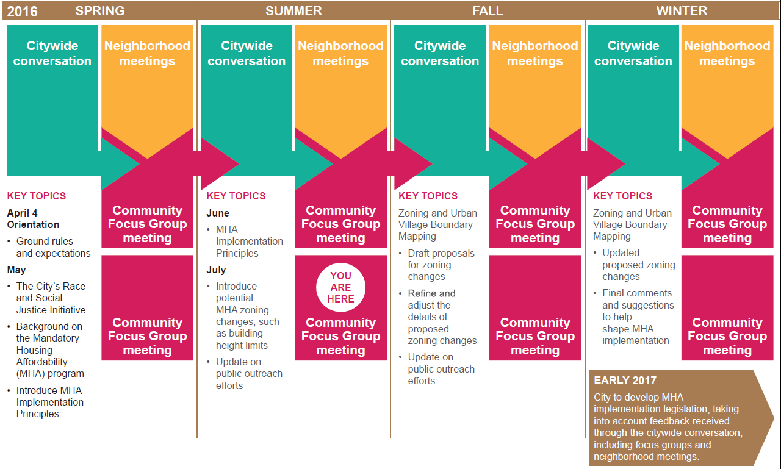
Where we’ve been
NOW

Slide 4
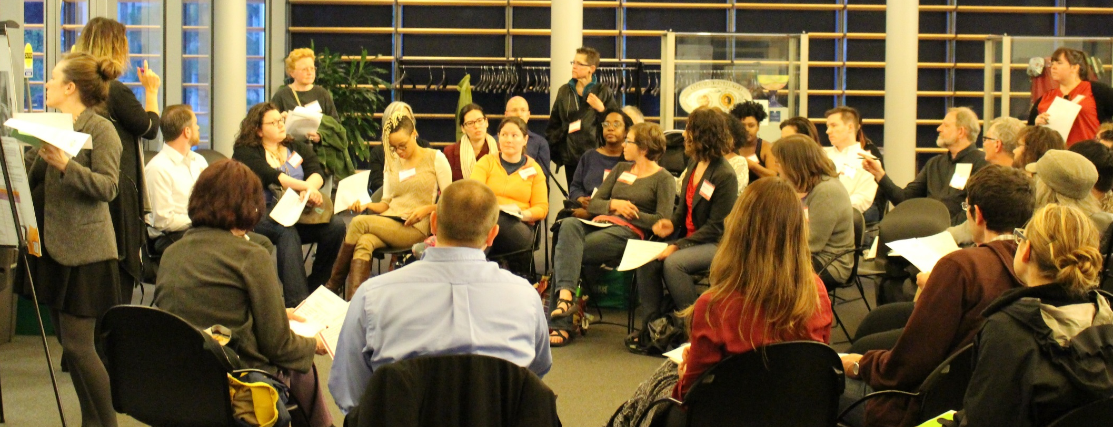
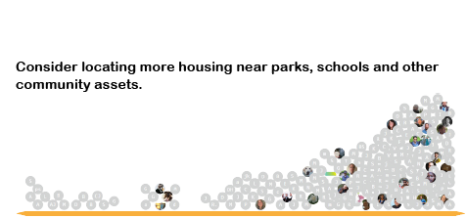
MHA Principles
A. Principles that form the foundation of MHA
  MHA will produce 6,000 affordable homes
  Allow a variety of housing types in existing single-family zones in urban villages
B. Community-based principles that will guide MHA implementation
  e.g., Plan for transitions between higher- and lower-scale zones
  e.g., Encourage a wide variety of housing options, including family-sized units
Consider.it
Focus Group

Slide 5
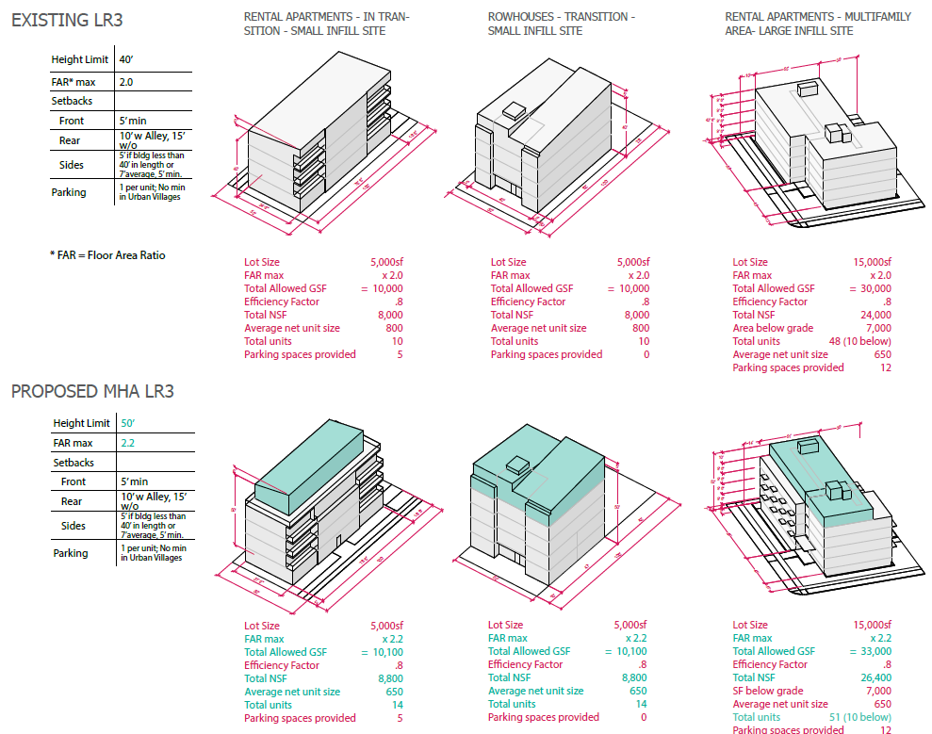
Typical MHA zone changes

Slide 6
Selective MHA zone changes
Rezones of single-family areas in urban villages
  Changes from Single Family to RSL, Lowrise, or in limited cases Neighborhood Commercial
Boundaries for expanded urban villages
  Specific urban village expansions based on Seattle 2035.
Points of local input and community preference
  e.g., Focus more investment along a mixed-use corridor
  e.g., Encourage development in a neighborhood “heart”
  e.g., Replace auto-oriented Commercial zoning with Neighborhood Commercial

Slide 7
Principles to Guide MHA Implementation
How the MHA Principles informed the draft zoning maps

Slide 8
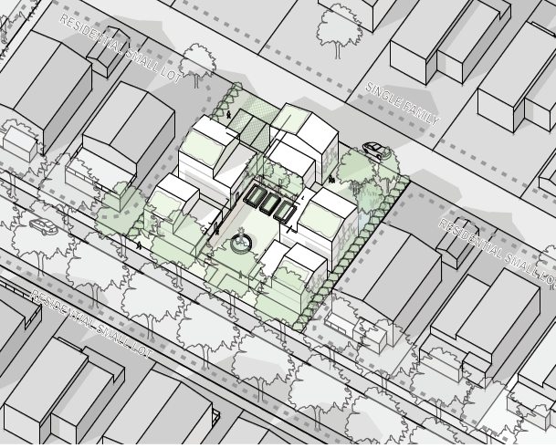
Example: Housing Options
  Encourage or incentivize a wide variety of housing sizes, including family-sized units and not just one-bedroom and studio units.
  Encourage more small-scale multi-unit housing that is family friendly, such as cottages, duplexes, rowhouses or townhouses.
  Applying the Residential Small Lot (RSL) zone and adding a new housing variety standard to the Lowrise 1 zone will provide a range of housing options.

Slide 9
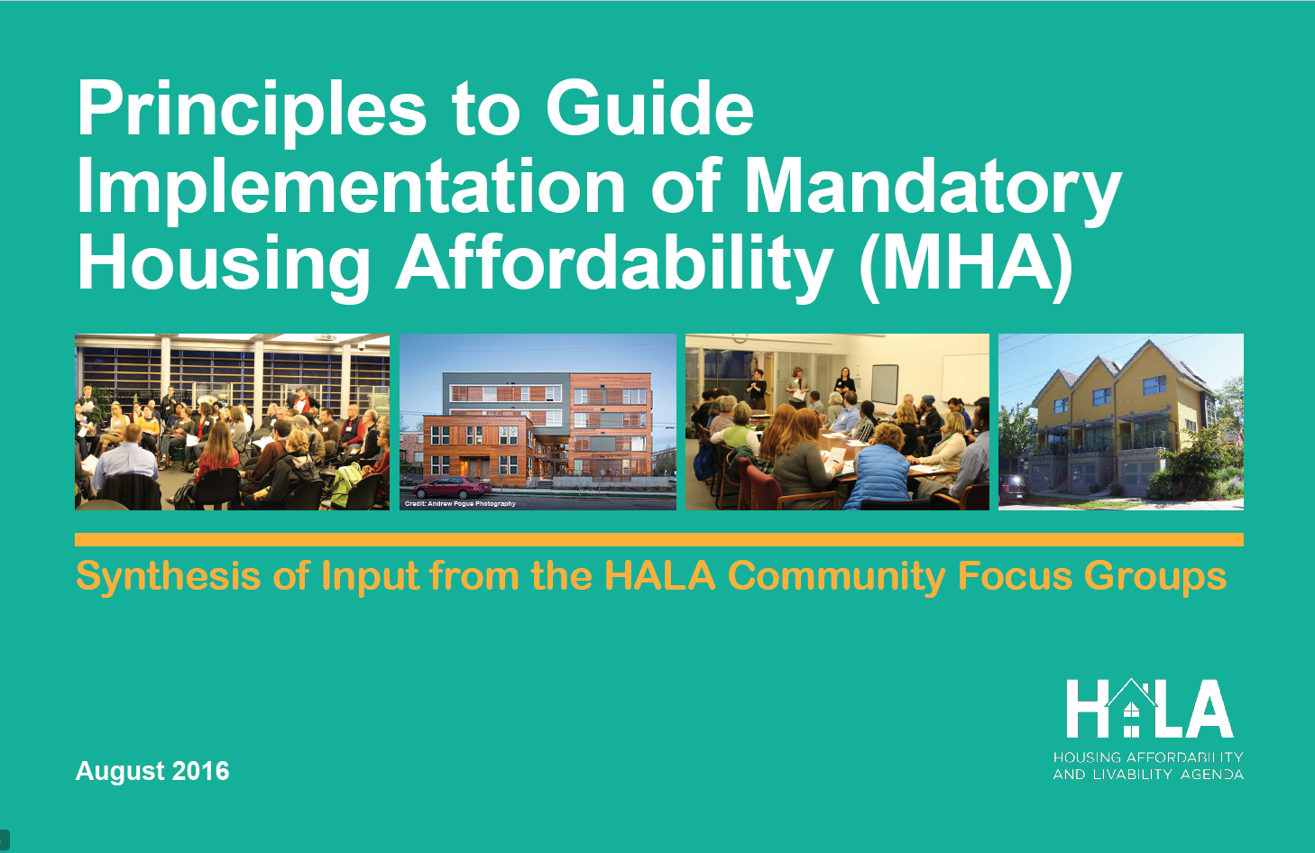
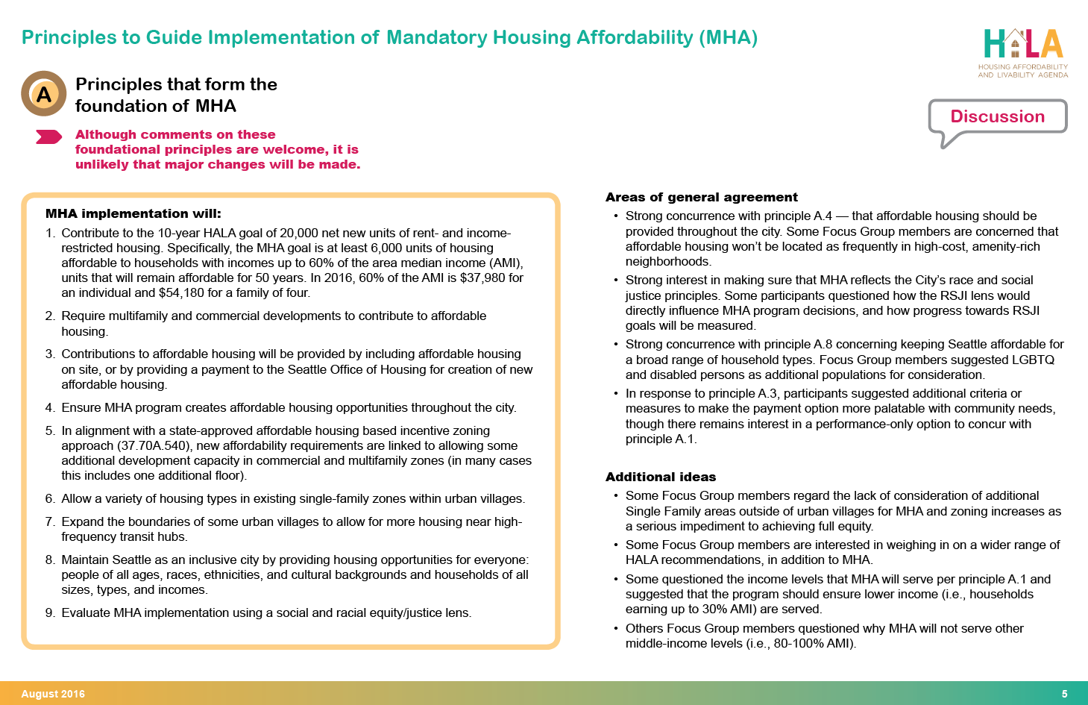
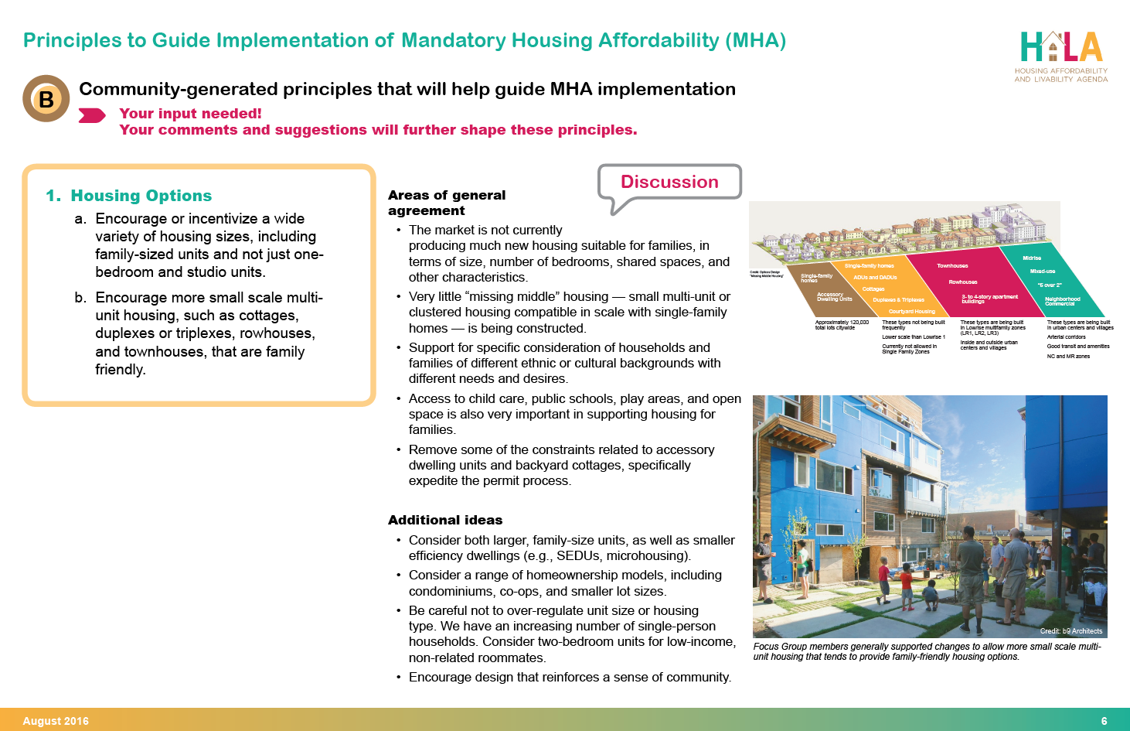
MHA Principles

Slide 10
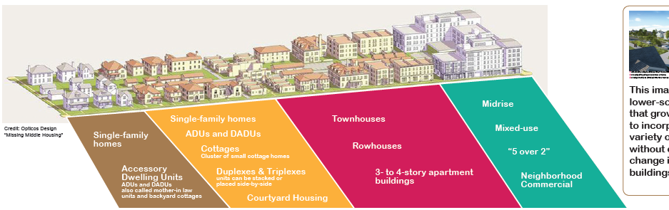
Example: Transitions
Plan for transitions between higher- and lower-scale zones as additional development capacity is accommodated.
  Zone full blocks instead of partial blocks to soften transition.
  Consider using low-rise zones to transition between higher- and lower-scale areas
  Use building setback requirements to create step-downs
  Draft zoning maps reflect the use of different types of transitions that respond to local conditions.

Slide 11
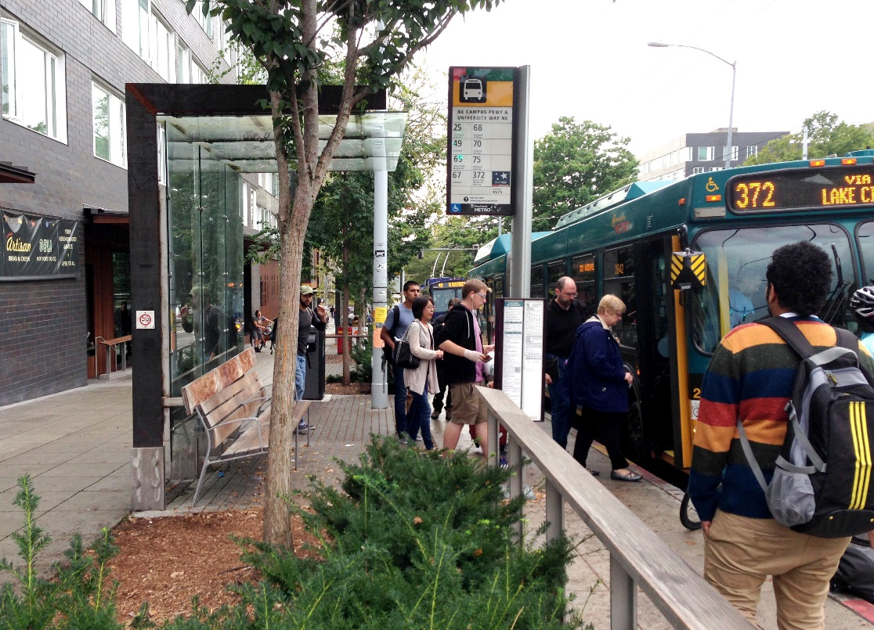
Example: Assets and Infrastructure
Assets and infrastructure
  Consider locating more housing near neighborhood assets and infrastructure such as parks, schools, and transit.
  Draft maps show zoning that allows more housing in locations near parks, transit, and other key neighborhood assets.

Slide 12
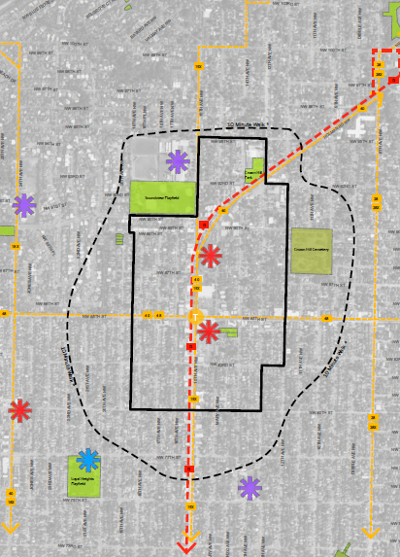
Example: Expansion Areas
Urban Village Expansion Areas
  Implement urban village expansions using 10-minute walksheds similar to those shown in the draft Seattle 2035 Plan update.
  Implement urban village expansions, but with modifications informed by local community members. Consider topography, “natural” boundaries, and varying ranges of mobility.
  Draft maps show a specific proposed urban village boundary expansion instead of the approximate line.

Slide 13
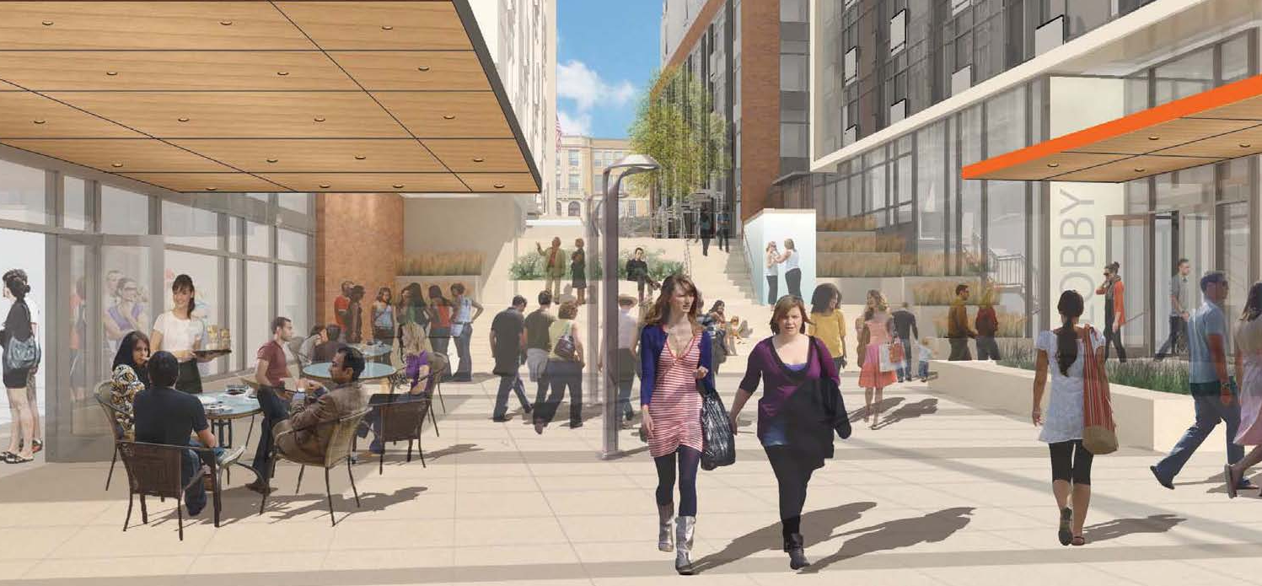
Example: Neighborhood Urban Design
Neighborhood Urban Design
  Consider local urban design priorities when zoning changes are made.
  Draft maps include examples where local design and placemaking preferences inform the placement of draft zone designations.

Slide 14
Key features of the draft zoning maps
Zoning changes to implement Mandatory Housing Affordability (MHA)

Slide 15
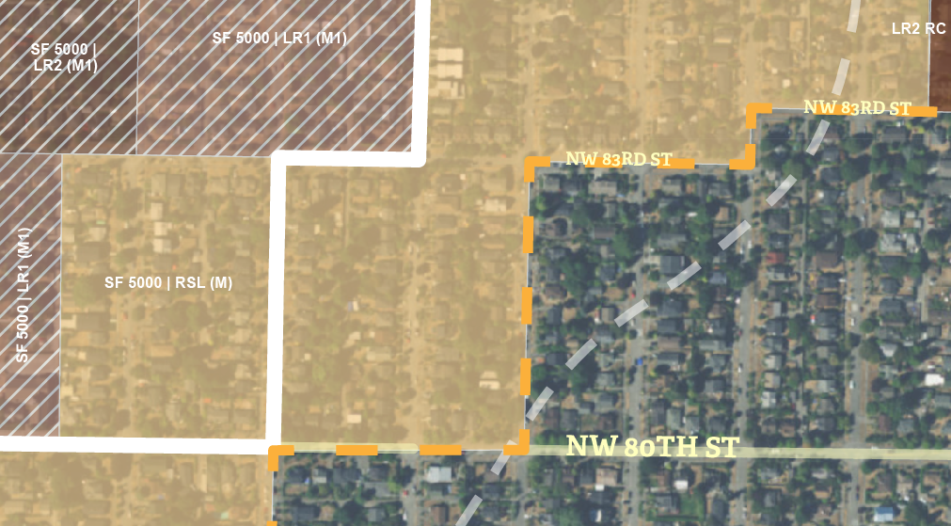
Shaded areas have MHA

Slide 16
Shaded areas have MHA
Zoning changes to put affordable housing requirements into effect
(multifamily, commercial, and single-family zones inside urban village and expansion areas)
No zoning changes and no MHA requirements
(single-family zones outside urban village)

Slide 17
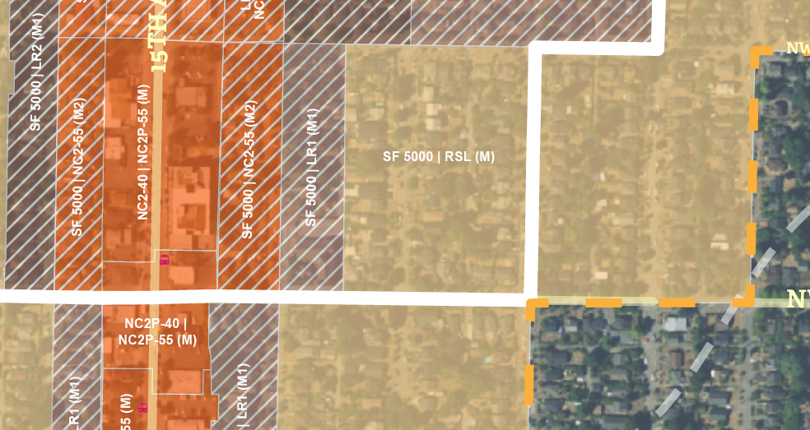
Zone categories

Slide 18
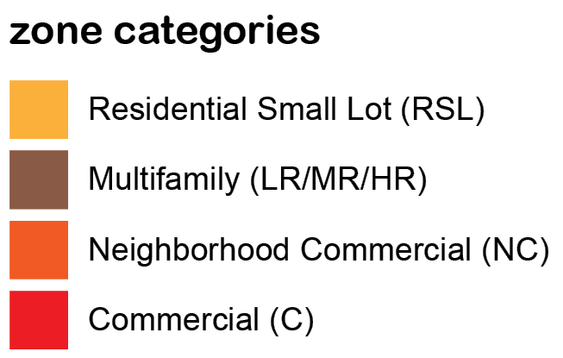
Zone categories

Slide 19
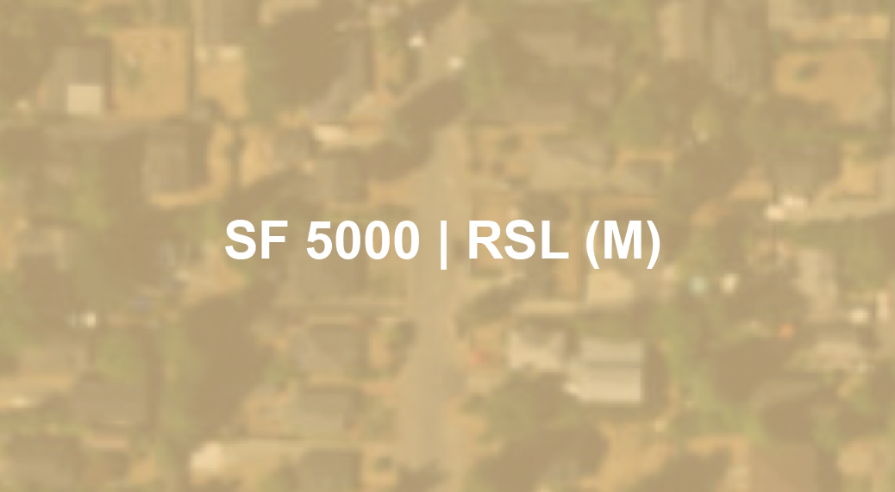
existing | draft proposal

Slide 20
existing | draft proposal
Current zoning:
Single Family 5000
Draft proposal:
Residential Small Lot (RSL)

Slide 21
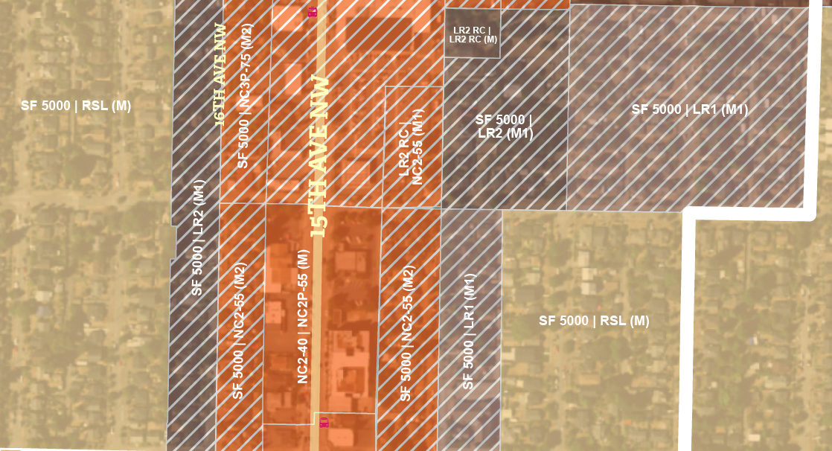
Solid vs. hatched areas

Slide 22
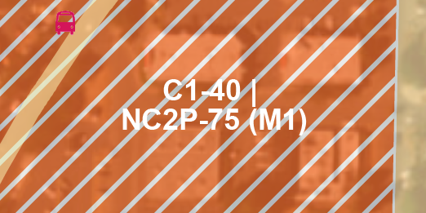
Solid vs. hatched areas
Hatching identifies where the draft map suggests a change from one zoning type to another
(e.g., Commercial to Neighborhood Commercial)

Slide 23
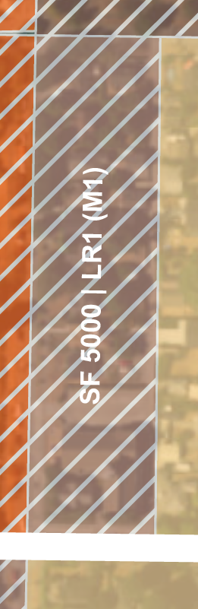
Solid vs. hatched areas
Hatching also indicates a change in zoning beyond the typical development capacity increase
(e.g., Single Family changing to Lowrise 1)

Slide 24
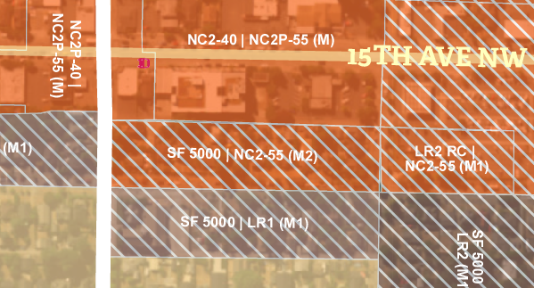
MHA requirements

Slide 25
MHA requirements

Slide 26
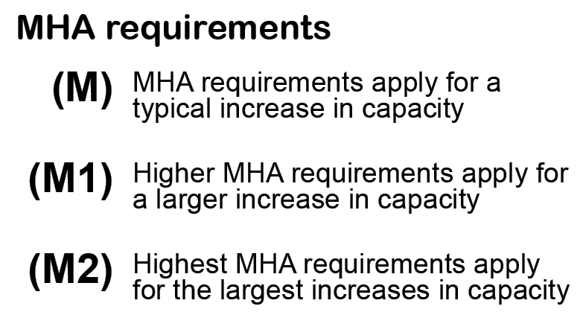
MHA requirements

Slide 27
Urban Village Expansion
Seattle 2035: introduced potential expansions for urban villages with very good transit
  Current and future light rail stations
  Intersection of 2 frequent bus lines serving urban centers
Proposed expansion areas
  Light rail Rainier Beach, Othello, Columbia City, North Rainier, North Beacon Hill, 23rd & Union–Jackson, Roosevelt, NE 130th St
  Frequent bus Crown Hill, Ballard, West Seattle Junction
MHA: zoning changes for single-family areas in urban villages and expansion areas

Slide 28
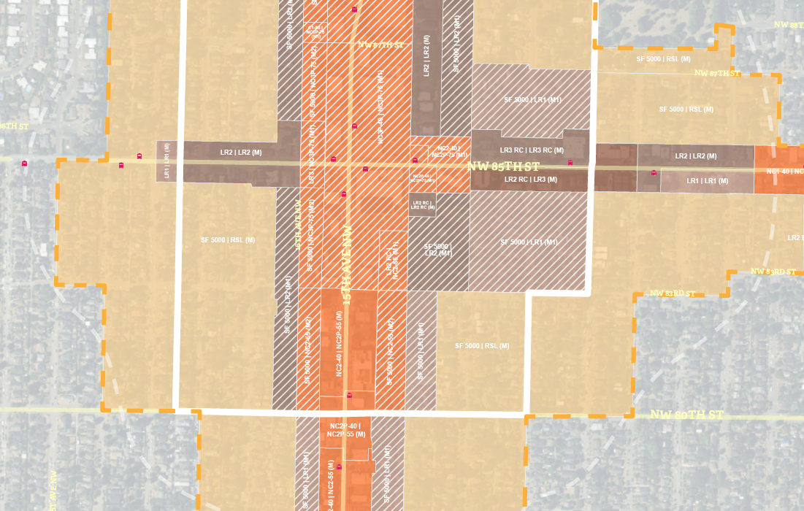
Urban Village Expansion
Current urban village boundary

Slide 29
Urban Village Expansion
Current urban village boundary
Seattle 2035
10-minute walkshed

Slide 30
Urban Village Expansion
Current urban village boundary
Proposed urban village expansion
Seattle 2035
10-minute walkshed

Slide 31
Urban Village Expansion
Expansion areas mostly single-family zoning
  Zoning could change to RSL, Lowrise, or in limited cases Neighborhood Commercial
Refining “approximate” 10-minute walkshed into proposed boundaries
  Guided by MHA Principles
  Follow logical street lines, not cutting through parcels or splitting blocks at alleys
  Consider local conditions (e.g., neighborhood business district, amenities, topography, street network)
  Consider larger expansions in high-opportunity areas, smaller expansions where displacement risk is high

Slide 32
Your feedback
Does the draft zoning map match the principles?
Commercial and Multifamily areas
Are the location and placement and height and scale reasonable and appropriate to implement MHA in this neighborhood?
Single Family rezone areas
Is the Residential Small Lot (RSL) zone proposed in appropriate places?
Are the places where Single Family is changed to Lowrise (LR) appropriate to allow multifamily housing options?
Urban Village expansion areas
Does the draft boundary expansion match an approximate 10-minute walk to the transit hub?
Does the draft urban village boundary reflect local factors and features?

Slide 33
Timeline for review
All urban village draft zoning maps online
Online dialogue at HALA.Consider.It
EIS Scoping Report
October
All urban village draft zoning maps online
Online dialogue at HALA.Consider.It
EIS Scoping Report
November
EIS alternatives with maps
Nov.-Jan.: 5 community meetings
Ongoing public feedback on draft zoning maps
Draft EIS released
November-January
5 community meetings around Seattle
Ongoing public feedback on draft MHA zoning maps
Final EIS released
October
November
December
January
February
March
April

