Slide 1
SEATTLE PLANNING COMMISSION
Thursday, March 12, 2015
3:00 – 5:30 PM
City Hall, Room L280
revised AGENDA
Chair’s Report & Minutes Approval 3:00 – 3:10 PM
Briefing: Proposed University District Comp Plan Annual Amendment 3:10 – 3:25 PM
Commission Staff
Briefing: Equity Appendix 3:25 – 4:35 PM
Nick Welch, DPD and Ryan Curren, OCR
Discussion:
Housing Affordability & Livability Advisory Committee progress 4:35 – 5:25 PM
Public Comment 5:25 – 5:30 PM
ADJOURN 5:30 PM

Slide 2
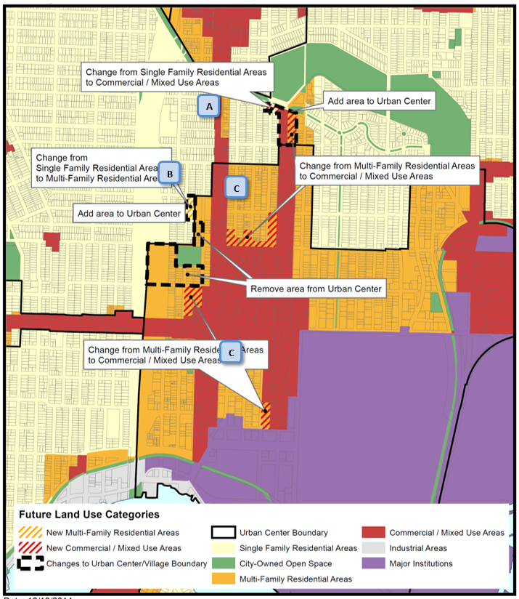
Comp Plan Amendments – U-District
Change Single-family Residential to Mixed Use/Commercial and add to Urban Center
Change from Single Family Residential to Multi Family Residential and add to Urban Center – Also, remove from Urban Center but maintain Multi Family on the FLUM
Change from Multi-Family Residential to Mixed Use/Commercial within the Urban Center

Slide 3
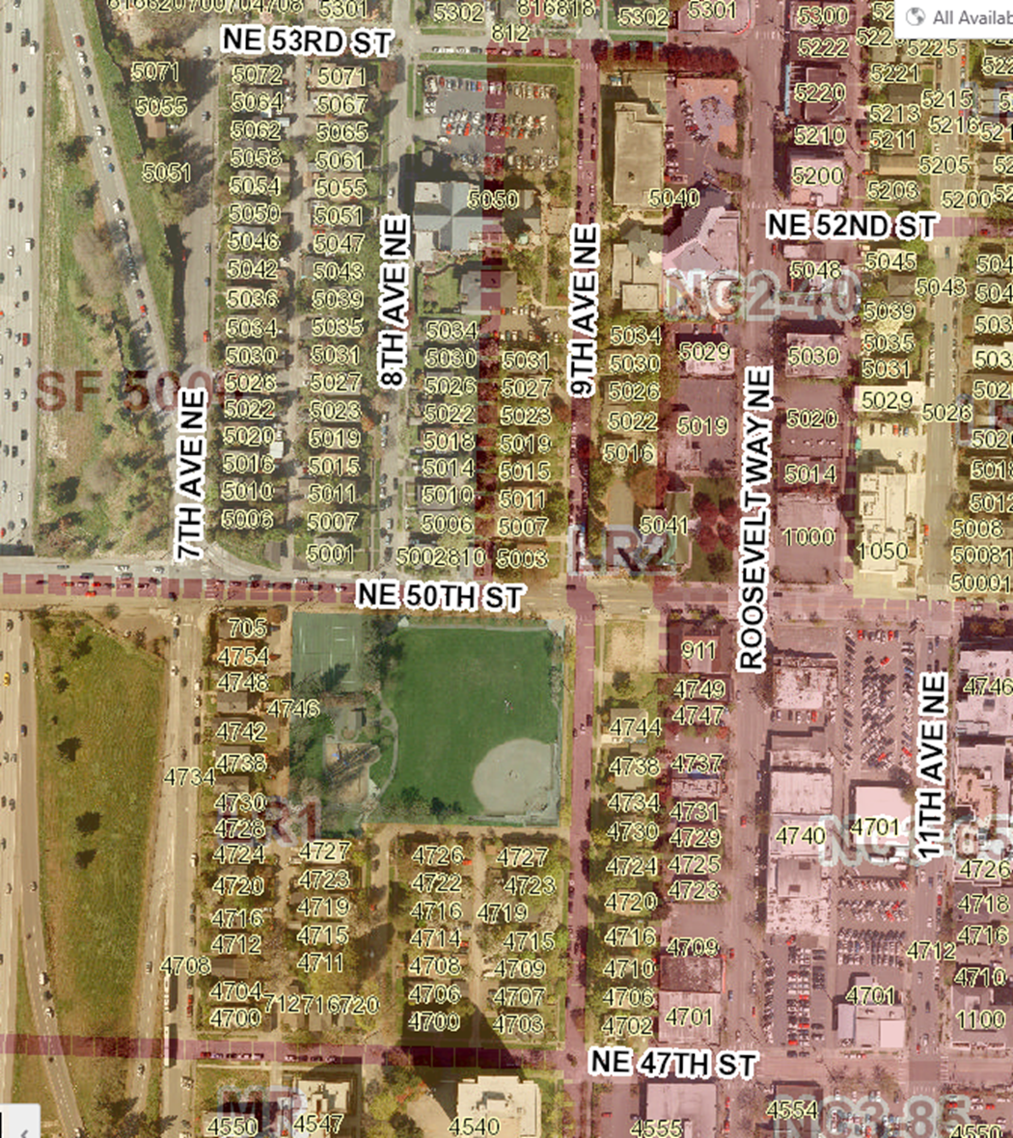
Split Parcel – include in Urban Center
Remove Area from Urban Center

Slide 4
FLUM Comments
Criteria for removing land from Urban Village or Center should be created and this amendment should hold until this work can be done.
Concern with naturally occurring affordable housing as justification
Concern with green space no longer being encompassed by the Urban Center
Supportive of flexibility within Urban Center

Slide 5
Goals and Policy Comments
Consistency with style guide – one goal, set of policies
Several goals are written as policies and are unclear to the reader
Policies are too prescriptive and link back to Comprehensive Plan policies that at the very least will change numbers in the major update
Concern with the use of the word single-family as an aspiration in an Urban Center
Concern with use of the word church in policy

Slide 6
Next Steps
Both the U-District and the Annual Amendments package have been appealed
No longer at PLUS in March, likely early summer
Action on letter will be postponed until we know which amendments will go forward

Slide 7
Housing Affordability and Livability Agenda (HALA)
Advisory Committee

Slide 8
HALA charge
Prioritize strategies that have the most powerful and lasting impact on solving the affordable housing crisis
Prioritize strategies that create housing opportunities for people least served by the housing market
Prioritize strategic actions that can be implemented within 3 years
Advance the City’s Race and Social Justice Initiative
Ground recommendation in data that is responsive to targets of estimated housing needs

Slide 9
HALA charge (continued)
Make recommendations that:
Are informed by public input from a diverse range of viewpoints
Reflect a collective approach that shares responsibility for achieving housing affordability across our community including for-profit and nonprofit developers, the public sector, philanthropic institutions, and employers.
Are a deliberate combination of policies and programs for which the individual merits and impacts have been weighed and balanced together in a holistic approach to addressing the City’s housing needs.

Slide 10
HALA Advisory Committee members
David Wertheimer - Co-Chair
Faith Li Pettis - Co-Chair
Alan Durning
Betsy Braun
Bill Rumpf
Catherine Benotto
Cindi Barker
David Moseley
David Neiman
Don Mar
Estela Ortega
Gabe Grant
Hal Ferris
Jermaine Smiley
Jon Scholes
Jonathan Grant
Kristin Ryan
Lisa Picard
MA Leonard
Maiko Winkler-Chin
Maria Barrientos
Marty Kooistra
Merf Ehman
Mitch Brown
Paul Lambros
Sean Flynn
Sylvester Cann IV
Ubax Gardheere

Slide 11
HALA Work Groups
Financing
New Affordable Housing Resources
Dave Cutler
Zoning and Housing Types
Catherine Benotto and Brad Khouri
Construction Costs and Timelines
Grace Kim
Tenant Access/Protections
Preservation
Sustainable Homeownership

