Slide 1
Seattle Planning Commission
Director’s Report from OPCD
Sam Assefa
Sep 12, 2019

Slide 2
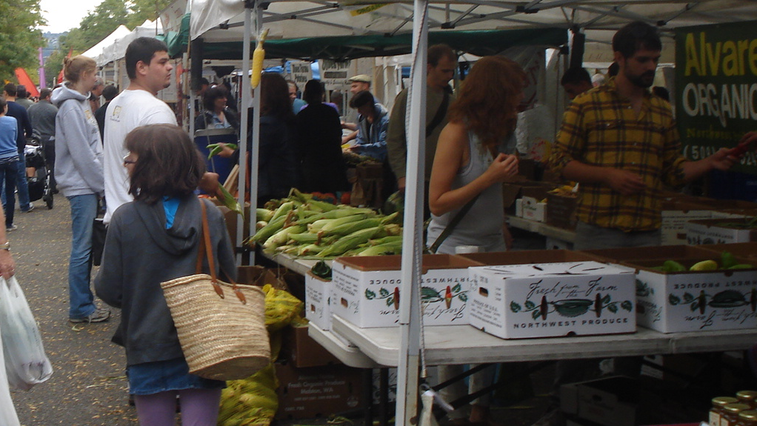
Overview of OPCD 2019 Work Plan
 | 2019 Priorities
 | Duwamish Valley Action Plan Crown Hill Community Plan Westwood / Highland Park Responding to Resolutions / Executive Orders Mt Baker Redevelopment Ballard Design Guidelines Capitol Hill Guidelines ADUs
 | Housing Choices MHA Follow-up Imagine Greater Downtown Public Spaces I-5 Lid Station Area Planning (130th & 145th Station Area / ST3) EDI Program Strategic Investment/Acquisition Industrial Lands Comprehensive Plan

Slide 3
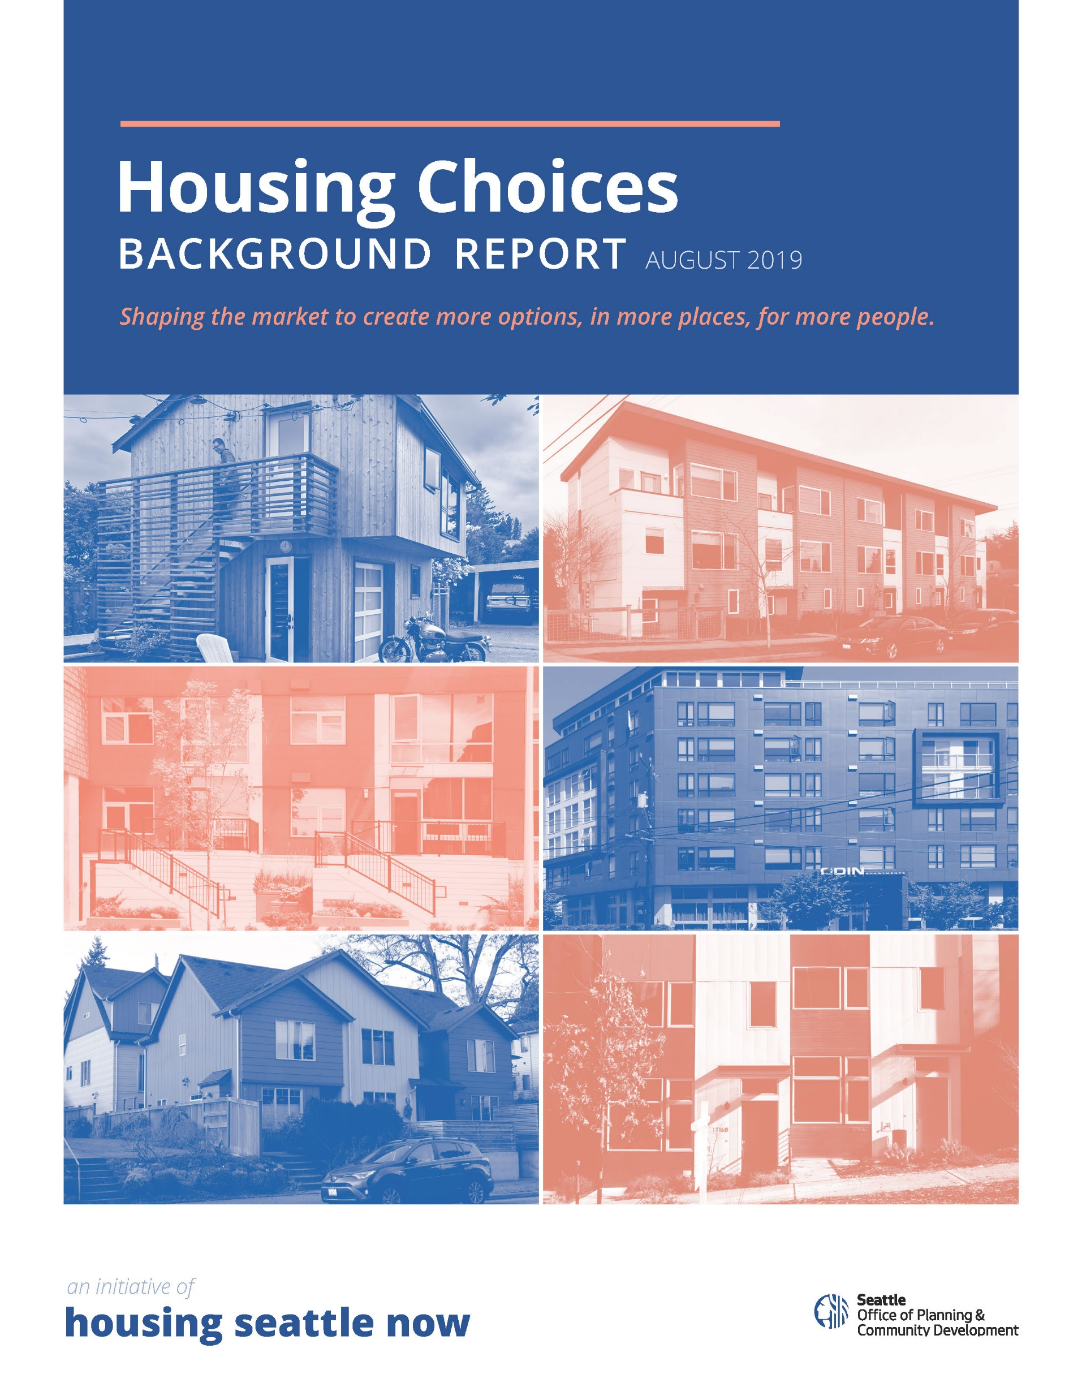
Housing Choices
2019 WORKPLAN
Data-intensive background report released Aug 8
Describes available market-rate housing for rent and ownership
  Who is being served? Who must look elsewhere?
Shaping the market to create more options, in more places, for more people
Will inform the work of the Affordable Middle Income Housing Advisory Committee
AMIHAC recommendations to the Mayor expected in late 2019, early 2020

Slide 4
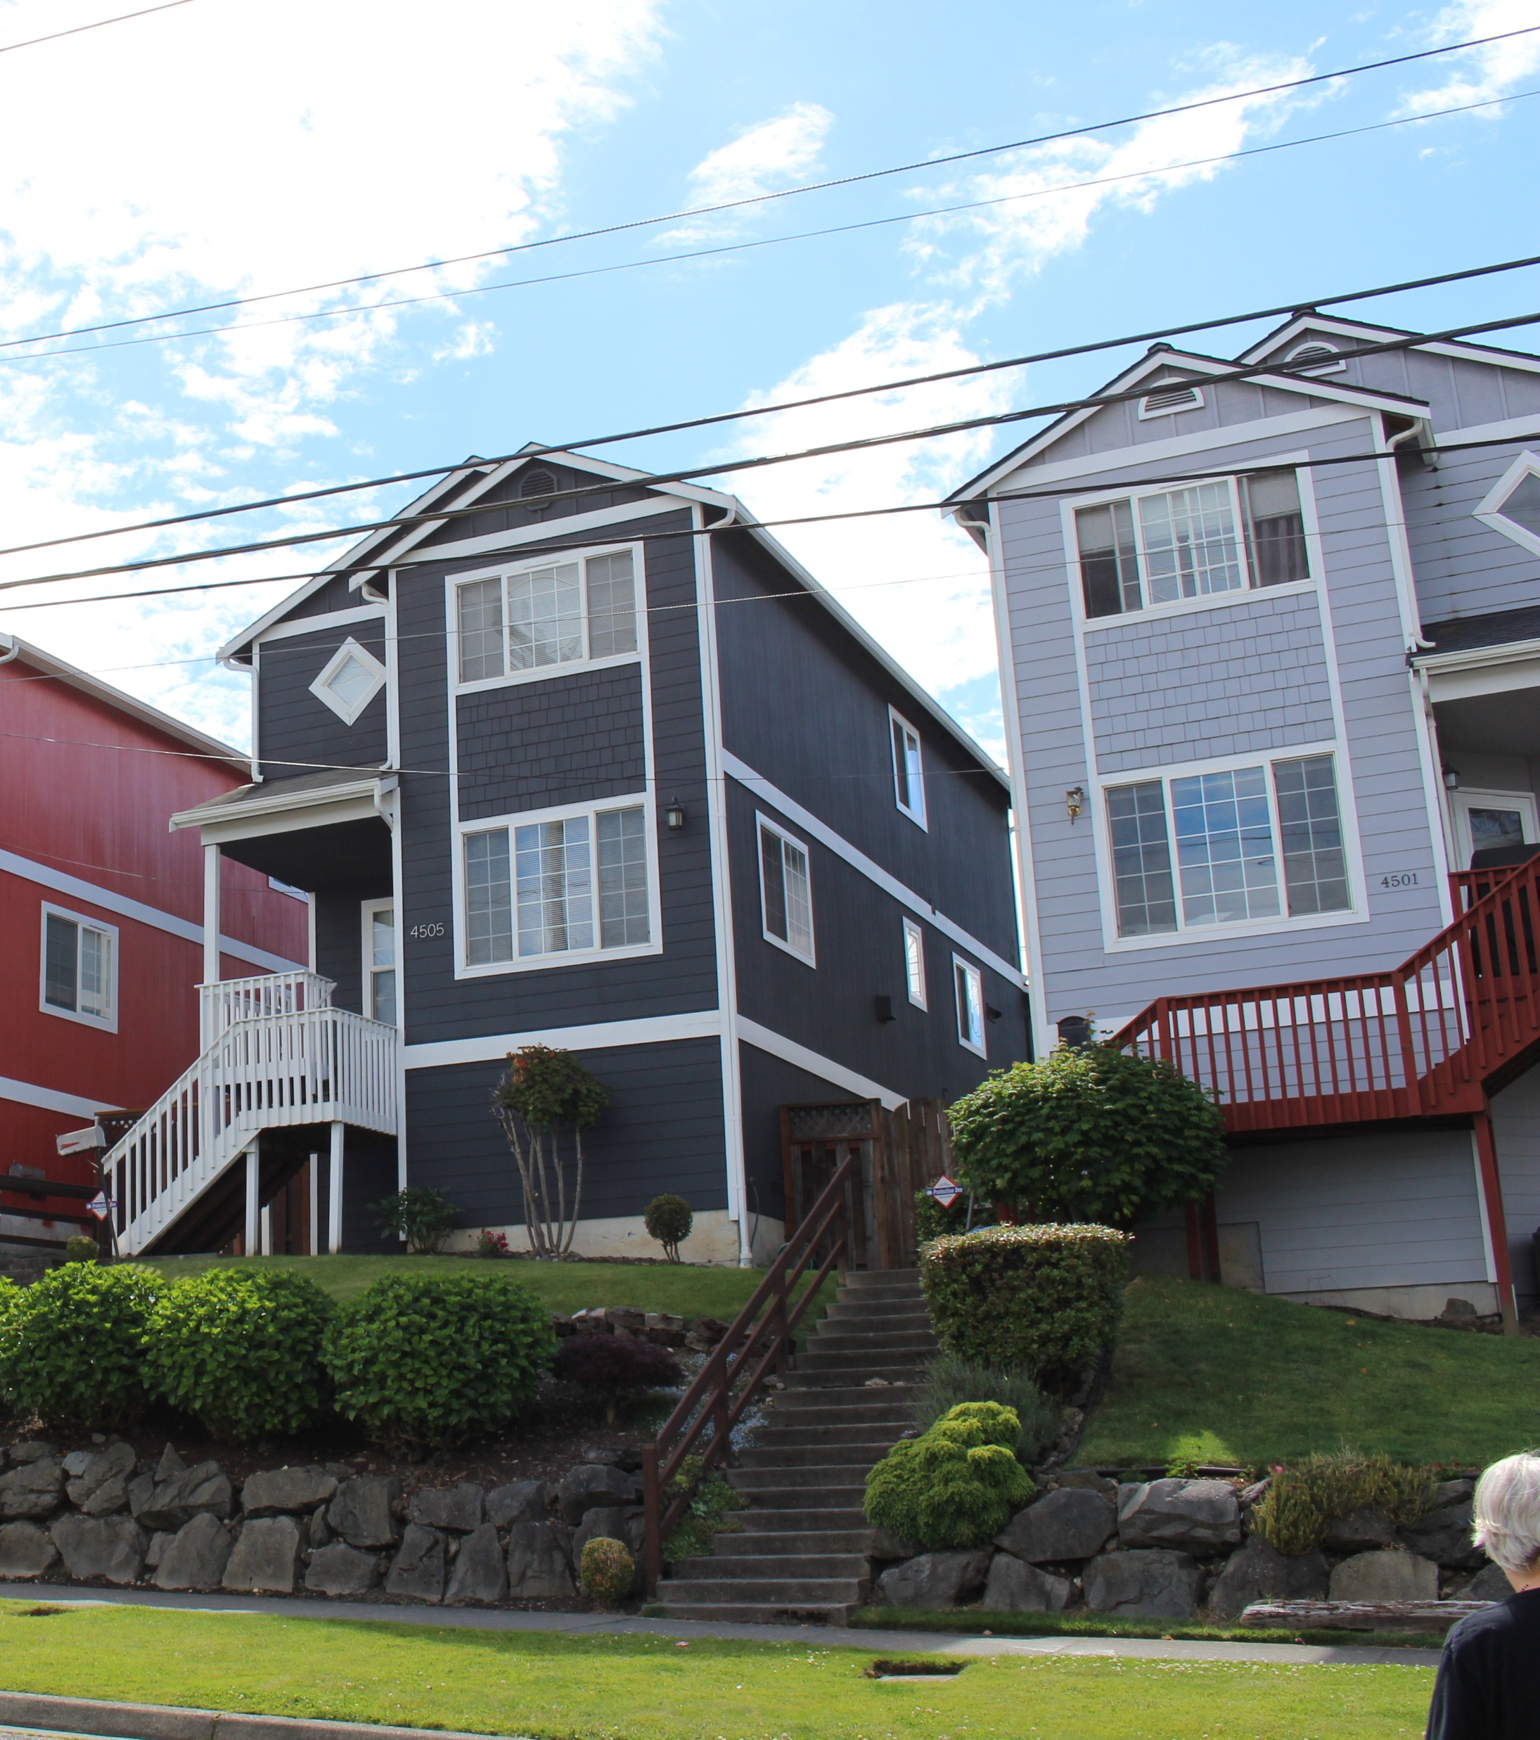
MHA Follow-up
2019 WORKPLAN
Council’s MHA Companion Resolution
  Incentives for family-sized homes, housing options for diversity of households
  Monitor changes in housing development, tree canopy
  Planning in neighborhood areas
  Compatible historic infill
Mayor’s Executive Order on Displacement
  Expand housing choices
  Affirms EDI effort to fight displacement and gentrification
  Explore equitable options in Opportunity Zones
  Work with neighborhood areas
  Compatible historic infill
Notes:
Most people building ADUs have cash or access to a lot of equity

Slide 5
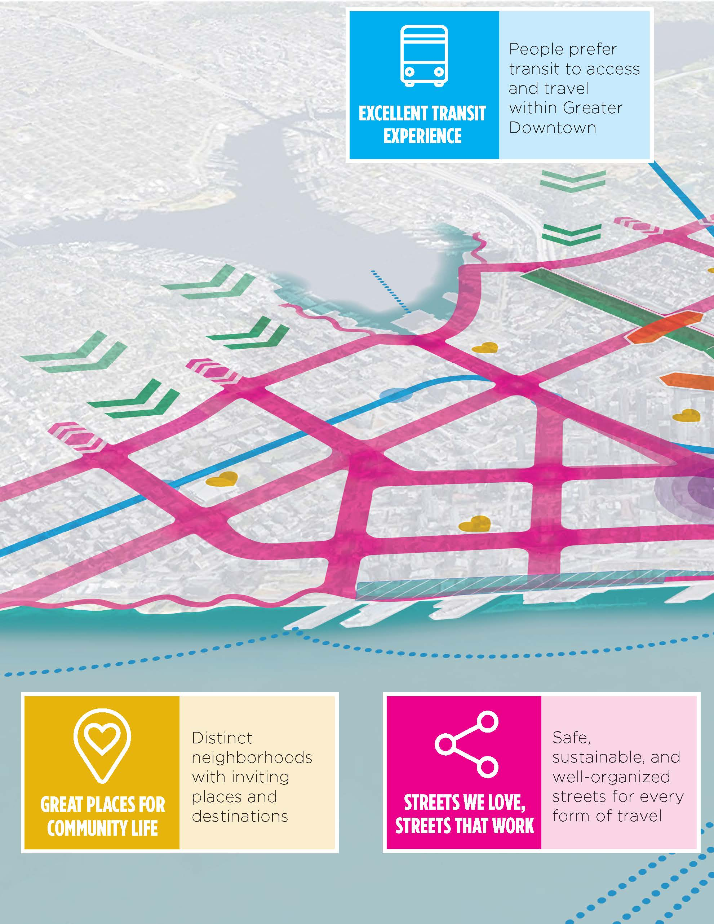
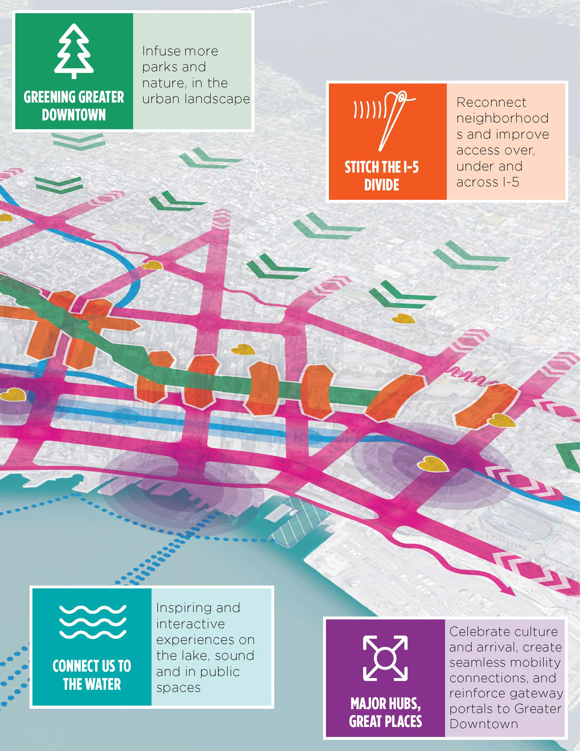
Imagine Greater Downtown
2019 WORKPLAN
Notes:
Excellent transit experience- Frequent, reliable transit, centered around people with great stations and stops
Greening greater DT- connect people with nature and restore our natural habitat
Stitch the I-5 Divide- Lid I-5 feasibility study, open space lid opportunity, light and functions to the spaces under I-5
Great Places for Community Life – a community heart in every neighborhood, authentic, expressive, active and vibrant life, for communities by communities
Streets we love, streets that work –a network of people first streets, zero emissions downtown, and making new mobility work for us.
Connect us to the water- accessing and experiencing water, realize full waterfront vision and find ways to connect people to water
Major Hubs, Great Places – an interconnected network of hubs, focused on the three hubs highlighted in purple, Jackson Hub, Colman Dock, and Westlake Crossroads

Slide 6


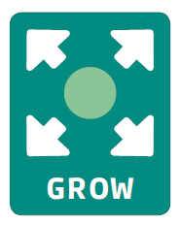

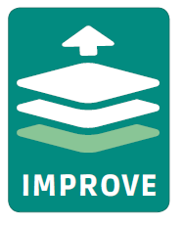

Create
Expand
Repurpose
Stack benefits
Activate
Integrate
Invite
Stitch together
Relate
Outside Citywide is an interdepartmental initiative to envision and create an integrated, equitable, and inspiring public space network for a thriving, green Seattle.

Slide 7
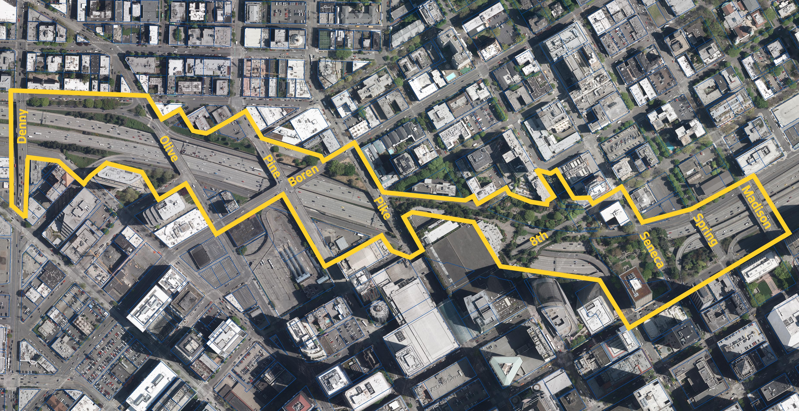
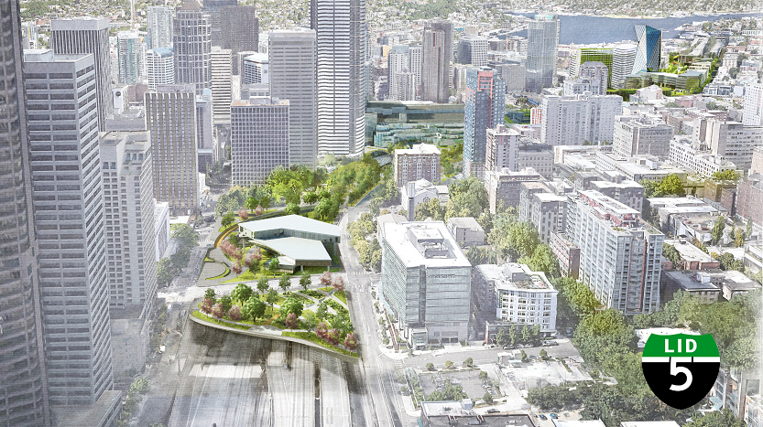
I-5 Lid Feasibility Study
2019 WORKPLAN
$1.5m study funded by Washington State Convention Center expansion
15-acre site with transformative potential
WSP selected as project consultant
Community advisory group will help steer which options evaluated
Initial engineering feasibility report will be released on Aug 22
Engineering and financial study completed in early 2020

Slide 8
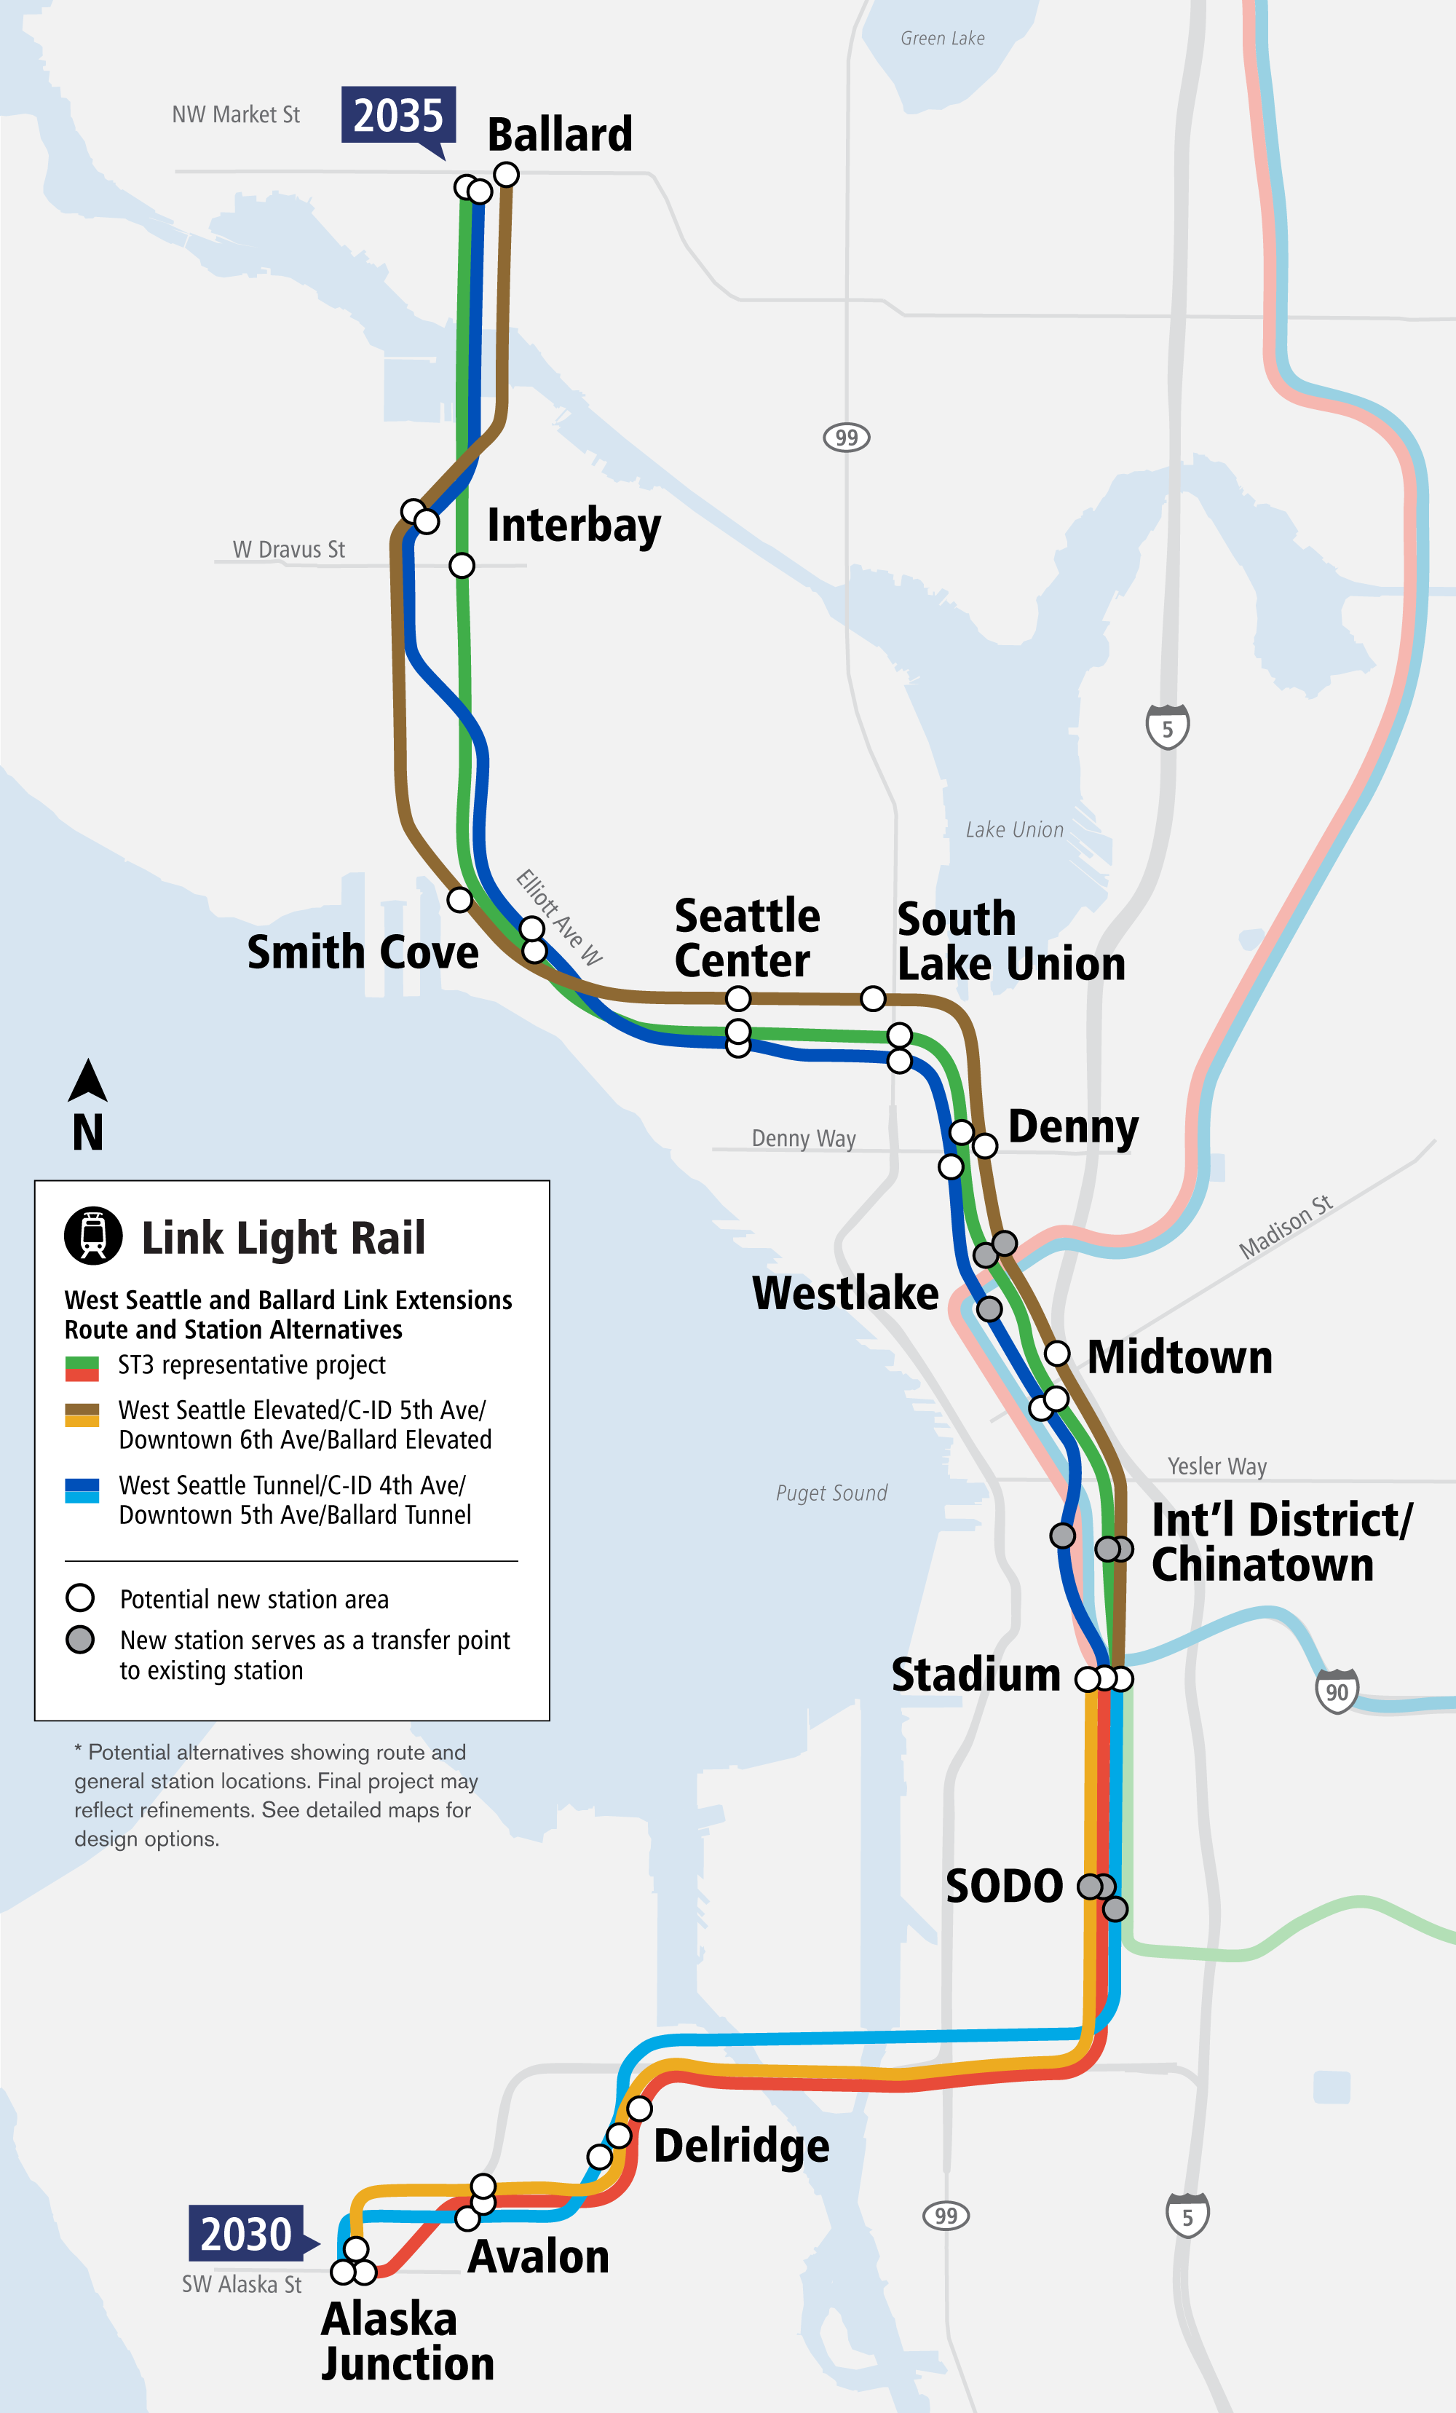
ST3 Station Area Planning
2019 WORKPLAN
West Seattle/Ballard: 14 new stations
Ongoing OPCD-ST collaboration on Racial Equity Analysis
Downtown alignment will include significant changes in public realm
Design standards for all new stations
Opportunities for equitable transit-oriented development
Community planning for housing and other changes near future stations

Slide 9
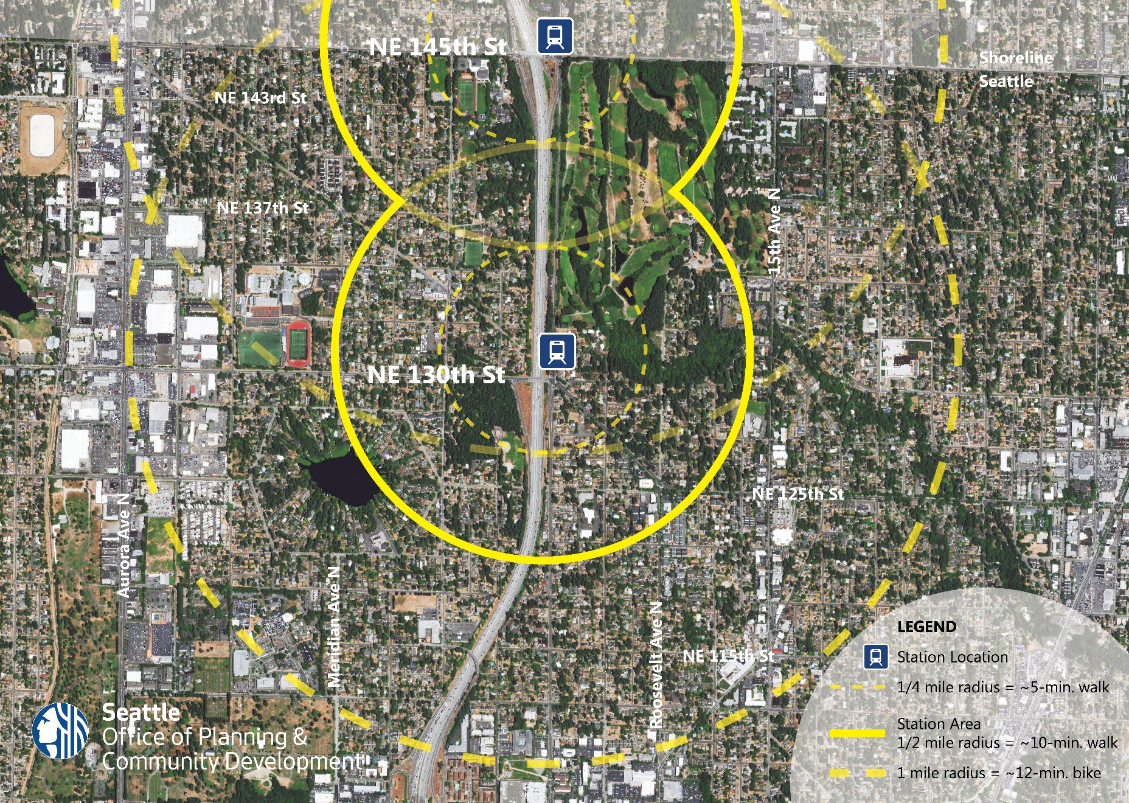
130th / 145th Station Area Planning
2019 WORKPLAN
Station area planning
  Land use
  Station access projects
Mobility planning
  Bicycle network
  Transit connections
Infrastructure improvements
  145th Ave BRT Stations
  145th Multi-modal Corridor Plan
  I-5 & 145th Interchange Project

Slide 10
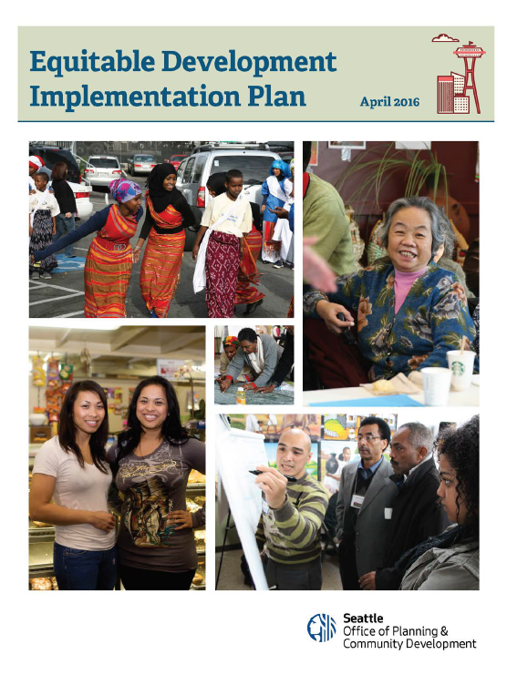
EDI Program
2019 WORKPLAN
2019 Funding cycle
  Over $5 million available
  37 organizations submitted ($29 M ask)
  Review committee recommended 10 projects & organization for a total of $5.04 million
  Announcement and press conference tomorrow
Monitoring Report Phase 1 – in Sept
  Equitable Development Outcome Indicators
Monitoring Report Phase 2 – 2020
  Heightened Displacement Risk Indicators
Notes:
The Equitable Development Implementation Plan also identified monitoring as one of the key types of change that is needed to advance equitable development and eliminate racial inequities.

Slide 11
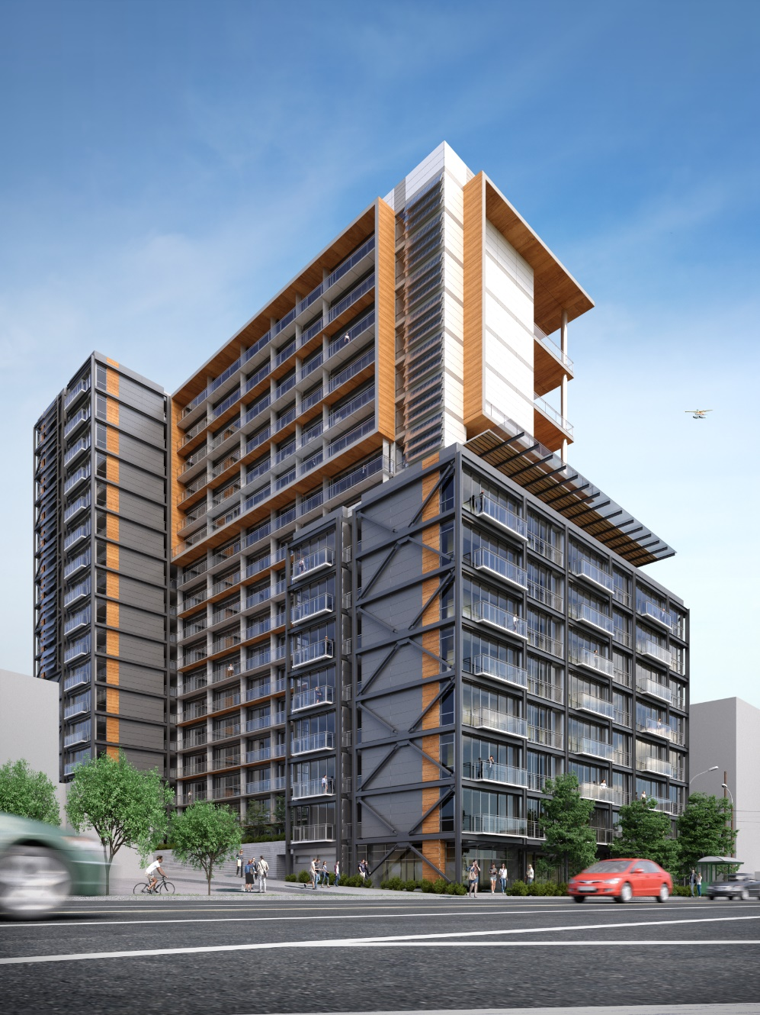
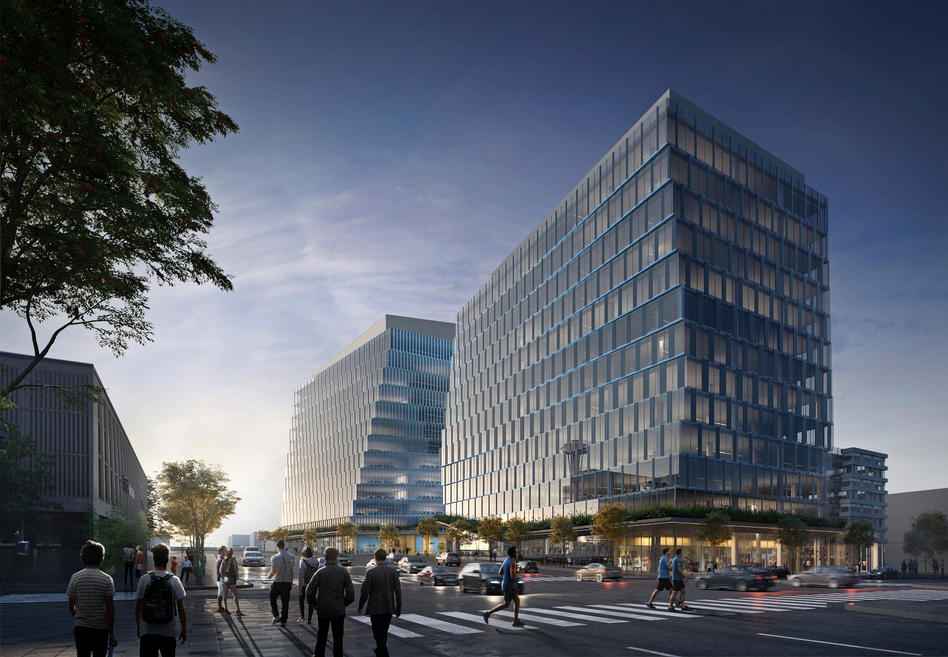
2019 WORKPLAN
Strategic Investment/Acquisition
EDI & Mercer Properties Sales
  $57 million dedicated from the sale of Mercer St properties to address displacement
  $15 million for EDI Site Acquisition Revolving Loan fund
  $42.7 million for Strategic Investment Fund
  including property acquisition at strategic locations
Notes:
The Equitable Development Implementation Plan also identified monitoring as one of the key types of change that is needed to advance equitable development and eliminate racial inequities.

Slide 12
Industrial Lands
2019 WORKPLAN
In July, Mayor Durkan launched a comprehensive review of Seattle’s industrial lands policies
Priority: equitable access to ladders of industrial jobs
Examine opportunities to grow Seattle’s industrial and maritime sectors
Alignment with climate and environmental protection goals
Comprehensive engagement will build on 2017 work with industrial stakeholders

Slide 13
Seattle Comprehensive Plan
2019 WORKPLAN
Early project planning underway for the next major update
  Identifying staffing and budget
  Developing framework for racial equity analysis
  Exploring community engagement strategies
  Evaluating potential approaches to environmental analysis
Comp Plan update due in 2023

Slide 14
Thank you
Sam Assefa, Director
Samuel.Assefa@seattle.gov

