Slide 1
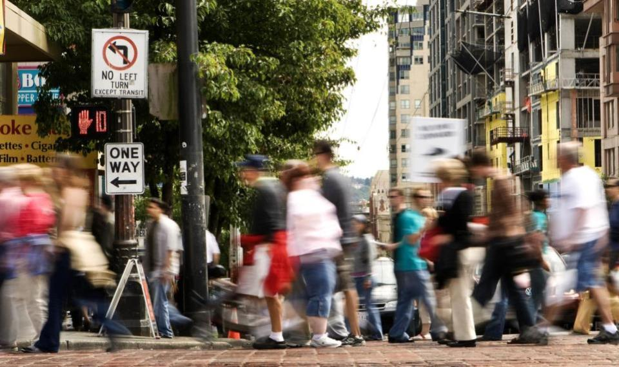

Pedestrian Master Plan
Update Briefing
Seattle Planning Commission
Michelle Marx, Kevin O’Neill
October 8, 2015

Slide 2
Our mission, vision, and core values
Mission: deliver a high-quality
transportation system for Seattle
Vision: connected people, places, and products
Committed to 5 core values to create a city that is:
Safe
Interconnected
Affordable
Vibrant
Innovative
For all
2
Notes:
Our core values for transportation anchor to the core values that Mayor Murray has laid out in his vision (Move Seattle) for Seattle:
Safe
Interconnected
Affordable
Vibrant
Innovative

Slide 3
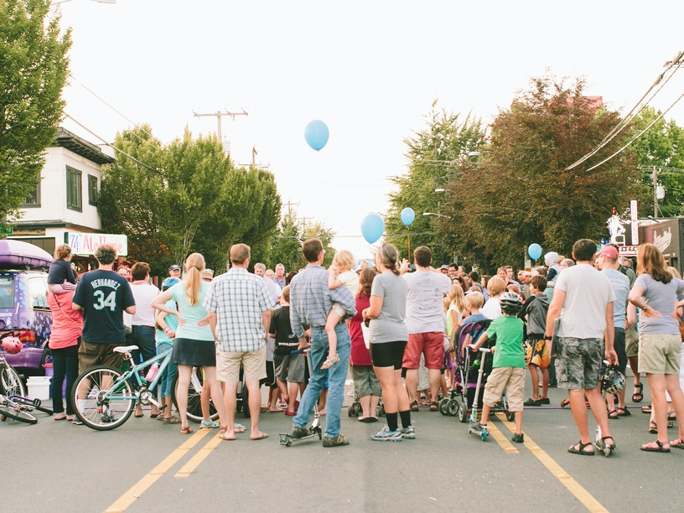
Presentation Overview
PMP update scope-of-work
Existing PMP structure
Ongoing prioritization update
Public outreach strategy

Slide 4
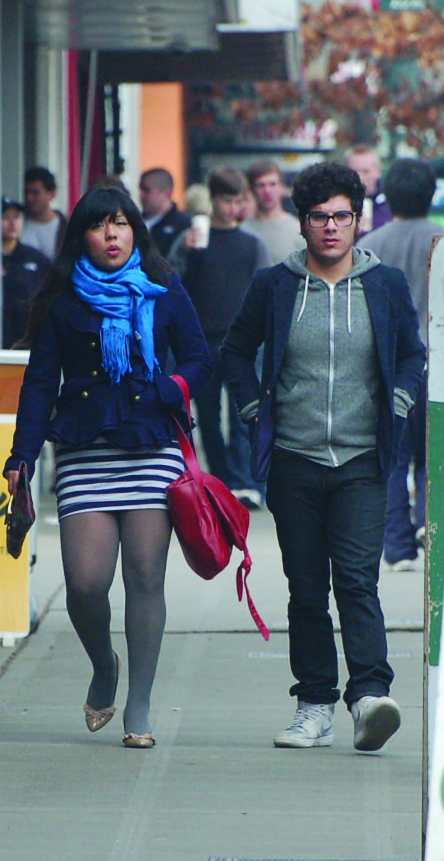
PMP update scope of work:
Assess Plan progress
Update data / prioritization
Update toolbox (including incorporating Neighborhood Greenways, Low Cost Sidewalks)
Establish performance targets
Develop implementation plan
4
Notes:
Original BIP noted that the overall framework of the PMP is still relevant, and that the update would be minor.
More of a plan “refresh” than update

Slide 5
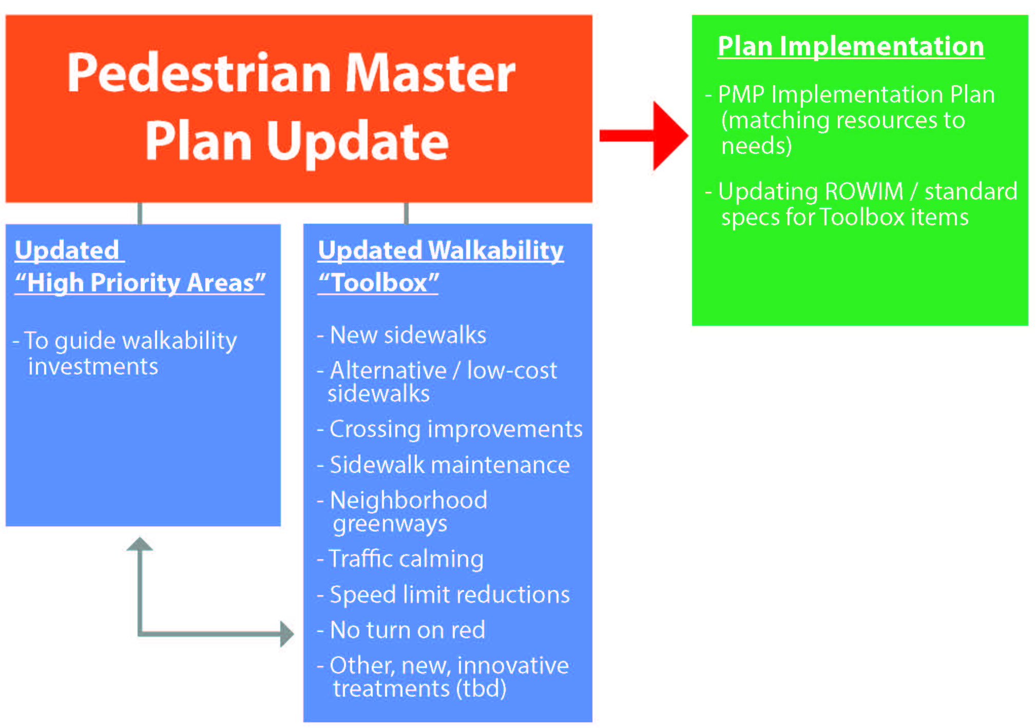
Which tools are appropriate for different locations?
Notes:
Alternative sidewalk concepts to be incorporated into updated PMP toolbox
PMP prioritization (analysis of demand + equity + safety) will help guide locations for these treatments

Slide 6
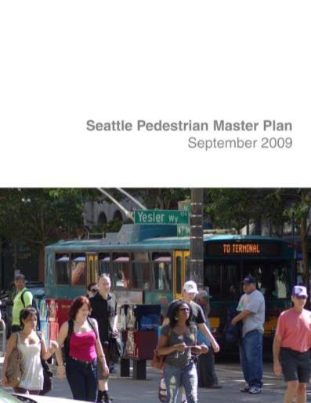
PMP is a resource allocation plan
Data-driven prioritization of funding
Designed to focus resources where:
  There is high existing and potential pedestrian demand
  There are safety concerns
  There are populations with the greatest need

Slide 7
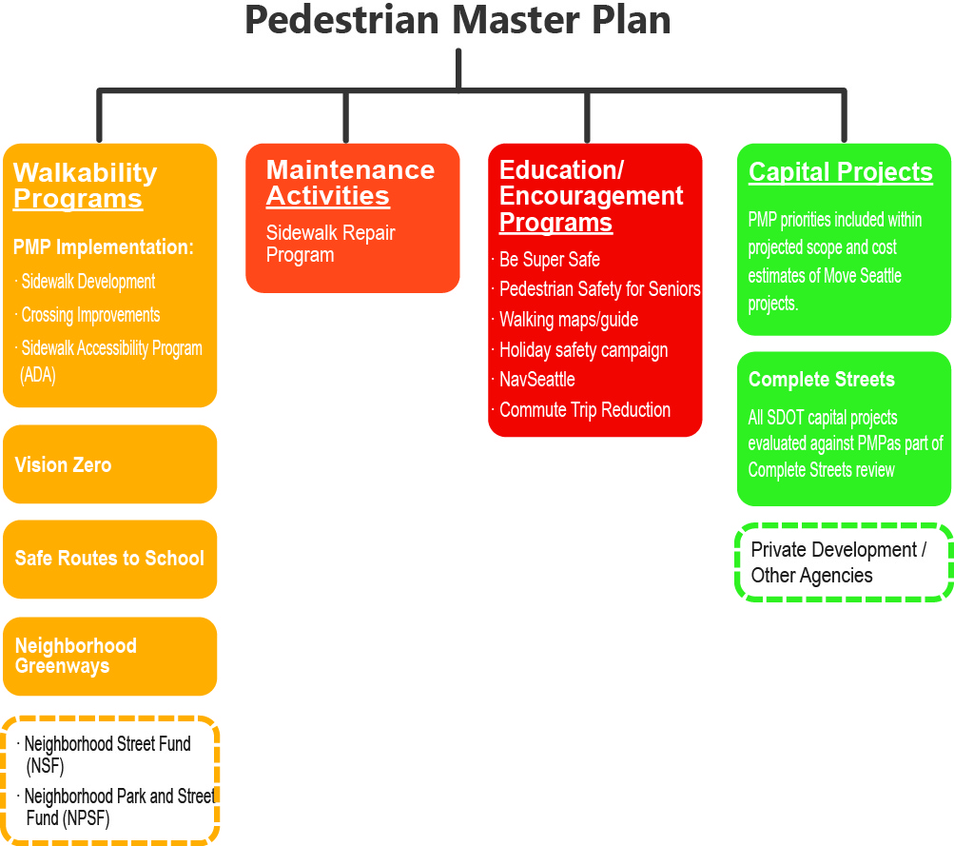
SDOT walkability programs guided by PMP
Notes:
Walkability programs guided by the PMP (all will use the walkabilty tools in the updated toolbox)

Slide 8
PMP prioritization guides investments
Projects in PMP High Priority Areas since 2009
New sidewalks | 70%
Repaired sidewalks | 78%
New crosswalks | 85%
Crossing improvements (ADA ramps, refuge islands, etc.) | 86%
New pedestrian signals | 92%

Slide 9
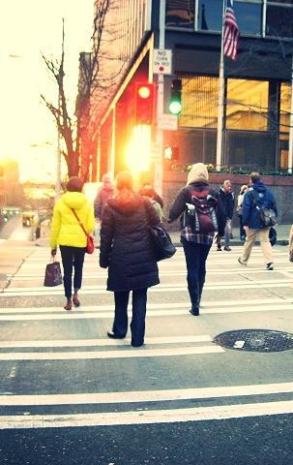
PMP Policy Framework
Plan Vision: Seattle is the most walkable city in the Nation
Plan Goals:
Safety: Reduce the number and severity of crashes involving pedestrians.
Equity: Make Seattle a more walkable city for all through equity in public engagement, service delivery, accessibility, and capital investments.
Vibrancy: Develop a connected pedestrian environment that sustains healthy communities and supports a vibrant economy.
Health: Get more people walking to improve mobility, health, and prevent disease.

Slide 10
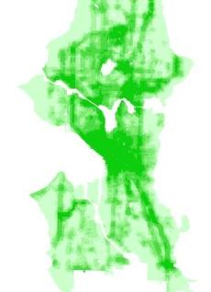
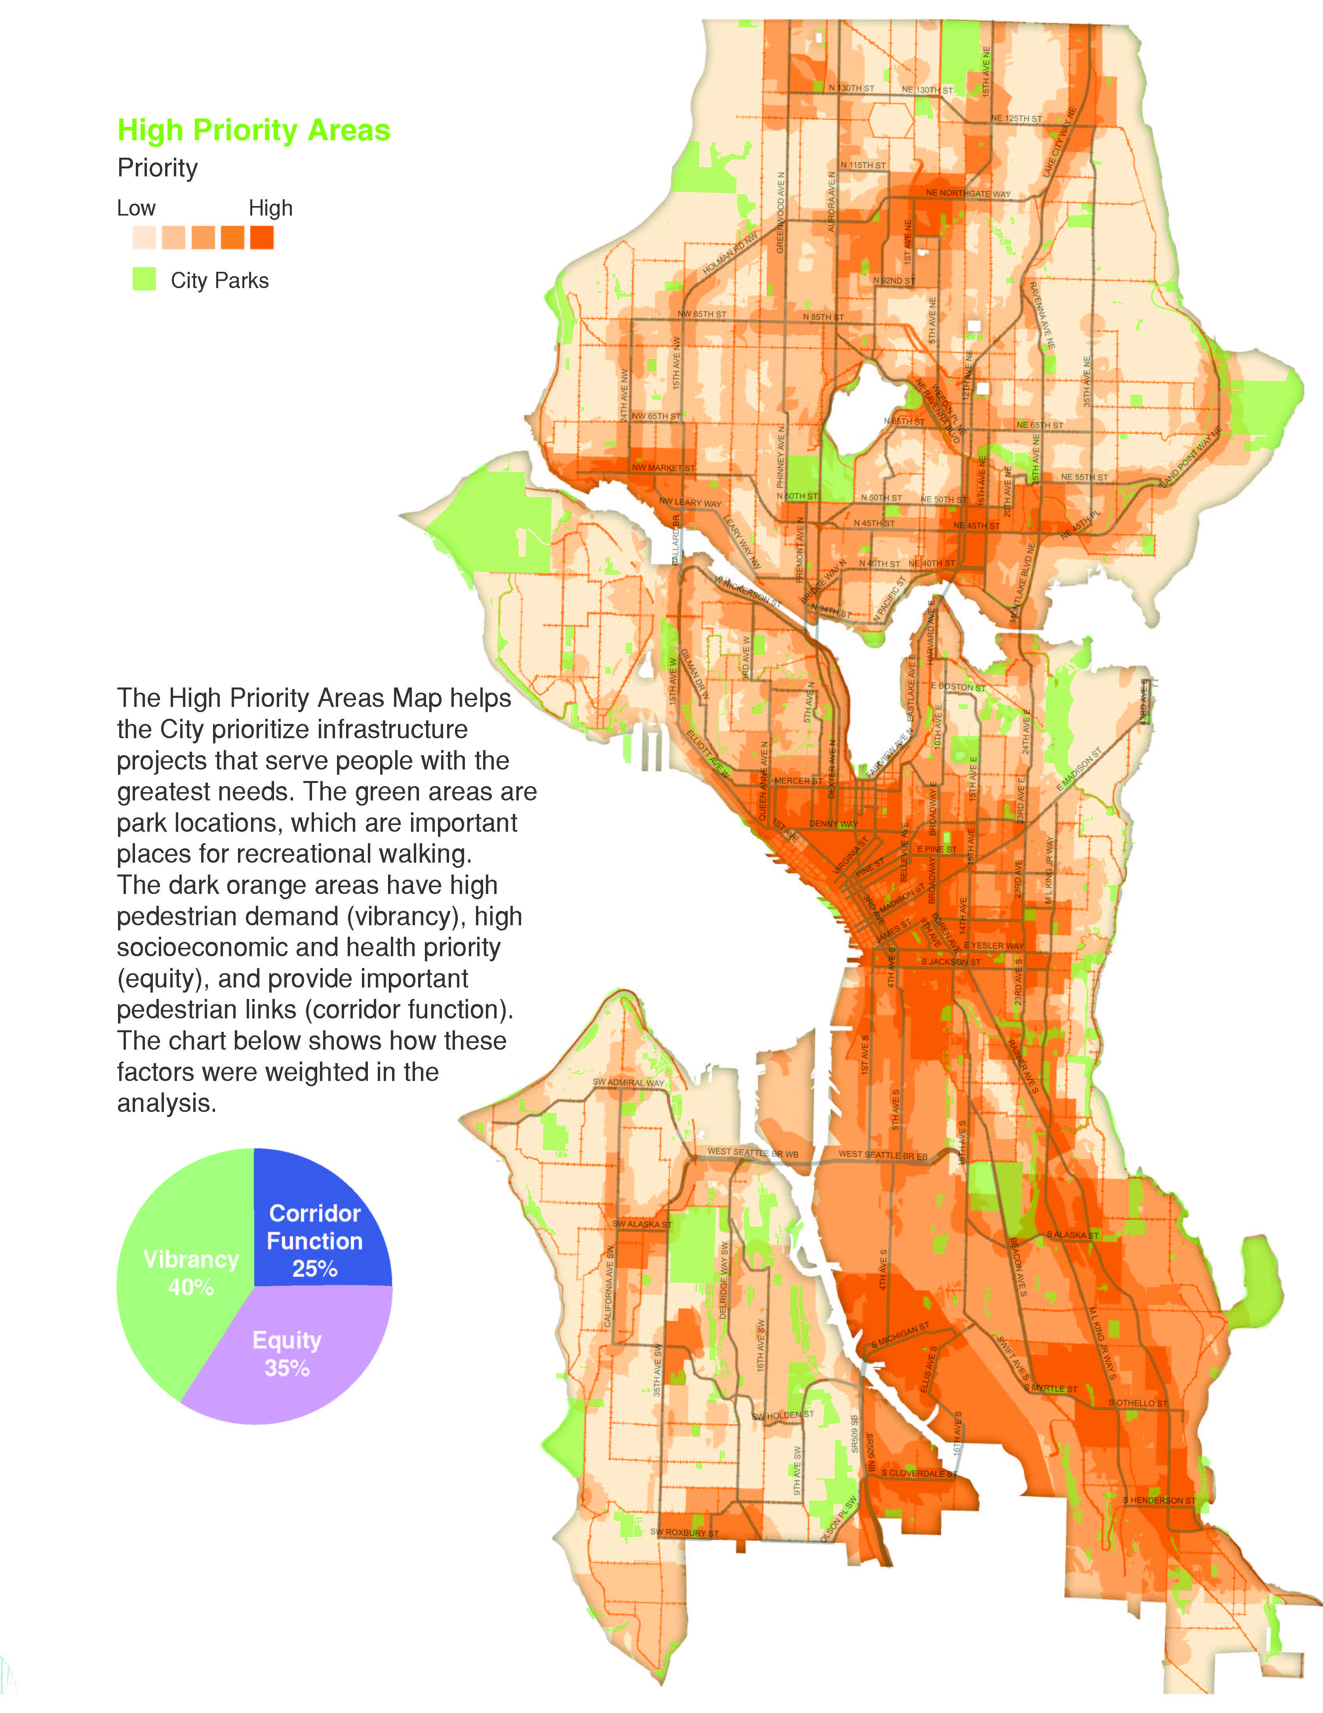
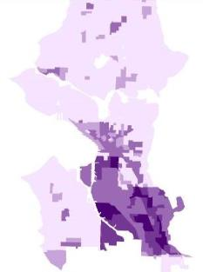
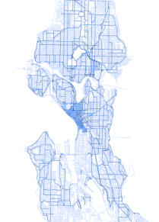
Building Blocks
Contribution to Total Score
High Priority Areas

Slide 11
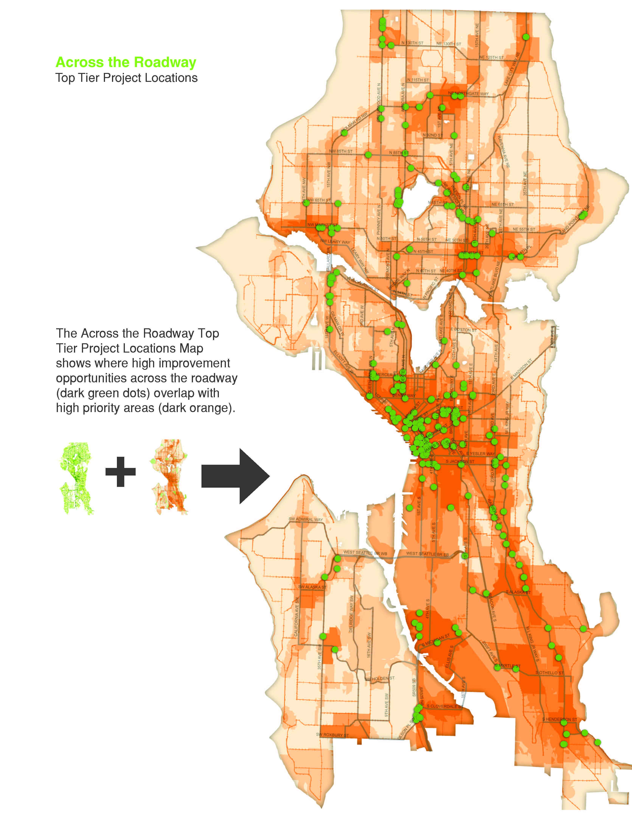
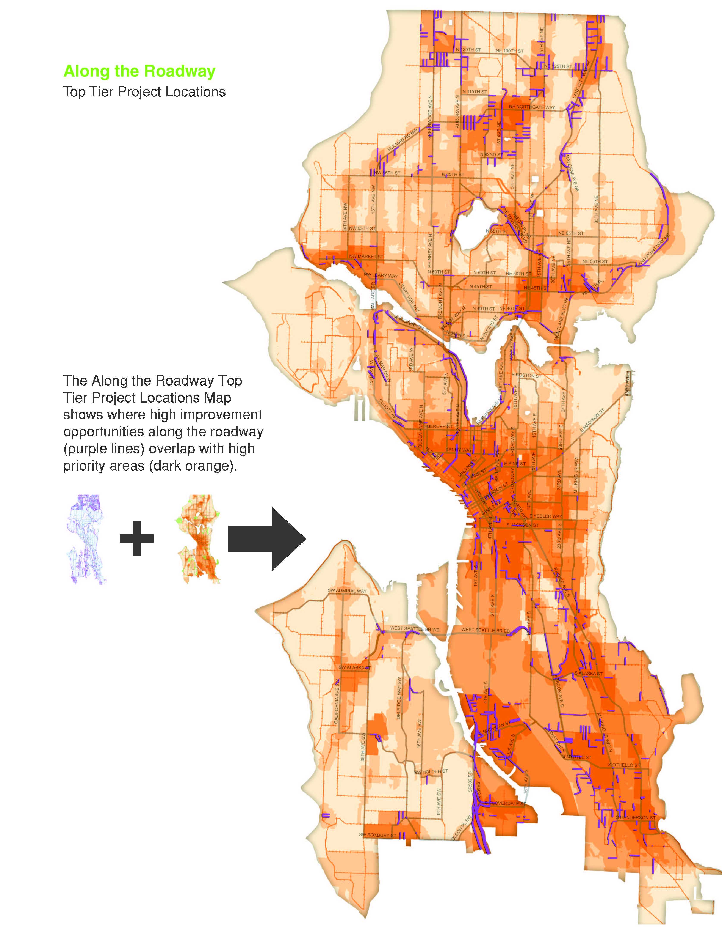
Notes:
These high ranking improvement opportunity areas were then layered over the citywide “heat map,” showing where high priority improvement opportunities overlay with high priority locations. The result is an identification of problem spots that lie within high pedestrian demand areas and areas where residents have the greatest need. These prioritized locations are where the City focuses its capital resources.
1,200 “Tier 1 / Tier 1” sidewalk locations
Areas where sidewalks are missing
Primarily on arterial streets, but not all
Total of 100 missing sidewalk locations addressed through BTG-funded Sidewalk Development Program (some improvements through other programs/projects…part of ongoing assessment work)
226 “Tier 1/Tier 1” CTR projects
Approx. 25-30% of these have been addressed through BTG-funded program (some by other programs…part of ongoing assessment work)
Improvements typically sign upgrades, new signals, intersection realignments, curb ramps, ped count down signals, etc.
Tier 1/Tier 1 projects ranked in order, and evaluation / implementation occurs in that order, more or less (except where there are leveraging opportunities, logical groupings, etc.)
Other “balancing factors” impacting a project’s order in the prioritization may pop up
To improve transit connections with new Link LRT in SE Seattle, the 2008 sidewalk projects were focused in this area.

Slide 12
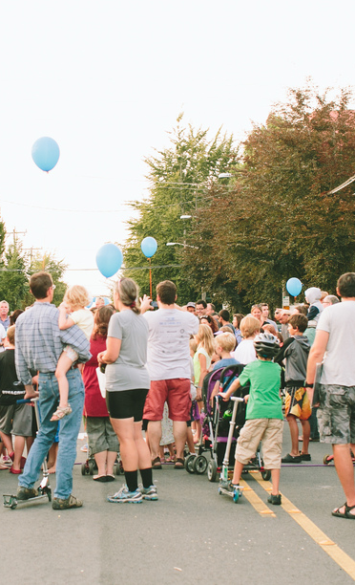
Goals for updated prioritization:
Update outdated data
Reground methodology with Plan goals
Revise criteria to align with recent SDOT/City initiatives
Streamline methodology where possible
  Separate “signal” from “noise”
  Narrow priority project list
  Emphasize connectivity
  Ground projects to “motivating need”

Slide 13
Updated prioritization structure
Safety: Reduce the number and severity of crashes involving pedestrians.
Equity: Make Seattle a more walkable city for all through equity in public engagement, service delivery, accessibility, and capital investments.
Vibrancy: Develop a connected pedestrian environment that sustains healthy communities and supports a vibrant economy.
Health: Get more people walking to improve health and increase mobility.
Existing:
CORRIDOR FUNCTION
SAFETY
ALONG THE ROAD
CROSSING THE ROAD
EQUITY
VIBRANCY
SAFETY
Proposed:
ALONG THE ROAD
CROSSING THE ROAD
EQUITY + HEALTH
VIBRANCY
Notes:
Align analysis with revised PMP goals
Reframe “Corridor Function” as “Safety”

Slide 14
Potential datasets: What’s most important?
Health and Equity Factors
Auto ownership
Low income population
Disability population
Diabetes rates
Physical activity rates
Obesity rates
Communities of color
Age 17 and younger
Age 65 and older
Low English-speaking ability
Low educational attainment
Renter households
Housing cost-burdened households
Canopy cover
Vibrancy Factors
Universities or Colleges
Major Generator (e.g. Pike Place, Convention Center)
Multi-family, condominiums and apartments
Major Retail
Minor Retail
Hospital and Community Service
Park and Open Space
Population forecast
Employment forecast
Light rail stations
Major bus stops
Minor bus stops
Trails
Bridges
Stairways
Urban Hubs/Villages
NC Zoning
FTN network
Arterials
Neighborhood Greenways
Schools
Along the Roadway
Street classifications (proxy for volume)
Arterial speed limit
Buffer
Sidewalk status
Slope (along)
Parking
Curb
Length of block
Peak hour parking
Street trees
Alleys
Crossing the Roadway
Street classifications (proxy for volume)
Arterial speed limit
Road width
Distance between traffic signals and stop signs
Crosswalk
Curb ramp
Signal control
Stop sign control
Number of collisions
Block length
Safety Factors
Pedestrian collisions
Arterial classifications
Roadway width
Signalized pedestrian crossing spacing
Speed

Slide 15
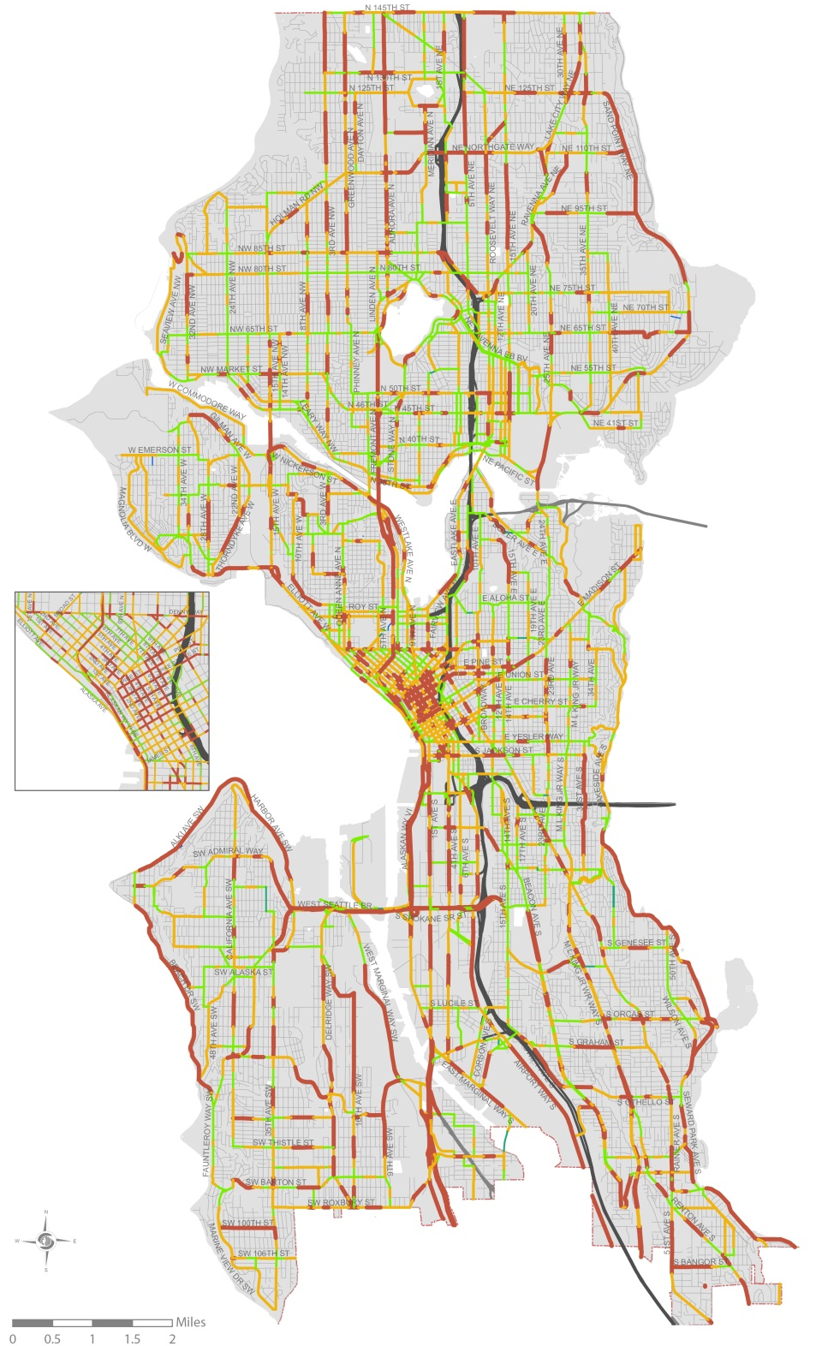
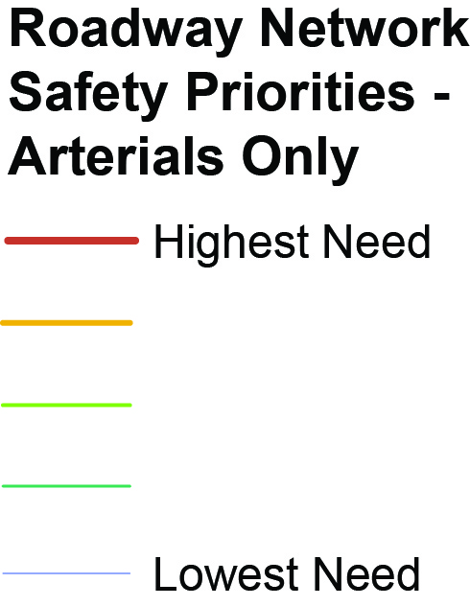
Safety (working draft)
Safety Goal: Reduce the number and severity of crashes involving pedestrians.
“Corridor Function”: Existing 2009 Factors
Seattle street types
Safety: Draft Updated Factors (based on SDOT Pedestrian Safety Analysis)
Pedestrian collisions | Serious injuries and fatalities highly weighted. Data from the last 8 years.
Arterial classifications | Proxy for volume; Majority of severe injuries occur on principal and minor arterials
Roadway width | Using # of lanes where available, and curb to curb width where # lanes is not available.
Signalized pedestrian crossing spacing | Capturing both signal-controlled intersections and signal-controlled mid-block crossing opportunities
Speed | 85th percentile speeds where available, and posted speed limit where actual speed is not available.

Slide 16
Equity + Health
Equity: Make Seattle a more walkable city for all through equity in public engagement, service delivery, accessibility, and capital investments.
Health: Get more people walking to improve health and increase mobility.
2009 Factors
Auto ownership
Low income population
Disability population
Diabetes rates
Physical activity rates
Obesity rates
Additional Factors Considered
Communities of color | Used in Seattle 2035, RSJI, Move Seattle/Levy, BMP Equity Analyses
Age 17 and younger | Our intention for including age would be dependence on walking but that is captured in low-income. Unsure how to account for “high concentration of vulnerable users.”
Age 65 and older
Low English-speaking ability | Captured with Communities of color
Low educational attainment | Captured with Low income
Renter households | Captured with Low income
Housing cost-burdened households | Captured with Low income
Canopy cover | Captured through “presence of buffer” in Along and Across the Roadway measures
Notes:
Goal: Invest in communities of greatest need based on populations who have no other choice but to walk (low income, auto ownership, disability) and populations who’s health will benefit the most by walking/who have worst health outcomes (diabetes, physical activity rates, obesity).
**What about historically underrepresented communities that experience the most barriers when it comes for advocating for improvements in their neighborhood? Explicitly talk about that?
Race.
Meeting with SKCPH to groundtruth the most salient data sets.

Slide 17
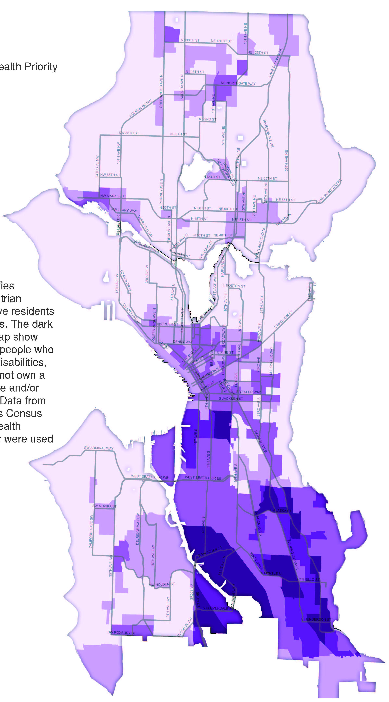
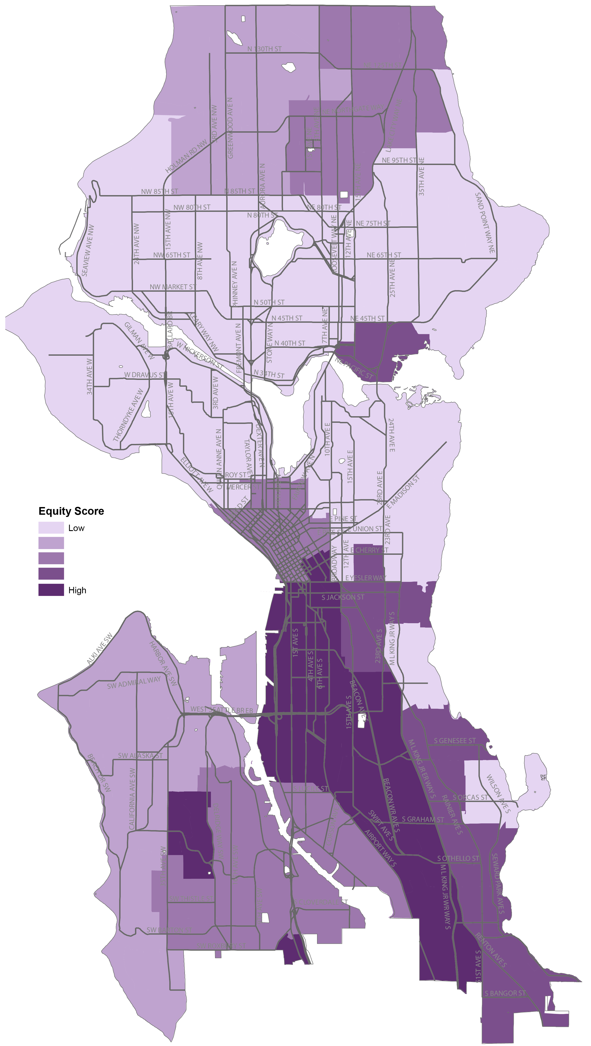
2009
2016
(working draft)

Slide 18
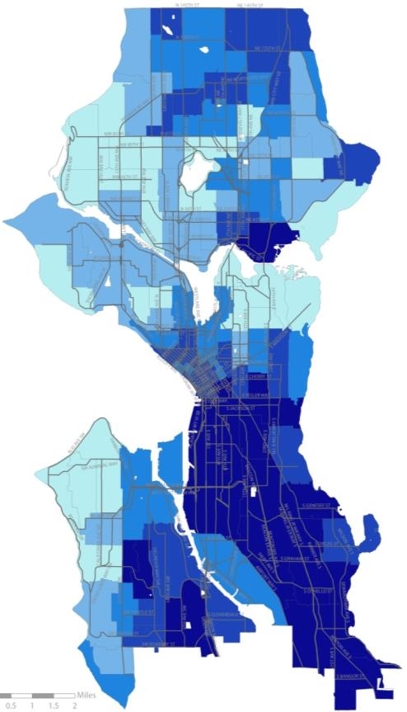
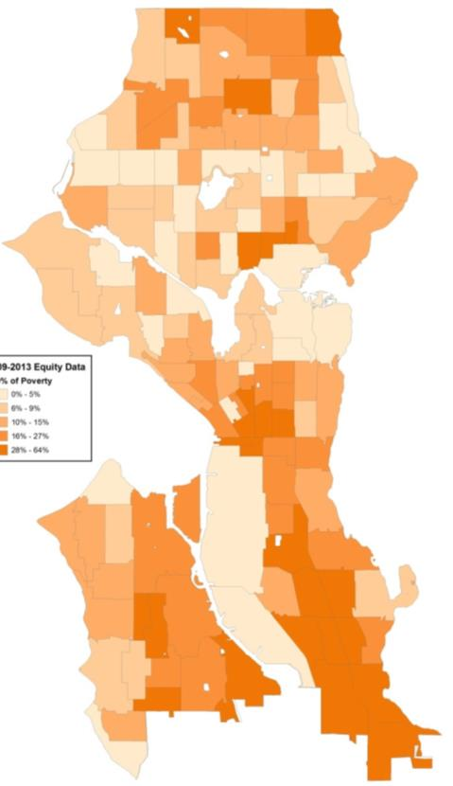
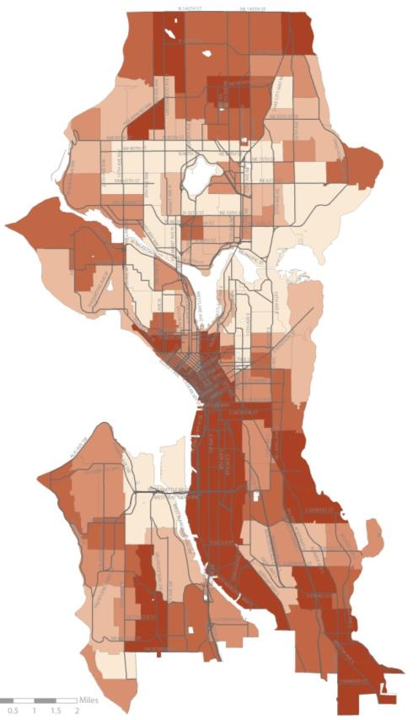
Equity datasets included
Communities of color
Low-income pop.
Disability pop.

Slide 19
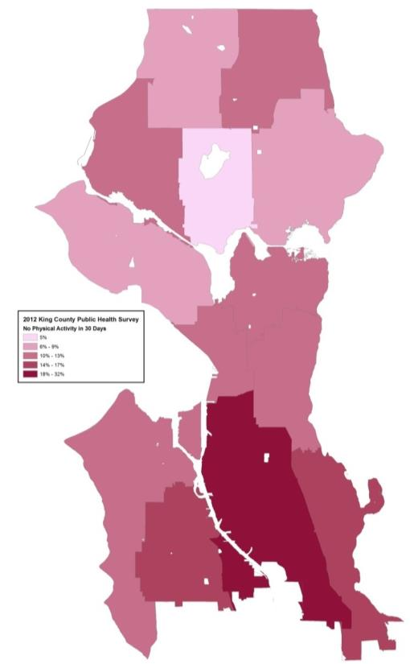
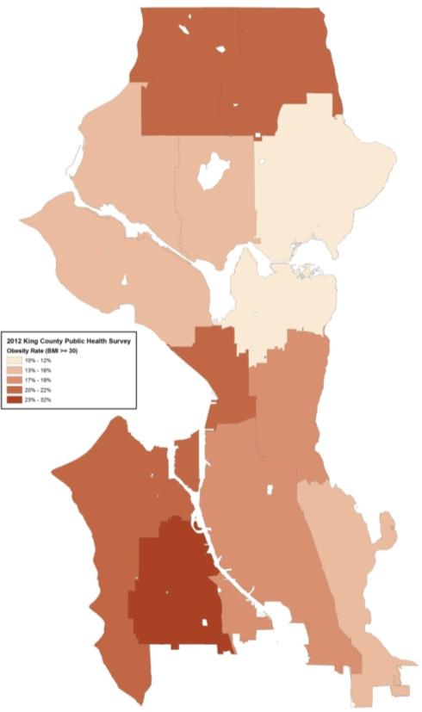
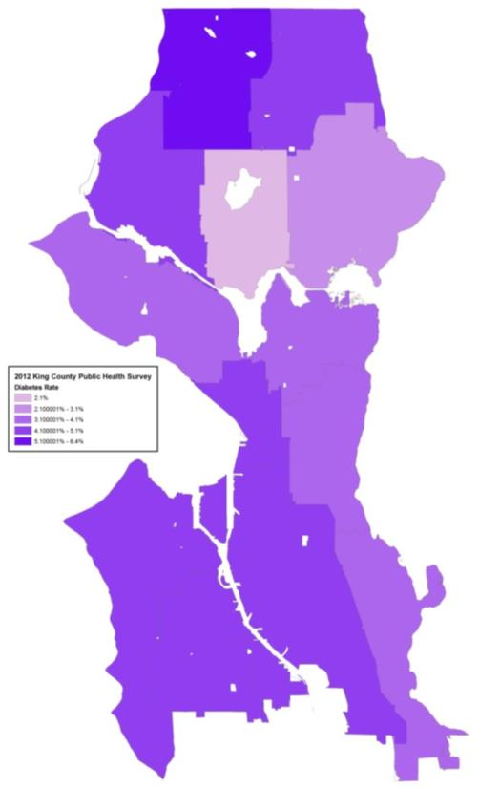
Equity datasets included
Physical activity
Obesity rate
Diabetes rate

Slide 20
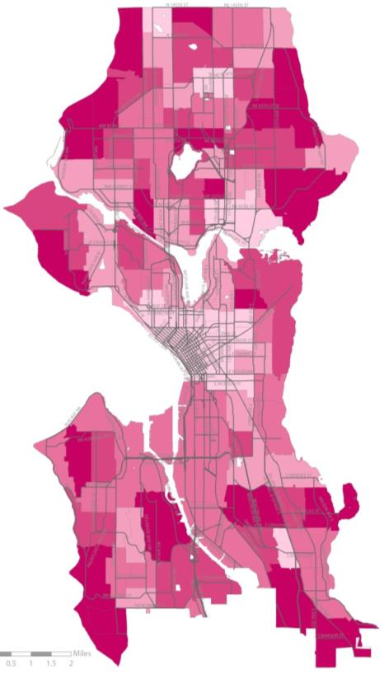
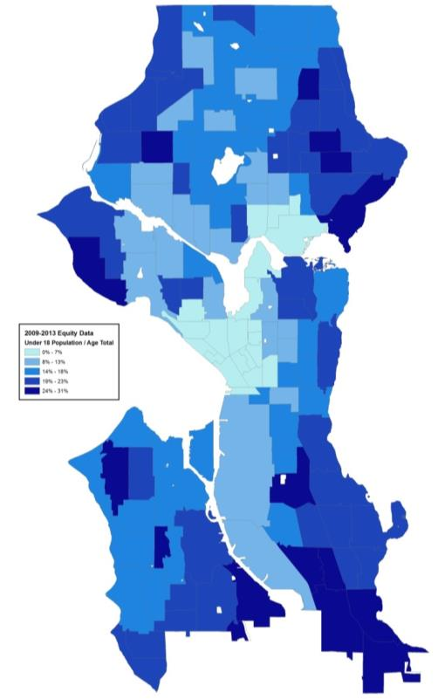
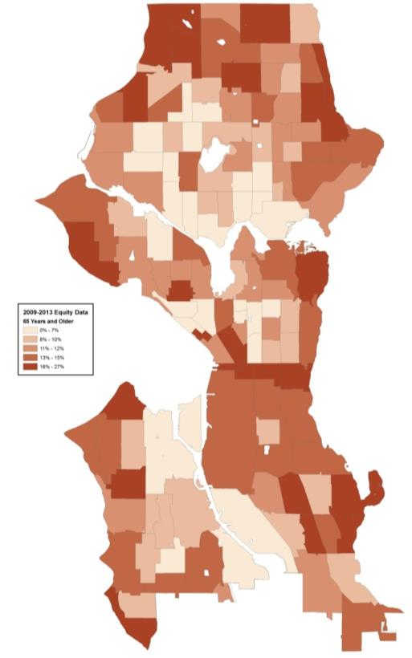
Equity datasets not recommended
Cars / household
Under 18 pop.
65 and older pop.

Slide 21
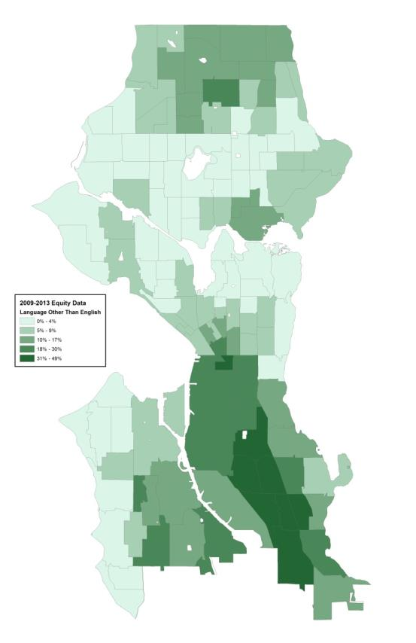
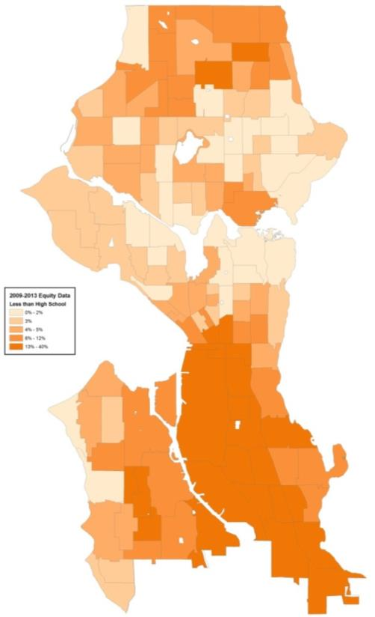
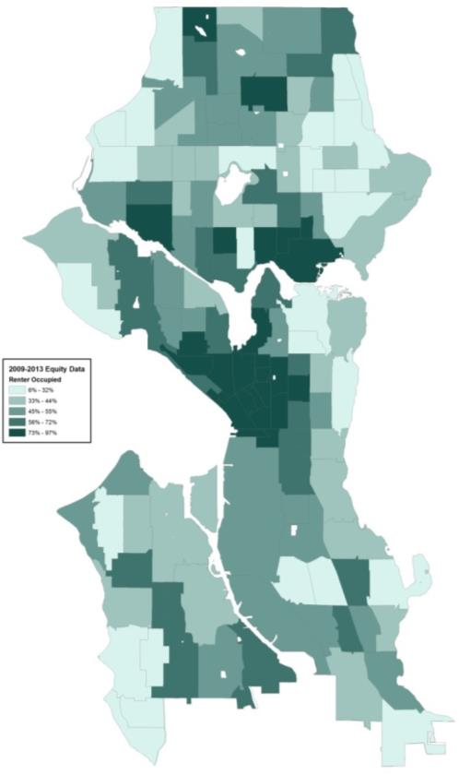
Equity datasets not recommended
Low English speaking ability
Low educational attainment
Renter occupied
Notes:
Add housing cost burdened households

Slide 22
Vibrancy
Vibrancy: Develop a connected pedestrian environment that sustains healthy communities and supports a vibrant economy.
2009 Factors
Universities or Colleges
Major Generator (e.g. Pike Place, Convention Center)
Multi-family, condominiums and apartments
Major Retail
Minor Retail
Hospital and Community Service
Park and Open Space
Population forecast
Employment forecast
Light rail stations
Major bus stops
Minor bus stops
Trails
Bridges
Stairways
Draft Updated Factors
Urban Villages & Urban Centers | Factors in job and housing growth. Urban Centers will be heavily weighted.
Neighborhood Commercial Zoning | Capture neighborhood retail destinations outside of urban villages.
10 minute walkshed to Frequent Transit Network (FTN) stops
10 minute walkshed to parks
10 minute walkshed to schools
Notes:
Goal: Focus resources on the streets that experience the most pedestrian demand (land-use and transportation-based demand).
Vibrancy = Pedestrian Demand

Slide 23
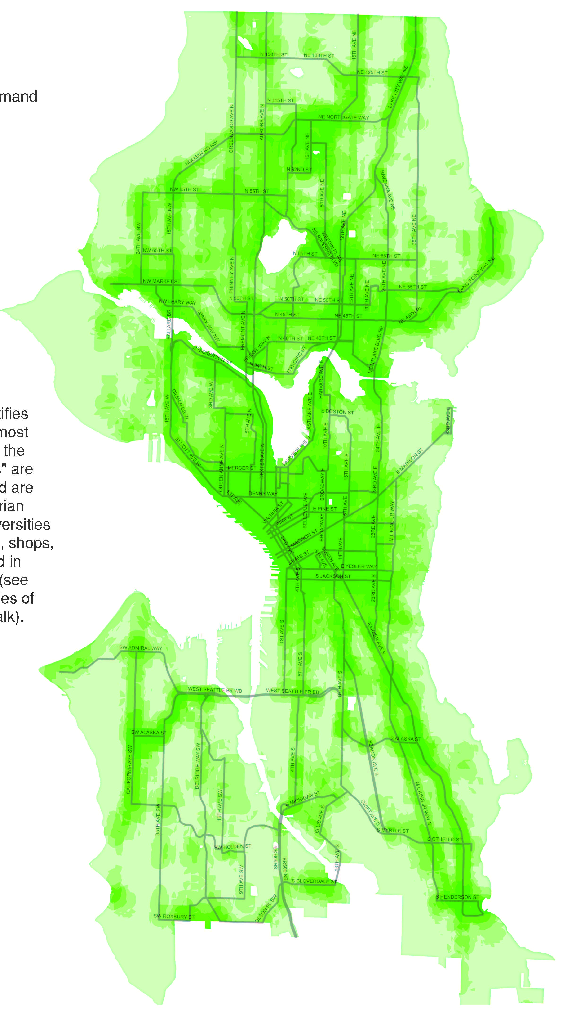
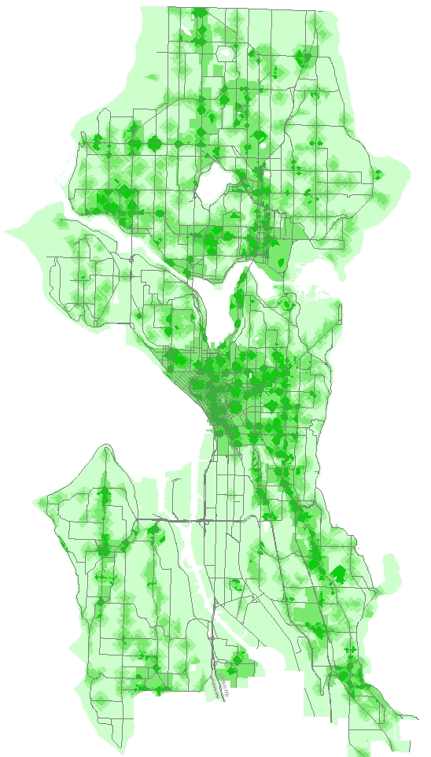
2009
2016
(working draft)

Slide 24
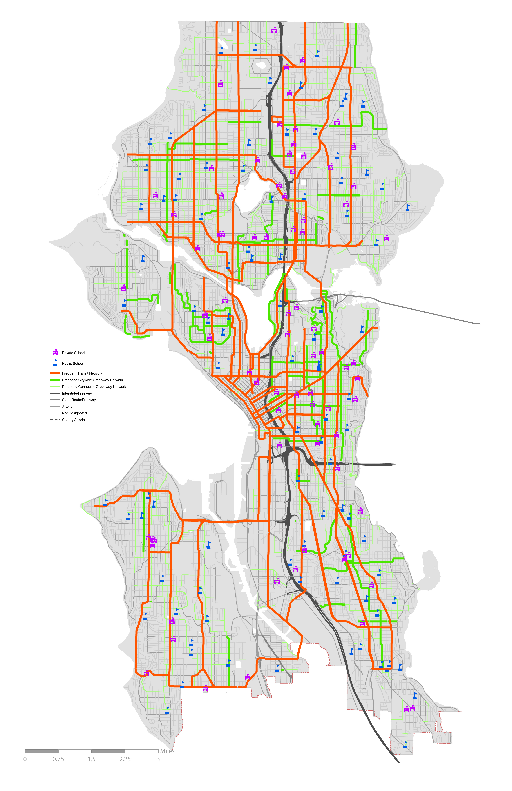
Explore priority focus on connections to key destinations (schools and transit)
Broader geographic distribution of priorities
Sharpens priorities by focusing on key generators
Addresses desire for system connectivity
Underscores role of greenways in PMP
Destination Connectivity Network
Frequent transit network without sidewalks
Neighborhood Greenways | Per adopted BMP (may look at pedestrian-oriented modifications)
Notes:
Urban center/urban village-focused
Less focus on new sidewalks in residential neighborhoods

Slide 25
Crossing the Roadway
Draft Factors
Road width
Distance between traffic signals and stop signs
Crosswalk
Curb ramp | Update via current ADA ramp audit
Signal control | Refine per SDOT’s Pedestrian Safety Analysis.
Stop sign control
Block length
Along the Roadway
Draft Factors
Sidewalk status
Curb
Buffer (parking, landscape)
Peak hour parking | Differentiated, and likely higher rated, than parking. Buffer during the busiest times.
Street trees | Presence of trees as a buffer and indicator of a quality walking environment. Presence of street trees is positively correlated with walkability. To be updated when SDOT's street tree inventory is completed.
Alleys | Used as a proxy for access control, limited to alleys, rather than many driveways.
Notes:
Accessibility Measures? Data available? (i.e. accessible pedestrian signals)
Street classifications: Discussion: Could the FHWA ARNOLD dataset be used as a better proxy?
Curb ramps: Discussion: To be updated via current ADA ramp audit?
Crossing completes a pedestrian infrastructure network link within various distances
(e.g. 1/8, 1/4 mile).
ATR and CTR should produce finite projects based on “quality of the pedestrian environment” factors.
Baseline condition analysis updated since 2008 for us to base this on?

Slide 26
Key public outreach question:
How to weigh factors?
Safety
Vibrancy
XX%
XX%
XX%
Equity + Health

Slide 27
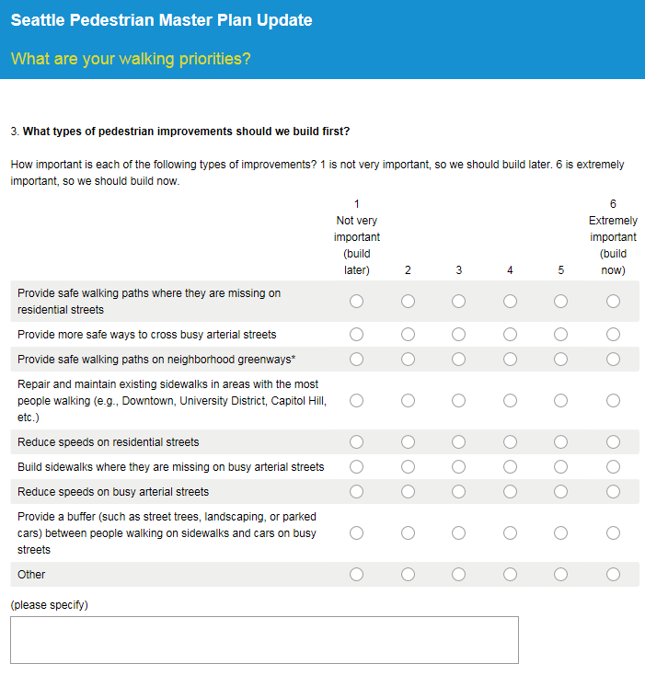
Public outreach
Event | Date
Pedestrian Advisory Board | 9/9/15
Summer Parkways | 9/12/15
Feet First Walks | 9/12/15
Seattle Design Festival: Feet First booth | 9/12 -13/15
Freight Advisory Board | 9/15/15
Seattle Design Commission | 9/17/15
Commission for People with Disabilities | 9/17/15
Park(ing) Day | 9/18/15
Summer Parkways | 9/19/15
Madison Bus Rapid Transit Open House | 9/28/15
Freight Master Plan Open House | 9/28/15
Feet First Walktober Events | October
Immigrant & Refugee Commission | 10/6/15
Freight Master Plan Open House | 10/6/15
Urban Forestry Commission | 10/7/15
Bicycle Advisory Board | 10/7/15
Seattle Planning Commission | 10/8/15
Pedestrian Advisory Board | 10/14/15
Open House #1 (Northgate) | 10/19/15
Open House #2 (Hillman City) | 10/21/15
Releasing public surveys (hopefully next week!) for feedback on:
  What factors make walking difficult in Seattle
  Types of walking improvements City should prioritize
  Low cost sidewalk concepts
  Community events and briefings in September/October
  Open House 10/19 in Northgate
  Open House 10/21 in Hillman City
  Currently working with OIRA on organizing focus groups (October/November)

Slide 28
Next steps
 | August | September | October | November | December | January | February | March
Public outreach
Update prioritization
Update toolbox
Establish performance targets
Develop public draft plan
Develop implementation plan

Slide 29





Questions?
michelle.marx@seattle.gov | (206) 684-0633
www.seattle.gov/transportation/bike.htm
www.seattle.gov/transportation

