Slide 1
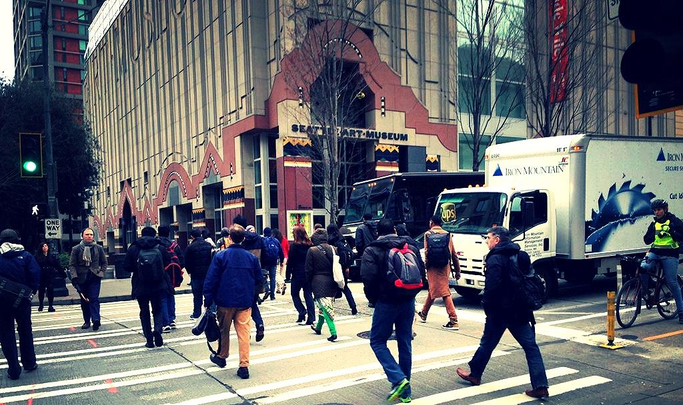
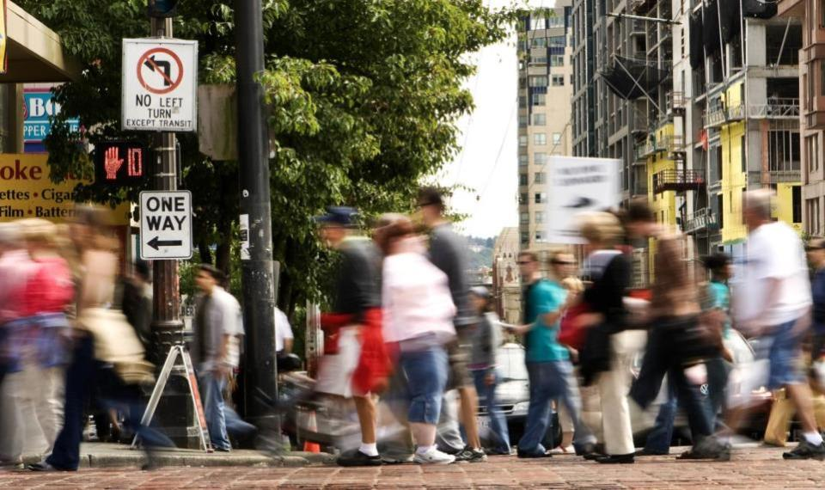

Pedestrian Master Plan Update
Seattle Planning Commission
Michelle Marx, Ian Macek, Kevin O’Neill
May 26, 2016

Slide 2
Our mission, vision, and core values
Mission: deliver a high-quality
transportation system for Seattle
Vision: connected people, places, and products
Committed to 5 core values to create a city that is:
Safe
Interconnected
Affordable
Vibrant
Innovative
For all
Notes:
Our core values for transportation anchor to the core values that Mayor Murray has laid out in his vision (Move Seattle) for Seattle:
Safe
Interconnected
Affordable
Vibrant
Innovative

Slide 3
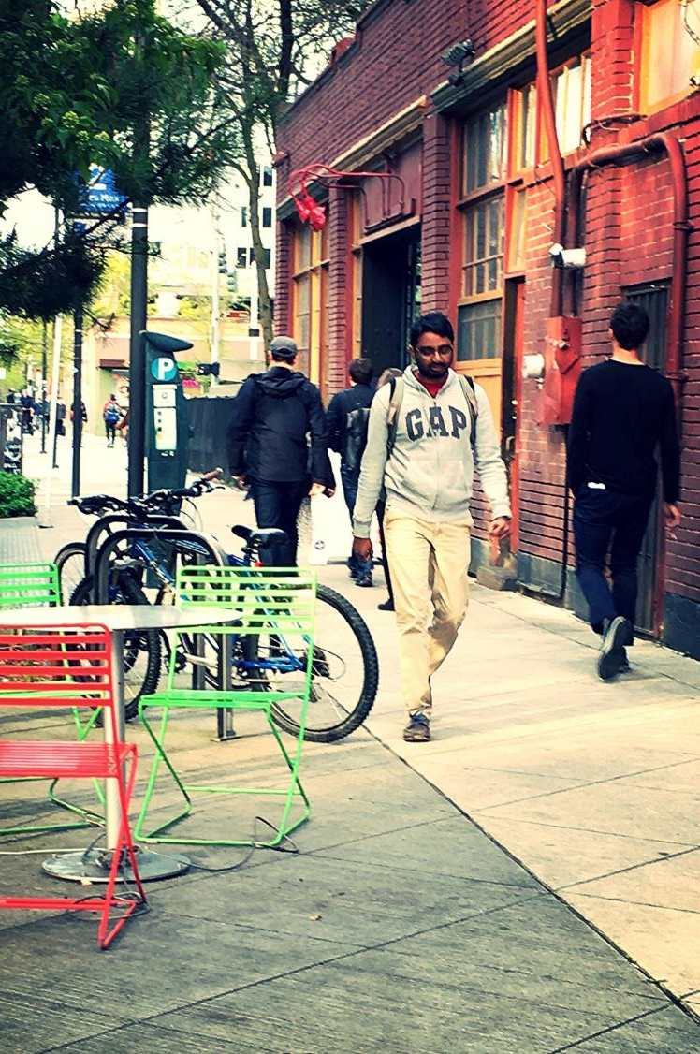
Presentation overview
What is the PMP?
PMP policy framework
What we’ve heard
Prioritizing pedestrian improvements
Plan implementation
Next steps
3

Slide 4
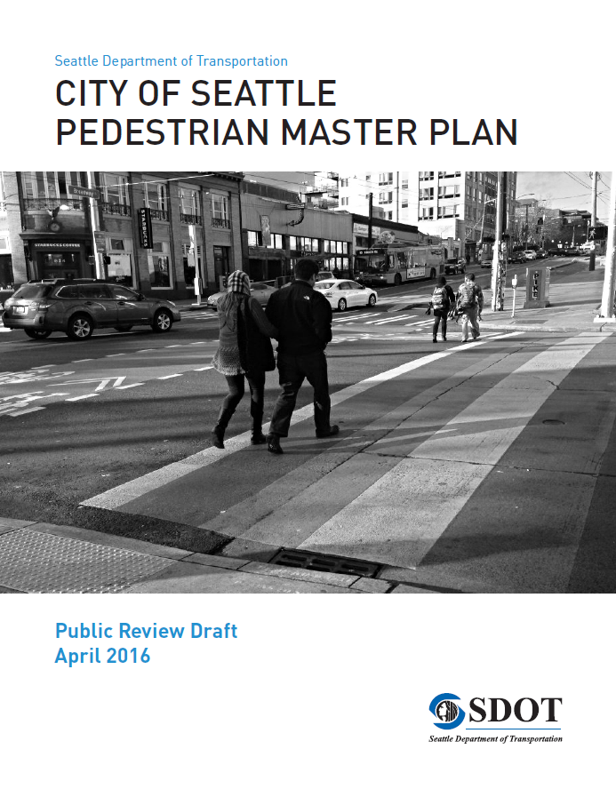
PMP is a resource allocation plan
20-year blueprint to provide walking improvements
Data-driven prioritization of funding
Designed to focus resources where:
  There is high existing and potential pedestrian demand
  There are safety concerns
  There are populations with the greatest need

Slide 5
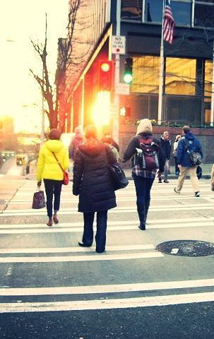
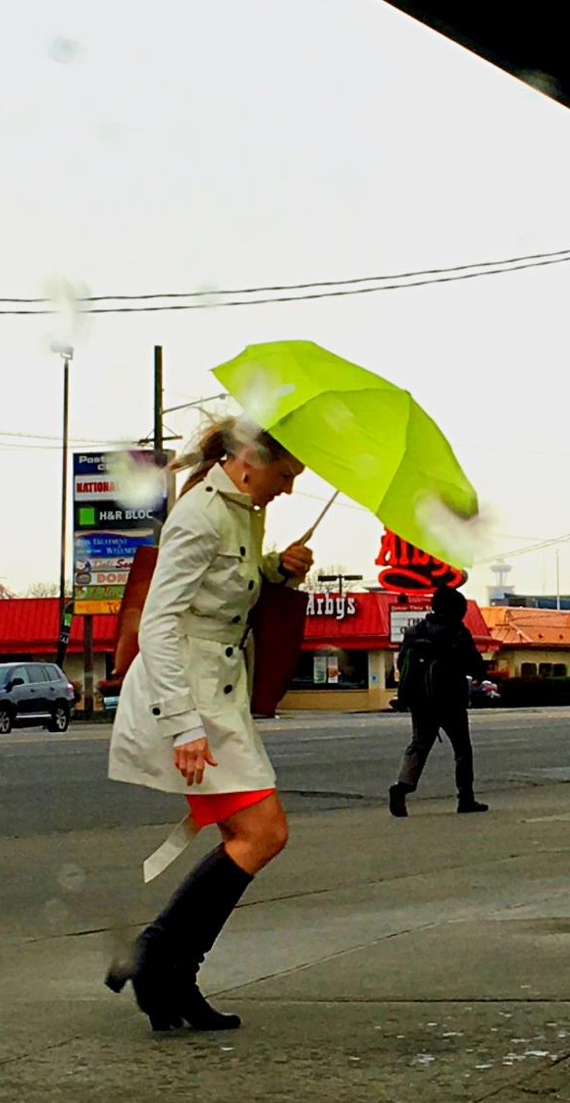
PMP Policy Framework
Vision: Seattle is the most walkable city in the Nation
Goals:
Safety: Reduce the number and severity of crashes involving pedestrians.
Equity: Make Seattle a more walkable city for all through equity in public engagement, service delivery, accessibility, and capital investments.
Vibrancy: Develop a connected pedestrian environment that sustains healthy communities and supports a vibrant economy.
Health: Get more people walking to improve mobility, health, and prevent disease.

Slide 6
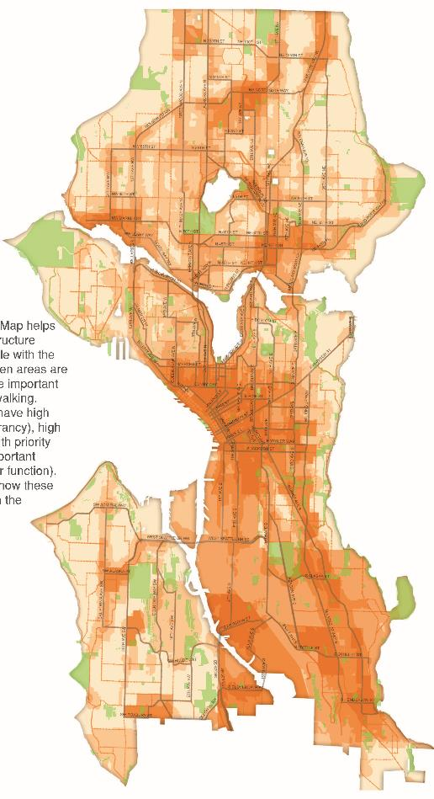
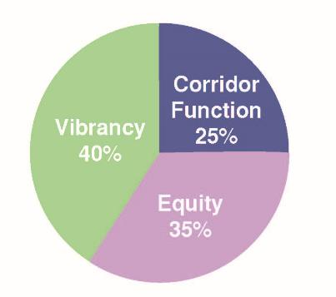
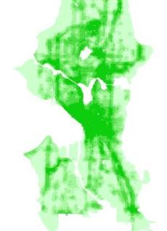
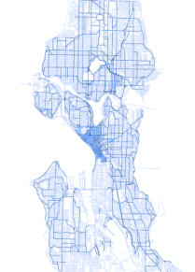
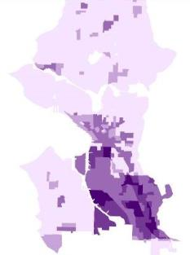
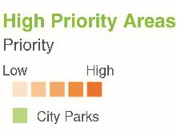
Existing PMP prioritization
High Priority Areas
Contribution to Total Score
Building Blocks
Vibrancy
(demand)
Corridor
Function
(safety)
Equity
Notes:
Walk through process, next step is “ATR” and “CTR”
Issues with 2009 methodology:
Old data (some as old as 2000 Census)
“Corridor function” = proxy for safety. Infrastructure should be prioritized using current Vision Zero safety data
Land-use based demand generators result in potential equity concerns
Heat map approach still results in some level of uncertainty about priorities and project to expect
Overwhelming number of “priorities”
These factors still reflect our Plan goals, but question is how to weigh them

Slide 7
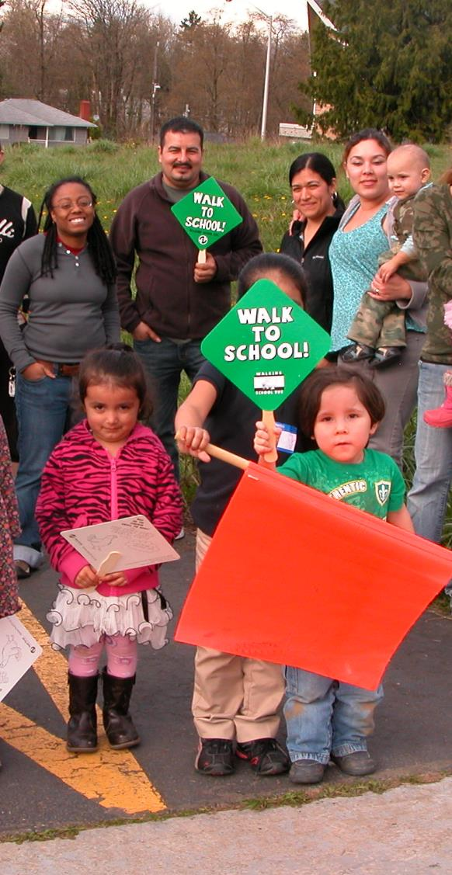
Why update the PMP?
Assess our progress
Ensure Plan continues to reflect community priorities and City policies
  Vision Zero
  Equity concerns
Update data / prioritization
Update strategies and actions (including incorporating Neighborhood Greenways, low-cost sidewalks)
Establish performance trends and targets
7
Notes:
Original BIP noted that the overall framework of the PMP is still relevant, and that the update would be minor.
More of a plan “refresh” than update

Slide 8
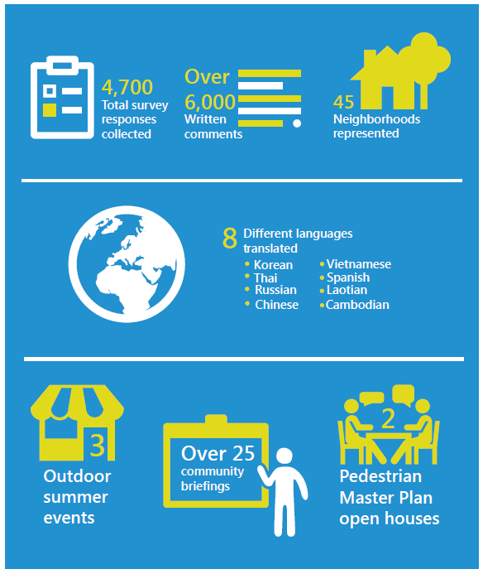
What we’ve heard
PMP Public Outreach in Numbers
Focus investments on:
Streets connecting families and children to schools
Streets connecting people to transit stops
Sidewalks and crossings on busy arterial streets
Residential streets where sidewalks are missing
Locations where pedestrians are injured
Notes:
The public survey asked three key questions about walking conditions in Seattle:
What makes it difficult or unpleasant for you to walk?
Where should the City prioritize walking improvements first?
What types of pedestrian improvements should we build first?

Slide 9
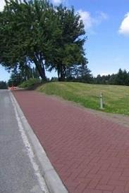
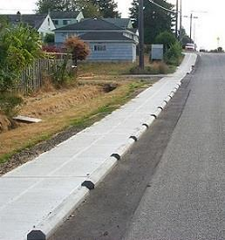
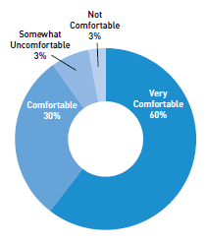
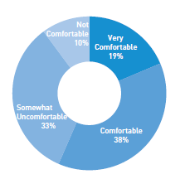
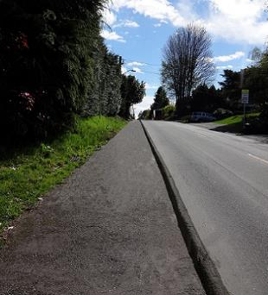
What we’ve heard:
Support for alternative sidewalk designs
Stamped and stained asphalt sidewalk with curb
Curb-separated walking path as same level as cars
Notes:
We showed six different types of alternative sidewalk designs and asked respondents to let us know comfortable they and members of their household or family would feel on this type of walking path.
As an example:
90% of respondents reported they would feel comfortable or very comfortable on a stamped/stained asphalt path with curb
57% for curb-separated walking paths

Slide 10
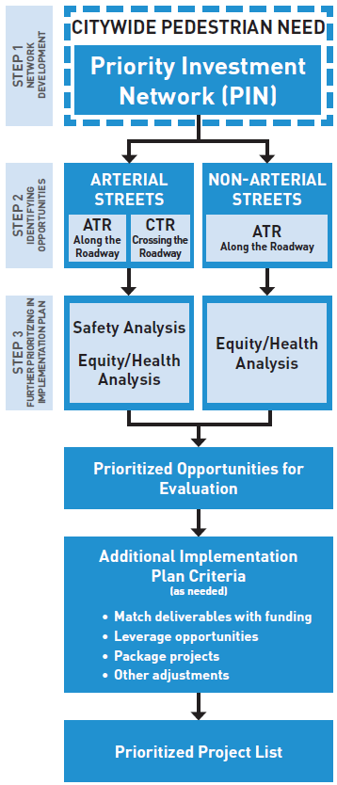
Prioritizing pedestrian improvements
Step 1
Develop a citywide “Priority Investment Network” (PIN) using demand (vibrancy) factors
Step 2
Identify opportunities to improve walking conditions along and crossing the streets in the PIN
Step 3
Further prioritization as the Plan is implemented, using safety and equity/health analyses to identify areas within the network to evaluate first

Slide 11
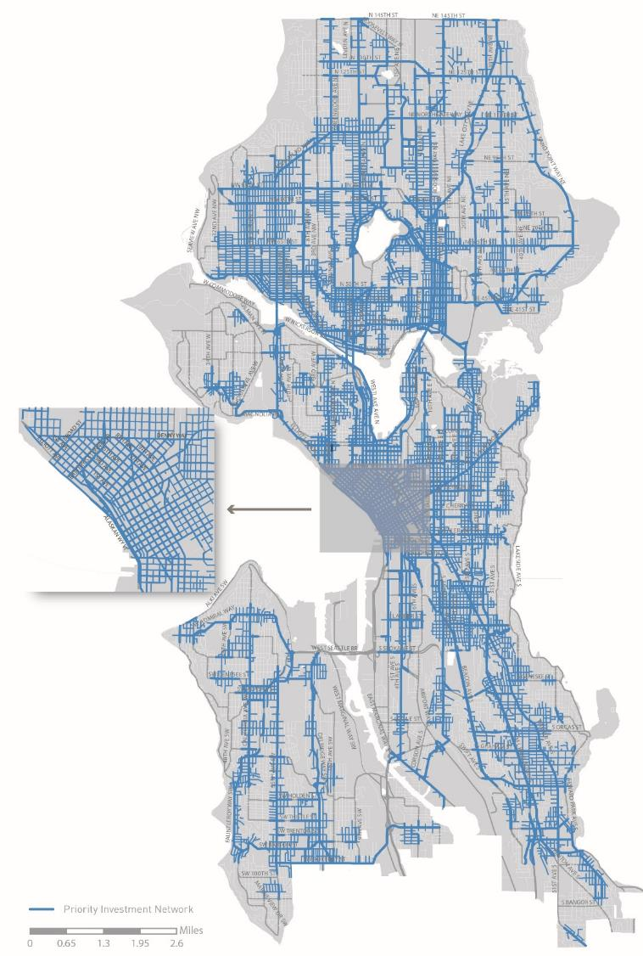
Step 1:
Priority Investment Network
Updated Factors
Walksheds to Frequent Transit Network (FTN) stops (walkshed distance based on transit type)
FTN arterials
Walksheds to public schools (1/4 mile)
Investments are directed to this network (further prioritization is required)
Responds to community priorities
Helps address desire for system connectivity
Distributes investment priorities across the city
Notes:
Based on public survey feedback we’ve narrowed that focus to two key pedestrian generators
Developed a connected network where investments will be directed
See detailed maps
Next step: To identify potential needs within this network…

Slide 12
Step 2: Identify opportunities for further evaluation
Along the roadway
Crossing the roadway
Evaluates arterial and non-arterial streets
  Sidewalk presence
Definition of sidewalk on arterials = includes curb
Does not assess sidewalk condition
Evaluates arterial streets
  Controlled stop spacing
  Crossing width
  Curb ramp status
Notes:
Evaluates arterials only
Identifies opportunities for further evaluation (not specific project recommendations)
Other types of crossing improvements (signals, lighting, etc.) driven by other analyses/programs

Slide 13
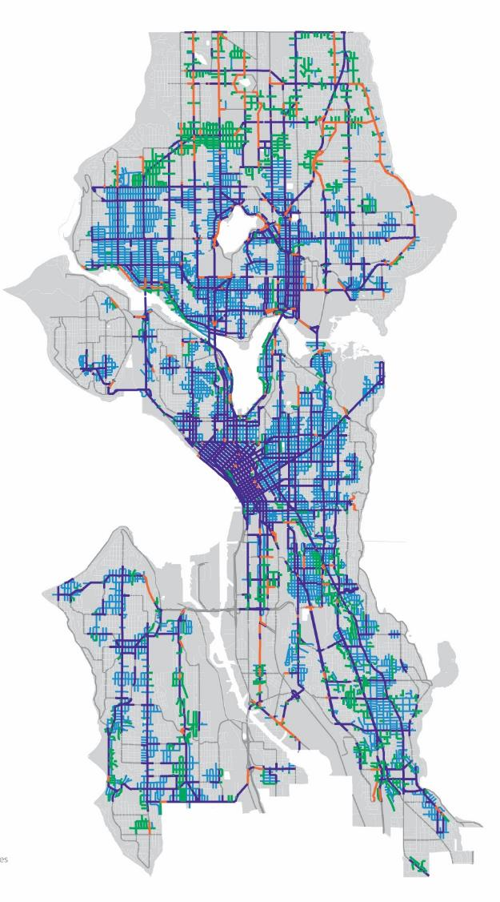

“Along the roadway”
opportunities
Arterial missing sidewalk (traditional sidewalks)
Non-arterial missing sidewalk (low-cost sidewalks)
Arterial streets (crossing improvements, maintenance)
Non-arterial streets (maintenance)
 | All arterials |  | All non-arterials
 | Citywide | Priority Investment Network | Citywide | Priority Investment Network
Total blockfaces | 12,791 | 9,158 | 32,511 | 14,770
Blockfaces missing sidewalks* | 1,400 | 669 | 10,001 | 3,058
Percent missing sidewalks | 10.9% | 7.3% | 30.7% | 20.7%
* Based on SDOT Asset Management database. Includes full or partial blockfaces. Not all locations may be feasible or desirable locations for new sidewalks.
Notes:
Evaluation is binary (Does not assess sidewalk condition)
Arterials and non-arterials considered separately

Slide 14
New sidewalk costs / funding
Draft Priority Investment Network (PIN) 20-year need
 | Blockfaces missing sidewalk* | Total cost (Arterials: $300K/blockface Non-arterials: $150K/blockface )**
Arterial streets within PIN | 669 (47.5 miles) | $200.7M
Non-arterial streets within PIN | 3,058 (202.5 miles) | Both sides of street: $459M One side of street: $229M
Total PIN sidewalk need | 3,727 | $429M to $659.7M
* Based on SDOT Asset Management database. Not all may be suitable locations for new sidewalks.
** Planning-level cost estimates can vary widely, based on site conditions, delivery method, and other factors. Cost estimate is in 2015 dollars.
Move Seattle funding (9-year)
SDOT Program | Total Levy Amount | Levy Deliverable
PMP Implementation Program (sidewalks) | $61M | Build 250 new blocks of sidewalk (traditional and “low cost” sidewalks), filling in 75% of the sidewalk gaps on priority transit corridors citywide
Safe Routes to School | $7M | Complete 9-12 Safe Routes to School projects each year
Vision Zero | $23M | Complete 12-15 corridor safety projects, improving safety for all travelers
Neighborhood Greenways | $48M | 60 miles of new greenways
Multimodal improvements | $104M | Complete 7+ multimodal corridor projects (will include pedestrian elements)
Drainage partnership | $10M | Partner with SPU to provide pedestrian infrastructure and address drainage issues in the flood-prone South Park neighborhood
Notes:
Plan is programming 9-year Move Seattle levy funding
Planning level cost estimate is for the full 20-year plan
These programs are not the only ways new sidewalks are built
Capital projects / Move Seattle (Complete Streets)
Private development
Implementation Plan will identify program/project leveraging opportunities:
Interdepartmental (working with Seattle Public Utilities on drainage partnerships)
Neighborhood Greenways program
Complete Streets leveraging opportunities
A lot of political focus on sidewalks right now in Seattle, but crossing conditions are critical…

Slide 15
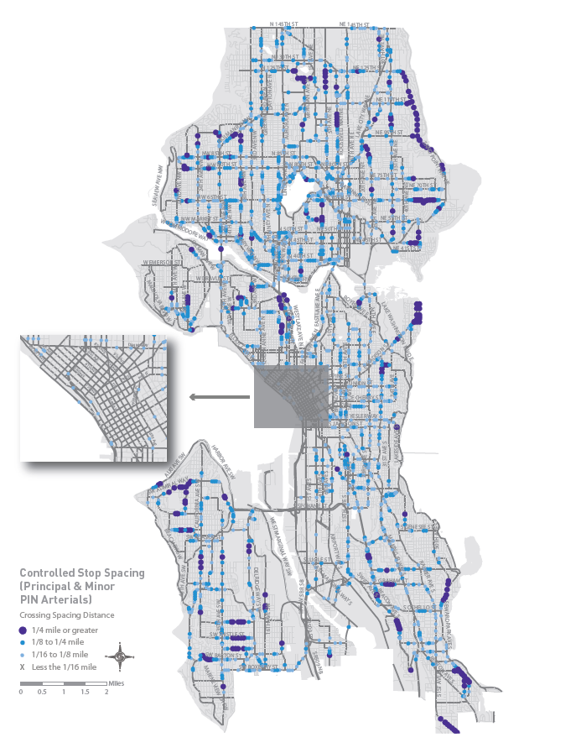
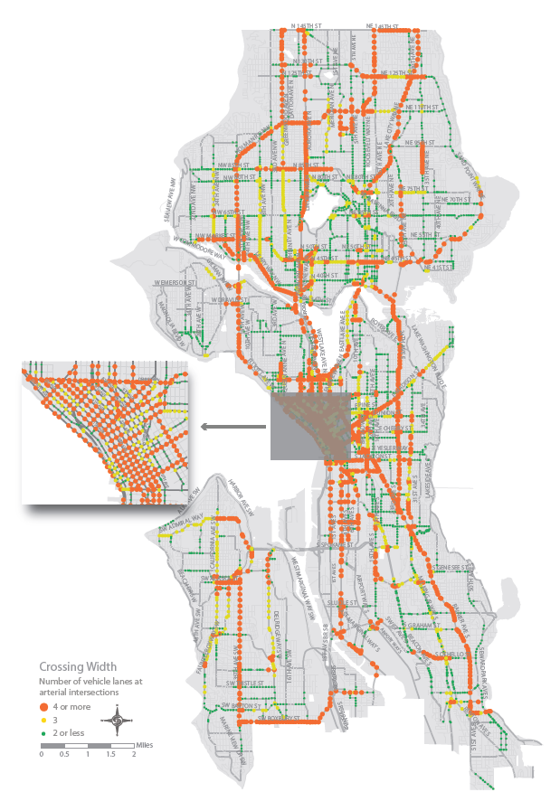
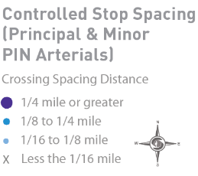
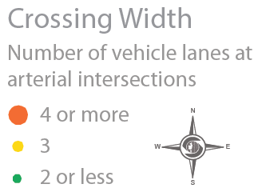
Crossing the roadway opportunities
Controlled stop spacing
Crossing width
Notes:
Evaluates arterials only
Intent is to identify infrastructure opportunities: Other types of crossing improvements (signal phasing improvements, pedestrian lighting, etc.) driven by other analyses/programs
New policies in the PMP:
Crossing distance spacing
Transit stop locations
Identifies opportunities for further evaluation (not specific project recommendations)
Curb ramp opportunities: Forthcoming

Slide 16
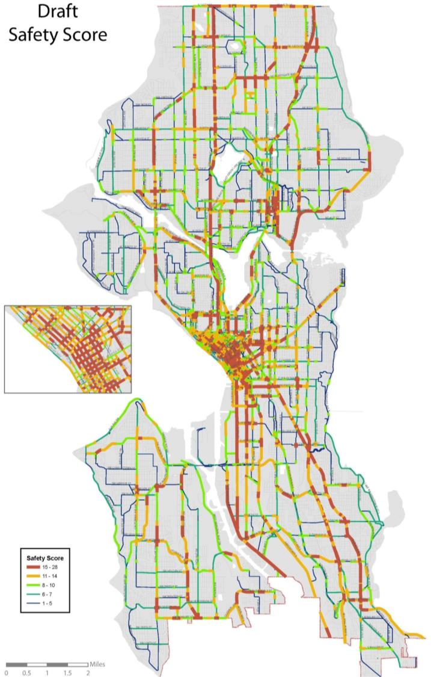
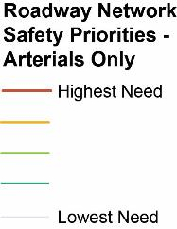
Step 3: Further prioritizing (arterials)
Safety Factors (based on SDOT Pedestrian Safety Analysis and Vision Zero objectives)
Pedestrian collisions | Serious injuries and fatalities more highly weighted. Data from the last 5 years.
Arterial classifications | Proxy for volume; Majority of severe injuries occur on principal and major arterials
Roadway width | Curb to curb width
Speed | 85th percentile speeds where available, and posted speed limit where actual speed is not available.
Controlled crossing spacing | On principal and major arterials

Slide 17
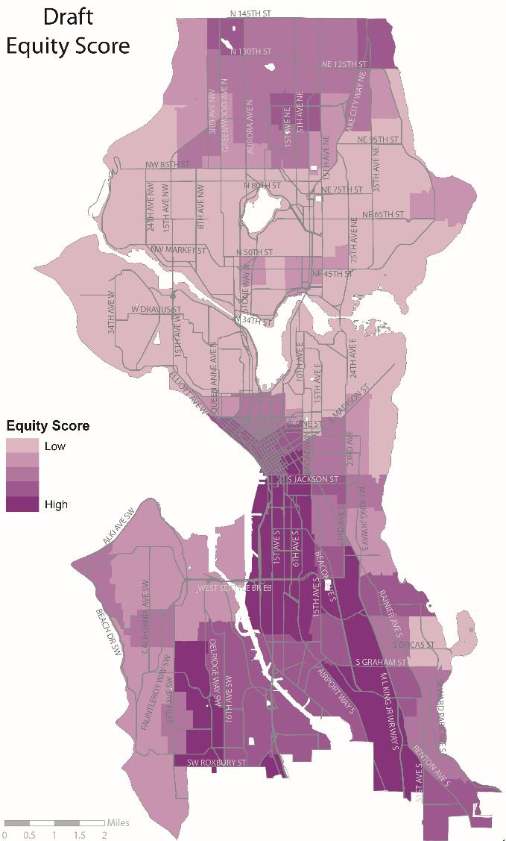
Step 3: Further prioritizing (arterials and non-arterials)
Health and Equity Factors
Communities of color (new)
Low income population
Disability population
Diabetes rates
Physical activity rates
Obesity rates

Slide 18
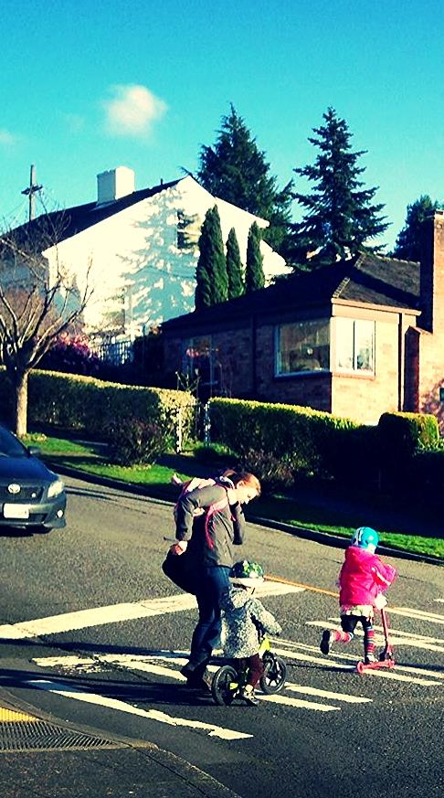
PMP Implementation Plan
Will be developed after Plan adoption
Identify locations within the PIN for near-term improvements based on:
  Safety/Equity/Health analyses
  Annual funding streams, grant opportunities, and other resources.
  Program/project leveraging opportunities
  Other balancing factors
Implementation Plan will be updated regularly
  Reflects changing funding and leveraging opportunities
  Allows safety/equity/health data to be updated regularly

Slide 19
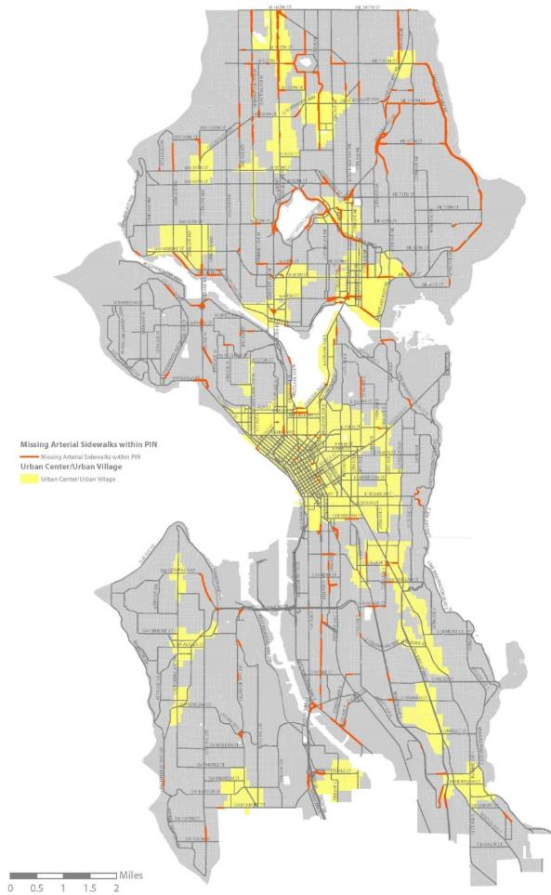
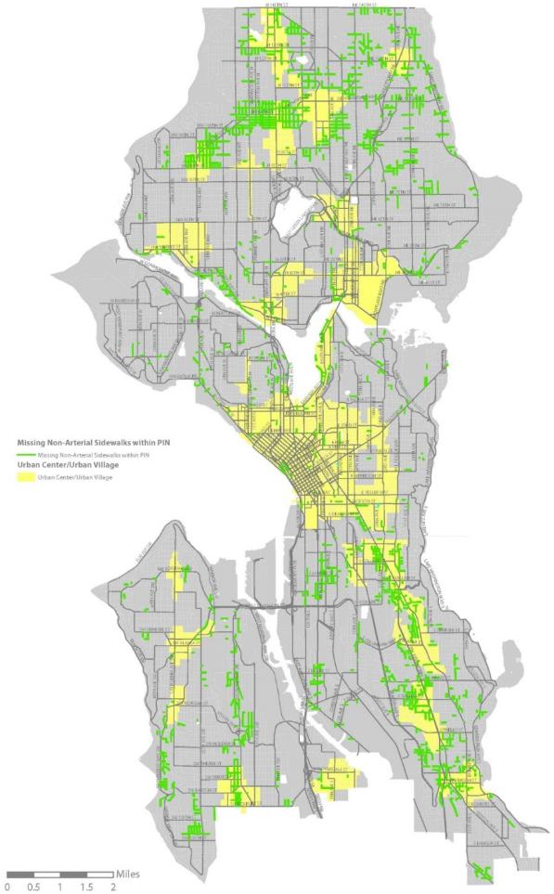
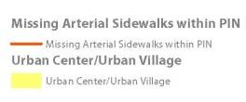

Role of land use in prioritization
Notes:
Implementation Plan:
Will apply safety and equity analyses
This allows up to update our safety/equity data annually (rather than having it calcify within the Plan). The result is a more dynamic, living Plan.
As noted, Implementation Plan will also consider annual funding streams, grant opportunities, program/project leveraging opportunities, etc.
Remaining questions: Role of land use?
How to be strategic with public dollars

Slide 20
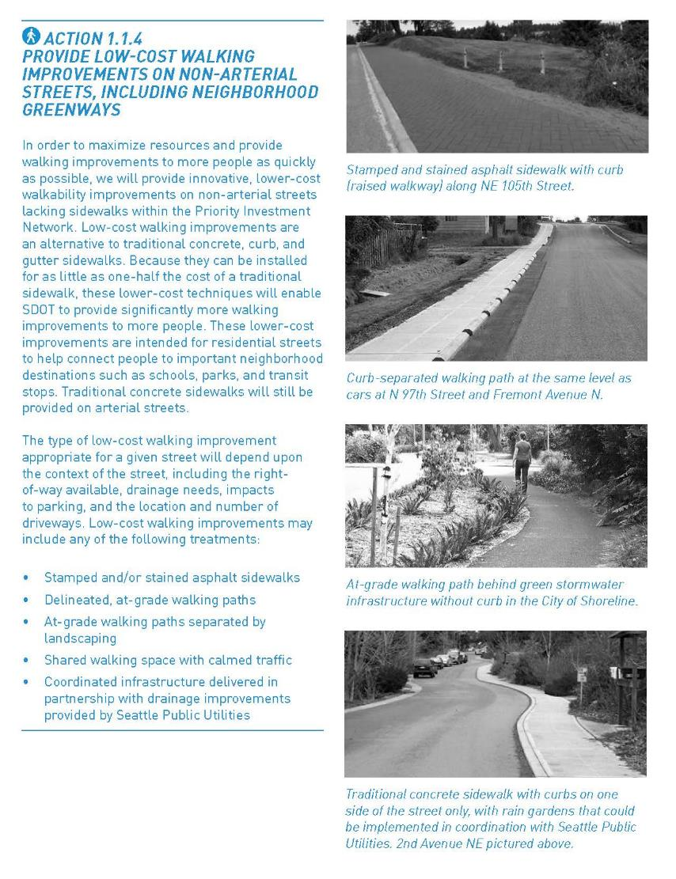
Implementing strategies and actions
Stem from Plan goals/objectives
Outline how we will improve walking conditions within the PIN.
19 implementing strategies
64 implementing actions

Slide 21
Plan performance measures
Measure | Desired trend | Performance target
Number of pedestrian fatalities and serious injury collisions | Decreasing rate | Pedestrian fatalities and serious injury collisions reach zero by 2030
Rate of crashes involving pedestrians | Decreasing rate of pedestrian crashes per 100,000 residents | (None recommended)
Percent of sidewalks within the PIN completed | Increasing percentage of Priority Investment Network arterial sidewalks completed | 100% of PIN arterial sidewalks complete by 2035
Mode share | Increasing percentage of walking trips | (None recommended)
Pedestrian activity | Increasing number of pedestrians at count locations over time | (None recommended)
Children walking or biking to or from school | Increasing number of trips by children | (None recommended)

Slide 22

PMP Public review draft
Public comment period
  45 days
Hard copy of the plan distributed to
  Seattle libraries
  City Council
  Mayor’s office
Available online
Work with Department of Neighborhoods (DON) to spread the word

Slide 23
Status and next steps
 | April | May |  | June | July | August
Develop draft plan
Release draft plan for public review
Public review and outreach
Address comments
Anticipated Mayor’s recommended plan*
*Implementation Plan will be developed after Plan adoption
Notes:
Working with DON on public outreach during the public review period

Slide 24





Questions?
michelle.marx@seattle.gov | (206) 684-0633
ian.macek@seattle.gov | (206) 684-7576
www.seattle.gov/transportation/pedMasterPlan.htm
www.seattle.gov/transportation

