Slide 1
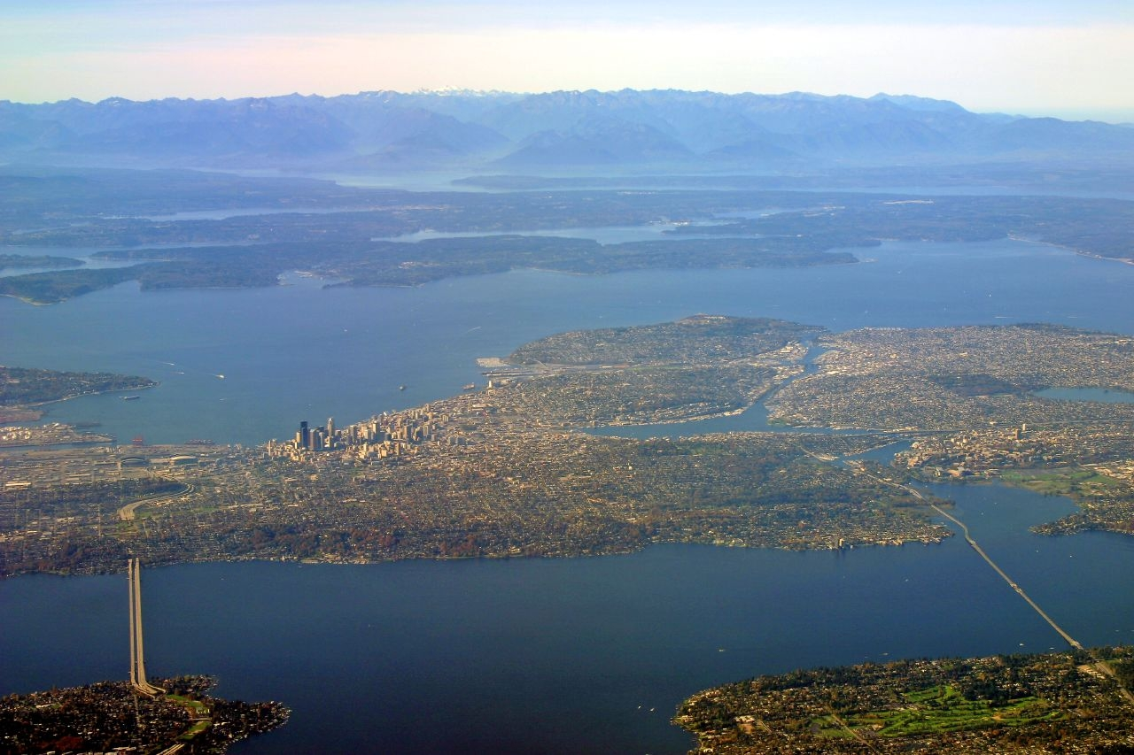

Seattle Planning Commission
November 13, 2014
Seattle’s Comprehensive Plan:
  What it is and why we have it
  How it’s working
  What’s new and what are we asking you

Slide 2
Capital Investments and Growth
The Challenge
Context
Discussion

Slide 3
Council Request
“Coordinating infrastructure with growth. As our cities grow, we must ensure our transportation, parks, and utility infrastructure growths and improve alongside new development. This will ensure that our dense neighborhoods continue to be livable places. We hope that Comprehensive Plan includes a framework for coordinating our capital investment plans with our plans for growth, and also with an eye to equity. We hope that at our fourth quarter update in December, when you are further along in the plan, you can share strategies for coordinating infrastructure investments.”

Slide 4
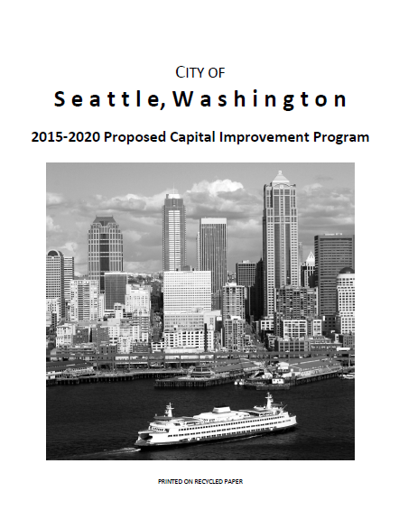
Current Plans
Comprehensive Plan
Application of the Plan
Capital Investments
Potential Future Discretionary Projects
Neighborhood Planning work-plan matrix
CIP
Comprehensive Plan informed development of the 2015-2020 Proposed CIP
867 pages

Slide 5
Past Approaches
SKIP
Capital Cabinet
IDTs for Northgate, SLU, SoDo
Strategic Capital Agenda - principles and other factors that guide the City's capital funding decisions

Slide 6
Questions for Discussion
What other principles or factors should be considered?
How can we communicate to public how decisions are made?
How can we better communicate Plan priorities to city departments?

