Slide 1
SEATTLE PLANNING COMMISSION
Thursday, August 13, 2015
3:00 – 5:05 pm
City Hall, Room L280
REVISED AGENDA
Chair’s Report & Minutes Approval 3:00 - 3:10 PM
Meet and Greet: Mayor Ed Murray 3:10 – 3:40 PM
Work Session: 2035 public Draft Review – Seattle Growth Strategy 3:40 – 4:20 PM
Tom Hauger, DPD
Public Comment on Annual Amendments Letter 4:20 – 4:25 PM
Approve: 2014-2015 Annual Comp Plan Amendment Letter 4:25 – 4:55 PM
Work Session: Housing Affordability and Livability Agenda 4:55 – 5:25 PM
Public Comment 5:25 – 5:30 PM
ADJOURN 5:30 PM

Slide 2
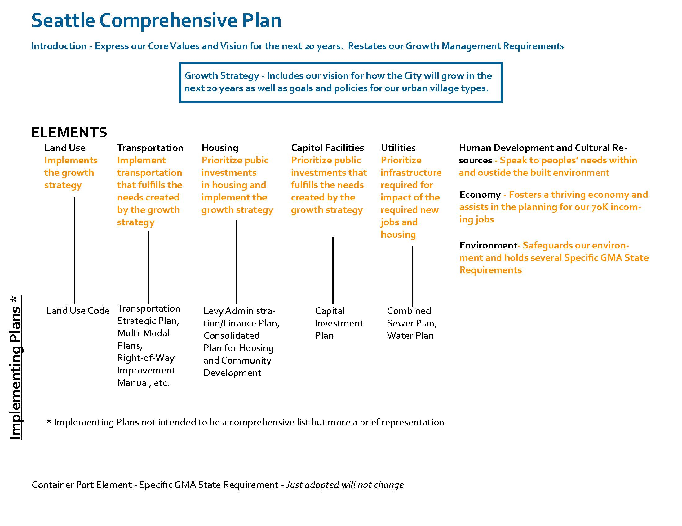

Slide 3
Seattle Growth Strategy
Current Policy in Public Draft GS1.5 Monitor urban centers and villages to track changes over time in the number of housing units and jobs, population and public investments, and use this information to make decisions about conducting further planning or providing additional investments to help meet the needs of residents in these locations.
Staff Recommendation as a replacement policy for GS1.5 Acknowledge that not all Urban Villages have the same needs. Monitor neighborhood-level demographics and indicators, and use this information to make equitable planning and investment decisions.
Notes:
Acknowledge that the Urban Village Strategy is inequitable
Monitor equitable indicators and not just growth
Make funding decisions based on equity

Slide 4
Seattle Growth Strategy
Current Policy in Public Draft GS2.4 Coordinate planning for transportation, utilities, open space and other public services to meet the anticipated growth and increased density.
Staff Recommendation as replacement policy for GS2.4 Coordinate planning for transportation, utilities, open space and other public services to meet the needs of the community you wish to serve.
Notes:
Remove growth and density and focus on community need and equitable investments

Slide 5
Seattle Growth Strategy
Current Policy in Public Draft on Displacement Concern - GS1.6 Monitor development activity in areas with high potential for displacement of marginalized populations and small businesses and identify and implement strategies that can limit that displacement.
GS2.9 Use zoning and other planning tools in places where growth and development are expected to shape the amount and pace of growth in ways that will control displacement of marginalized populations, community services and institutions.
Staff recommendation to replace policy for GS1.6/2.9. Seek to provide equitable access to Urban Villages and Centers where transit service and community amenities are plentiful. Encourage targeted use of incentive zoning, cultural district overlays, and other citywide investment tools to prevent displacement of marginalized populations and culturally significant institutions and businesses.
Notes:
Attempt to put in more specificity and more meat into these policies. These came from adopted Transit Community policies.

Slide 6
Seattle Growth Strategy
Current Policy in Public Draft that Define Boundary of Urban Villages/Centers GS2.3 Establish boundaries for urban centers, urban villages, and manufacturing/industrial centers that reflect existing development patterns, intended community characteristics, and recognized neighborhood areas. GS2.11 Permit varying sizes of urban villages based on local conditions, but limit sizes so that most village areas are within walking distance from employment and service areas in the village. GS2.12 Reflect the area that is generally within a ten-minute walk of frequent light rail stations in urban villages.
Staff Recommendation on replacement of GS2.3 and GS2.12 with the following. Keep GS2.11? GS2.3 Establish boundaries for urban centers, urban villages, and manufacturing/industrial centers that reflect existing development patterns, intended community characteristics, and the 10 minute walkshed(defined below) from frequent and reliable transit as defined by policy GS2.?? GS2.?? Define frequent and reliable transit as: light rail stations; Places where two corridors that currently provide frequent transit service intersect, as shown in either red, orange, or yellow on the Frequent Transit Network map (Figure 4-1 in the Seattle Transit Master Plan) as updated to show actual 2012 frequent transit service levels; Existing multimodal hubs and transportation centers shown in Figure 5-5 in the Seattle Transit Master Plan GS2.???? Boundaries of existing Urban Villages and Urban Centers may only be revisited through a community planning process and an amendment to the Comprehensive Plan.
Notes:
GS2.3 Commission has expressed concern that there boundary changes are not directive enough and as currently adopted language the Transit Communities policy give direction on this point.
GS2.12 is not specific enough, again Transit Communities gives some guidance here.
GS2.???? Is staffs attempt at proposing a process that can happen give community members a clear path forward

Slide 7
SPC letter re: 2014/15 Proposed Amendments to Comp Plan
Proposed FLUM amendments

Slide 8
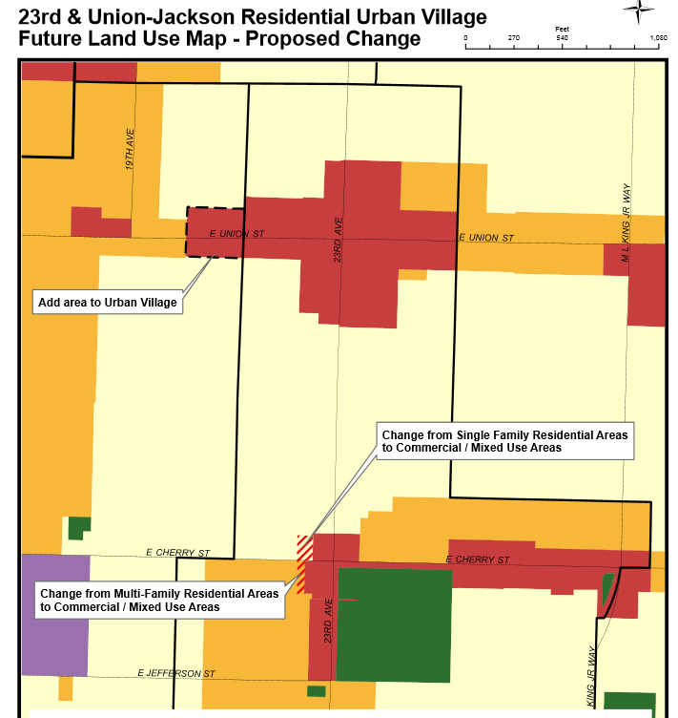
Central Area Update
Parcels include:
700 22nd Ave. (within UV)
E. Union Street
2002, 2006, 2008, 2012, 2016, 2018
1412 20th Ave.
E. John Street
2001, 2015

Slide 9
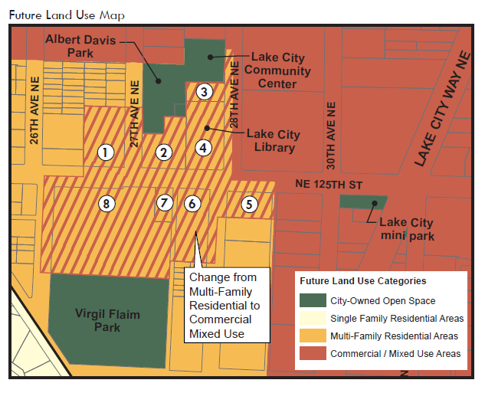
Lake City Update
Parcels Include:
NE 125th St.
2611, 2700, 2707, 2727, 2805
28th Ave. NE
12501, 12531
27th Ave. NE
12509

Slide 10
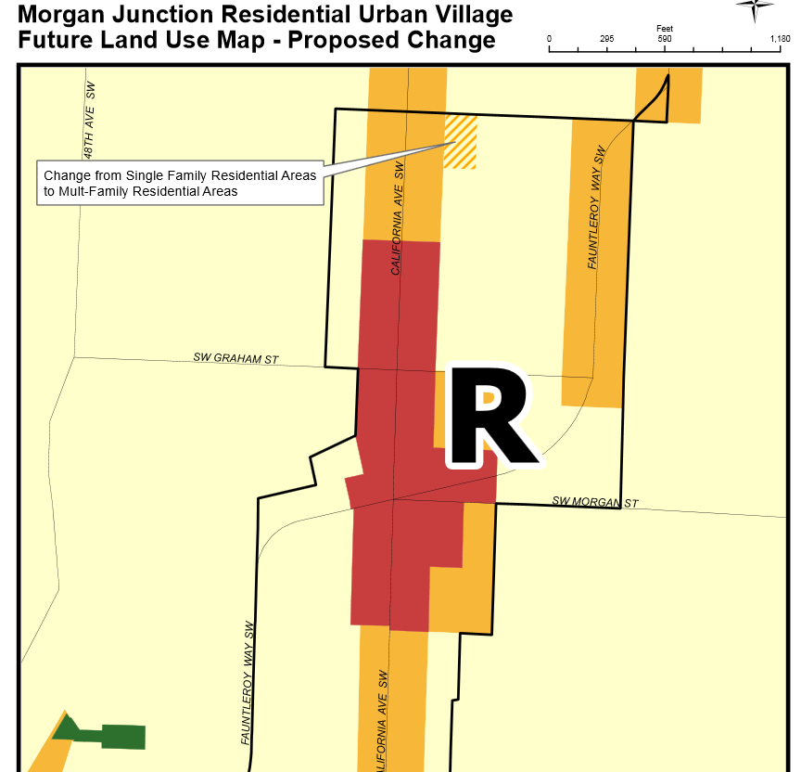
Morgan Junction Update
Parcel Included:
4201 SW. Juneau Street

Slide 11
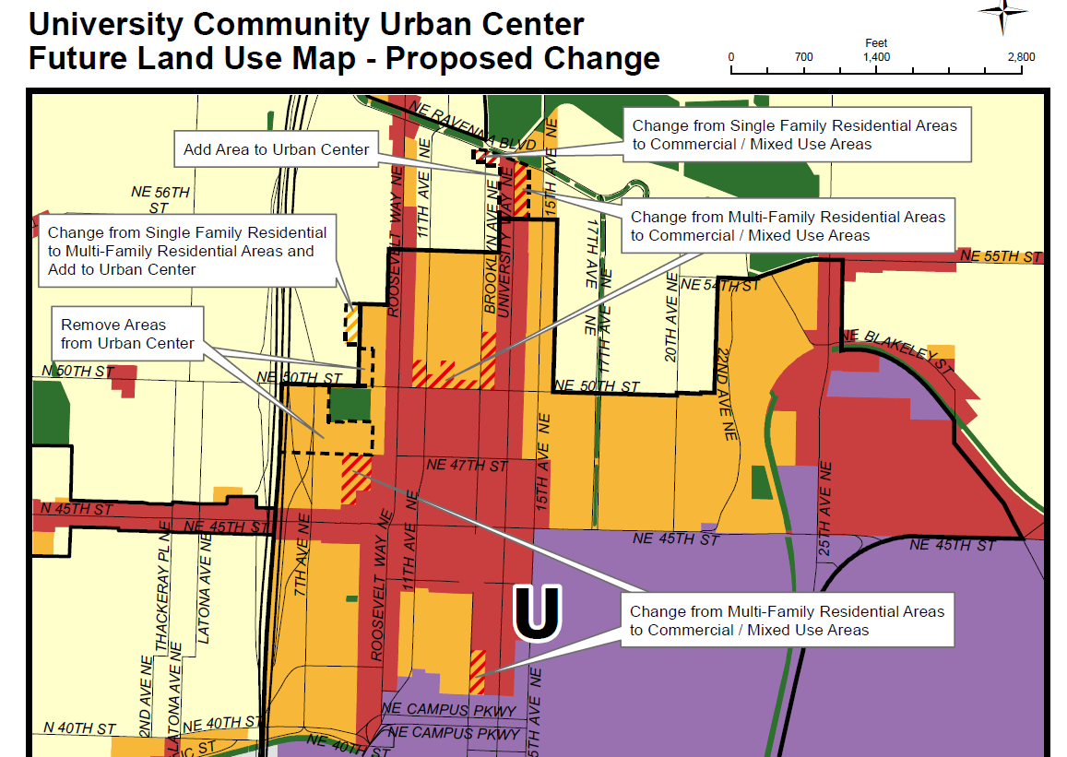
U-District Update
Parcels Include:
Several

Slide 12
SPC letter re: 2014/15 Proposed Amendments to Comp Plan
Central Area Neighborhood Plan
Planning Commission Recommendation: Adopt with modification
Change since March – none
Lake City Neighborhood Plan
Planning Commission Recommendation: Adopt
Change since March – none
Notes:
Cherry Hill Baptist church

Slide 13
SPC letter re: 2014/15 Proposed Amendments to Comp Plan
Morgan Junction Neighborhood Plan
Planning Commission Recommendation: Adopt
Change since March – some revised language
4. University District Update
Planning Commission Recommendation: Adopt with modifications
Change since March – revised language, no FLUM change
Notes:
Morgan – revised language in response to SPC concerns re: parcel specificity, single family character reference remains
UD – comments largely addressed re: Comp plan references, family sized as opposed to ground related

Slide 14
SPC letter re: 2014/15 Proposed Amendments to Comp Plan
Downtown Neighborhood Plan Updates
Planning Commission Recommendation: Adopt
Change since March – none

Slide 15
Housing Affordability and Livability Agenda – SPC approach
Two top near-term priorities for Commission to review and comment on:
Build Affordability as we grow: Commercial Linkage Fee and Mandatory Inclusionary Housing (with upzones in proportion to requirements)
Increase Opportunities for Multifamily Housing, including:

Slide 16
Housing Affordability and Livability Agenda – SPC approach
Increase the amount of land zoned for MF housing in urban villages and walksheds (MF.1)
Expand the boundaries of Urban Villages to reflect walksheds for transit, amenities and services (MF.2)
Increase housing options on single family zoned land within Urban Villages (MF.3) – rezone SF to RSL or Lowrise
Add multifamily zoning to create transitions next to more intensive zones

Slide 17
Housing Affordability and Livability Agenda – SPC approach
Second level priority and related:
Expand the Multifamily Property Tax Exemption Program
Comprehensive Parking Reform
Prevent displacement of low-income residents (tenants and homeowners)

Slide 18
Housing Affordability and Livability Agenda – timing
Select Committee on Housing Affordability fall 2015 legislation:
Work Plan Resolution
Mandatory Inclusionary Zoning, Commercial Linkage Fee Resolution
Commercial Linkage Fee Regulatory Framework Council Bill

Slide 19
Housing Affordability and Livability Agenda – timing
Work Plan Resolution
Establishes City’s affordable Housing objectives based on HALA recs
Sets out multi year work program for implementation of recs
Requests state level changes
Concurs with housing targets that guided HALA recs
Timing
9/9 Public Hearing
9/18 Discussion
9/21 Committee vote
9/28 Full Council vote

Slide 20
Housing Affordability and Livability Agenda – timing
Mandatory Inclusionary Zoning (MIZ), Commercial Linkage Fee (CLF) Resolution
Establish intent to consider future upzones to implement MIZ and CLF
Establish expectations for planning and outreach that must precede Council action
Identify other HALA recommended land use regulatory changes that Council will consider
Timing
9/9 Public Hearing
9/18 Discussion
9/21 Committee vote
9/28 Full Council vote

Slide 21
Housing Affordability and Livability Agenda – timing
Commercial Linkage Fee Bill
New Chapter in Seattle Muni Code that establishes a commercial linkage fee program
Requirements of chapter not applicable to new development until future upzones occur.
Timing
9/18 Briefing
9/30 Public Hearing
10/5 Discussion
10/12 Committee vote
11/2 Full Council vote

Slide 22
Housing Affordability and Livability Agenda – Commercial Linkage Fee
Mandatory requirement of new commercial construction to pay a per square foot fee to the City for the production and preservation of affordable housing
Fees will fund housing at 0 – 80% AMI but primarily at or below 60% AMI
Fees based on value of upzones and vary by market and construction type

Slide 23
Housing Affordability and Livability Agenda – Commercial Linkage Fee
Under 85’ – rezone specified areas to provide additional capacity for commercial development
Highrise – additional floor area (1 FAR) equivalent to site size; fees based on existing Incentive Zoning for affordable housing
Phased in over 3 years, fee schedule set for 10 years (indexed for CPI) with changes subject to Mayor and Council undertaking a specified Technical Review Committee process, existing IZ will remain until CLF is implemented

