Slide 1
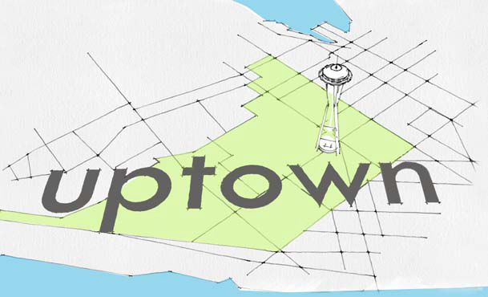
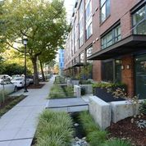
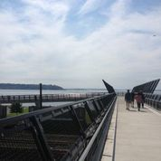
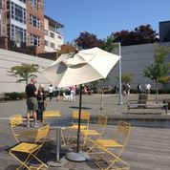
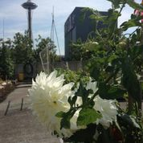
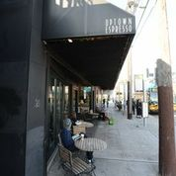
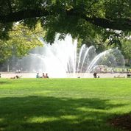

DESIGNING A FRAMEWORK
FOR UPTOWN’S FUTURE
City of Seattle
Department of Planning and Development
Notes:
Opening slide, Introductions:
Self (Marshall)
Robert Nellams, SC Director and host (in terms of venue)
Rick Hooper (if present) OH Director
Josh Brower, Seattle Planning Commissioner
Debi Frausto, Chair of the Uptown Alliance Urban Design Framework committee
Special thanks to John Coney who helped get the ball rolling on the community side

Slide 2
DESIGNING A FRAMEWORK
FOR UPTOWN’S FUTURE
What is an Urban Design Framework?
A shared community vision for the physical development of the Uptown neighborhood developed collaboratively between the City and the neighborhood.
A road map for City departments working on zoning, design guidelines, facilities and services.
A coordinated strategy to make the most of opportunities (redevelopment, the north portal, reconnecting the street grid east of Seattle Center…).
City of Seattle
Department of Planning and Development
Notes:
Why now why here?
Uptown is one of six Urban Centers in Seattle. Several large infrastructure and development projects are planned or underway in the neighborhood including Two way Mercer and the north portal of the State Route 99 tunnel.

Slide 3
DESIGNING A FRAMEWORK
FOR UPTOWN’S FUTURE
Uptown By The Numbers
297 Acres
7,300 Residents
14,801 Jobs
Capacity for 5,000 jobs and 4,000 Households
20-year Growth Targets for jobs and housing range from 2,000 – 3,500.
City of Seattle
Department of Planning and Development
Notes:
Why now why here?
Uptown is one of six Urban Centers in Seattle. Several large infrastructure and development projects are planned or underway in the neighborhood including Two way Mercer and the north portal of the State Route 99 tunnel.

Slide 4
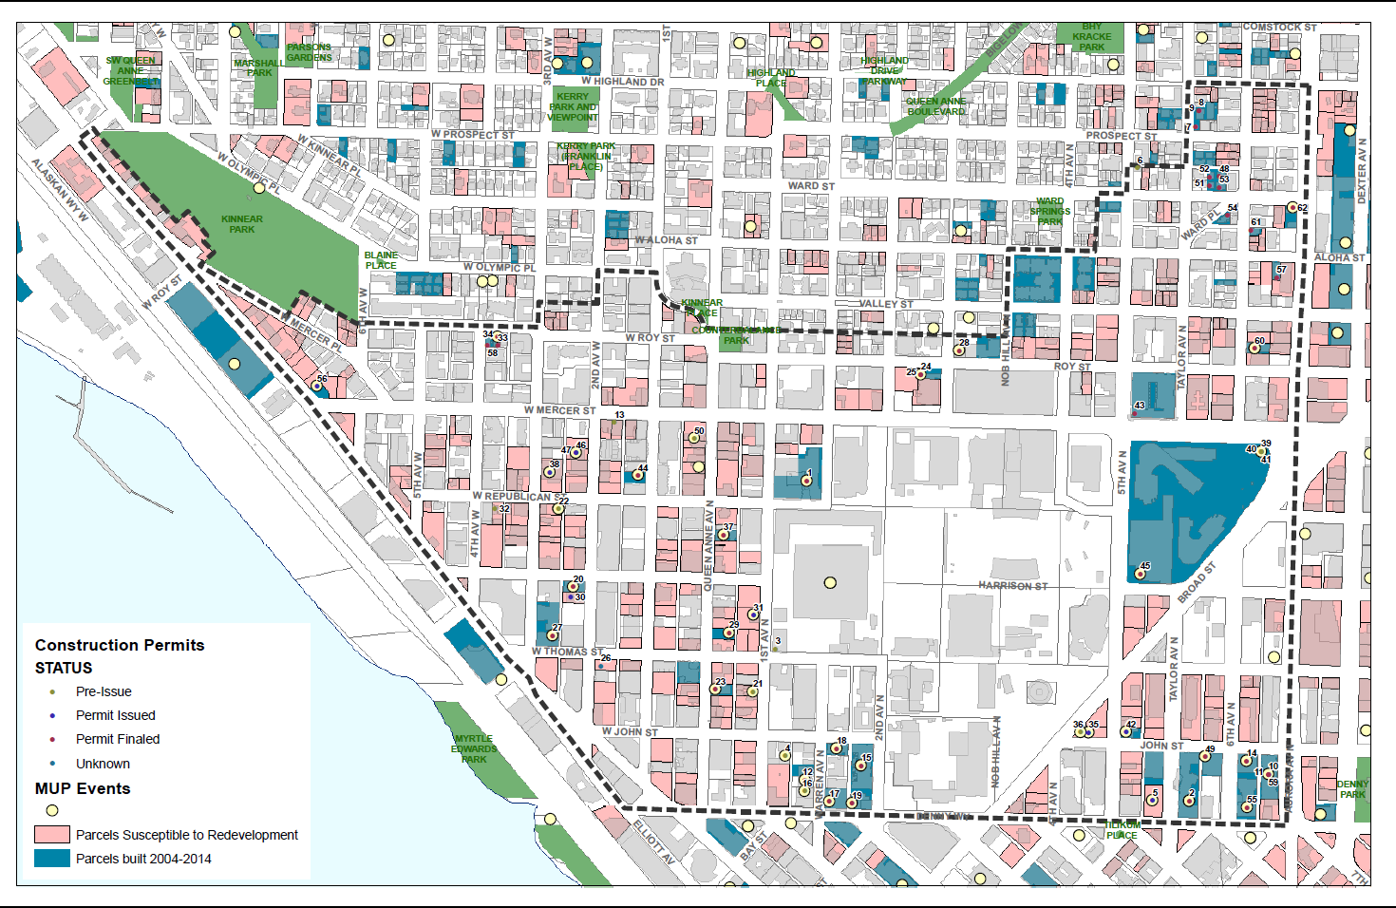
DESIGNING A FRAMEWORK
FOR UPTOWN’S FUTURE

Slide 5
Charrette 1
DESIGNING A FRAMEWORK
FOR UPTOWN’S FUTURE
Neighborhood Character
Neighborhood Connections
Neighborhood Edges

Slide 6
DESIGNING A FRAMEWORK
FOR UPTOWN’S FUTURE

Slide 7
DESIGNING A FRAMEWORK
FOR UPTOWN’S FUTURE

Slide 8
DESIGNING A FRAMEWORK
FOR UPTOWN’S FUTURE

Slide 9
Neighborhood Character Drill-Down
DESIGNING A FRAMEWORK
FOR UPTOWN’S FUTURE
Land Use
Urban Form – including Height
Neighborhood Amenities

Slide 10
Street Character
DESIGNING A FRAMEWORK
FOR UPTOWN’S FUTURE
Street Typology
Bike/Ped/Freight
Neighborhood Connections

Slide 11
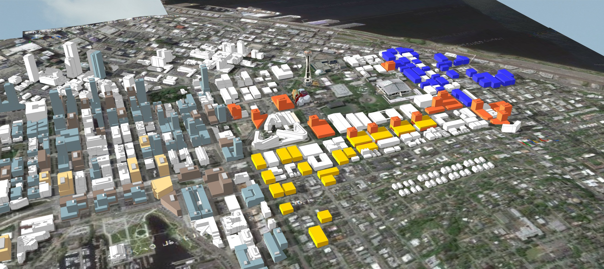
DESIGNING A FRAMEWORK
FOR UPTOWN’S FUTURE

Slide 12
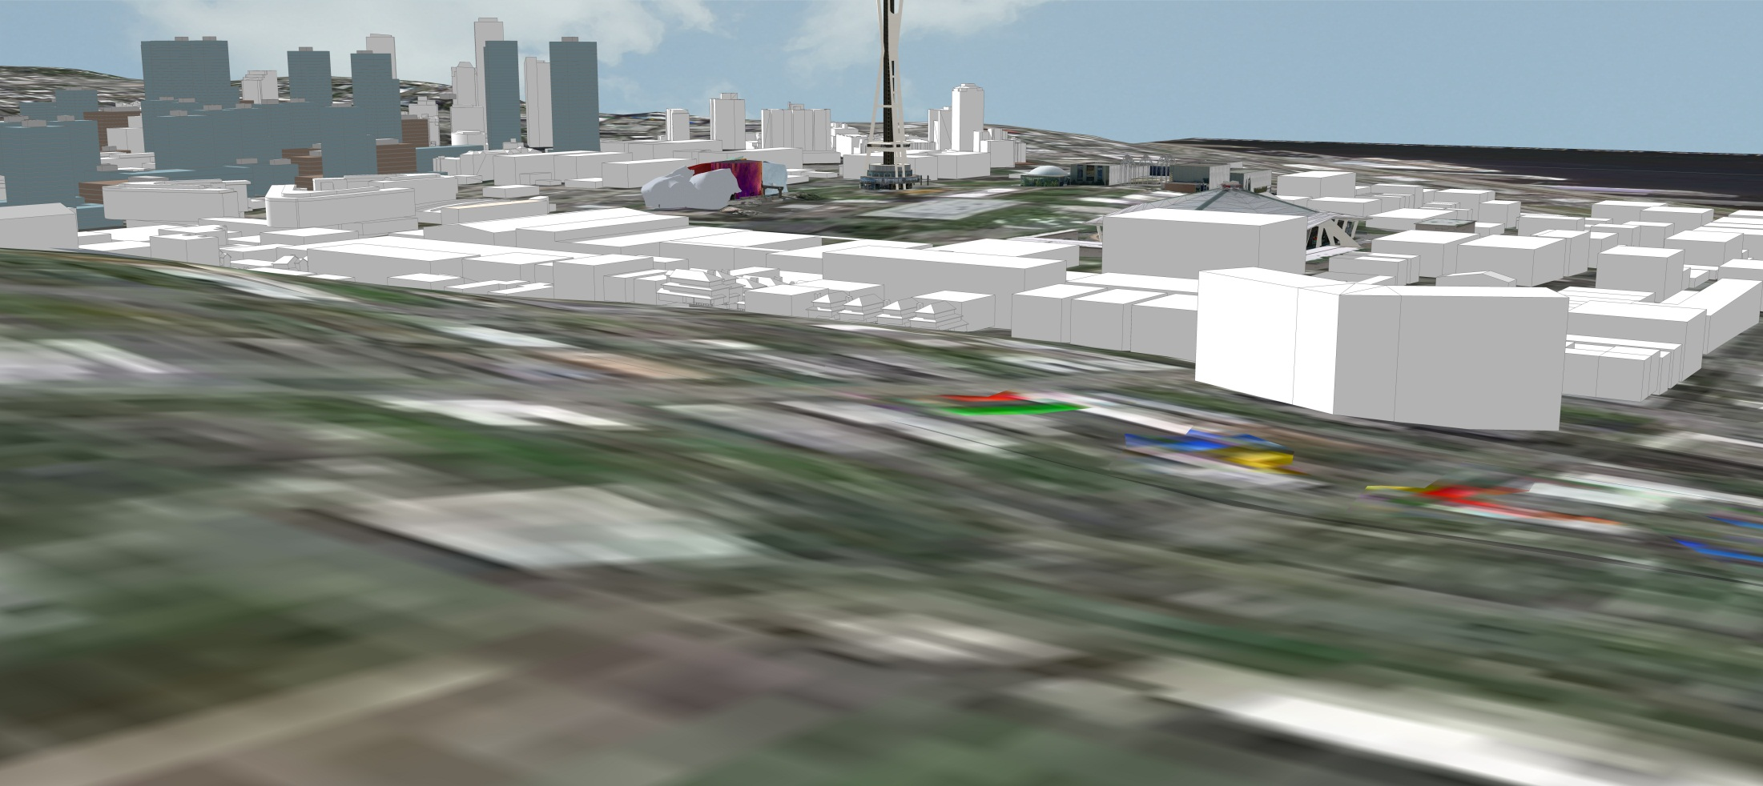
DESIGNING A FRAMEWORK
FOR UPTOWN’S FUTURE

Slide 13
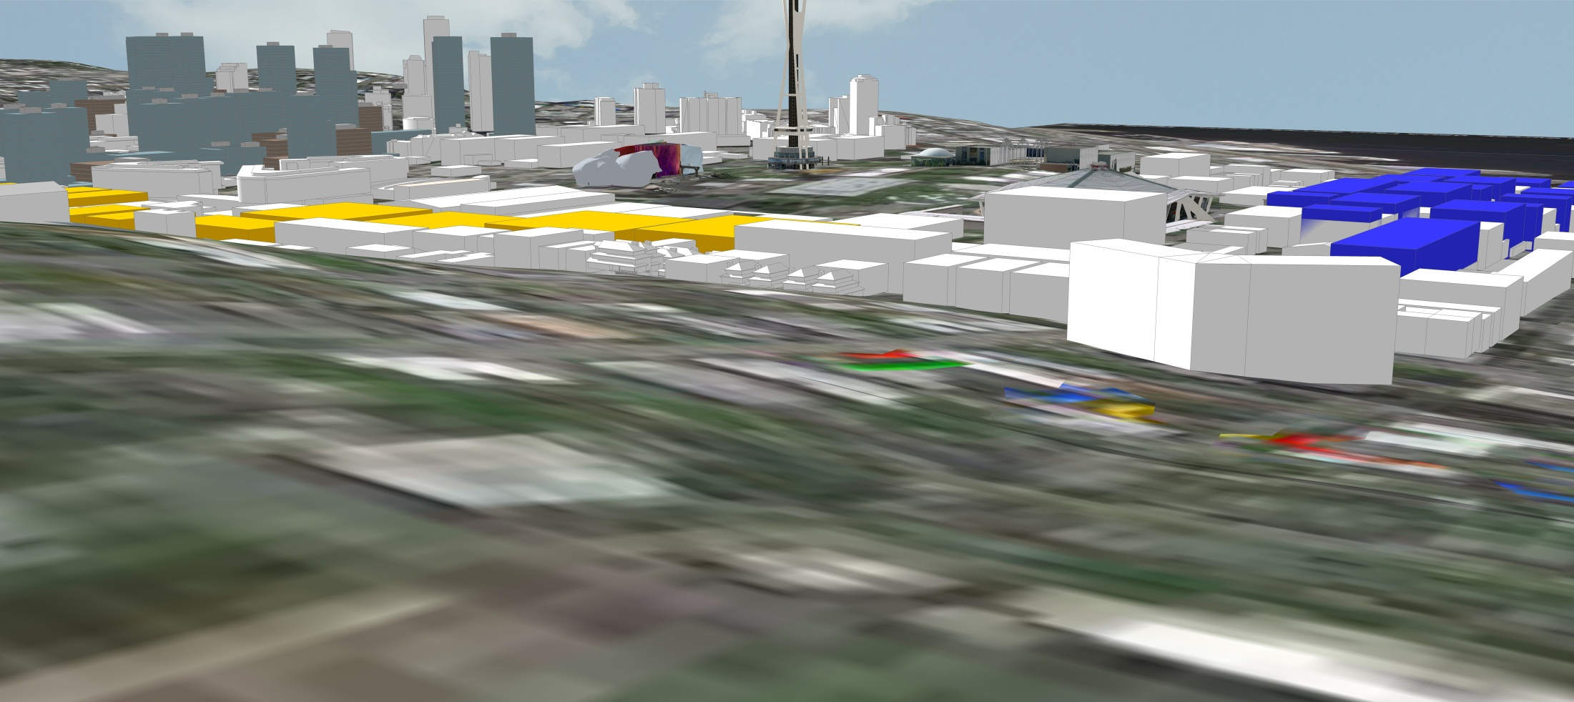
DESIGNING A FRAMEWORK
FOR UPTOWN’S FUTURE

Slide 14
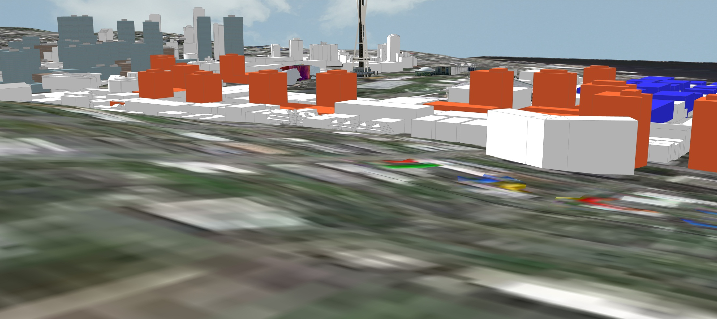
DESIGNING A FRAMEWORK
FOR UPTOWN’S FUTURE

Slide 15
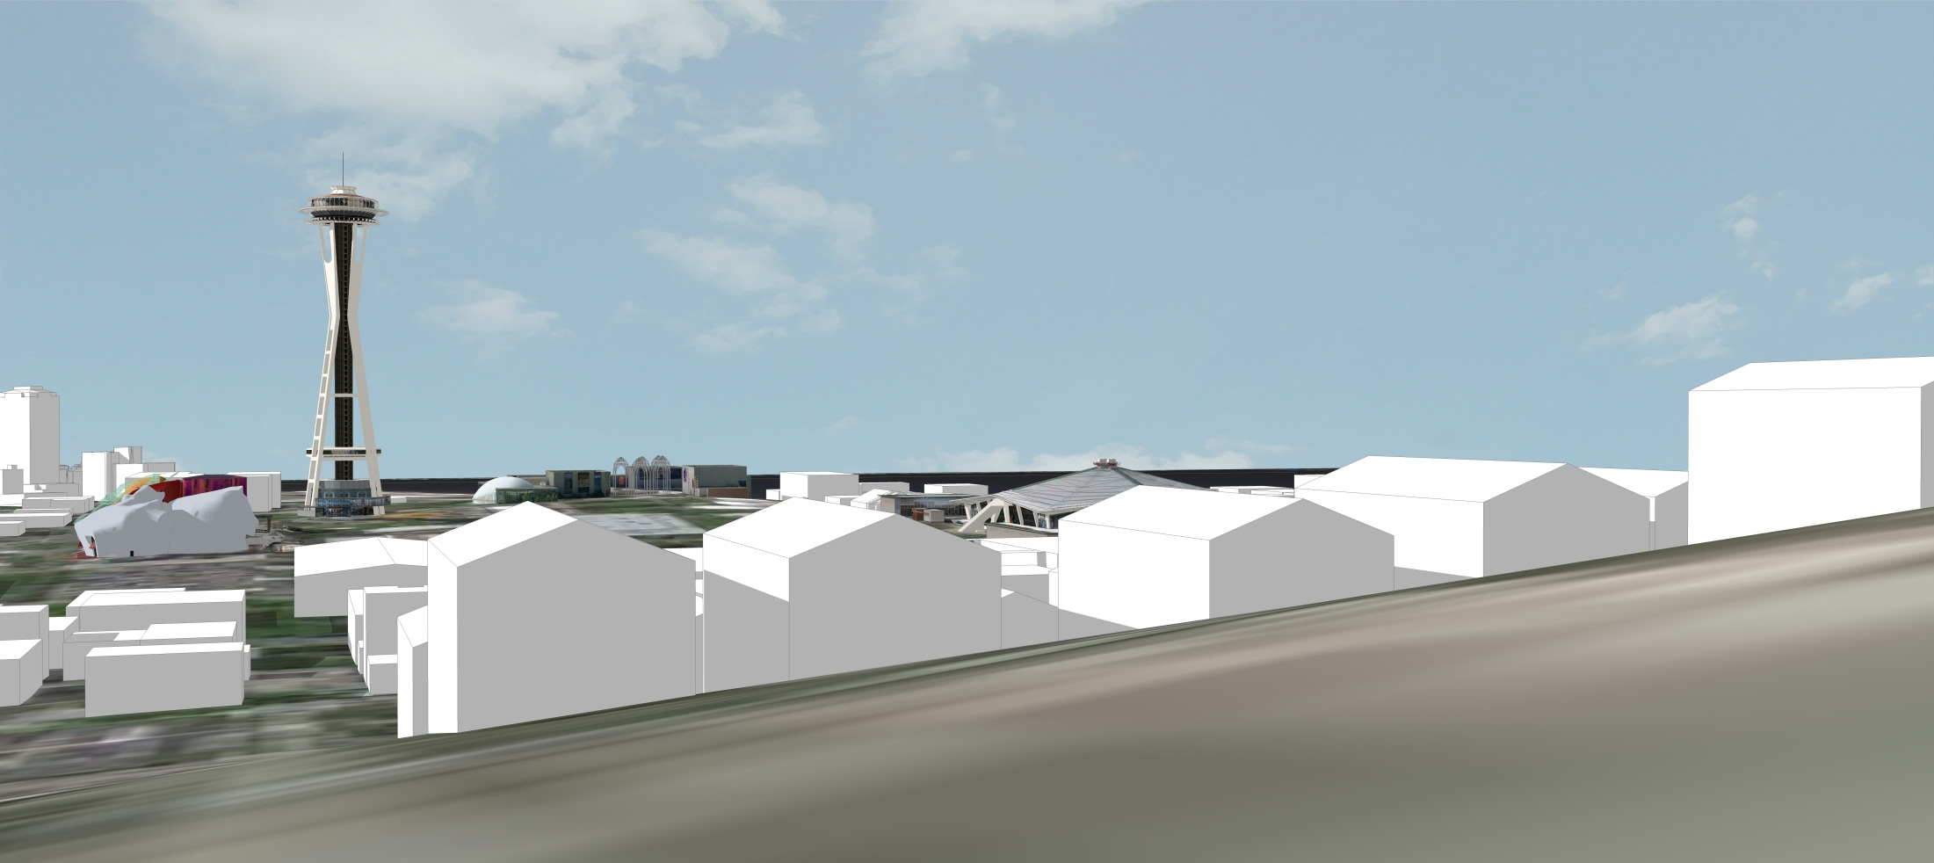
DESIGNING A FRAMEWORK
FOR UPTOWN’S FUTURE

Slide 16
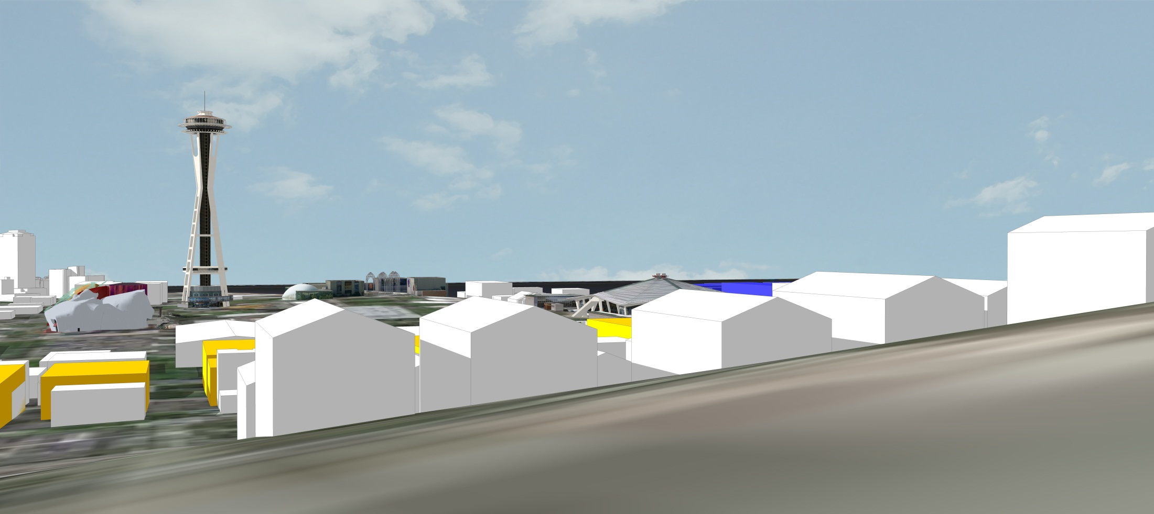
DESIGNING A FRAMEWORK
FOR UPTOWN’S FUTURE

Slide 17
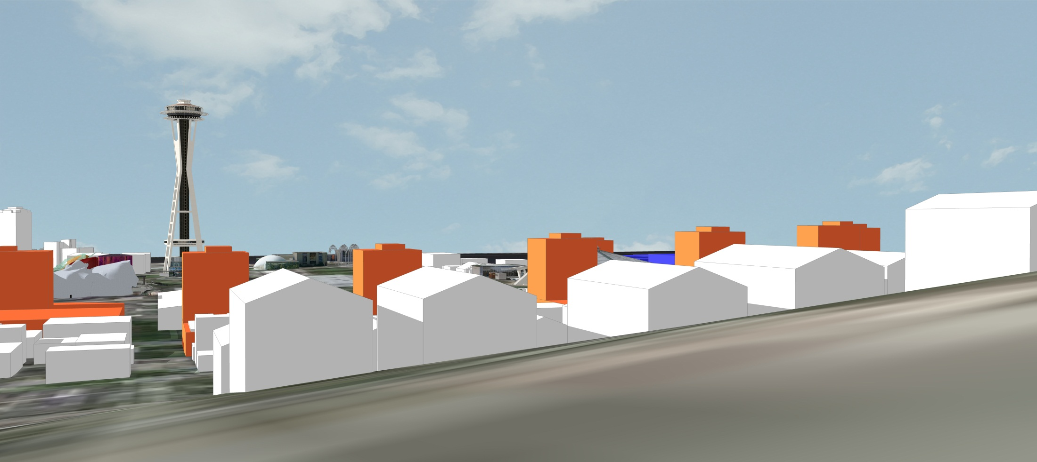
DESIGNING A FRAMEWORK
FOR UPTOWN’S FUTURE

Slide 18
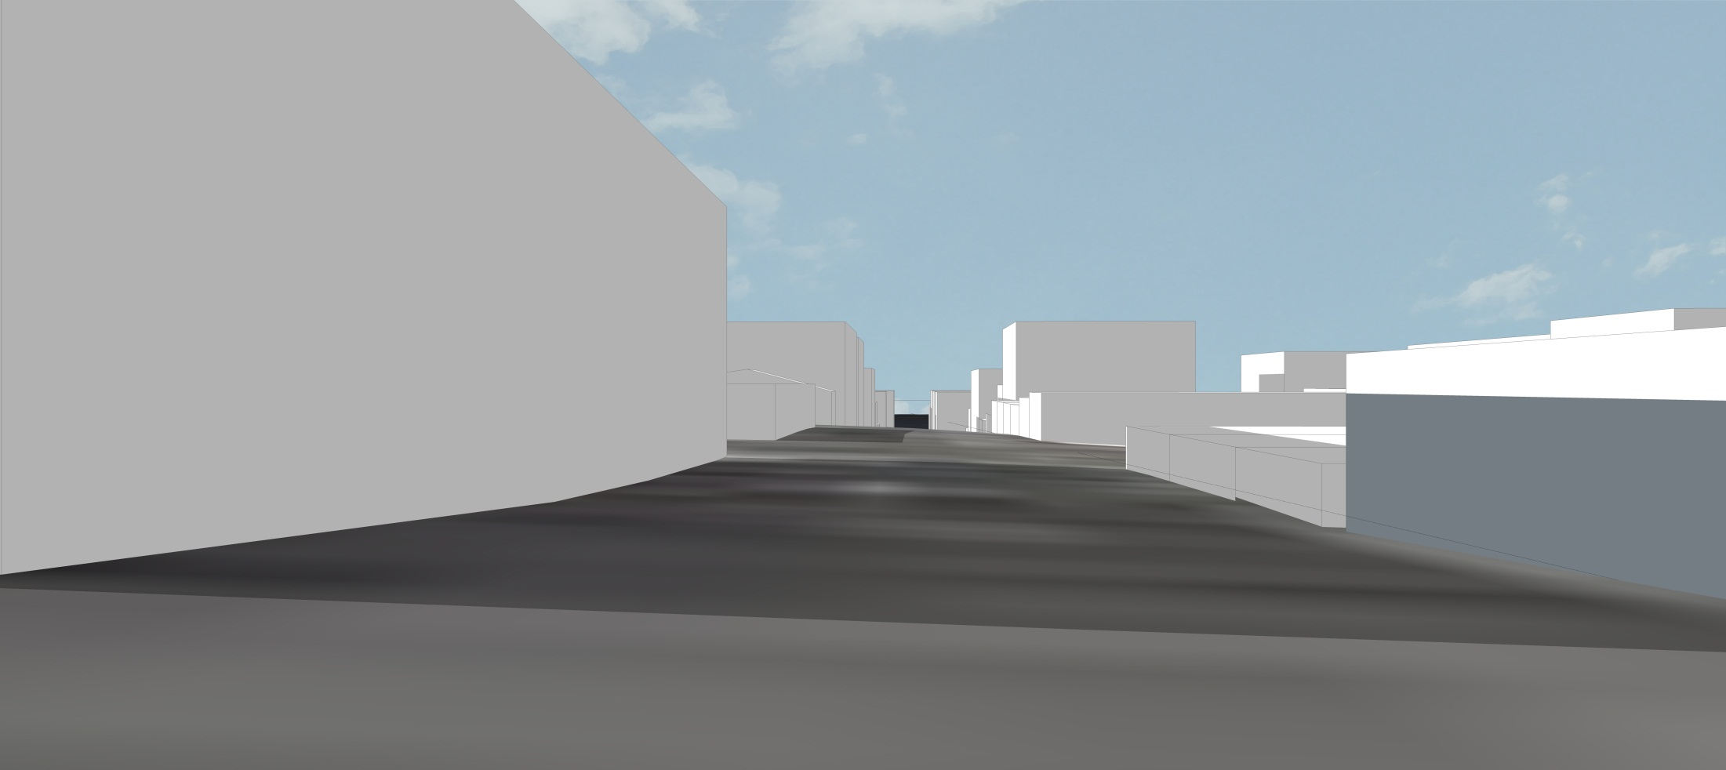
DESIGNING A FRAMEWORK
FOR UPTOWN’S FUTURE

Slide 19
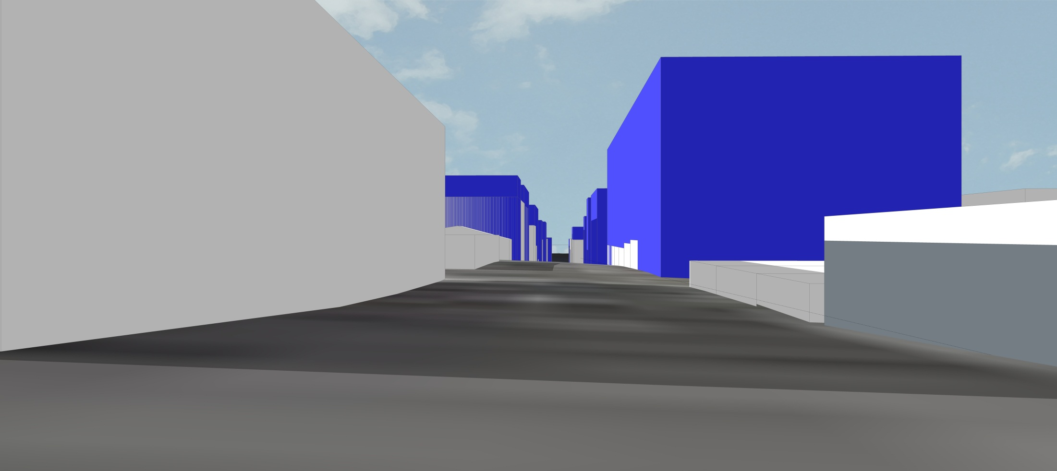
DESIGNING A FRAMEWORK
FOR UPTOWN’S FUTURE

Slide 20
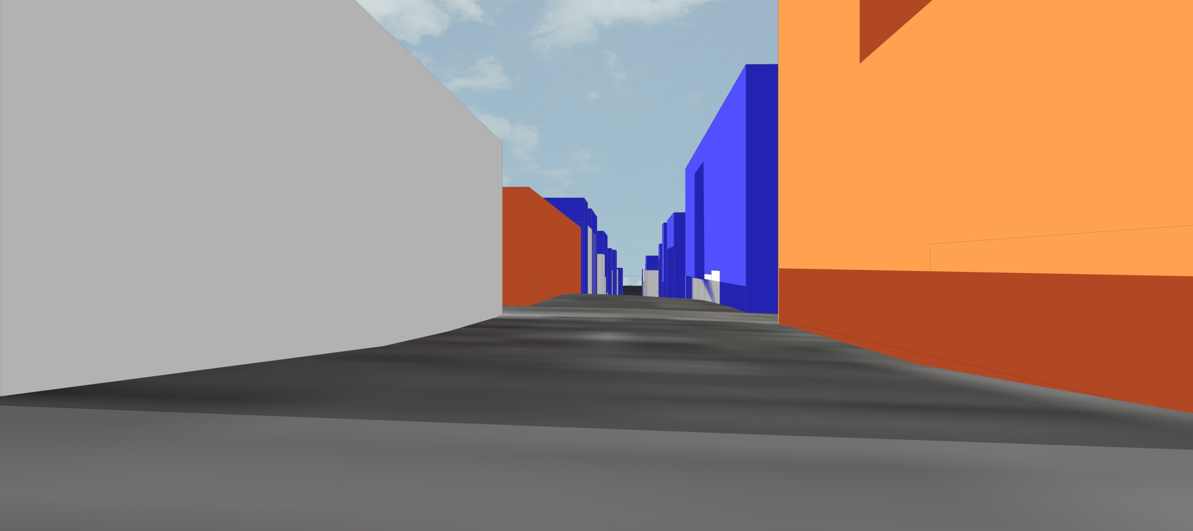
DESIGNING A FRAMEWORK
FOR UPTOWN’S FUTURE

Slide 21
November 7 2011 Uptown Community Open House
DESIGNING A FRAMEWORK
FOR UPTOWN’S FUTURE
Community Design Charrettes
Implement Urban Design Framework Recommendations
Adopt any Needed Code Amendments
Project Kick Off Open House
Community Open House
November 2013
Thru January 2015
Feb 2015
Mar 2015
Late 2015/2016
Establish Community Priorities
Develop Draft Urban Design Framework
Public Review of Draft Urban Design Framework
Potentially: Update Uptown Design Guidelines, Develop Streetscape Plans and Business District Strategies
Potentially: Recommend land use changes, Environmental Review and Land Use Legislation as needed
City of Seattle
Department of Planning and Development
Notes:
Project Milestones

