Slide 1
SRT Meeting
11/18/2021

Slide 2
Agenda
TAG Overview (10 mins)
Review Action Items (30 mins)
  SPD PDR Assessment
  Best Practices
  PO Resource Assessment
  Frequent Request
Discussion: CPDO and Central PRA Office (15 mins)
Next Steps (5 mins)

Slide 3
Action Items 10/21/2021
Item | Description | Participants | Completion
CDPO Office | Whether the City should create a new, independent, cabinet level executive position of Chief Public Records Officer, who will ensure recommendations are implemented, and have authority to oversee PRA production city wide | All | 12/16: Final Report
Central PRA office | Whether the city should be creating a city-wide centralized PRA office. This is to include dedicated PRA officers with a higher level of training and expertise on the tools for searching records and that will have the time to dedicate to continual improvement and adapt to continually changing technology and evolving ways employees communicate and create records | All | 12/16: Final Report
Public Records Best Practices | Contact/research government PDR programs focusing on technology, resources, structure and leadership | Norman Dizon Jennifer Winkler Katelyn Berger Matt Cantrell Rachel Acosta | 12/16: Final report
PDO Resource Assessment | Determining workload, resource allocation, and deficit assessment | CPRA | 12/16
Frequent Request Management | Whether there are mechanisms for frequently requested records or information, to make the records and data publicly accessible through open source, searchable databases or dashboards that would both increase transparency and reduce workload on PRA Officers | CPRA/All | 12/16
Dept Leadership Review | Determine and execute on review of completed items with appropriate departmental stakeholders | CPRA Team | 12/31

Slide 4
TAG Meeting
Meeting notes and brief report out
Media member nominations
Meeting slides

Slide 5
SPD PDR Assessment
Presentation of review of 2015 audit and additional program requirements

Slide 6
Public Records Best Practices
Review and discussion of findings

Slide 7
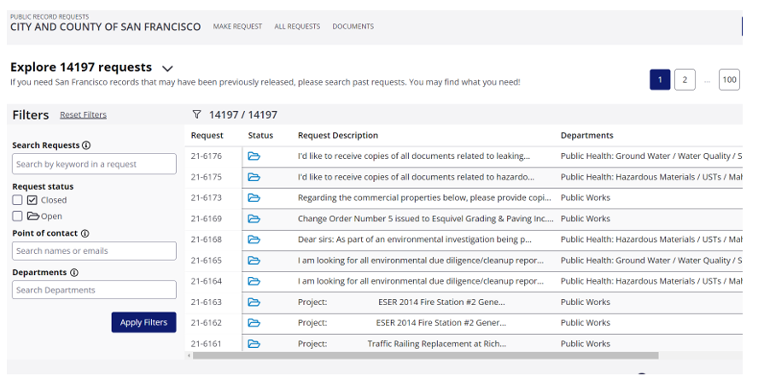
Best Practice: Searchable PDRs
https://www.nextrequest.com/

Slide 8
PDO Resource Assessment

Slide 9
Frequent Requests
Discussion about how to leverage Open Data

Slide 10
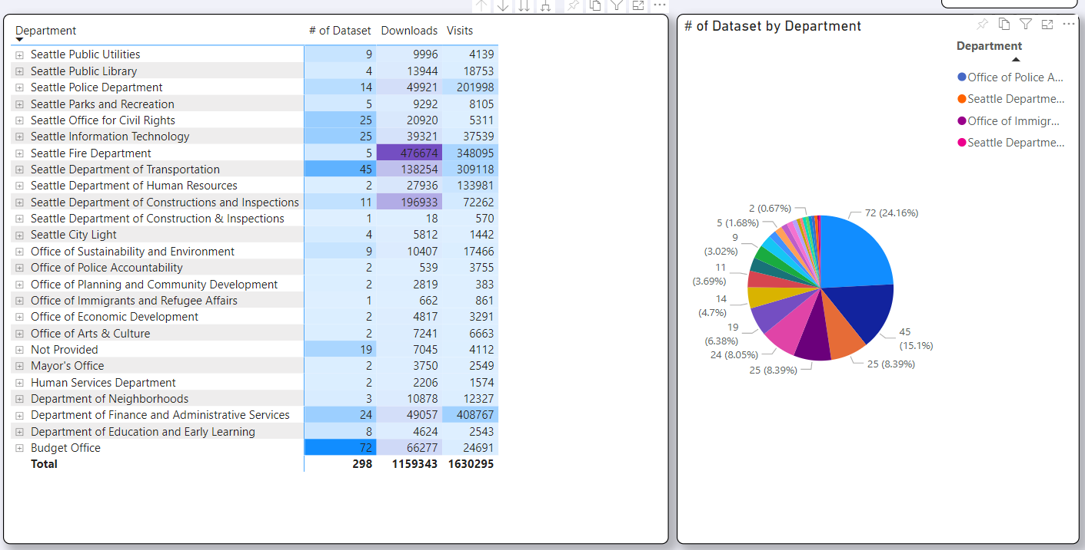
CoS Open Data

Slide 11
CDPO/Central PRA Office
Open Discussion

Slide 12
CPDO/Central PRA Office: DRAFT
Pros
Cons
One-City appearance
Increased consistency and coordination
One stop shop for requesters
Centralized funding
Reduction in unfunded dept. resources
Reduction in (re)training and support requirements
Nice to not worry about being a records custodian
Would be beneficial to have a centralized and independent appeals option
Increase and access to resources
3 govt branches with executive branch leadership?
Potential oversight dept conflicts
Cost and funding of new dept – what can it replace?
Complexity of requests
Staffing and dept support structure:
  70+ FTE and PT PDOs currently
  Est. 200 requests/PDO = 75 FTE
  SPD: 7K+ requests, 8 FTE
Dept leadership would have trust issues with outside PDOs
Loss of subject matter experts
Loss of institutional knowledge
Loss of soft skills in communicating with requesters, coordinating with PIOs and leadership representing the dept appropriately
Loss of regulatory or other technical knowledge (Utilities for example) that would take a long time to rebuild

Slide 13
Next Steps
Item | Description | Participants | Completion
CDPO Office | Whether the City should create a new, independent, cabinet level executive position of Chief Public Records Officer, who will ensure recommendations are implemented, and have authority to oversee PRA production city wide | All | 11/18: Begin discussion 12/16: Final Report
Central PRA office | Whether the city should be creating a city-wide centralized PRA office. This is to include dedicated PRA officers with a higher level of training and expertise on the tools for searching records and that will have the time to dedicate to continual improvement and adapt to continually changing technology and evolving ways employees communicate and create records | All | 11/18: Begin discussion 12/16: Final Report
Public Records Best Practices | Contact/research government PDR programs focusing on technology, resources, structure and leadership | Norman Dizon Jennifer Winkler Katelyn Berger Matt Cantrell Rachel Acosta | 10/21: Initial report 12/16: Final report
PDO Resource Assessment | Determining workload, resource allocation, and deficit assessment | CPRA | 11/18: Initial Report 12/16: Final Report
Frequent Request Management | Whether there are mechanisms for frequently requested records or information, to make the records and data publicly accessible through open source, searchable databases or dashboards that would both increase transparency and reduce workload on PRA Officers | CPRA/All | 11/18
Dept Leadership Review | Determine and execute on review of completed items with appropriate departmental stakeholders | CPRA Team | 11/2021
TAG Cadence | Determine the ideal composition, and structure, longevity, and meeting cadence for a long-term Transparency Advisory Group |  | 12/16

Slide 14
Objectives
Objective | Detail | Resources Required | ETA | Status
Form SRT | Seattle IT shall convene a Systemic Review Team (SRT) of internal departmental stakeholders. CPRA program staff, the City Clerk and Seattle Police Department shall help identify departmental representatives and Public Disclosure Officers who will participate in or support the Systemic Review Team (SRT) and provide input and information as appropriate. The City Attorney and the Central Budget Office (CBO) shall also be consulted and included as appropriate | PDOs, CBO, Clerk’s Office, Law | 9/2021 | Complete
Maturity Assessment Review | This SRT will review the CPRA Maturity Assessment recommendations pertaining to the City's structure, processes, and procedures city-wide for PRA requests, and look at processes, tools, and best practices in other governmental or private companies. | External stakeholders and advisors | 9/2021-10/2021 | In process
External Consultation | The SRT shall consult with external stakeholder on priorities and ongoing concerns related to PRA compliance, and on recommendations to be made by the SRT | TAG: Media representatives, transparency advocates, technologists, and known PRA experts | 11/2021
SPD Assessment | The SRT shall separately assess and make specific recommendations on investments and improvements to the SPD Public Disclosure Unit based on best practices | SPD stakeholders, 2015 SPD PRA Audit, external advisors | 11/2021 | In process
SPD Auditor’s Report | The SRT should consult with SPD, CPRA, and the City Attorney’s Office to review the Public Disclosure Unit staffing assessment SPD conducted, review the March 2015 Auditor’s report regarding SPD’s Public Disclosure Process, and review SPD’s 2021 response updates for making recommendations specifically pertaining to SPD. |  | 10/2021 | In process
Budget Process | Any CPRA recommendations, SPD related recommendations, or stakeholder input that is ultimately endorsed by the internal SRT that requires new budget actions or authority should be reviewed by the CBO to be included in the 2022 budget process, or a supplemental budget process, and beyond. | CBO, IT Finance, Dept Management/Executive | 12/2021 for 2022 supplemental or 3/2022 for 2023 budget process

Slide 15
Deliverables
Deliverables | Detail | Resource/Stakeholder | ETA | Status
Baseline Assessment | A baseline assessment of current public disclosure processes and technologies and resources | CPRA Maturity Assessment, Departmental Assessment, Law, Clerk’s office | 10/2021 | In process
Program Recommendations | The SRT will make recommendations by December 31, 2021 on any additional ways the City could improve the system to expedite the production of public records, including whether there should be greater centralization of the function, additional personnel, updated technology, better training, and more recommendations of best practices | SRT, TAG stakeholders | 12/2021
CPDO Office | Whether the City should create a new, independent, cabinet level executive position of Chief Public Records Officer, who will ensure recommendations are implemented, and have authority to oversee PRA production city wide | External stakeholder assessment, review of public and private sector structures | 11/2021
Central PRA office | Whether the city should be creating a city-wide centralized PRA office. This is to include dedicated PRA officers with a higher level of training and expertise on the tools for searching records and that will have the time to dedicate to continual improvement and adapt to continually changing technology and evolving ways employees communicate and create records | Maturity Assessment, external stakeholder assessment, review of public and private sector structures | 12/2021
PDO Workload/Resource Assessment | How the current PRA Officers workload across departments compares to best practices for staffing levels to respond to PRA requests quickly and fully. While centralizing PRA officers may create some efficiencies, the SRT should also consider if improvements could be made to address situations where departments may be currently under resourcing this work. The SRT should examine the number of full-time employees needed for optimal PRA compliance. This may include whether it makes sense to pool resources among smaller departments or having PRA Officers who specialize subject matters or types of records | PDOs, Department leadership, Law | 10/2021 | In process
Resource/Investment Requirements | Investments that may be needed for additional technological tools for efficient and accurate production of records in response to PRA request, such as Advanced eDiscovery software to improve the accuracy of search results with auditing capabilities and redaction and review software to reliably automate many of the time-consuming redaction requirements | SRT and TAG | 12/2021
Frequent Request Management | Whether there are mechanisms for frequently requested records or information, to make the records and data publicly accessible through open source, searchable databases or dashboards that would both increase transparency and reduce workload on PRA Officers | Open Data team assessment, SRT, Law | 11/2021
TAG Oversight | Determine the ideal composition, and structure, longevity, and meeting cadence for a long-term Transparency Advisory Group | SRT and TAG experience and recommendations | 12/2021

