Slide 1
Transparency Advisory Group Meeting
1/20/2022

Slide 2
Agenda
Introductions
Update on Mayor’s Office
Update on Annual Report – approval for additions
Centralized Office Analysis Summary
CPRA Dashboard
Next Steps

Slide 3
TAG Charter
Provide Input
Deliverable
Areas where there seem to be systemic barriers or issues related to timely compliance.
Policy, procedure, or training changes.
New technologies and tools being considered to aid in retention, archival, or production of records.
Current volume and response times for requests.
Other issues that impact the obligation of the City under the PRA.
Raise concerns about any specific or systemic issues, policy, or practices.
An annual report to the public that describes the work of the preceding year and make recommendations on investments and improvements the City can make.

Slide 4
Action Items 12/16/2021
Item | Description | Participants | Completion
Media Invitations | Working with TAG recommendations, invite members of the media to attend the next meeting. | All | 12/31
Recommendations | Prepare program recommendations for next meeting discussion, as content for end of year deliverable, send for review | All | 12/31
Annual Report | An annual report to the public that describes the work of the preceding year and make recommendations on investments and improvements the City can make. | All/CPRA Team | 12/31

Slide 5
Annual Report
2021 TAG Annual Report.docx
  Two meetings in 2021
  Membership
  Meeting cadence: every 8 weeks
  Charter/PRA Directive/Objectives
  Meeting agendas and notes
  Recommendations
  Additions: review/approval

Slide 6
Centralized Office/CPRO
Recommendations | Benefits | Challenges
Centralized Office | One City appearance and experience for requesters | Government divisions: potential conflicts of interest and difficulty in covering the entire City
 | Increased consistency and coordination for multi-department and all-City requests | Employment concerns including where existing PDOs go, accountability and supervision, compliance, and departmental issue sensitivity
 | Centralized funding, resources, and personnel for all departments | Estimated cost and funding of a new department ($2.4M - $2.8M) and lack of clarity about whether this could replace the existing positions
 | Reduced training and support requirements for departmental PDOs | Complexity of requests and records requiring PDOs dedicated to departments
 | Eliminate redundancy in identifying records custodianship | Loss of accountability about what is now a departmental responsibility
 | Independent appeals process increasing trust in City processes | Loss of departmental trust in PDOs
 |  | Loss of institutional knowledge about department operations and their records
 |  | Loss or disruption of positions in departments when duties are changed or removed
 |  | Impact on departmental communications and relationships with requesters and customers
 |  | Loss of regulatory and technical knowledge specific to departments
Chief Public Records Officer | Increased support of funding requests | Inability to fully represent the concerns and requirements of all City departments
 |  | Loss of departmental independence in dedicating resources according to need and budgets
 | Citywide attention to the importance of records requests | Potential conflicts of interest and authority among government branches.
 | Standardized compliance and performance metrics

Slide 7
Metrics/Dashboard

Slide 9
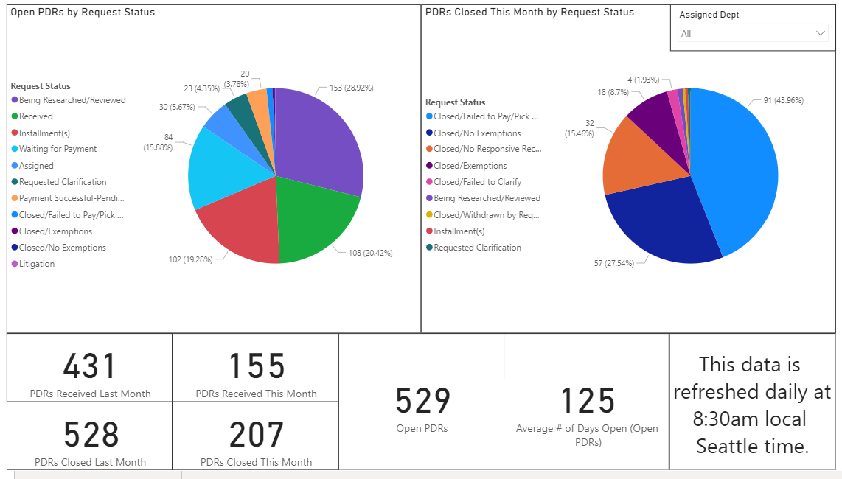

Slide 10
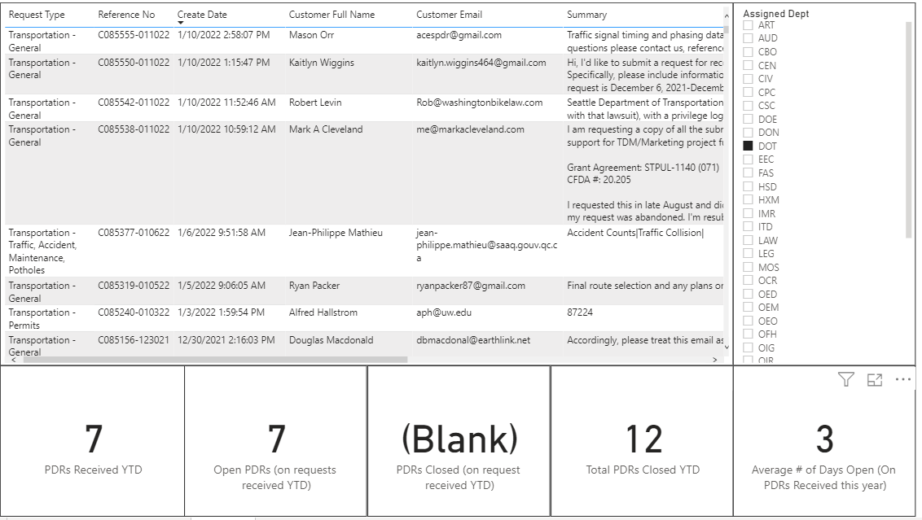

Slide 11
Next Steps
Finalize direction from new administration (CPRA)
Determine TAG agenda for 2022

